Slide 1
The Internet Of Things

Slide 2
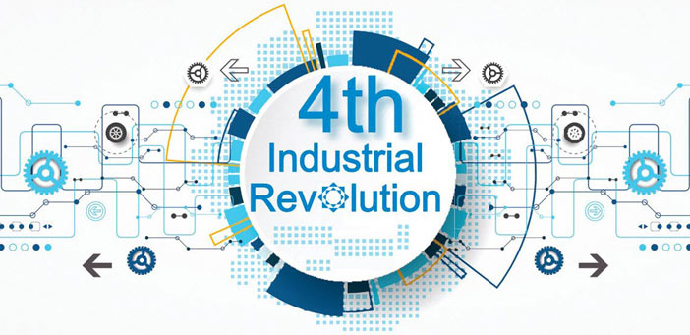
According to the World Economic Forum “We stand on the brink of a technological revolution that will fundamentally alter the way we live, work, and relate to one another. In its scale, scope, and complexity, the transformation will be unlike anything humankind has experienced before”
CENTRO ESCOLAR UNIVERSITY

Slide 3
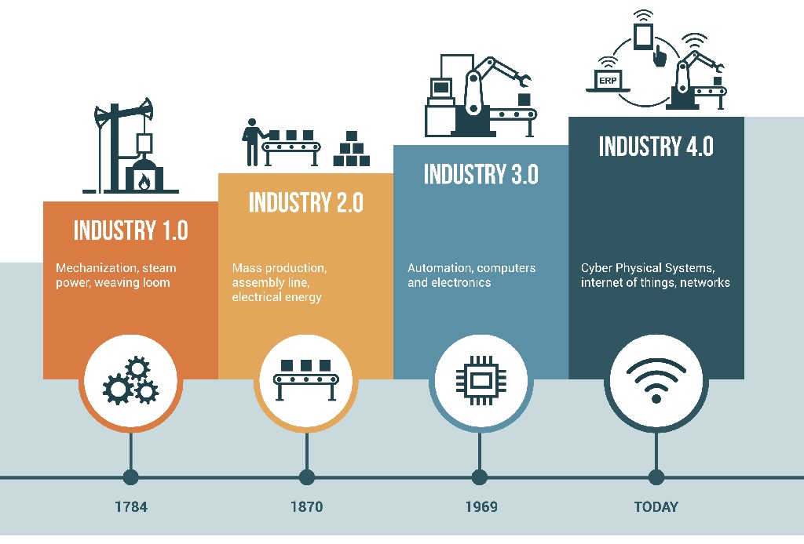
Industrial Revolutions
CENTRO ESCOLAR UNIVERSITY

Slide 4
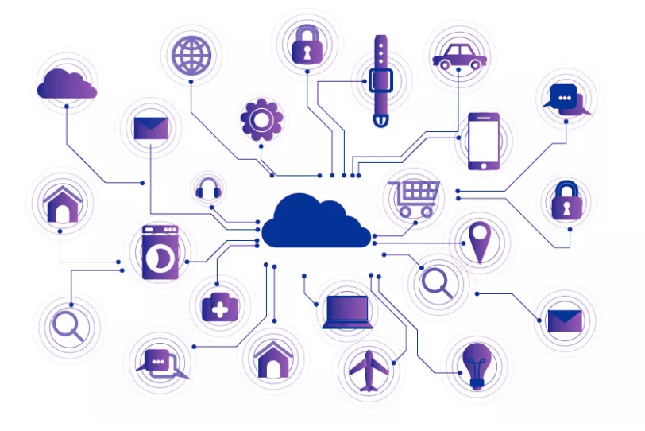
What is Internet of Things?
The Internet of things (IoT) describes physical objects (or groups of such objects) with sensors, processing ability, software, and other technologies that connect and exchange data with other devices and systems over the Internet or other communications networks.
CENTRO ESCOLAR UNIVERSITY

Slide 5
What is Internet of Things?
Internet of Things
Computing
Internet
Sensors
Machines
CENTRO ESCOLAR UNIVERSITY

Slide 6
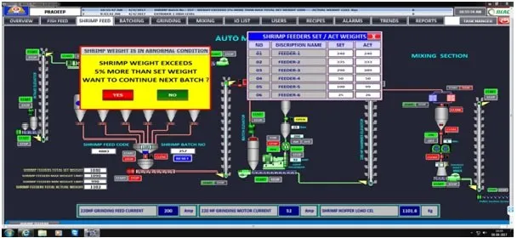
What is Internet of Things?
Internet of things (IoT) = SCADA ?
To monitor and control industrial processes locally or remotely
CENTRO ESCOLAR UNIVERSITY

Slide 7
What is Internet of Things?
Internet of things (IoT) = SCADA ?
Industrial IoT focuses on machine data to improve productivity
SCADA used to focus on monitoring and controlling
SCADA systems are standard with industrial systems and IoT adds features and functionality where SCADA ends
CENTRO ESCOLAR UNIVERSITY

Slide 8
Industrial Applications of IoT
Manufacturing
Agriculture
Healthcare
Building / Home Automation
Environment
Military
Energy Management
Transportation
CENTRO ESCOLAR UNIVERSITY

Slide 9
Applications of IoT in Manufacturing
IoT connects consumers, manufacturers and products. This leads to a new era with a more connected environment. The internet of things is a global technology that is transforming the industry and manufacturing sector. Let us see some of the applications of IoT in manufacturing industry
Benefits of IoT in manufacturing
IoT recognize manufacturing delays and helps to identify the underlying causes
Production units benefit majorly with automation of various processes in the manufacturing industry. This allows the maximum utilization of raw material and manufacturing components.
IoT leads to better allocation of resources. It allows users to shift their focus on clients and profits rather than worrying about tedious and time consuming tasks
CENTRO ESCOLAR UNIVERSITY

Slide 10
Applications of IoT in Manufacturing
Intelligent product enhancement
Similar to the other applications of IoT, IoT in manufacturing also enhances production quality. Previously, the creation of products would require a heavy market research and customer suggestions, with IoT, owners have access to large amounts of data and information. IoT acts as a reliable source of information about any product and hence ensures better profits.
2. Quality control
IoT proposes real-time monitoring of appliances and products in the industry. Manufacturers can predict the breakdown of certain machinery parts and offer solutions instead of waiting for the machine to collapse. IoT benefits systems by monitoring the status of engines, machinery and their mechanism. The automation of certain processes reduces the dependency on manual labour.
CENTRO ESCOLAR UNIVERSITY

Slide 11
Applications of IoT in Manufacturing
3. Product safety
Despite a complicated set of operations ensuring customer safety, hazards and dangers still find their way into the market. Unknown reasons may cause serious incidents. IoT deploys sensibility, control and management techniques to track such incidents and raise alerts in case of potential threats.
4. Improved facility service
IoT improves the conditions of workplaces and offers safety and security to any typical facility. Safety managers communicate through applications and access real-time information regarding threats and safety events. This allows organizations to monitor events, enhance communication and increase production.
CENTRO ESCOLAR UNIVERSITY

Slide 12
Applications of IoT in Manufacturing
5. Predictive maintenance
Routine maintenance checks are automated via IoT. IoT sensors monitor the operations and perform data analysis on the real time data in clouds. Predictive maintenance is where the device schedules a routine self maintenance check to keep a track of its functionality. It reports bugs and damages to its authorities who then take actions to fix the ongoing issues.
6. Supply chain management
IoT devices trace and monitor the real-time data incoming from supply chains. Authorities can monitor and control machinery, equipment, and delivery systems from remote locations. Some IoT systems also offer ERP softwares that reduces the need for manually documenting the processes.
CENTRO ESCOLAR UNIVERSITY

Slide 13
Applications of IoT in Manufacturing
7. Production flow monitoring
One of the important processes in manufacturing is production flow. Manually, it gets difficult to manage and track the production flow. IoT uses sensors that provide the owners with real-time data to monitor the prediction. These sensors give details about the parts of machines and generate service calls when they notice a breakdown or damaged parts.
8. Smart metering
This allows the consumption of resources in a more effective manner and reduces the wastage of these precious resources. Smart meters track the consumption of water, fuels and electricity. They measure the usage of these resources and deploy methods to consume these resources more efficiently.
CENTRO ESCOLAR UNIVERSITY

Slide 14
Applications of IoT in Manufacturing
9. Inventory management
RFID and IoT can represent inventory management as a seamless and efficient process. Each inventory comes with an RFID tag and each tag generates its own Unique identification (UID). The data that RFID tags collect plays a vital role in running most organisations these days. The systems monitor the output of RFID tags and send notifications to users in case of missing inventory.
10. Digital twins
Digital twins is the method of creating exact copies or replicas of actual, hardware devices by using cloud. IoT scientists and IT officials create these models for testing and deploying purposes before they publish the real life model. This technology is now being used in large buildings, construction sites and also in cities.
CENTRO ESCOLAR UNIVERSITY

Slide 15

IoT-based Smart Farming
Utilize wireless IoT applications to collect data regarding the location, well-being, and health of their livestock
Monitor pregnant cows:
Sensor powered by battery is expelled when its water breaks.
This sends an information via the Internet to the rancher.
CENTRO ESCOLAR UNIVERSITY

Slide 16

IoT for the Elderly
With a built-in accelerometer that automatically detects falls
Medication reminder
With a GPS, which allows an emergency operator to locate and provide directions to the individual.
CENTRO ESCOLAR UNIVERSITY

Slide 17
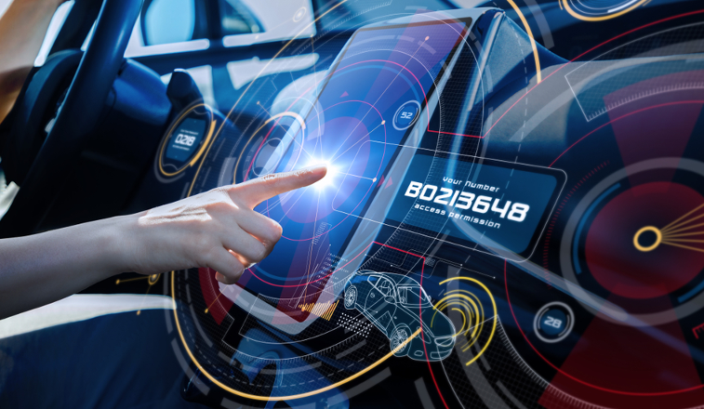
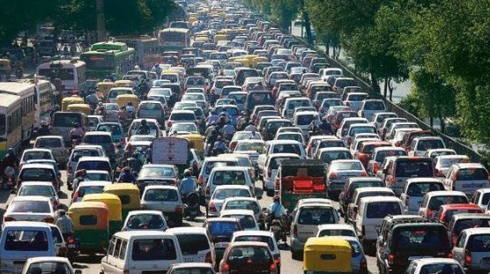
How Does This Impact You?
CENTRO ESCOLAR UNIVERSITY

Slide 18
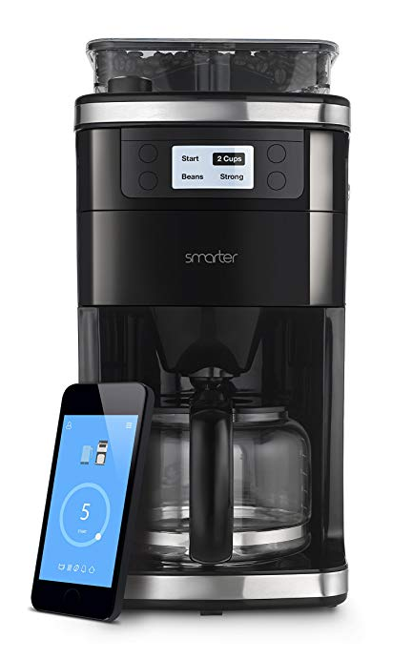

How Does This Impact You?
CENTRO ESCOLAR UNIVERSITY

Slide 19

Intelligent fork
The HAPIfork is an electronic fork that helps you monitor and track your eating habits.
It also alerts you with the help of indicator lights and gentle vibrations when you are eating too fast.
CENTRO ESCOLAR UNIVERSITY

Slide 20
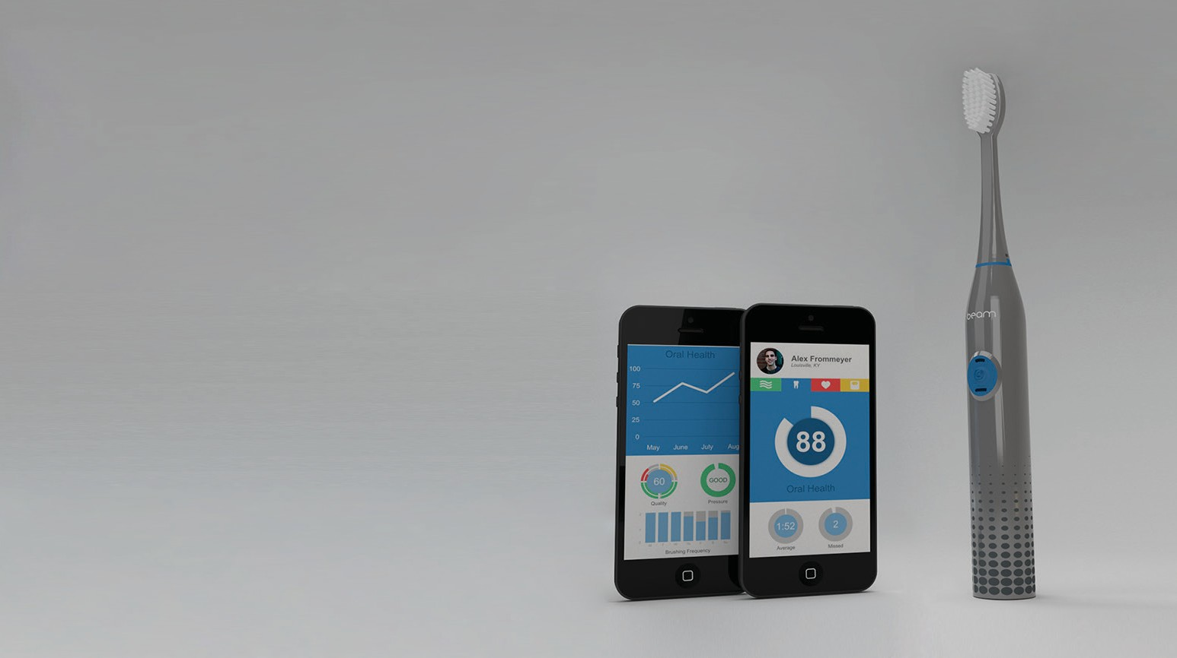
Smart Tooth Brush
The Beam Brush is a connected toothbrush that engages users with their daily hygiene routine.
CENTRO ESCLAR UNIVERSITY

Slide 21

Smart Egg Tray
Egg Minder syncs with your smartphone to tell you how many eggs you’ve got at home (up to 14 eggs) and when they’re going bad.
CENTRO ESCOLAR UNIVERSITY

Slide 22
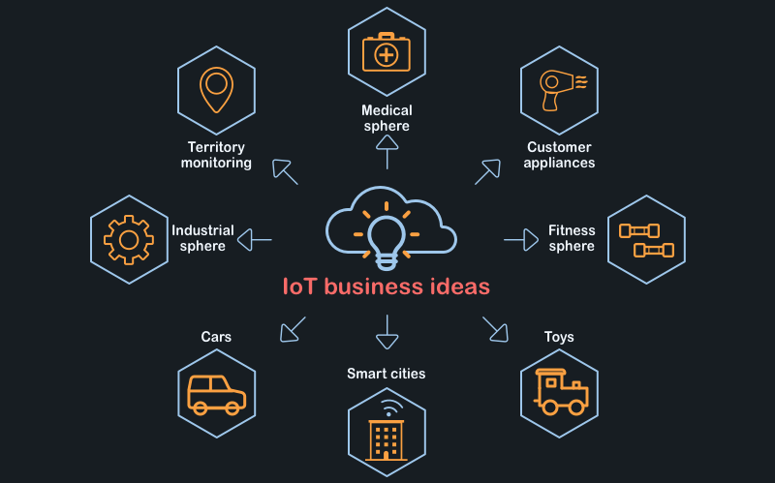
IoT business opportunities
CENTRO ESCOLAR UNIVERSITY

Slide 23
Social Internet of Things
Social Internet of things (SIoT) is a new kind of IoT that focuses the importance of social interaction and relationship between IoT devices
IoT is passive and SIoT is active. It is programmed and managed by AI
Unplanned works can be executed
CENTRO ESCOLAR UNIVERSITY

Slide 24
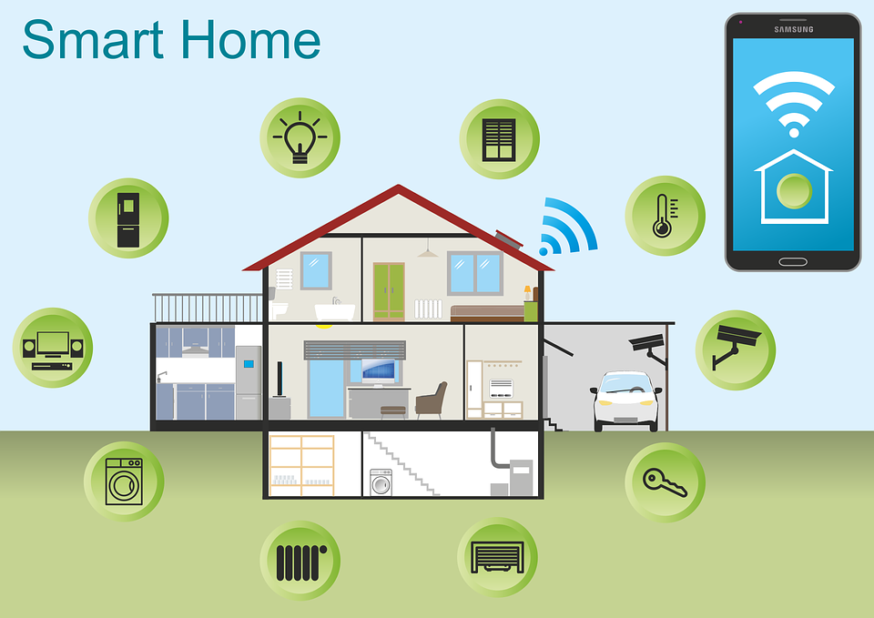
Smart Home Concept
CENTRO ESCOLAR UNIVERSITY

Slide 25
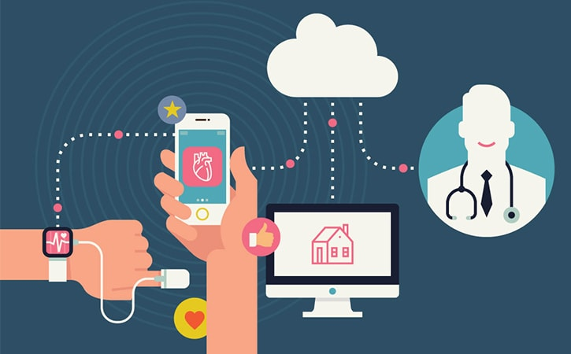
Health Care
CENTRO ESCOLAR UNIVERSITY

Slide 26
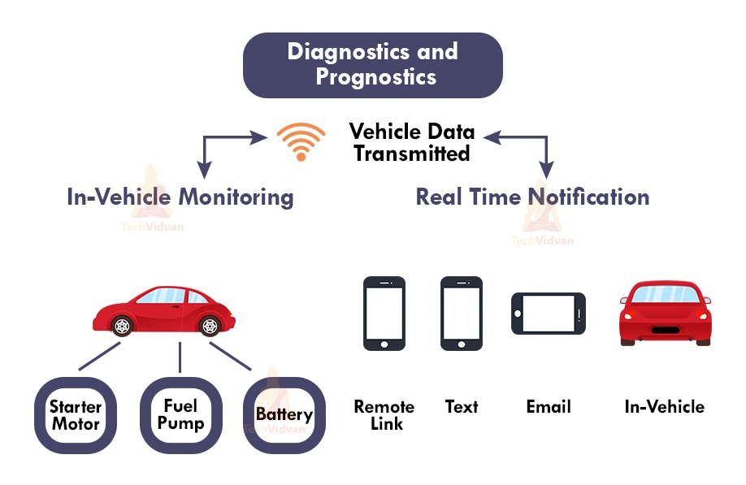
Transportation
CENTRO ESCOLAR UNIVERSITY

Slide 27

IoT − Advantages
Improved Customer Engagement – Current analytics suffer from blind-spots and significant flaws in accuracy; and as noted, engagement remains passive. IoT completely transforms this to achieve richer and more effective engagement with audiences.
CENTRO ESCOLAR UNIVERSITY

Slide 28
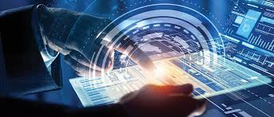
IoT − Advantages
Technology Optimization – The same technologies and data which improve the customer experience also improve device use, and aid in more potent improvements to technology. IoT unlocks a world of critical functional and field data.
CENTRO ESCOLAR UNIVERSITY

Slide 29
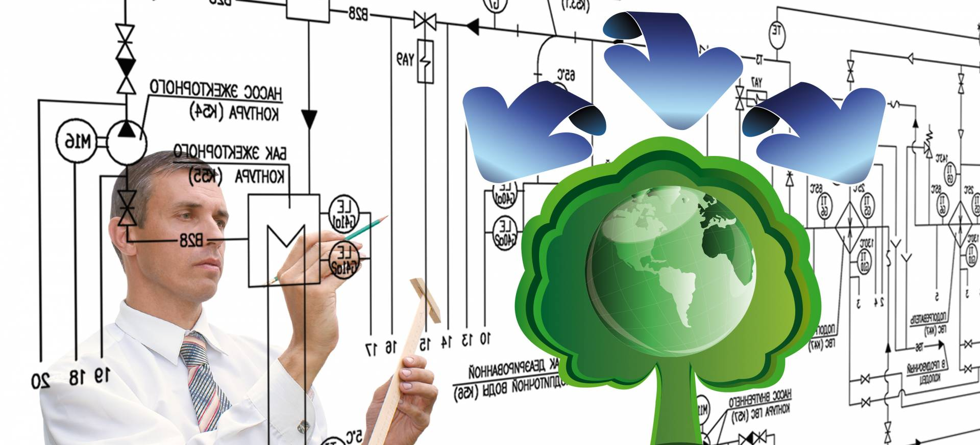
IoT − Advantages
Reduced Waste – IoT makes areas of improvement clear. Current analytics give us superficial insight, but IoT provides real-world information leading to more effective management of resources.
CENTRO ESCOLAR UNIVERSITY

Slide 30
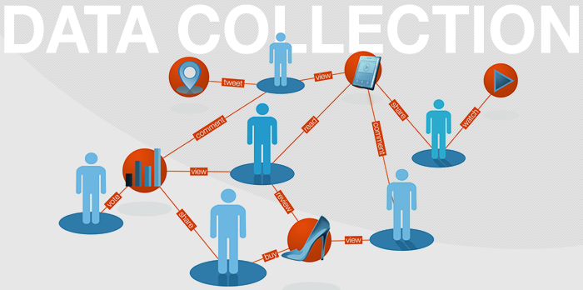
IoT − Advantages
Enhanced Data Collection – Modern data collection suffers from its limitations and its design for passive use. IoT breaks it out of those spaces, and places it exactly where humans really want to go to analyze our world. It allows an accurate picture of everything.
CENTRO ESCOLAR UNIVERSITY

Slide 31

IoT − Disadvantages
Security – IoT creates an ecosystem of constantly connected devices communicating over networks. The system offers little control despite any security measures. This leaves users exposed to various kinds of attackers.
CENTRO ESCOLAR UNIVERSITY

Slide 32

IoT − Disadvantages
Privacy – The sophistication of IoT provides substantial personal data in extreme detail without the user's active participation.
CENTRO ESCOLAR UNIVERSITY

Slide 33

IoT − Disadvantages
Complexity – Some find IoT systems complicated in terms of design, deployment, and maintenance given their use of multiple technologies and a large set of new enabling technologies.
CENTRO ESCOLAR UNIVERSITY

Slide 34

IoT − Disadvantages
Compliance – IoT, like any other technology in the realm of business, must comply with regulations. Its complexity makes the issue of compliance seem incredibly challenging when many consider standard software compliance a battle.
CENTRO ESCOLAR UNIVERSITY

Slide 35




Securing IoT Devices
    Authentication – IoT devices connecting to the network create a trust relationship, based on validated identity through mechanisms such as: passwords, tokens, biometrics, RFID, X.509 digital certificate, shared secret, or endpoint MAC address.
    Network Enforced Policy – controls all elements that route and transport endpoint traffic securely over the network through established security protocols.
    Authorization – a trust relationship is established based on authentication and authorization of a device that determines what information can be accessed and shared.
    Secure Analytics: Visibility and Control – provides reconnaissance, threat detection, and threat mitigation for all elements that aggregate and correlate information.
CENTRO ESCOLAR UNIVERSITY

Slide 36
THANK YOU!
CENTRO ESCOLAR UNIVERSITY

