Slide 1
OME Electromagnetic Radiation
Lecture 7
Infrared radiation

Slide 2
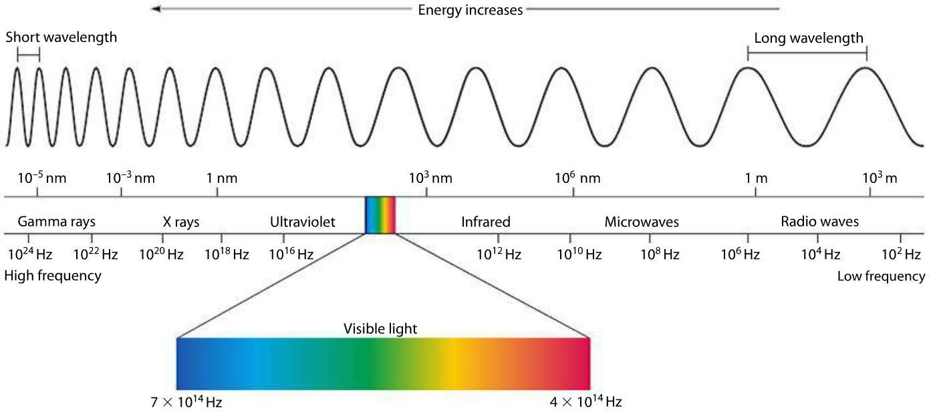
Electromagnetic spectrum

Slide 3
Electromagnetic Spectrum
Name | Frequency (Hz) | Wavelength | Photon energy (eV)
Radio | 3 kHz - 300 MHz | 100 km - 1 m | ≤ 1.24 µeV
Microwave | 300 MHz - 300 GHz | 1 mm - 1 m | 1.24 meV – 1.24 µeV
Infrared | 300 GHz -400 THz | 750 nm - 1 mm | 1.7 eV – 1.24 meV
Visible light | 400 THz - 750 THz | 400 nm - 750 nm | 3 eV – 1.7 eV
Ultraviolet | 750 THz - 30 PHz | 10 nm - 400 nm | 124 eV – 3 eV
X-ray | 30 PHz - 30 EHz | 0.01 nm - 10 nm | 124 keV – 124 eV
Gamma ray | > 30 EHz | < 0.01 nm | > 124 keV
Invisible heat rays.
Infra-red frequencies can induce heat in conductors and non-conductors. Infra-red frequencies are not able to induce a current in conductor.

Slide 4
Division of infrared
IR‐A (near-infrared): 760 and 1,400 nm
IR‐B (mid-infrared): 1,400 and 3,000 nm
IR‐C (far-infrared): 3,000 nm and 1 mm

Slide 5
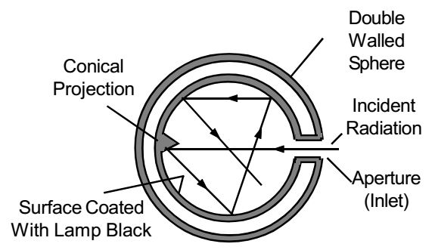
Black-body radiator
A blackbody radiator is defined as an object that absorbs all electromagnetic radiation that falls on it at all frequencies over all angles of incidence.

Slide 6
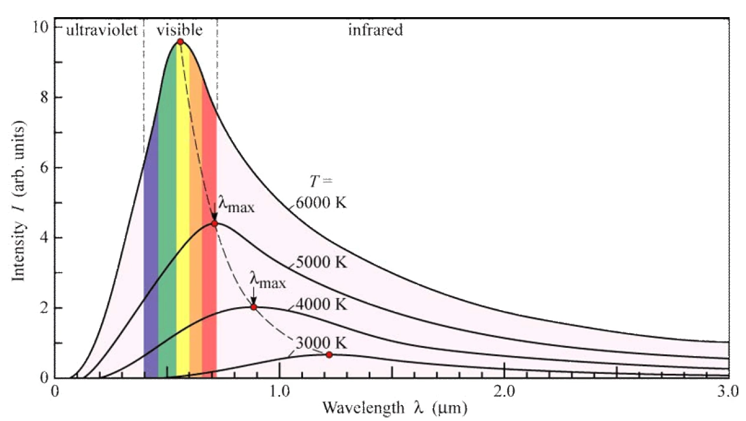
Black-body radiation

Slide 7
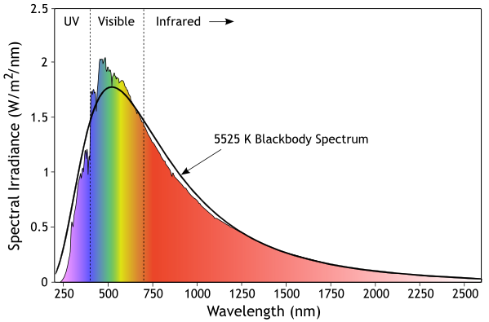
Solar radiation

Slide 8
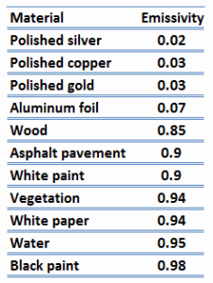
Emissivity

Slide 9

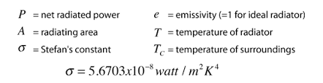
Stefan's Law

Slide 10
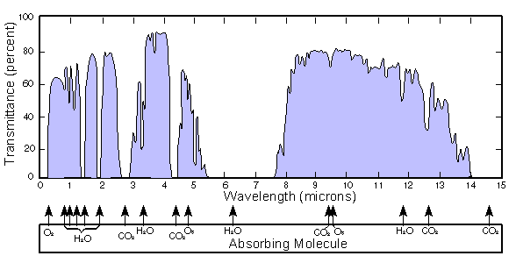
Absorption of infrared energy by the atmosphere
‘7 – 14 micron’
‘3 – 5 micron’

Slide 11
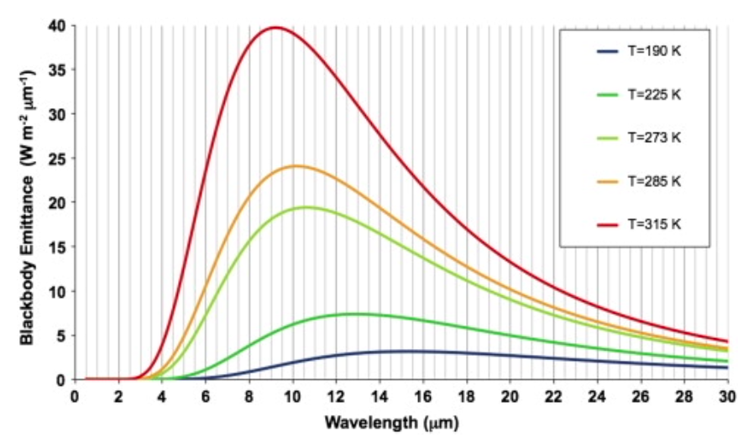
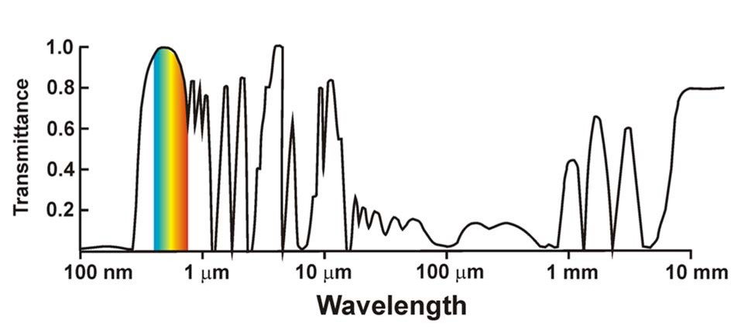
Greenhouse effect

Slide 12
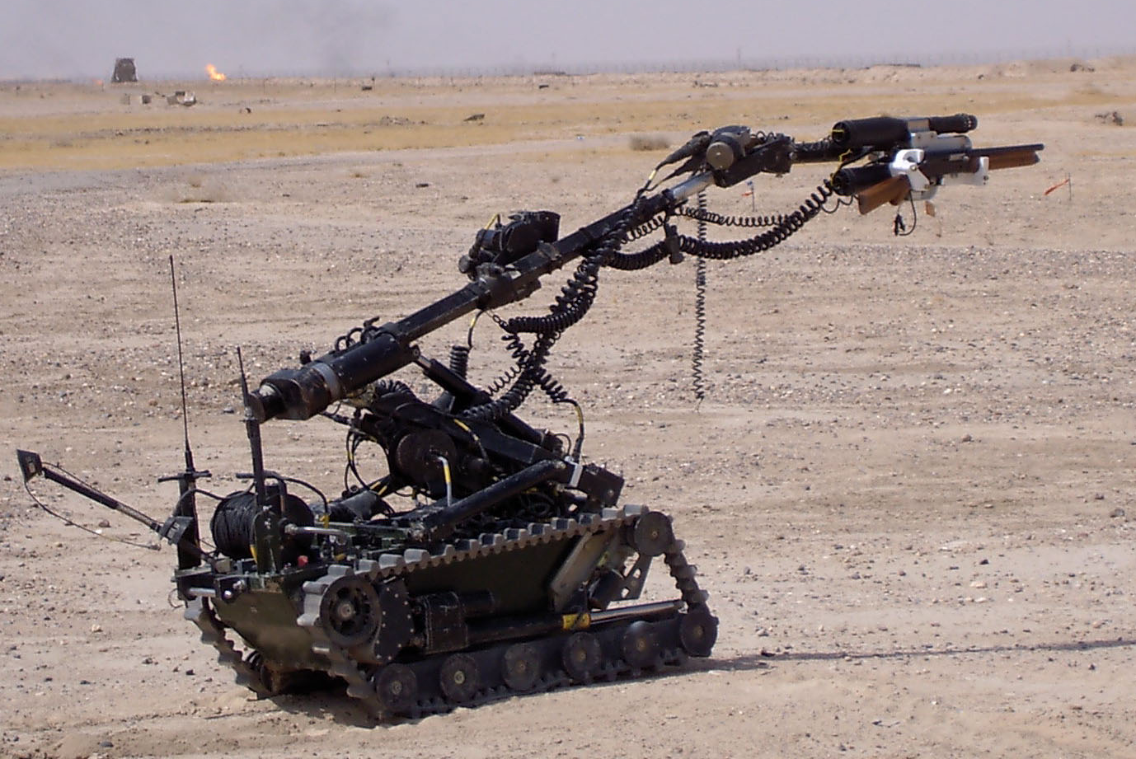
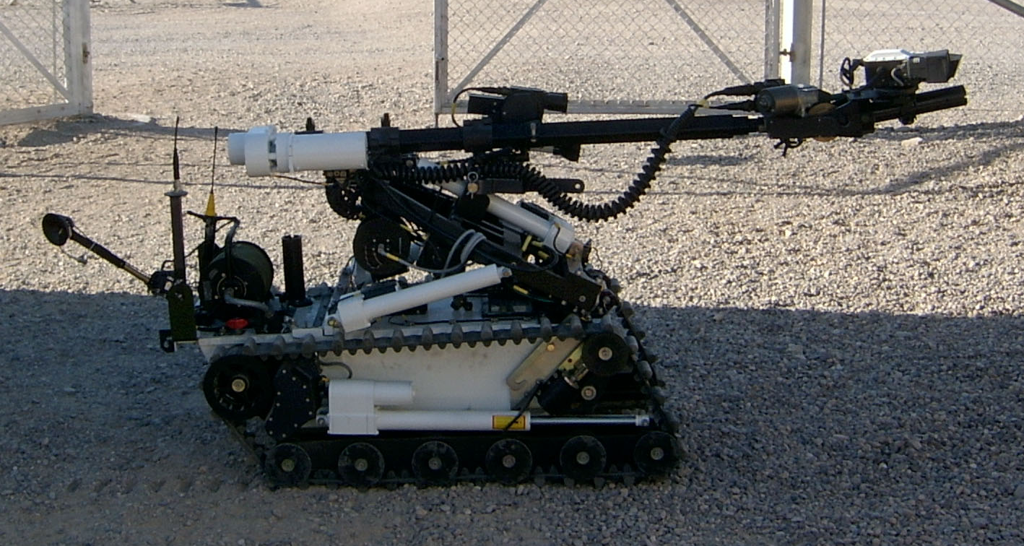
Wheelbarrow overheating
Equation

Slide 13
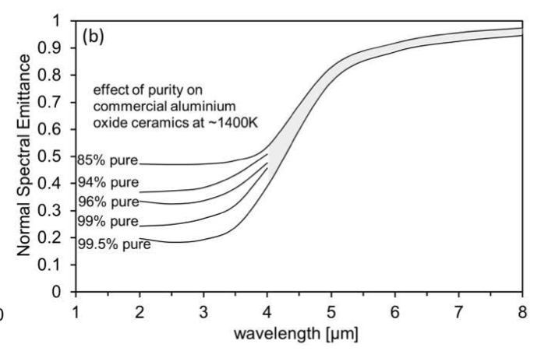
Spectral emittance of white oxide paint e.g., aluminium oxide or titanium oxide

Slide 14
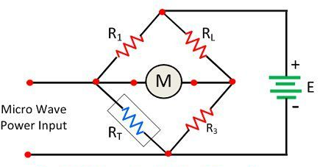
Bolometers
Infra-red
Power input

Slide 15
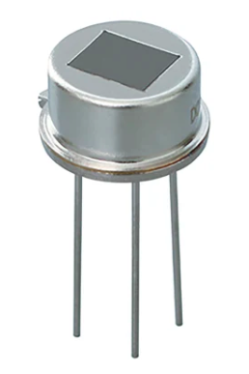
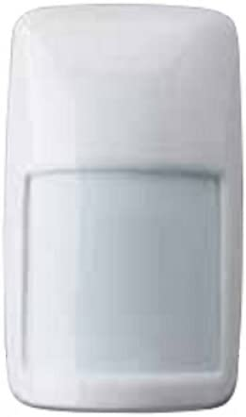
Pyroelectric sensors
Lithium tantalate sensitivity -2.3 10⁻⁴ C/°C/m²

Slide 16
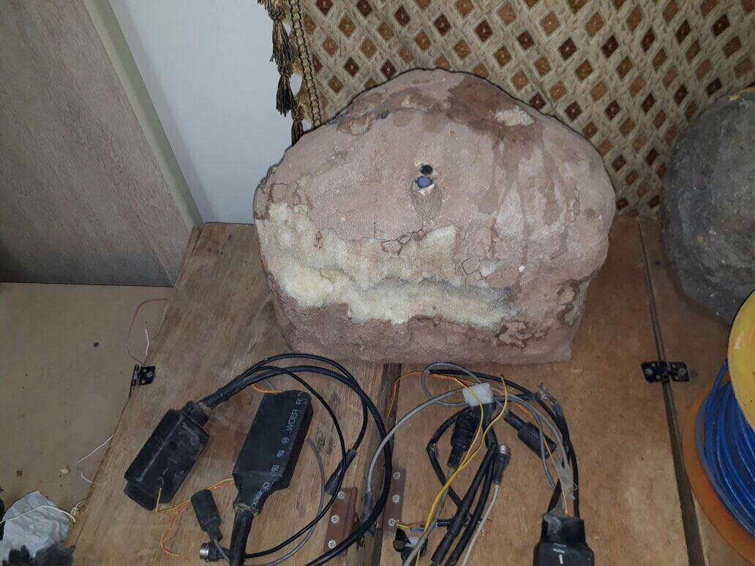
PIR roadside IED (Iran)

Slide 17
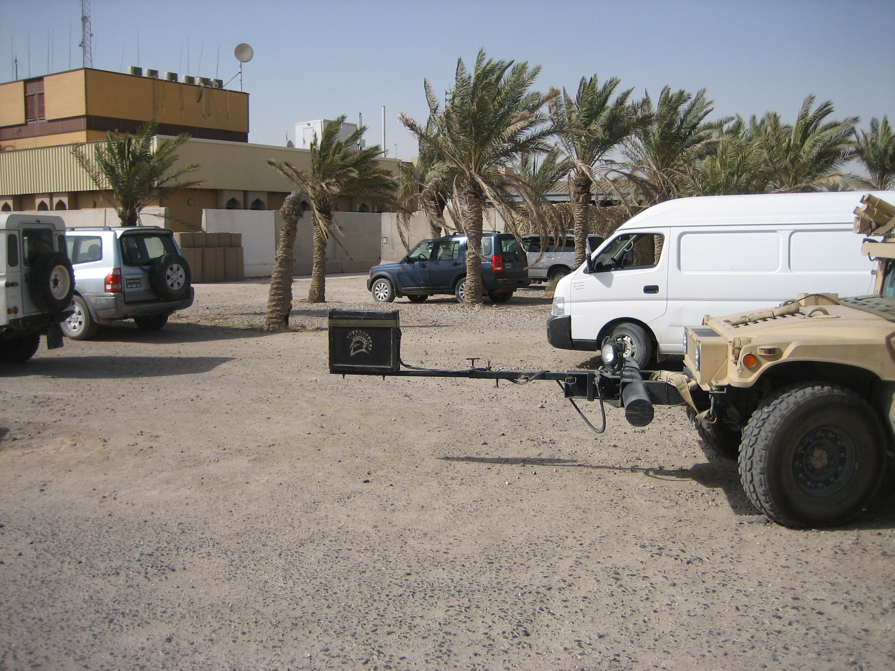
PIR roadside IED (Iran)

Slide 18
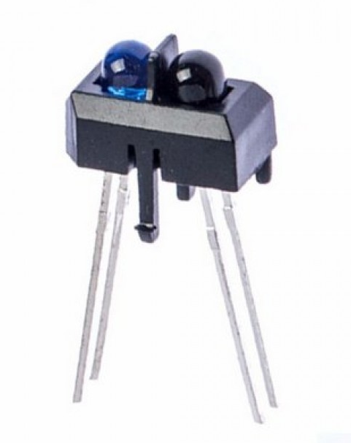
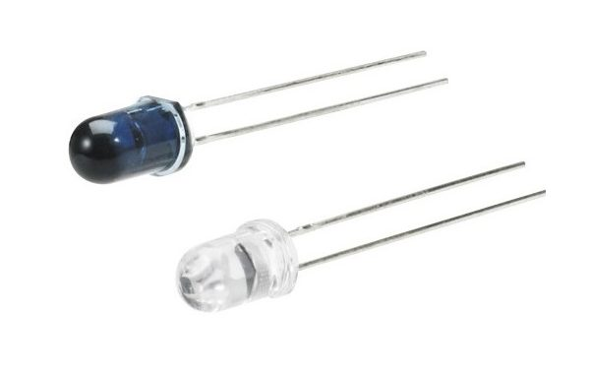
Photovoltaic sensors
IR LED and photodiode pair

Slide 19
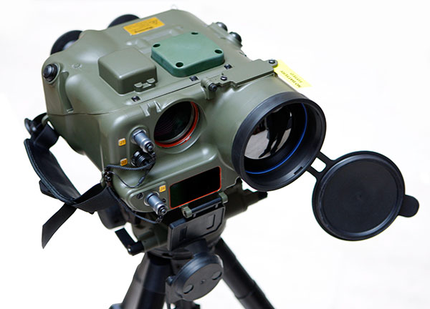
Thermal imagers
Uncooled detectors have a thermal resolution of about 1 K, whilst cooled detectors, e.g., indium antimonide have thermal resolution of about 0.1 K

Slide 20
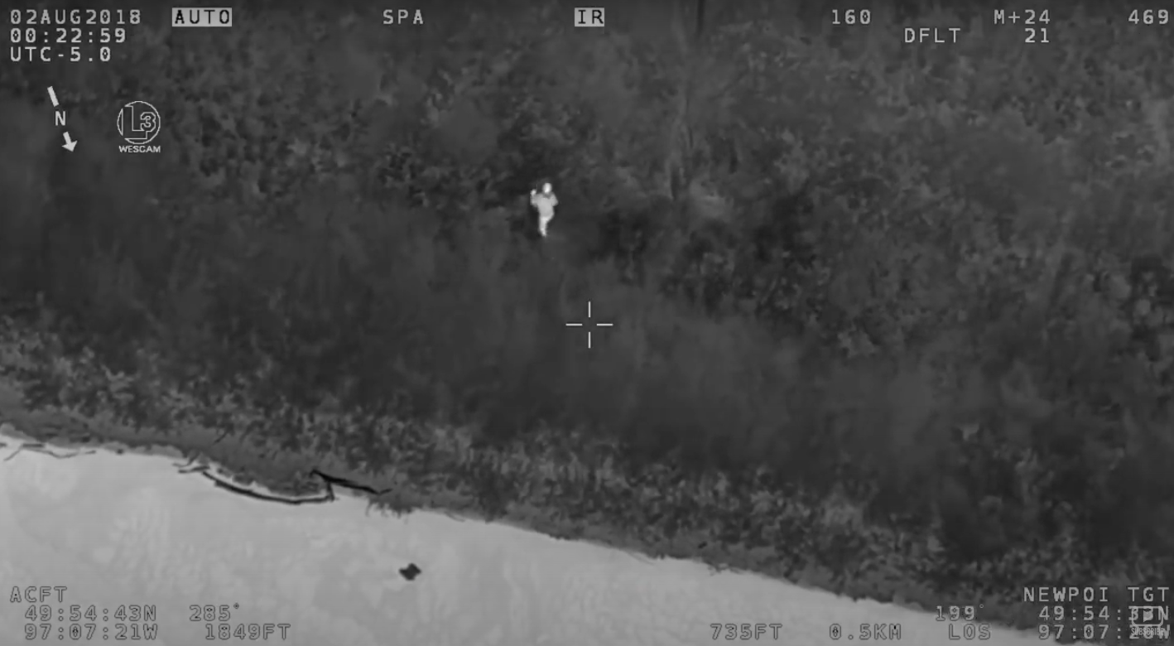
Detectors cooled, uncooled, indium antimonide

Slide 21
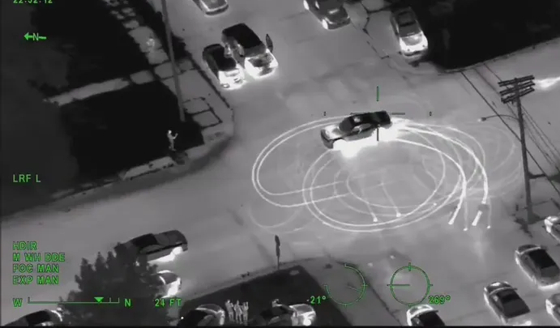
Cooled indium antimonide detectors

Slide 22
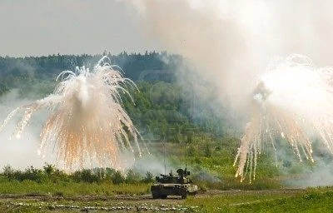
Obscurants

Slide 23
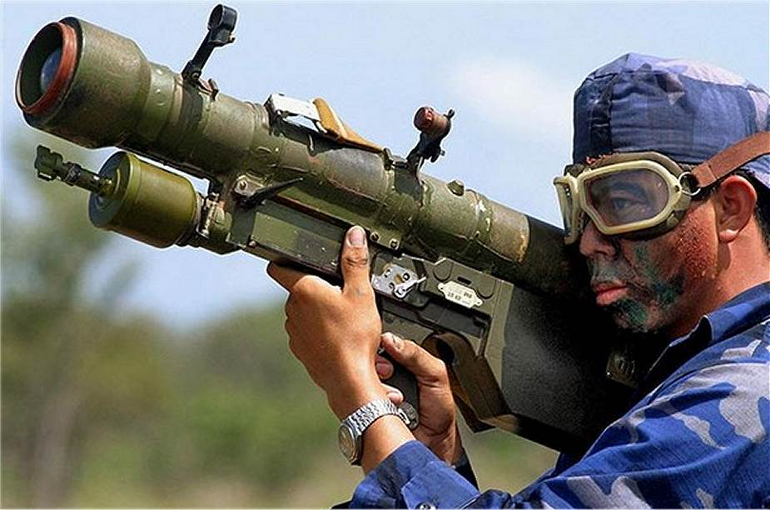
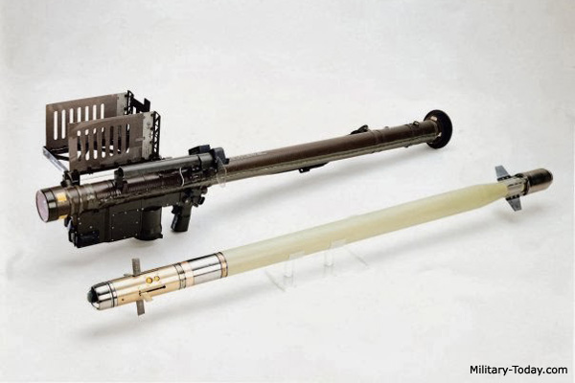
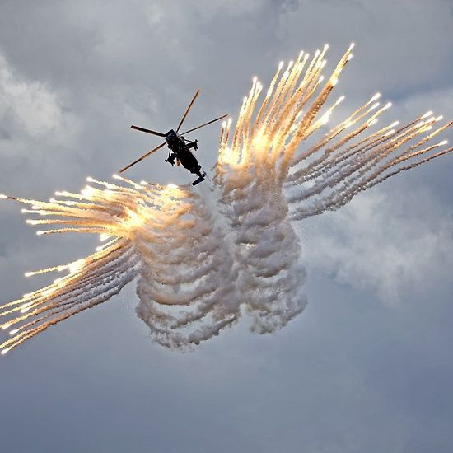
Name the 7 regions of the electromagnetic spectrum and state a defining characteristic for each region.

Slide 24
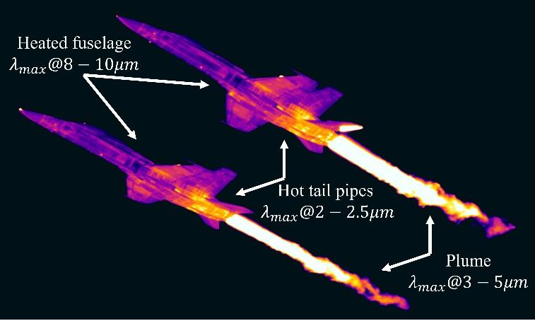
Target characteristics

Slide 25
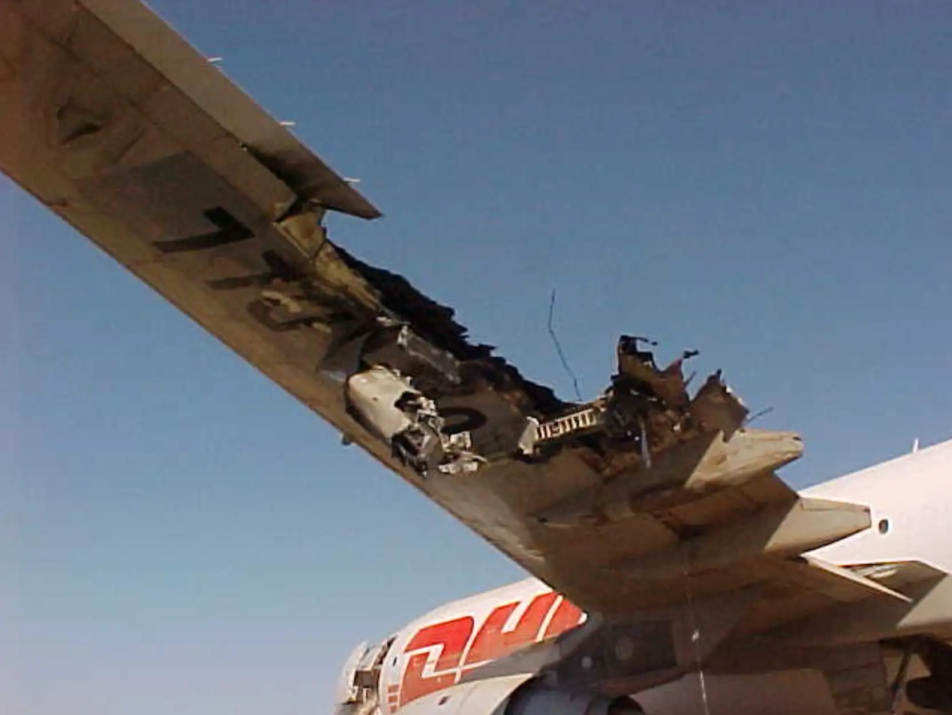
SAM7 strike on A300 Baghdad 2003

Slide 26
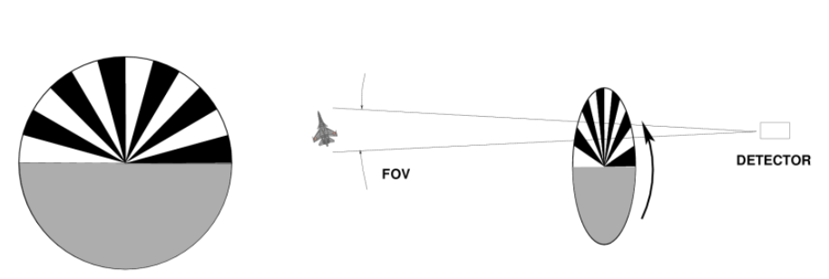
Spinning reticle design
PbS detector 2-2.7 micrometre waveband.

Slide 27
Magnesium-Teflon-Viton (MTV) compositions

Slide 28
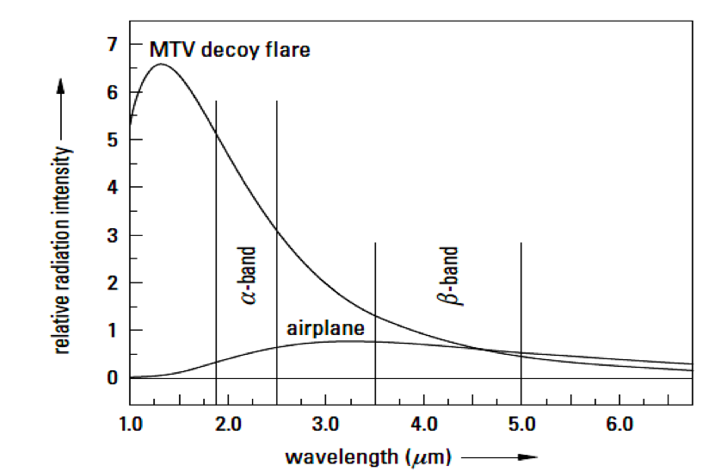
Magnesium-Teflon-Viton compositions

Slide 29
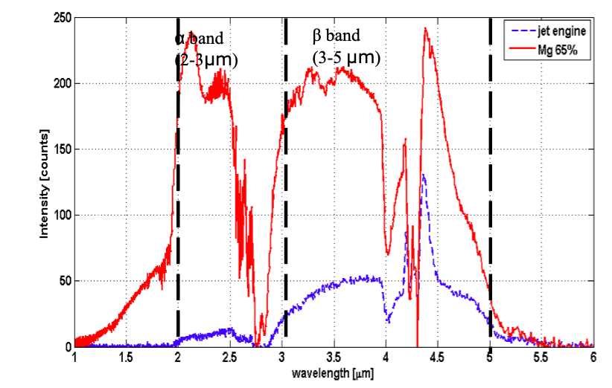

Slide 30
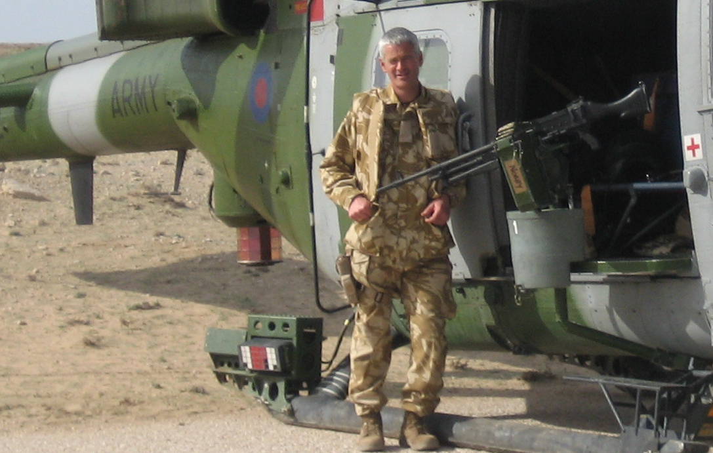
Directed Infra-Red Countermeasures (DIRCM)

Slide 31
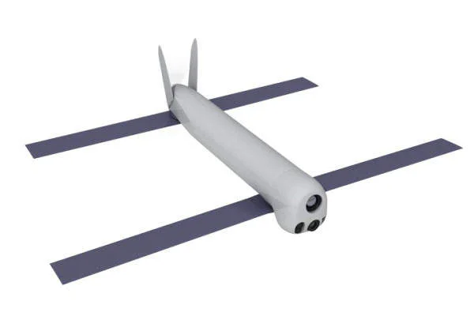
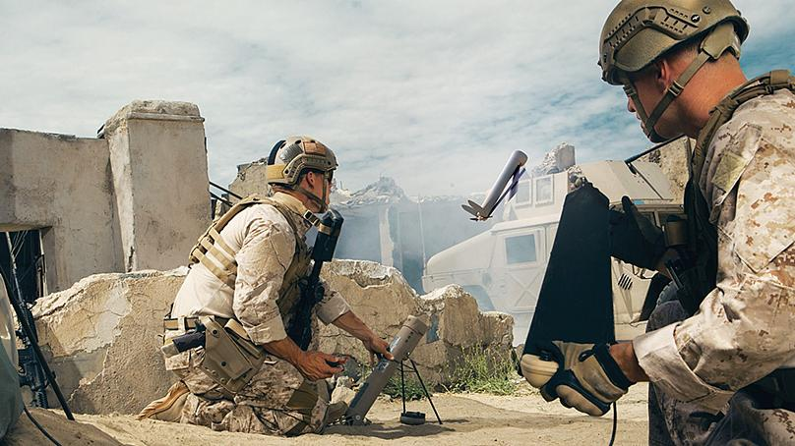
Switchblade

Slide 32
Infrared health hazards
IR radiation below 3,000 nm will penetrate into different depths of the cornea to varying degrees, depending on the specific wavelength. The iris can absorb energy only at wavelengths below approximately 1,300 nm.
IR thermal injury may have significant biological effects on the human skin. The IR-A rays induce free radicals in the dermis and diminish the skin’s antioxidant capacity, the main cause of premature skin aging.
Both the skin and the cornea are opaque to wavelengths >1,400 nm. Exposure to IR radiation in this region causes injury through thermal mechanisms, with absorbed radiation being converted to heat.
TLVs can be calculated for three types of injury:
retinal thermal injury from exposure to 385–1,400 nm radiation
retinal photochemical injury from chronic blue light (400–500 nm) exposure
possible delayed effects leading to cataract formation from exposure to 770–1,400 nm radiation

