Slide 1

MANAGING PROJECTS IN THE ORGANISATION

Slide 2
TEAM MEMBERS
NAME | BELBIN QUESTIONAIRE RESULTS | PRESENTATION TASK
DIANA CRETU | TEAM WORKER SPECIALIST | PROJECT LIFE CYCLE SMART GOAL GANTT CHAT
IRINA TANASE | RESOURCE INVESTIGATOR PLANT | QUAD CHART STAKEHOLDER ANALYSIS
LUCIANA FLOREA | RESOURCE INVESTIGATOR COMPLETE FINISHER | IRON TRIANGLE EVALUATION

Slide 3
PROJECT LIFE CYCLE,SMART, GANTT CHAT
DIANA CRETU
2123838
CANCER RESEARCH UK

Slide 4

PROJECT LIFE CYCLE
The advantages of the project life cycle are:
Provide a structure for project delivery
Improves communication between team members
It provides for the progressive evolution of the project
(Kanda, 2010)

Slide 5
PROJECT LIFE CYCLE
TERMINATION PHASE
MONITORING
CONCEPTION
PHASE
PROJECT DEFINITION
PLANNING PHASE
BRAINSTORM MEETINGS
IMPLEMENTATION PHASE
TO-DO LIST
PROJECT'S RATIONALE
BELBIN QUESTIONAIRE
SKILLS MATRIX
GANTT CHAT
TASKS (researching the organisation, contacting the organisation, making flyers, identifying a sponsor)
CLOSURE OF PROJECT
REVIEW
AIM/OBJECTIVES (create a strategy that will encourage funding, and expand awareness)

Slide 6
SKILLS MATRIX
SKILLS/ NAME | COMMUNICATION | ACTIVE LISTENING | CONFLICT RESOLUTION | PROBLEM- SOLVING | SELF-AWARENESS | EMPATHY | ORGANIZATIONAL SKILLS | CREATIVITY | FLEXIBILITY | TIME MANAGEMENT
ANA | 5 | 3 | 4 | 5 | 5 | 5 | 5 | 5 | 4 | 5
DIANA | 5 | 5 | 4 | 5 | 5 | 5 | 3 | 4 | 5 | 3
IRINA | 5 | 4 | 5 | 5 | 5 | 5 | 4 | 5 | 3 | 4
“A skills matrix is a comprehensive evaluation matrix table that summarizes the basic indicators of the skills required for employees to work in a certain position". (Yura and Andryei, 2014, p40)

Slide 7

SMART-A SMART analysis was performed to assist the team in more thoroughly assessing the project and establishing its goals. This procedure addresses all aspects of the project.
S- SPECIFIC
M- MEASURABLE
A- AGREED UPON
R- REALISTIC
T-TIME(COST)LIMITED

Slide 8
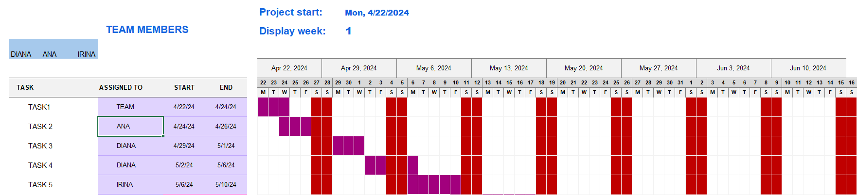
GANTT CHART
“Gantt chart provides a graphical illustration of a schedule that helps to plan, coordinate, and track specific activities in a project.”
(Trojanowska and Dostatni, 2017, p87)

Slide 9
Quad Chart, STAKEHOLDERS ANALYSIS
Irina Tanase
1920088
Cancer Research UK

Slide 10
Quad Chart
Purpose
Aim: to achieve a world where more people survive cancer
Objective 1: Raise funds to finance innovative and impactful cancer research projects.
Objective 2: Support the service of the company.
Stakeholders
1.Employees
2. Volunteers
3. Donors
4. Healthare Providers
5. NHS
6. Community Groups
7. Goverment Officials and Policy Makers
Desired end Results
Created a fundraising link and a facebook page linked with the Cancer Research Uk.
Gained donations towards the charity page.
Measures of succes
Raising awareness
200£ raised
Impact on Patient Care

Slide 11

Stakeholders
Cancer Patients and survivors
Donors
Researchers and Scientists
Volunteers
Healthcare Professionals
Government and Regulatory Bodies
Community Organizations
Sponsors
Media and Public
Suppliers and Service Providers

Slide 12
Stakeholders analysis table
Stakeholders | Perspective | Impact on the Project
Cancer Patients | Hope for better trataments | Guiding research priorities
Donors | Desire for impact | Public awarness and engagement
Researches and Scientists | Expertise and knowledge | Scientific discoveries
Volunteers | Desire for contribution | Cost savings
Healthcare Professionals | Clinical Expertise | Clinical Trials participation
Goverment | Funding allocation | Policy and regulation
Community Organizations | Community Engagement | Improved acces to service
Sponsors | Brand visability and reputation | Financial support
Media and Public | Information Dissemination | Visability and reach
Suppliers and Service Providers | Business perspective | Research Support

Slide 13

"With limited resources and attention, managers have sought ways to categorize and prioritize stakeholders. The underlying assumption is that some stakeholders matter more than others. "
(Crane, B.2020)

Slide 14
Stakeholders analysis table
Stakeholder | Importance | Influence
Cancer Patients | Medium | High
Donors | High | High
Project Team | Medium | High
Volunteers | Medium | High
Healthcare professionals | High | Medium
Goverment | High | Medium
Project Sponsors | High | Medium
Sponsors | High | Medium
Partners | Medium | Low
Suppliers and Service Providers | Medium | Medium

Slide 15
"Stakeholder involvement is critical for identifying research priorities that are relevant."
(Ruble, K. et al. 2023)

Slide 16
IRON TRIANGLE, EVALUATION
LUCIANA FLOREA
2126969
CANCER RESEARCH UK

Slide 17
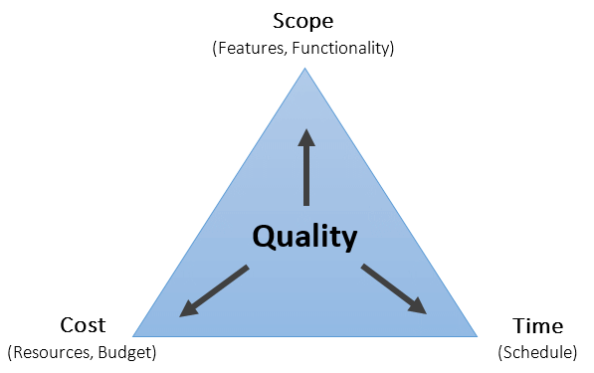
IRON TRIANGLE
2. TIME
Project timeline
26.04.2024 to
30.06.2024
Schedule management
research
contacting the organisation
identify a sponsor
creating the charity fundraiser online page
creating flyers and sharing it within our community
create links to social media and promoting the organisation
SCOPE
Organising a charitable event with the objective of raising funds for the company Cancer Research UK.
Components
Raise the amount of £200 in donations
Raise awareness
Get the community involved.
Expectations
In order or succeed we expect to raise the full amount of £200 in time with the deadline.
3.0 COST
Raising £200 (non profit)
No expenses

Slide 18
HARD AND SOFT EVALUATION
Reflection is a key feature of competency development (Illeris, 2014)
SOFT EVALUATION (QUALITATIVE METRICS)
1. Donor satisfaction
Feedback and surveys (feedback collected through a donor feedback form questionnaire, will attach in the next slide)
Testimonials
2. Volunteer and participant experience
Some of the answers gathered from the feedback forms are that the level of marketing applied by the company so far doesn’t educate people enough, the information put out there is not as much and as often.
Most people donated to the fundraiser in hope that they ened up helping others in need.
3. Community impact
Our purpose was to bring awareness into our communities
4. Media coverage
People responded well through social media
5. Innovation and creativity
HARD EVALUATION (Quantitative metrics)
Fundraising amount set at £220.00
Total funds raised £22.00
Comparison to targets 11% of the £200.00 target
Donor contributions – the average amount is £10.00 per person, considered a medium amount
2. Participation rate
Number of participants -3 people engaged so far
Engagement level – low at the moment
3.0 Campaign reach
The marketing campaign has reached to people through social media, mostly. The amount of people that responded is very low, at present 3 donations have been made by 3 different persons.
IN A FUNDRAISING PROJECT BOTH HARD AND SOFT EVALUATIONS ARE ESSENTIAL

Slide 19
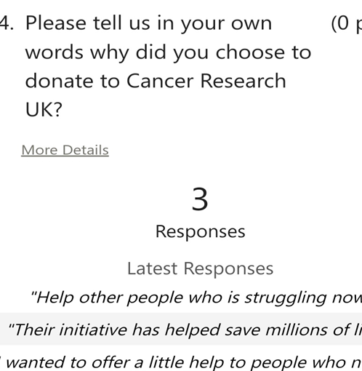
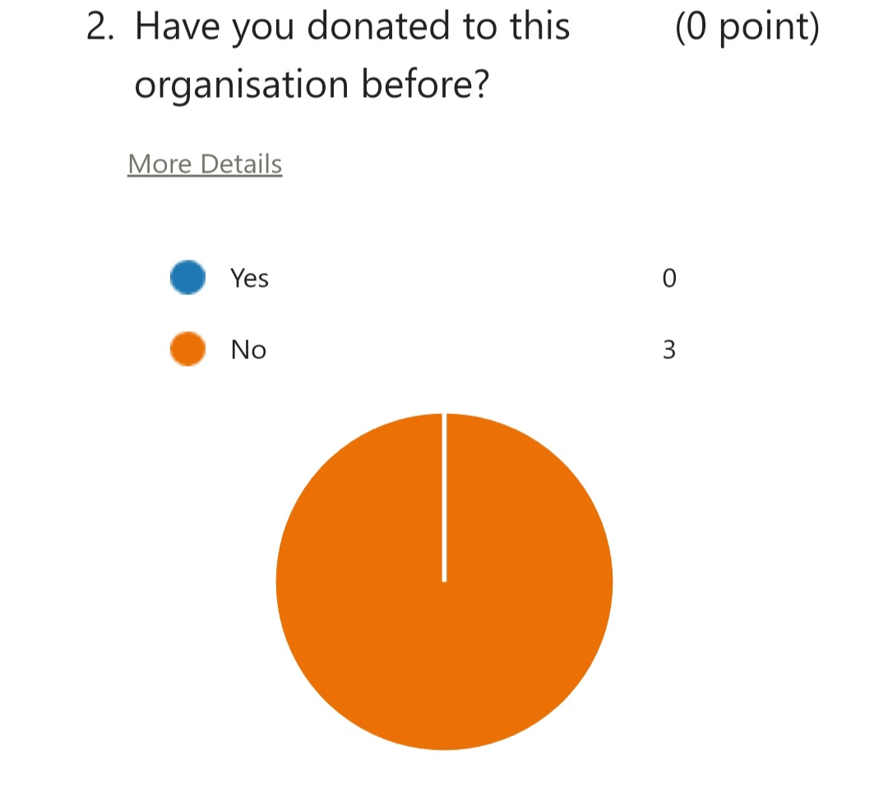
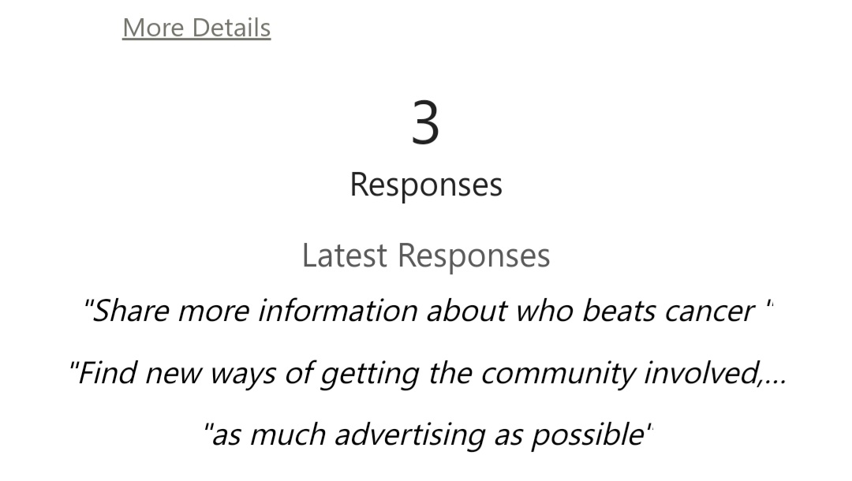
DONORS FEEDBACK FORM
https://forms.office.com/Pages/AnalysisPage.aspx?AnalyzerToken=N2adsz3siJGDf6XJmyRrdqpbiqv2ucf0&id=-REPTm4EBUWcuNshUjEeIbk90DwF1jZFvw8J9K7udltUN1FGV0czT0ZUQ1M0VE1KWFFMNEhTSE5HRi4u

Slide 20
EVALUATION
PESTLE ANALYSIS
Economical factors
Cancer Research UK relies on donations from the people for two main reasons: to stay free to help people in need whenever and wherever they are needed, and to stay separate from political and economic interests. The company responds quick to situations because its donors react regularly. Changes in people’s personal finances can have an immediate impact on the company’s funding.
Technological factors
New and updated equipment may affect the company’s operations because of the competition emphasizing their use of modern equipment and technologies.
SWOT ANALYSIS
Strengths
A powerful brand with digital innovations and strong corporate partnerships.
Together with their partners they had a significant impact which has helped reducing the number of cancer deaths.
Weakness
Vulnerability to the economical changes

Slide 21

Risk assessment
Internal Risks
Lack of experience of team members
The amount set might be too high given the amount of time set to raise it.
External Risks
Lack of communication from the company
Donors lack of finances.

Slide 22
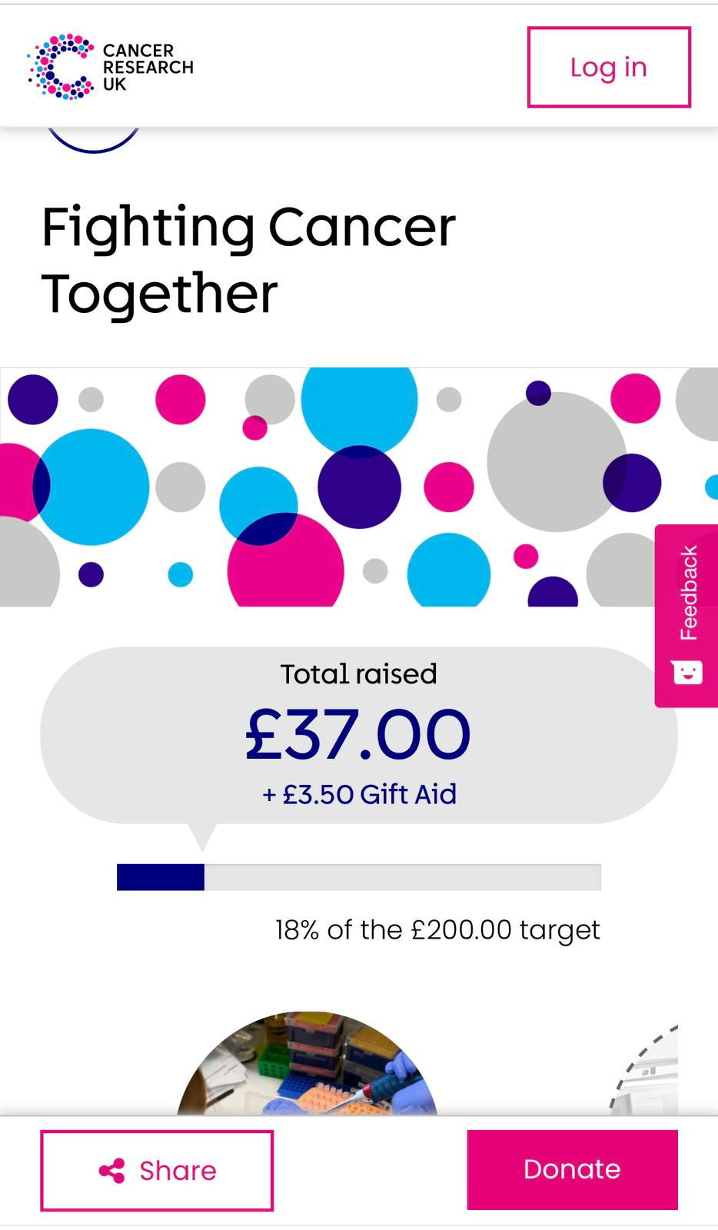

Slide 23

REFERENCES
Yura N. and Andryei A., 2022, Using Talent Management to Train and Develop Employees in the Mining Industry, Embedded Self-Organised System, 9 (4), pp. 39–44, DOI: https://doi.org/10.14464/ess.v9i4.582.
Kanda A. 2011, Project Management, A Life Cycle Approach, New Delhi, PHI Learning Limited.
Trojanowska J. and Dostatni E., 2017, Application Of The Theory of Constraints For Project Management, Management and Production Engineering Review, 8(3), pp87-95, DOI: 10.1515/mper-2017-0031
Crane, B. (2020). Revisiting Who, When, and Why Stakeholders Matter: Trust and Stakeholder Connectedness. Business & Society, 59(2), 263-286. https://doi-org.ezproxy.uwtsd.ac.uk/10.1177/0007650318756983
Ruble, K. et al. (2023) ‘Communicating neurocognitive impacts of childhood cancer: Engaging stakeholders to identify research priorities’, Patient education and counseling, 116, pp. 107935–107935. Available at: https://doi.org/10.1016/j.pec.2023.107935.

