Slide 1
Bourdieu, Taste and Class

Slide 2
Key Themes
How is class performed through food consumption, amongst other lifestyle activities
Notions of conspicuous consumption and display
Class as
  Distinction
  Taste
In what ways does food create distinctions between us and them?
  How can we apply Bourdieu?

Slide 3
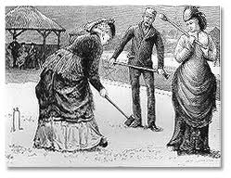
Veblen (1994), The Leisure Class
Conspicuous consumption and its relation to class
Spending for the sake of prestige
Symbolic, over the utilitarian, role of goods
The way that the elite ‘leisure class’ differentiated themselves from the working class

Slide 4
Emulation
The leisure class set the social standard
Working class aspire to attain that standard
“the possession of goods …becomes the conventional basis of reputability” (Veblen 1994 : 37)

Slide 5
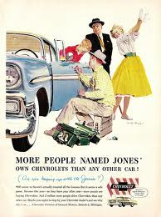
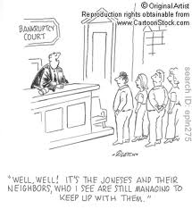
Or in other words…..

Slide 6
Bourdieu (1984) Distinction
‘Taste’ among the French bourgeoisie
They distinguish themselves from other classes through their everyday consumption of household items,
  such as furniture, clothing and food
Different social groups inhabit differentiated social spaces
These are characterised by distinct lifestyles

Slide 7
Cultural Capital
The difference between cultural and economic capital
‘Taste’ is a mode of social and class distinction
The cultured elites are distinguished from the newly-wealthy,
  not in terms of their material resources
  but in the expression and articulation of their preferred everyday ‘tastes’

Slide 8
Broadcasting Class
Taste performs a social orientation role
Gives a ‘sense of one’s place’
Possession of certain ‘prestige’ commodities becomes a means for an individual to acquire and express social status
Aesthetic judgements are culturally and socially determined

Slide 9
Habitus, Emulation and Trajectories
Tastes change and the goal posts move
Trajectory Effect
  Practices of a given group (habitus)
  Objective possibilities that are open to them
Relationship is not static
Symbolic boundaries are social boundaries
Struggle over ‘tastes’ are political struggles

Slide 10
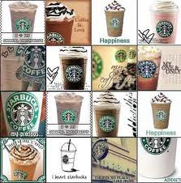
Roseberry (1996), Yuppie Coffees
The emergence of gourmet coffee market in the US
Backdrop of declining sales
Shift from mass market to segmentation
Imagines, but also reflects existing, class and generational relations

Slide 11
Are you an individual or a ‘Joel’?
We may think of ourselves as actors and individuals
But our ‘choices’ are shaped along class lines
Not an orchestrated conspiracy by big business
Small and medium players, and new entrants to the market
Bumbling experimentation and stumbling upon strategies

