Slide 1



Hospitality and Guest services
Student name: Ioana Roxana Apostol
ID: 2223646

Slide 2

Table of Contents
Slide 1: Title
Slide 2: Company Background
Slide 3: Main consumers of Fairfield Marriott
Slide 4: Nature, Scope and role of the Guest services
Slide 5: Nature, Scope and role of the Guest services (Contd..)
Slide 6: Role and functions of the Guest services
Slide 7: Importance of Hospitality
Slide 8: Exceeding the Guest expectations
Slide 9: Conclusion
Slide 10: References
Slide 11: Thank You

Slide 3


Company Background
Marriott International founded in 1927 has its headquarters in Bethesda.
The company has more than 7,000 properties in over 130 countries with brands that include Fairfield and many more.
Fairfield has more than 1000 properties worldwide that caters its guests with the highest level of service.
Notes:
As per the report published by Forbes (2022), Marriott International engages in the franchise and operations of residential, hotel, and timeshare properties. According to the data published in Statista (2023), Marriott International is the leading hotel company in terms of revenue, generating more than $20 billion dollars in 2022. Among the brands of Marriott International, Fairfield has been selected for this assignment, for which all the aspects of the brand will be clearly highlighted for generating a proper understanding of the subject matter.

Slide 4
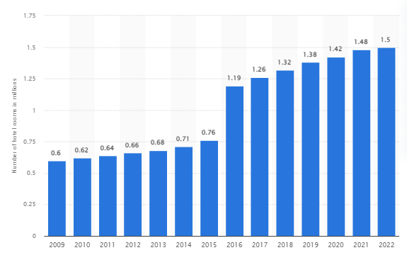
Main Consumers of Fairfield Marriott
Main consumer of Fairfield by Marriot mainly consists of solo, over-the-road, or luxury travellers and other travel professionals offering signature spaces such as ‘meeting salons’ and ‘lounges”.
The brand has its fair number of guest rooms for always accommodating its guests comfortably.
Notes:
The Luxury Brand Group’s presentation by Marriott International on the State of Luxury Travel has demonstrated the shift in customer behaviour and attitudes in the post-pandemic world. The demands of the guests have changed with luxury travelling shifting from a flashier to a much more silent form of affluence. In this aspect, Elyssa (2020) has pointed out that the current target groups of Marriott International and Fairfield mainly consists of solo, over-the-road, or luxury travellers and other travel professionals offering. The company has more than 1.5 million guestrooms in several properties worldwide surpassing Hilton Worldwide by more than 400 thousand hotel rooms (Statista, 2023). It can be deduced that Fairfield has its fair number of guest rooms as well for always accommodating its guests comfortably.

Slide 5

Nature, Scope and role of the Guest services
Provides the highest level of services to all its guests by providing several facilities and amenities such as airport transportation, 24-hour front desk service, room service, free Wi-Fi, and free breakfasts.
Notes:
An article published by Fairfield (2022) shows that the brand has a great room view from all its guestrooms that significantly leverages the company’s amazing customer service and great hospitality for improving its long-term brand reputation in the market.

Slide 6

Nature, Scope and role of the Guest services (Contd..)
Provides special offers, discounts, and many more to its guests
Shops by Fairfield enables guests to buy their premium hotel mattresses
Notes:
The report published by Fairfield (2022) highlights that the brand continuously gives special offers to its guests for elevating the brand’s level of customer service. It has also been found that the Fairfield Shops sells their hotel’s premium pillows and mattresses that enable the guests to bring the comfort of the brand to their homes.

Slide 7
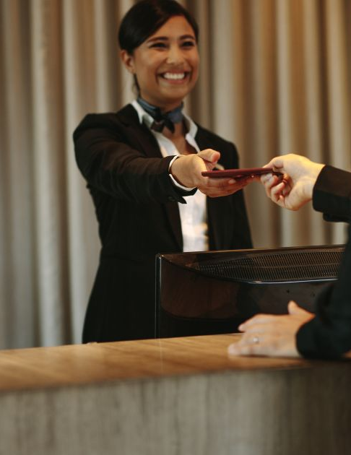
Role and functions of the Guest services
Assist the guests during check-in and check-out
Providing the guests with hotel services
Attending the guests while their stay
Notes:
With the growth of the organisational management of the services, the staff must be taking care of the details that can help in managing the needs of the guests. It is the responsibility of the employees to develop the influence of organisational morale and values in front of the guests. Moreover, Juanamasta et al. (2019) suggested that the trust of the hotels is within the hand of the employees as they help in giving the guests, the services that can be memorable. Attending to the needs of the guests and managing the essentials of the clients, is the sole purpose of the employees while attending to them. The organisational value and the happiness are also signified with the help of gestures and the lookouts that caters to the proper code of conduct for the employees

Slide 8
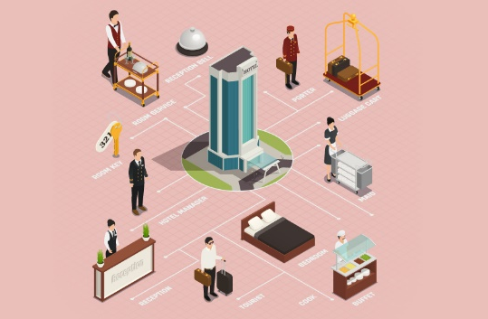

Importance of Hospitality
Gaining loyal customers
Rarity of the services
Growth in the business
Over 86% of the customers pay more for better customer experiences (Xu et al., 2020)
Notes:
With the growth of the hospitality provisions, the hotels can be able to conduct better services and cater to improvised loyalty of the consumers. It is stated by Xu et al. (2020), that a satisfied customer will go on boosting about the experience to three of their friends while an angry customer will go ahead and tell 3000 people about the negative experiences that they have shared with the organisation. This impacts the overall services and the hospitality ratio of the hotel industry and impacts over the consumer loyalty gain. According to Raman (2019), providing the consumers with better hospitality can help in significantly separating the organization from the remaining imitable organisations within the competitive scenarios. This refers to the active consideration of hiring proactive team members who are polite and efficient in their contributions.

Slide 9
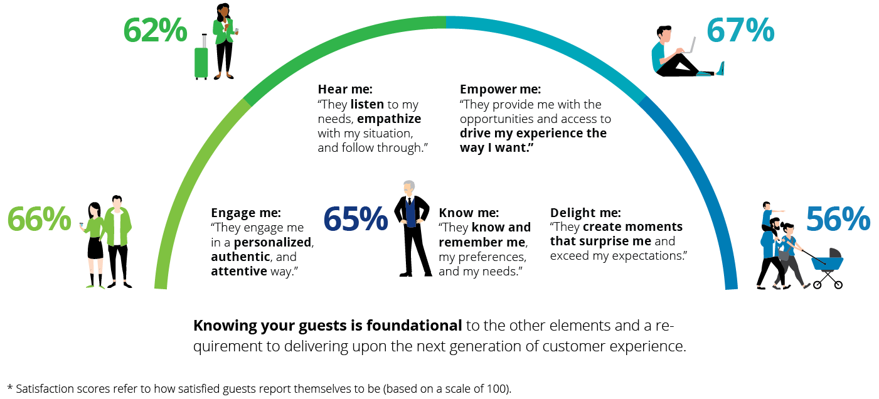
Exceeding the Guest expectations
Earning the trust of the employees and the customers
Guest reviewing to improve the feedbacks
Simplifying the user-experiences (Huang and Rust, 2021)
Enhancing the customer services
Notes:
Due to the consideration of the negative reviews, the customers often feel enraged and organisation losses a chance to improve their mistakes. Huang and Rust (2021) suggested that the development of the negative feedbacks is often heard from 4% of the customers who are not satisfied with the service. This must be modified and taken care of for the recognition of the needs and the improvements that the organisation must be taking care of for better customer loyalty.

Slide 10
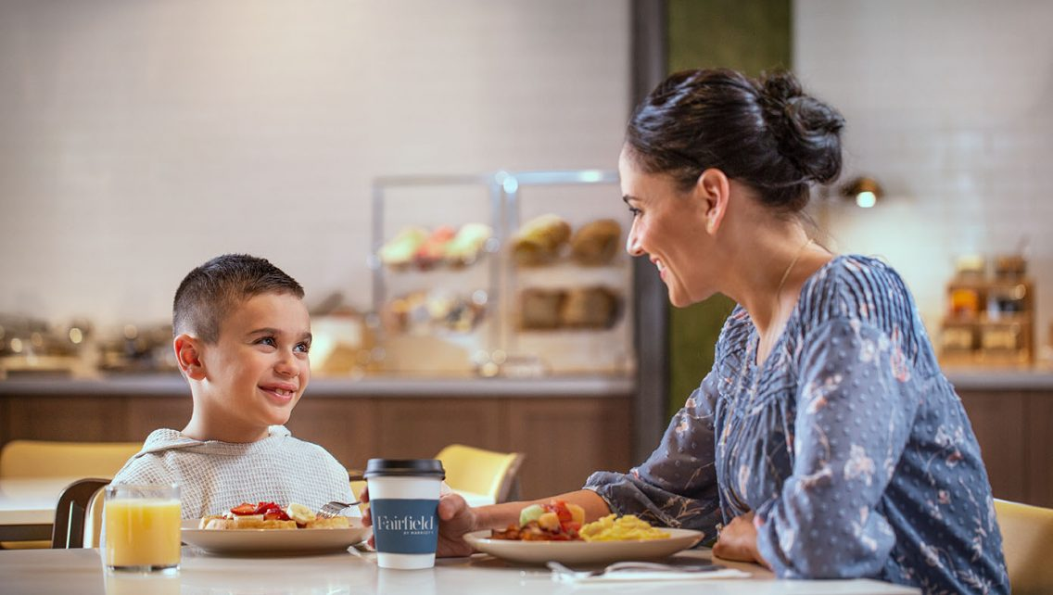
Conclusion
The growth of the organisational acceptance regarding the management of the brand name of Marriott has been taken care of by Fairfield Marriott.
The depiction of the project provides with the ideas of taking care of the customer needs and managing the organisational value for better customer experiences.
Catering to the proper means of helping the customers also must be taken care of for better ideas and the realisation of the roles and functions.
With the development of the services, the organisation must be keeping the ideas and the actions of the employees subtle so that it can reflect the ethnicity and the culture of the organisation.

Slide 11

References
Elyssa, A. (2020) Marriott: The luxury consumer is changing, but demand remains strong ... Available at: https://hotelbusiness.com/marriott-the-luxury-consumer-is-changing-but-demand-remains-strong/ (Accessed: 10 May 2023).
Fairfield (2022) Fairfield by Marriott: Business Hotels, Business Hotels | Fairfield Inn and Suites. Available at: https://fairfield.marriott.com/ (Accessed: 10 May 2023).
Forbes (2022) Marriott International | Mar Stock Price, company Overview & News, Forbes. Available at: https://www.forbes.com/companies/marriott-international/ (Accessed: 10 May 2023).
Huang, M.H. and Rust, R.T., (2021). Engaged to a robot? The role of AI in service. Journal of Service Research, 24(1), pp.30-41.
Juanamasta, I.G., Wati, N.M.N., Hendrawati, E., Wahyuni, W., Pramudianti, M., Wisnujati, N.S., Setiawati, A.P., Susetyorini, S., Elan, U., Rusdiyanto, R. and Astanto, D., (2019). The role of customer service through customer relationship management (Crm) to increase customer loyalty and good image. International Journal of Scientific and Technology Research, 8(10), pp.2004-2007.
Raman, P., (2019). Understanding female consumers’ intention to shop online: The role of trust, convenience and customer service. Asia Pacific Journal of Marketing and Logistics.
Statista (2023) Marriott Revenue Worldwide 2022, Statista. Available at: https://www.statista.com/statistics/266279/revenue-of-the-marriott-international-inc-hotel-chain/ (Accessed: 10 May 2023).
Xu, Y., Shieh, C.H., van Esch, P. and Ling, I.L., (2020). AI customer service: Task complexity, problem-solving ability, and usage intention. Australasian marketing journal, 28(4), pp.189-199.

Slide 12


