Slide 1
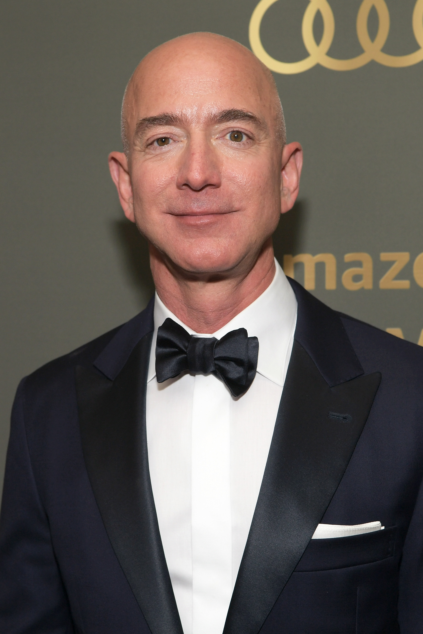

Jeff Bezos
Bio
12th January 1964
Net Worth- $193.4 Billion(as of 8/11/20 according to Forbes)
Founder and CEO of Amazon
Success
Jeff Bezos took his business from his garage in Seattle to one of the biggest companies in world and has made him the richest man in the world.
Bezos started off by selling books in his garage and today amazon is the go-to place for almost anything you can imagine.

