Slide 1
AHAN5007
The Body, Culture and Society
Symbolism and the Social Body

Slide 2
Theory reminder: Functionalism
Behaviour can be understood in terms of individual needs and motivations
Different elements of ‘culture’ are interconnected and form a system
To understand an element we must seeks its function within the cultural system

Slide 3
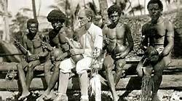
“Whether we consider a very simple or primitive culture or an extremely complex and developed one, we are confronted by a vast apparatus, partly material, partly human and partly spiritual by which man is able to cope with the concrete specific problems that face him" (Malinowski 1944:36).

Slide 4
Theory Reminder: Structuralism
Culture (like language) is governed by unwritten rules of behaviour
Practitioners understand but are not able to articulate these rules.
May be expressed as binary oppositions (e.g. raw/cooked, hot/cold, clean/dirty)
Aim to understand the underlying meaning involved in human thought as expressed in cultural acts.

Slide 5
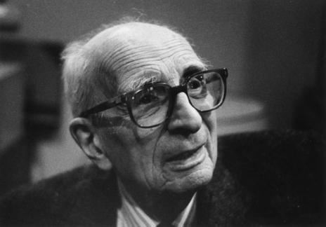
“In contrast with scientific explanation, the problem here is not to attribute confused and disorganized states, emotions, or representations to an objective cause, but rather to articulate them into a whole or system.” (Lévi-Strauss, 1999, p. 136)

Slide 6
Theoretical Reminder:
Structural-Functionalism
Society is a system of relationships maintaining itself through cybernetic feedback
Institutions are orderly sets of relationships whose function is to maintain the society as a system
Individuals are largely irrelevant
Analagous to the body: organs exist to support the structure as a whole

Slide 7
“This important distinction, between structure as an actually existing concrete reality, to be directly observed, and structural form, as what the field-worker describes, may be made clearer perhaps by a consideration of the continuity of social structure through time, a continuity which is not static like that of a building, but a dynamic continuity, like that of the organic structure of a living body. Throughout the life of an organism its structure is being constantly renewed; and similarly the social life constantly renews the social structure.” (Radcliffe-Brown, 1940, p. 4)

Slide 8
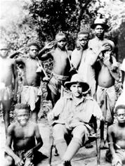
Witchcraft among the Zande
(Evans-Pritchard)
E.E. Evans-Pritchard, Witchcraft, Oracles and Magic among the Azande
2 levels of illness causation
  Natural causes (accident leads to infection)
  Witchcraft (Why me? Why at this particular time?)
Witchcraft is believed to be a physical and inherited trait – a substance that can be found on autopsy
Important social function of belief in witchcraft

Slide 9
Bodies and Social Groups
(Mary Douglas)
The function of taboos against 'pollution' (or religious defilement) is in protecting 'primitive' society 'from behaviour that will wreck it' (Douglas 1992, p. 4).
Rituals and symbolic behaviour involve the body in replicating social situations (e.g. rites of transition).

Slide 10
‘If there is no concern to preserve social boundaries, I would not expect to find concern with bodily boundaries. The relation of head to feet, of brain and sexual organs, of mouth and anus are commonly treated so that they express the relevant patterns of hierarchy… bodily control is an expression of social control.’ (Douglas, 1973, p. 99)

