Slide 1


Collaboration in action-The critical role of teamwork to achieving success.
By Cody Peacey (2404220)
ThePhoto by PhotoAuthor is licensed under CCYYSA.

Slide 2



Fundamental principles of teamwork
Communication
Identifying team goals
Support
(Deakinco.com,2024)

Slide 3
Benefits of effective teamwork
Support
Better communication
Problem solving
(Middleton,2024)

Slide 4
Challenges of teamwork
Lack of trust
Lack of collaboration
Poor communication
(Chellappa,2024)

Slide 5
Examples of teamwork in policing
Drawing people together to work on action plans
Sharing of information with colleagues
Deal with conflict collaboratively
(Chief Bakes,2016)

Slide 6
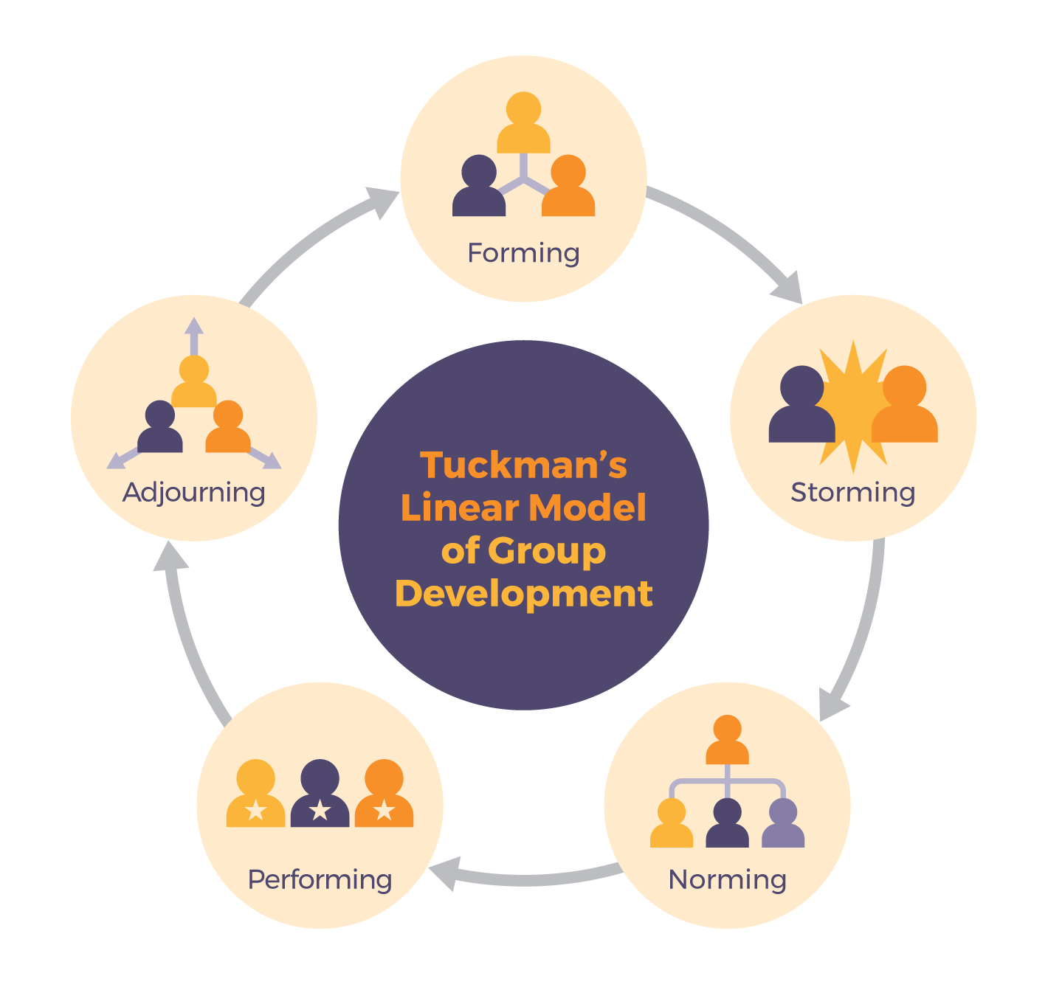
Theory- Tuckman's stages of development
ThePhoto by PhotoAuthor is licensed under CCYYSA.

Slide 7
Forming
Start of a role
Getting to know each other
Establish their roles
(Hughes,2024)

Slide 8
Storming
Conflict
Push against boundaries
Testing each other
(Hughes,2024)

Slide 9
Successful case study
Police and charities working together
Tackling mental health incidents
G999 Scheme
(BBC News,2020)

Slide 10
Negative case study
Case of Daniel Pelka
Poor communication between authorities
Ineffective collaboration
(BBC News, 2013)

Slide 11
Reference list
Chief Bakes (2016), Teamworking a competency framework, Available at:TEAMWORKING - A - Competency Framework - Police Community
Deakinco.com (2023), Key elements of teamwork, Available at:Key Elements of Effective Teamwork | DeakinCo.
Srikant Chellappa (2024), 5 challenges every team encounters!, Available at:Teamwork Challenges And How To Overcome Them - Engagedly
Hughes (2024), Forming, storming, norming and performing, Available at:Forming, Storming, Norming, and Performing - Tuckman's Model for Nurturing a Team to High Performance
BBC News (2020), Police and charity staff work together to tackle mental health incidents, Available at:Police and charity staff work together to tackle mental health incidents - BBC News
BBC News (2013), Starved boy Daniel Pelka 'invisible' to professionals, Available at:Starved boy Daniel Pelka 'invisible' to professionals - BBC News

