Slide 1
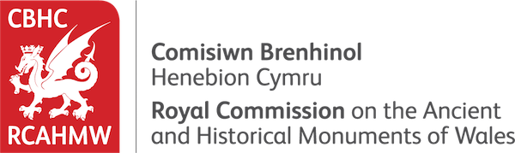
An Overview of the Royal Commission and the work of a Commissioner
Dr Louise Emanuel

Slide 2
Background
1908 the administrative frameworks were in place to establish individual Royal Commissions on Ancient Monuments separately in Scotland, England and Wales.
On 10 August 1908 a Royal Commission was authorised and appointed by King Edward VII to 'make an inventory of the Ancient and Historical Monuments and Constructions connected with or illustrative of the contemporary culture, civilisation and conditions of life of the people in Wales and Monmouthshire from the earliest times, and to specify those which seem most worthy of preservation'.

Slide 3
it was felt that an independent and official body was needed to prepare a reliable inventory from which examples could be selected and recommended for statutory protection
Originally located in London, now in Aberystwyth

Slide 4
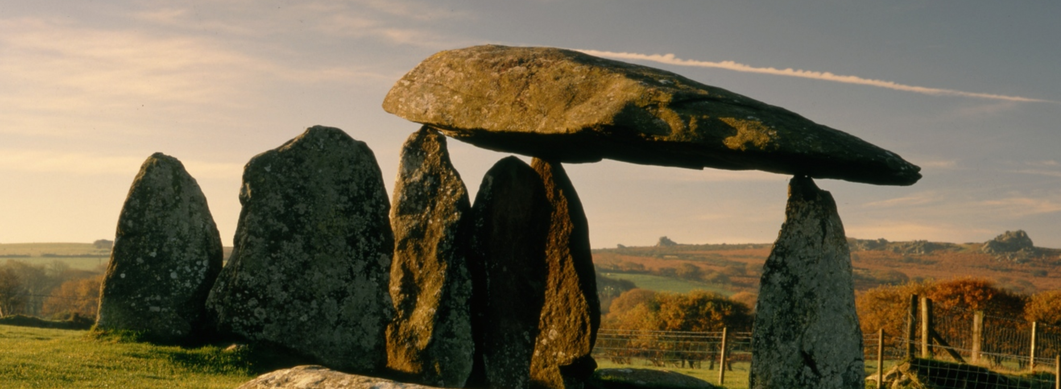
Mission Statement
The Royal Commission has a national role in the management of the archaeological, built and maritime heritage of Wales, as an originator, curator and supplier of information for individual, corporate and governmental decision-makers, researchers and the general public. To this end it;
Surveys, Interprets and Records the man-made environment of Wales;
Compiles, Maintains and Curates the National Monuments Record of Wales;
Promotes an understanding of this information by all appropriate means.

Slide 5
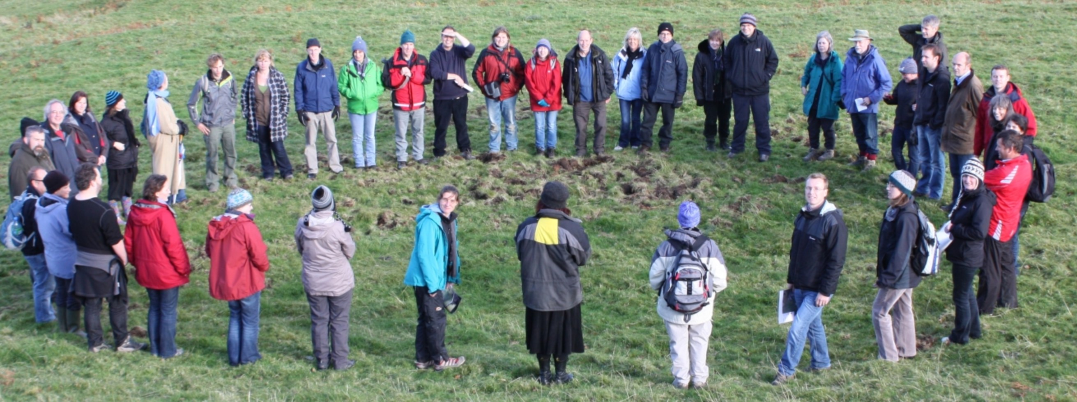
Staff
Permanent staff of around thirty-five people who work full time or part time at its offices in Aberystwyth.
Most staff fulfil specialist roles, for example in archive administration, archaeology, photography, graphics, education, architectural history or information management.
Work is guided by the Secretary of the Commission and by its Chairperson and Commissioners.

Slide 6

Commissioners
Commissioners are appointed by HM The Queen, on the advice of the Welsh Government and the Secretary of State for Wales.
Appointed under a Royal Warrant
They have executive oversight of the Royal Commission’s work.
No more than 10 commissioners at any given time
Various specialisms

Slide 7
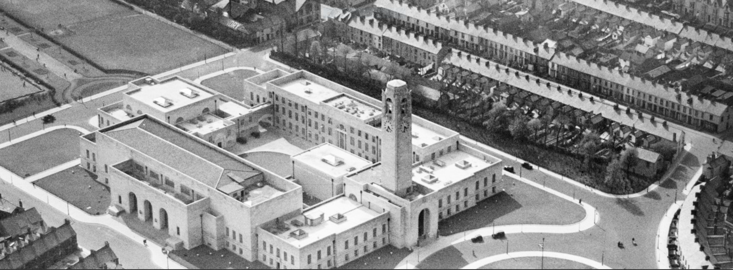
The National Monuments Record of Wales (NMRW)
The National Monuments Record of Wales (NMRW) holds the national collection of information about the historic environment of Wales from the earliest times to the present day.
It includes almost 2 million photographs and many thousands of drawings, surveys, reports and maps within the following collections:
The main record file series: the records include photographs, drawings, reports, correspondence, etc.
The drawings collection: this collection includes over 11,000 drawings of many types.
The photographic negative collection: the collection comprises about 1.5 million negatives, among them historically important and fragile examples of early photographic techniques.

Slide 8
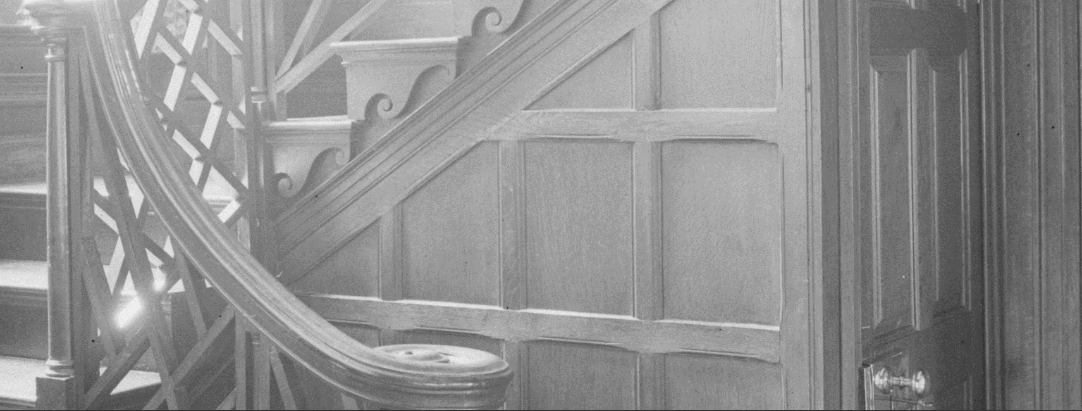
The aerial photographic collections: over 500,000 photographs, including vertical and oblique photography. Photographs originate from the Royal Commission’s own flying programme and from other major sources, including Ordnance Survey and the Royal Air Force and the Aerofilms collection.
Ordnance Survey maps: about 30,000 large-scale maps, covering the whole of Wales in several editions and at various scales.
Special collections: many special collections donated or loaned by other organisations and individuals, or produced through particular RCAHMW projects.
Digital archive: this is a fast-growing collection of digital photographs, texts and surveys produced by the Royal Commission or external sources. Wherever possible these are made directly accessible through Coflein.
The library collections: the NMRW also maintains a specialist library which aims to provide published sources to complement the unpublished information available in the archive.

Slide 9
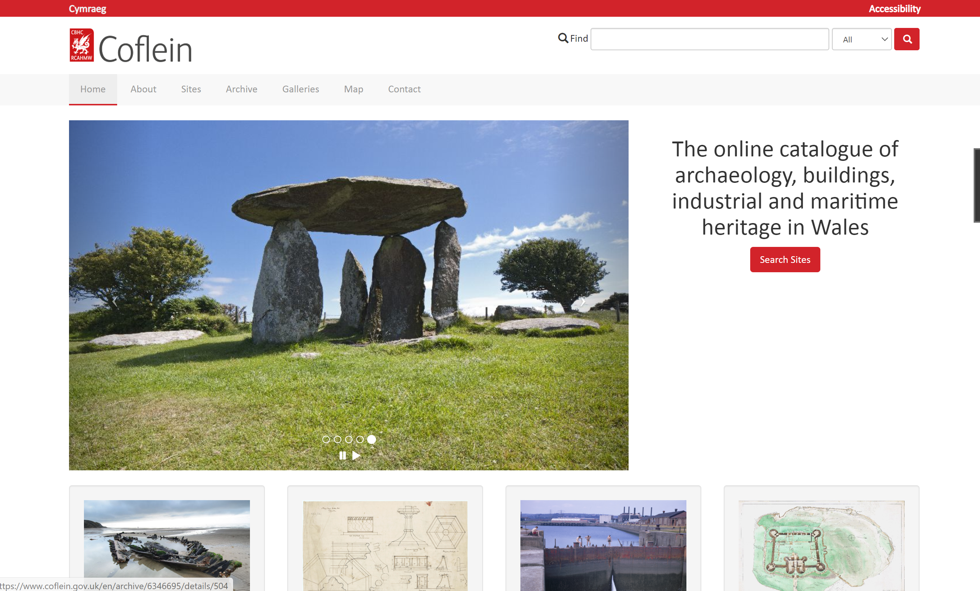
Coflein - https://www.coflein.gov.uk/en

Slide 10
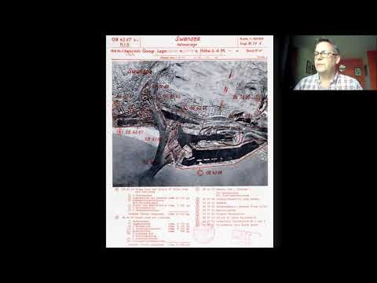
A History of Aerial Photography in Wales in Twenty Pictures - David Thomas

Slide 11
Projects
Wales Slate World Heritage Site bid: work to compile a persuasive dossier of evidence to inform the bid for UNESCO World Heritage Site status.
Commemorating the Forgotten U-boat War: our project to commemorate the First World War at sea around the Welsh coast, partly funded by the National Lottery Heritage Fund (NLHF), in partnership with Bangor University and the Nautical Archaeology Society, marine geophysical surveys to capture high-resolution data of 17 wrecks.
Unloved Heritage: Ceredigion Off-limits?: to empower young people to define what aspects of the heritage they value and why, and to help them acquire the skills to research and record that heritage and tell compelling stories about it.
CHERISH: five-year project, which runs until 31 December 2021, funded by the EU Interreg fund, in partnership with Aberystwyth University, Geological Survey Ireland and The Discovery Programme Ireland.

Slide 12
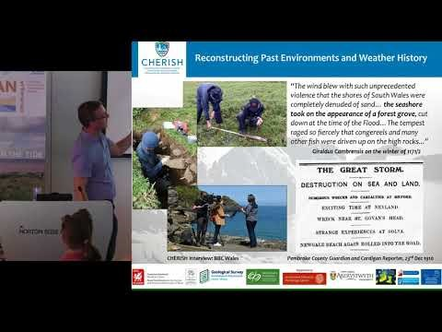
Joining forces: The Cherish project - Understanding climate change and coastal heritage in Wales – Toby Driver

Slide 13

New technologies in heritage, interpretation and outreach
Wednesday 10 February 2021: Conference
8-12 February 2021: Workshops
Online via Zoom

