Slide 1
Reflexive Counselling Skills
Theories of reflection : Shon
Skills Application
Dr Beverly Cole

Slide 2
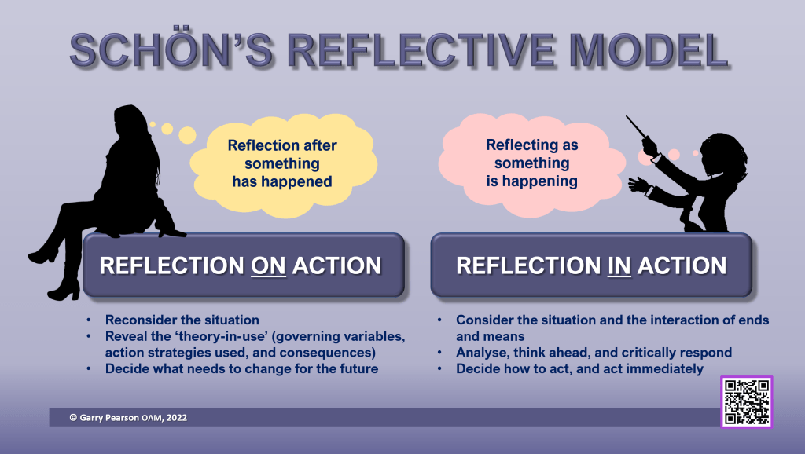

Slide 3

Schön (1983) The theory of reflecting in, and reflecting on, one’s practice.
Schön (1983) based his work on that of Dewey and is most widely known for his theory of reflecting in and reflecting on one’s practice.
His theory was grounded in reflection from a professional knowledge and learning perspective (Bolton, 2014.p.6).
In simple terms this is described as reflecting AS the experience is occurring or reflecting ON the experience AFTER it has occurred.

Slide 4
Schön (1983) The theory of reflecting in, and reflecting on, one’s practice
Reflecting in action refers to situations such as:
Thinking on your feet
Acting straight away, and thinking about what to do next.
Reflecting on action means:
Thinking about what you would do differently next time
Taking time to reflect and process

Slide 5
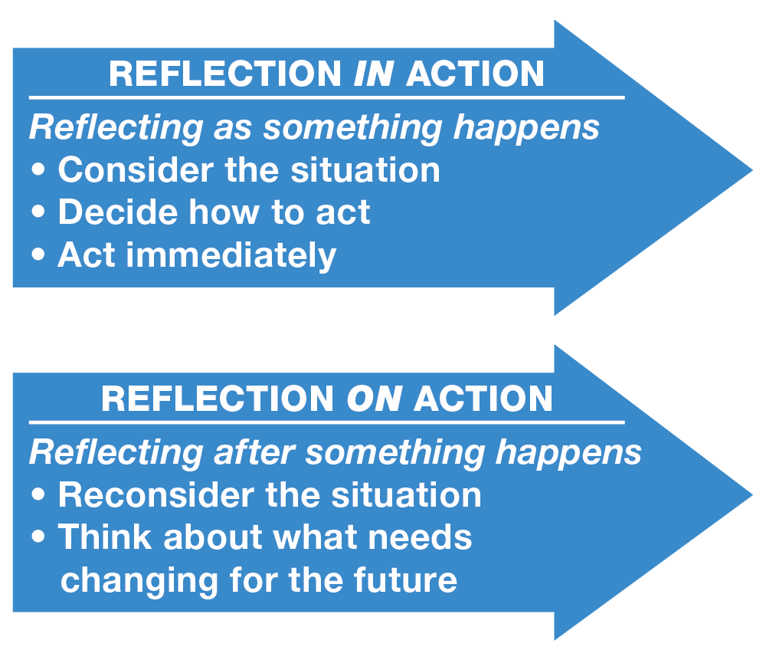

Slide 6
To apply Schon's reflective practice model…
Adopt a reflective attitude before your client session.
While in the Triad, be mindful of what is happening, how you and your client are reacting, and any challenges or opportunities that arise.
Then, after the Triad, review your reaction and the feedback from your colleagues.
Ask yourself some reflective questions.

Slide 7
To apply Schon's reflective practice model…
Discuss your reflections with your colleague.
Keep track of your reflections and actions by using a reflective journal
Schon's reflective practice model is an effective tool for enhancing practice and professional learning.
By reflecting in action and on action, you can learn from your own experiences and grow

Slide 8

ANY QUESTIONS……Bring these to our workshop

Slide 9
References:
Berne, E. (1961) Transactional Analysis in Psychotherapy. New York. Grove Press.
Berne, E. (1962, 1976) ‘Classification of positions’, Transactional Analysis Bulletin, vol. 1, 3: p. 23
Berne, E. (1972) What Do You Say After You Say Hello. New York. Grove Press.
Ernst, F (1971) ‘The OK Corral: the grid to get-on-with’ Transactional Analysis Journal, vol. 1, 4: p.p. 231-40
Freud, S. (1989 [1940]) An Outline of Psycho-Analysis (trans. J. Strachey), London, W. W. Norton & Company.
Goulding, R. and Goulding, M. (1976) ‘Injunctions, Decisions and Redecisions’, Transactional Analysis Journal, vol. 6, 1: pp. 41-48
Kahler, T. Ph.D. and Hedges Capers, Div. M., LHD., (1974) “The Miniscript”, Transactional Analysis Journal, vol. 4 1: pp. 26-42.
Steiner, C. M. (1966) ‘Script and Counterscript’ Transactional Analysis Bulletin, vol.18
Widdowson, M. (2010) Transactional Analysis: 100 Key Points & Techniques. London and New York, Routledge.

