Slide 1
Acknowledgement: The use of AI (Canva) to Create Images

Slide 2


Business Plan
Tara
Pop-up Kitchen
Tara! Pop-up Kitchen
Presented by: Mark Jeffrey Pascual
Student Number: 2229176
Module: Leading Restaurant Strategy BMGM6001

Slide 3

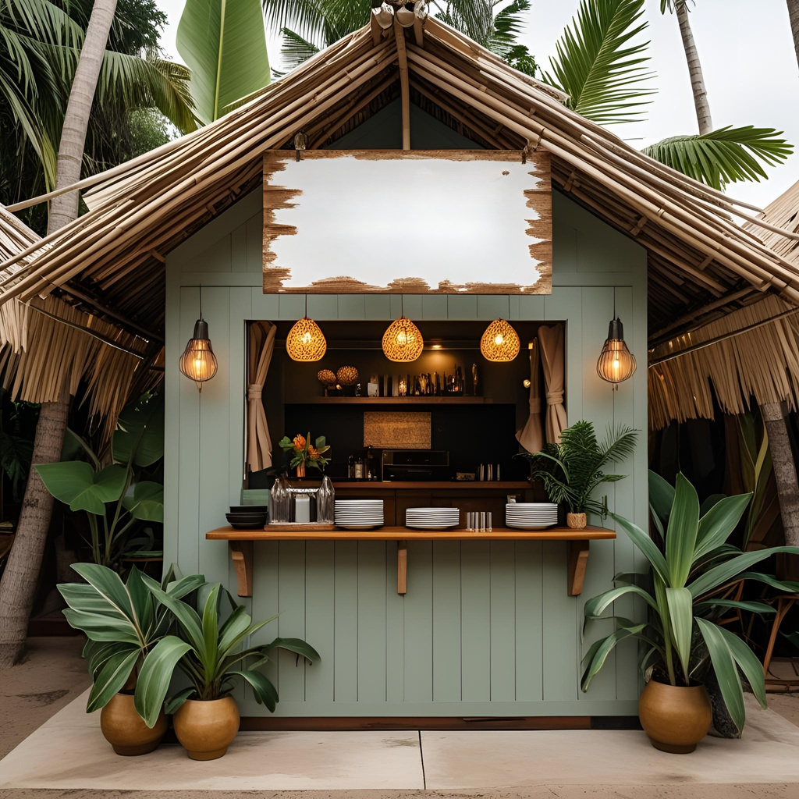
Business Idea
POP-UP
CASUAL PREMIUM
Concept
  Pop-up kitchen celebrating
Asian Filipino cuisine
  Location: Swansea & surrounding areas
  USP: Locally sourced Welsh produce +
culturally rich storytelling
  Experience: Seasonal, limited-time dining events
  Target Market: Adventurous diners &
cultural explorers
  Brand Identity:
  “Home, Longing for Home”
    “Tara” = “Come in” (Filipino)
    “Tara” = “Goodbye” (Welsh)
Tara
Pop-up Kitchen
COMMUNITY
PRIVATE HIRE

Slide 4
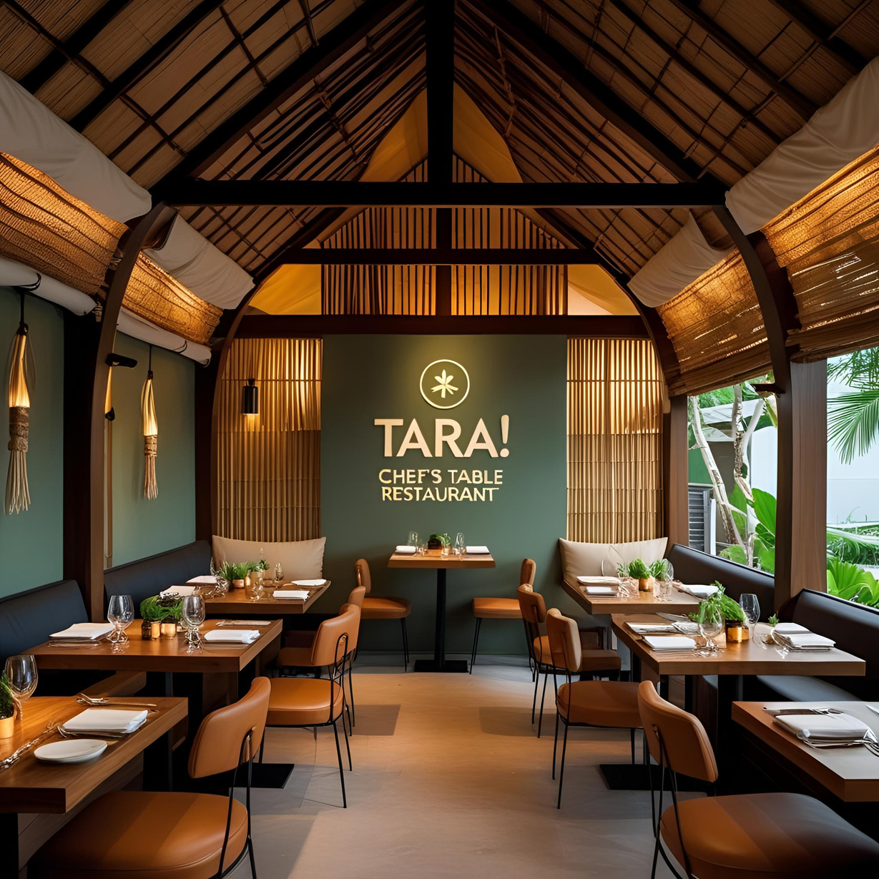


SWOT Analysis
Strengths
Weaknesses
  Authenticity
  Strong brand identity
  Sustainability, using locally sourced Welsh produce
  Limited public familiarity with Filipino cuisine in Swansea
  Inconsistent access to suitable pop-up venues
S
W
Threats
T
O
Opportunities
  Venue availability
  Competitors with established customer bases
  Economic pressures affecting hospitality sector
  Rising interest in global and underrepresented cuisines
  Chance to pioneer Filipino food in the region
  Potential transition into a permanent location
  Seasonal food festivals and event partnerships

Slide 5
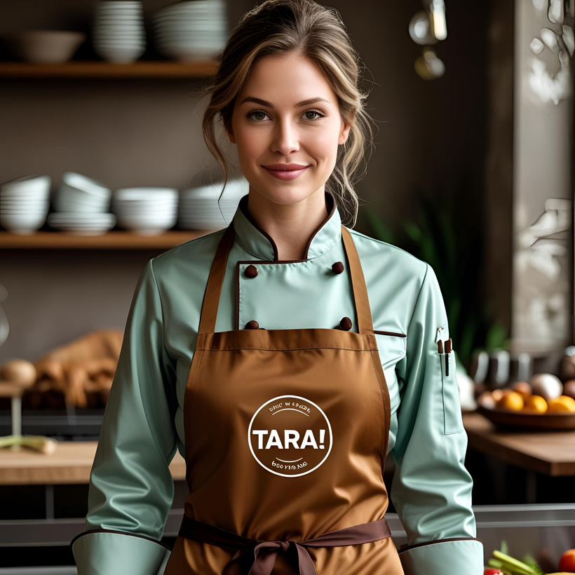

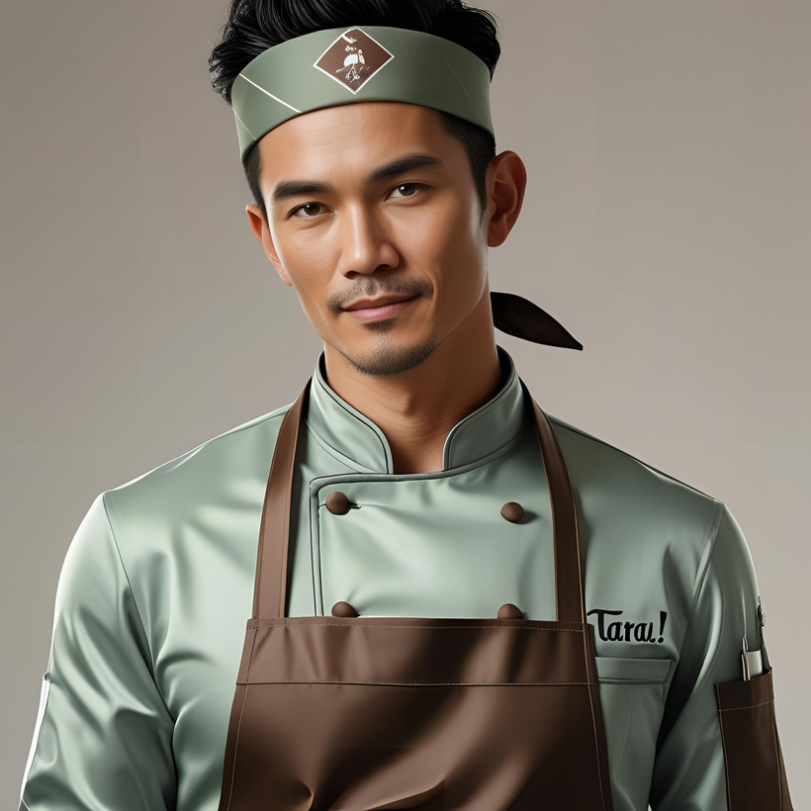
The Team
Heart of our Hospitality
Chef
Owner
Front of House
Additional Staff Requirements
  Sous Chef
  Front of House (2)
Training and Development
  HACCP and Food Safety Certification
  Customer Engagement Training
  On-site Placement Training for FOH and
Chef Roles
  Sales & Marketing Workshops
Outsourced Support/Key Partners
  Accounting
  Business Consultancy

Slide 6



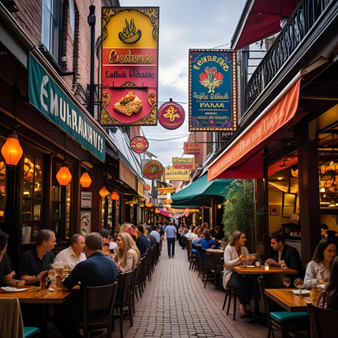




Market Research
01
01
Key points
PEST Analysis
04
Swansea population approx. 246,700, with growing cultural diversity driving culinary interest
(Swansea Council,2023)
  Political & economic factors: post-Brexit local sourcing trends, inflationary pressures
  Social factors: growing appetite for ethnic food and cultural storytelling
  Technological opportunities: mobile POS, QR menus, online ordering, social media engagement
05
02
UK food sector demand rising for ethnic cuisines, especially among ages 25–40 (Credence,2024)
02
Millennials & Gen Z value authenticity, sustainability, immersive dining experiences (Maxwell, 2018;Insight trends,2025)
Competitor Profiles
03
  Adelina’s Bar and Kitchen
  The Secret Bar & Kitchen
  Mor Mumbles
04
Pop-up restaurants gaining popularity for novelty
Customer Profiles
Pop-up restaurants gaining popularity for locally sourced ingredients
  Culinary Explorers (Ages 25–40)
  Cultural Enthusiasts (Ages 40–60)
  Filipino British & Southeast Asian Diaspora (Ages 18–50)
05
03

Slide 7
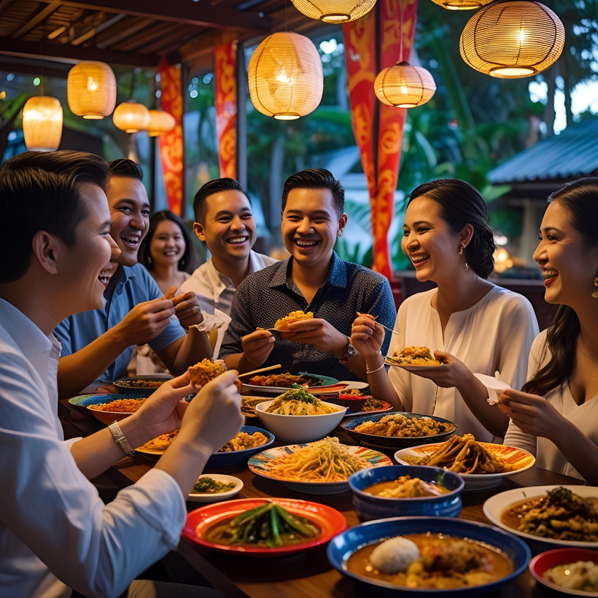




Price
Product
  Quality Indicator
  Value for Money
  Competitive Comparison
  Accessibility & Variety
  Flexibility
  Food Presentation
  Portioning & Style
  Branding & Visual Identity
  Ambience & Experience
Placement
Promotion
Marketing Plan
  Market Positioning
  Delivery Method
  Service Style
  Customer Experience
  Digital Marketing
  Community Engagement
  Advertising Channels
  Overall Strategy

Slide 8
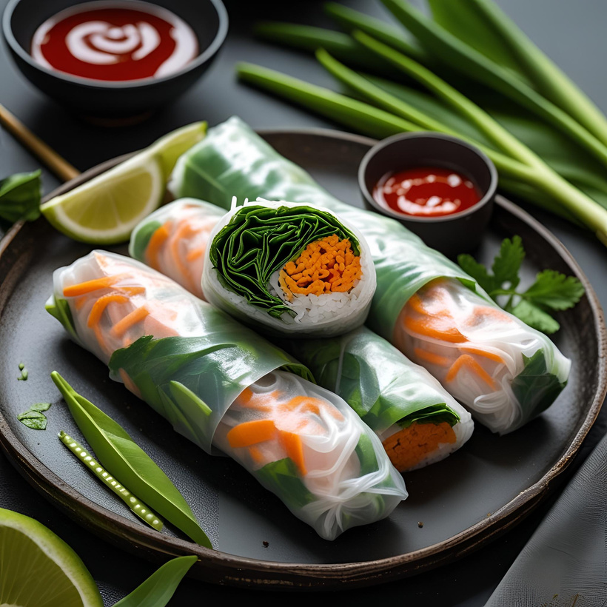
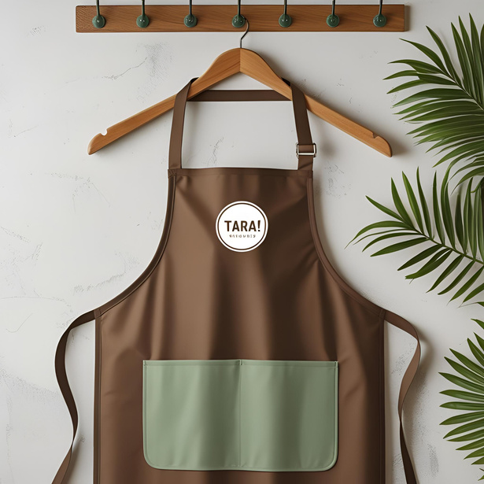
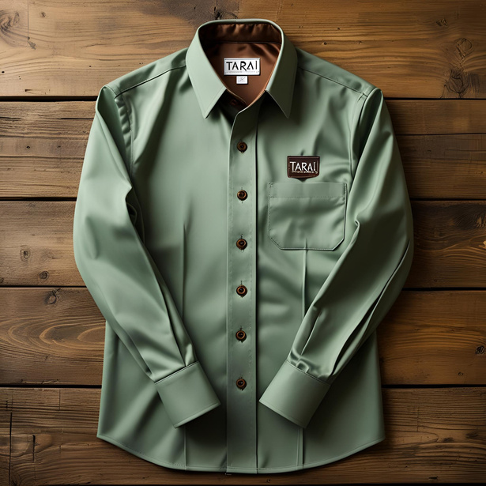
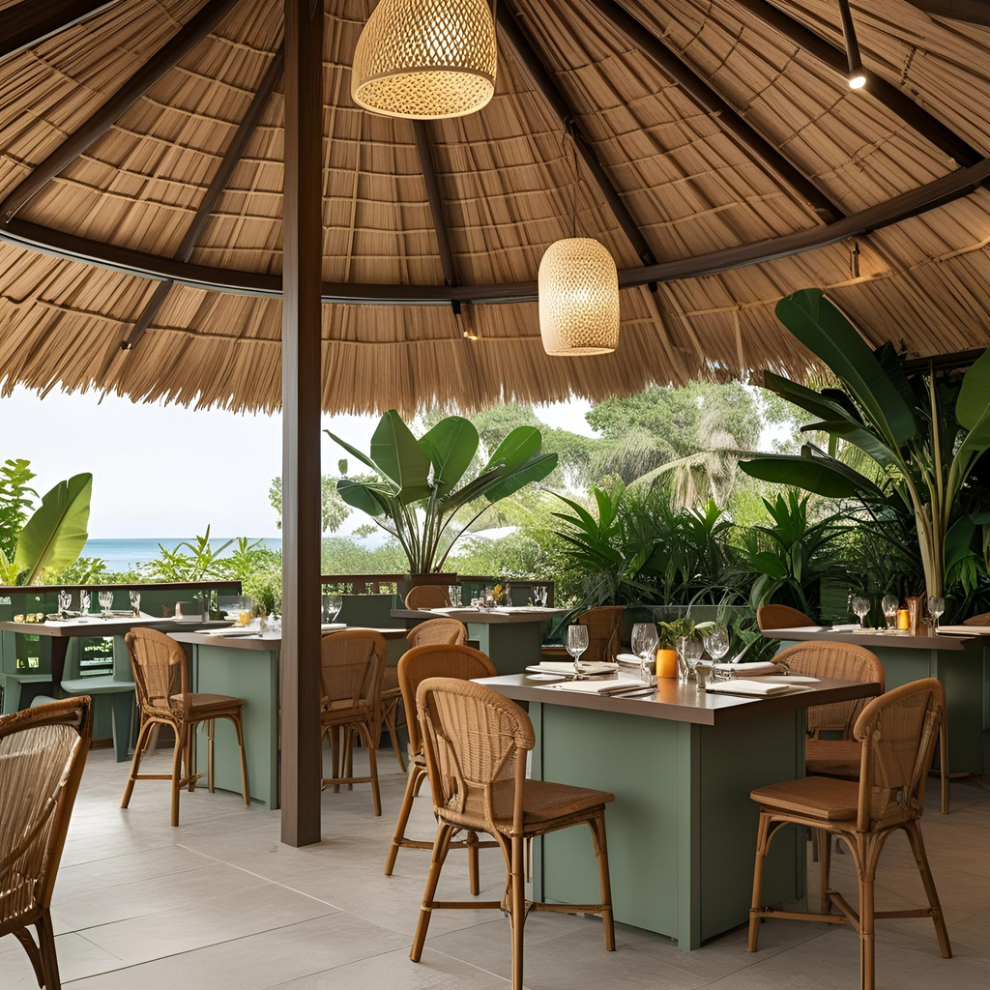
Branding & Visual Identity
Snacks from £8
Apron
FOH uniform
Interior

Slide 9

Tara
Menu & Menu Pricing
Tara
Pop-up Kitchen
Pop-up Kitchen
Tasting Menu
(5course)
Oyster Kilawin
Lumpia Pork
Tofu Kilawin (v) Lumpia (v)
King Prawn Sinigang Consommé
Garden tomato Sinigang Consommé
John Dory with Coconut & Squash Mussel Sauce
Vegetable Laing with Coconut Rice (V)
Heritage Lamb Kaldereta
Crisp Lechon Belly or
Vegetable Laing (v)
Dessert choice: Mango & Peach Tart or Ube Soufflé
£55 pp
Snacks
Snack Duo: Buchi & Welsh Cake (V) 8
Lumpia Pork £8
Lumpia (V) £8
Starters
Oyster Kilawin £14
Tofu Kilawin (V) £13
King Prawn Sinigang Consommé £16
Garden Tomato Consommé £12
Mains
Heritage Lamb Kaldereta £28
Crisp Lechon Belly with Mango & Bagoong Slaw £28
John Dory with Coconut & Squash Mussel Sauce £28
Vegetable Laing with Coconut Rice (V) £22
Desserts
Mango & Peach Tart with Vanilla Bean Ice Cream £13
Ube Soufflé with Coconut Ice Cream £13

Slide 10

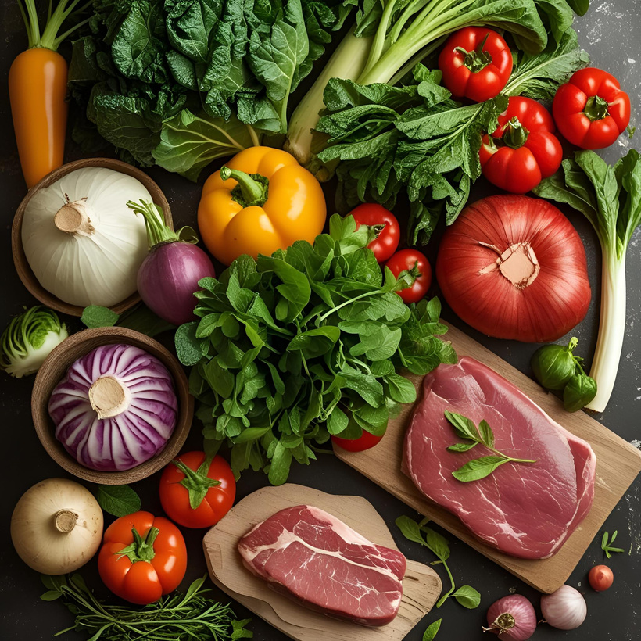
Premises
Tara! Pop-Up Kitchen requires versatile, cost-effective locations for food production, admin, and service.
Cloud/Shared Commercial Kitchens
• Monthly rental: £1,500–£3,000 (DEPHNA, 2024)
Local Community Kitchen Hire (e.g., Ffarm Moelyci)
• Daily hire from £200+ (NCASS,2025)
Equipment
Tara! Pop-Up Kitchen utilises shared commercial kitchens to minimise overhead costs while investing in essential branded tools to maintain quality and consistency across all events.
  Back-of-House (Shared Kitchen)
  Tara!-Owned:
Front of House and Back of House
Essentials
Equipment & Suppliers
Key Suppliers
Strategically chosen suppliers ensure Tara! delivers fresh, authentic Filipino-Welsh cuisine using local and imported ingredients:
1. Castle Howell Foods – Local meats, dairy, eggs
2. Gower Salt Marsh Lamb – Specialty premium lamb
3. Swansea Fish Market – Daily fresh seafood
4. Swansea Oriental Market – Filipino staples
5. Gower Farmers Market – Seasonal vegetables & herbs
6. Swansea City Market – Fresh fruit

Slide 11




Revenue based on
Tasting menus: ~493 guests
@ £55 = £27,115
À la carte: ~2,1680 guests
@ £30 = £65,040
Snacks: ~1,228 guests
(50% of total) @ £8.14 = ~£10,845
(Average of 13 guest per day)
(Service operates 4 days a week for 52 weeks)
Financial Projections
Key Expenditures
Staff Wages: £25,088
→ Based on UK minimum wage of
£11.44/hour (GOV.UK, 2024)
Shared Kitchen Hire: £12,000
Ingredients: £18,000
→ Premium locally sourced items
(e.g. Gower Salt Marsh Lamb,
Castle Howell)
Marketing, Insurance, Utilities, Accounting: £10,810
Financial Overview
Total Income £103,000
Total Expenses £65,898
Net Profit £37,102

Slide 12
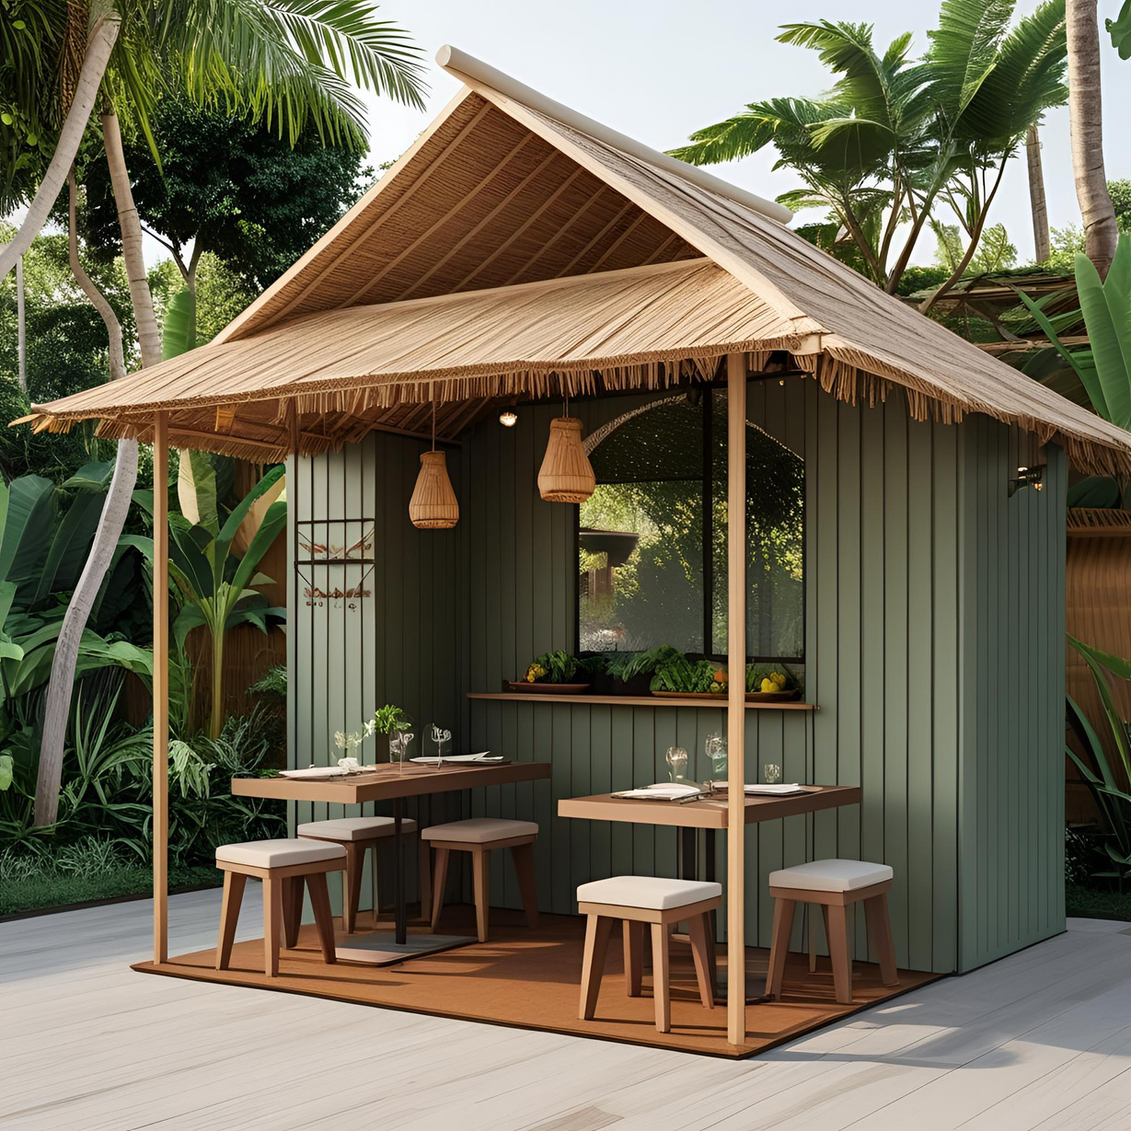
Thank you!
“Home, Longing for Home”
Tara
Pop-up Kitchen
We are Excited to have you Soon!

Slide 13
References:
Dephna, (2024). How to Compare Commercial Kitchen Rental Near You. Available at: https://www.dephna.com/insights/how-to-compare-commercial-kitchen-rental-prices-near-you/ (Accessed 11 June 2025)
GOV.UK, (2024). National Minimum Wage and National Living Wage rates. Available at: https://www.gov.uk/national-minimum-wage-rates (Accessed on 12 June 2025)
GOV.UK (2025). Register Your Company. Available at :https://www.gov.uk/limited-company-formation/register-your-company (Accessed 12 June 2025)
Insight Trends, (2025). Restaurants: Gen Z is Shaping the Future of Dining Culture Available at: https://www.insighttrendsworld.com/post/restaurants-how-gen-z-is-shaping-the-future-of-dining-culture (Accessed 8 June 2025)
Jain, R., Jain, S., & Jain, S. (2022). Analyzing and exploring the effectiveness of each element of 7Ps of marketing mix. International Journal of All Research Education and Scientific Methods (IJARESM), 10(1), 2455-6211. ( Accessed on 14 June 2025)
Maxwell, (2018). Millennials Driving Ethnic-Food Trends. Available at: https://www.foodserviceandhospitality.com/millennials-driving-ethnic-food-trends/ (Accessed 10 June 2025)
Nisbets, 2024. Catering Equipment for Professional Kitchens. Available at: https://www.nisbets.co.uk/ (Accessed 10 Jun. 2025).
NCASS,(2025) Commercial Kitchen Spaces to Rent. Available at: https://www.ncass.org.uk/commercial-kitchen-spaces-to-rent/ (Accessed 11 June 2025)
Rafiq, M. and Ahmed, P.K. (1995), "Using the 7Ps as a generic marketing mix: an exploratory survey of UK and European marketing academics", Marketing Intelligence & Planning, Vol. 13 No. 9, pp. 4-15. https://doi.org/10.1108/02634509510097793 (Accessed on 14 June 2025)
Swansea Council, (2023). Population. Available at: https://www.swansea.gov.uk/population (Accessed 10 June 2025)

