Slide 1
Name: Nareshkumar Patel
Student number: 1713063
Subject: Entrepreneurship (LCMB7004)
( BUSINESS PLAN )
Lecturer name: Richard small

Slide 2
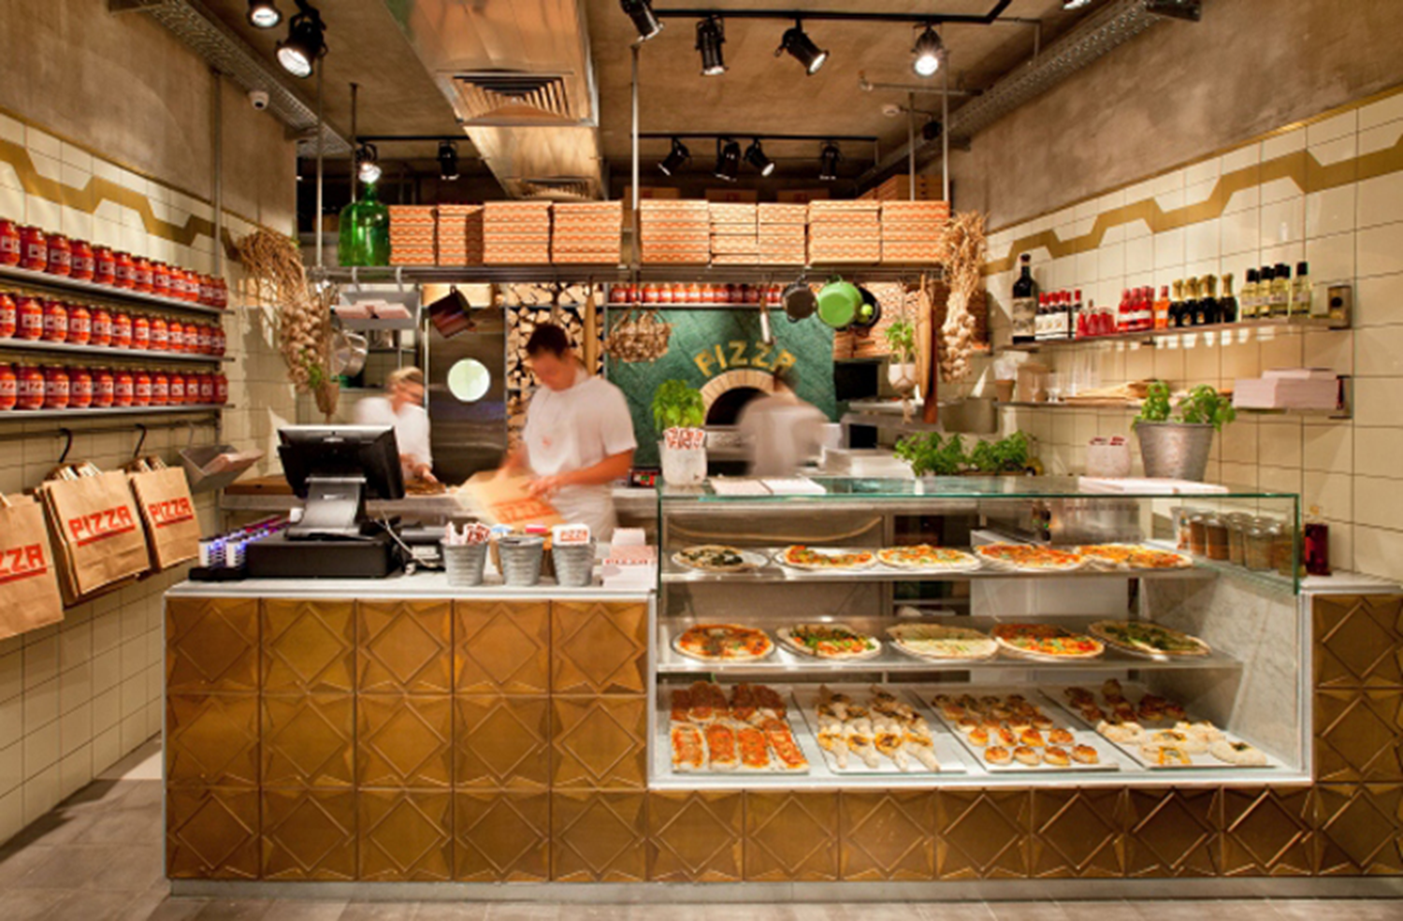
E Che Pizza
We are preparing a business plan on the topic of Pizza Making and Delivering Business. The following assignment will be discussing the various things required for running a pizza business in London. The name of our business will, ‘E Che Pizza’. Our business will be a pizza restaurant and we will be serving number of products along with pizzas. The nature of our business will be of fast food restaurant.
As we will be providing basically pizzas, but along with that we will also be providing some other fast food products along with some beverages. The detail of the same is as following:
Pizzas (different flavours with traditional recipes)
Burgers
Sandwiches
Rolls (Chicken and veg-rolls)
Beverages (Juices, cold drinks, shakes etc.)

Slide 3

E Che Pizza

Slide 4
MISSION
Our mission is to provide the best quality of various pizzas, sandwiches and burgers to the customers. We are also committed to provide the best satisfaction to the customers in England.
VISION
We are having a vision to grow our business all over the England by opening various outlets of our business. We will be expanding our business in various cities of England.

Slide 5
COMPETITORS
Paradise slice pizza / Halal Pizza shop / pizza pick Up / The Pizza Man / Bambino Pizza shop
International Food chain players are operating in London including Pizza Hut and Domino’s.
Why we worry about them?
Why our business is success?
- International (traditional) recipes,
- affordability for everyone

Slide 6
BUSINESS MODEL
To make E Che Pizza a successful venture, We have made following strategies ^{(1,2)}
Sale Strategies
Marketing Strategies
Competitive Strategies
Personnel Strategies

Slide 7
Sales Strategies^{(1,2)}
Needed to be customer oriented firstly.
we also need to provide the quality products at lower prices.
What are basic sales strategies will be:
adults and teenage customers.
The employees will also have evening meals at our restaurant.
The other thing that will be done is contracting with local offices and school canteens. We will provide them products at their place.

Slide 8
Marketing strategies^{(1,2)}
For doing quality business, we need quality marketing. And the quality marketing of the business can be done by using following measures:
Family / Friends / Relatives
Advertisement through newspapers, Business articles
Advertisement on TV, Radio
Social media (Facebook, Instagram, Twitter)

Slide 9
Competitive strategies^{(1,2)}
The fast food is the business which is having great competition. So there is need to have better strategies to have edge on the competitors. For that we need some strong competitive polices, strong marketing team and quality products to attract more and more customers to our business.
Some discount policies or free sample policies for the customers.
When we talk about strategies for competitors, location matters a lot. The prime location of the business provides the prime customers to business. So we need to choose the suitable most place for our business.
Maintenance of costs

Slide 10
Personnel Strategies ^{(1,2)}
Personnel are the main asset of any business. So the efficient staffs are required for ensuring the efficiency of the operations of the business.
Manager(1),Cashier/Receptionist(1),Chefs(2),Delivery Boys(2),Waiters(2),Cleaner(1).
Expected Profits^{(***)}
So as per the estimated sales revenue and costs of the business, we can generate the profits for the business as following:( for first quarter )
Initial expenses (28000£)
Profit^{( 1st quarter)} = Sales – Costs = £36750 - £18950 = £17800
*** Details about scale up in Excel Sheet

Slide 11
Conclusion:
This is the one of the best business anybody can have nowadays as per the needs of the customers. The levels of, people have, love for fast food needed to be utilised by the business houses. So, this is one of those opportunities which can be capitalised.
The main things needed to be kept in mind is the level of competition available in the market, the costs of the business, the product needed to be of supreme quality to have better sales in the market and last is the business should be at the best and prime location.

Slide 12
REFERENCES:
Blackwell, E. (2011), How to Prepare a Business Plan: Planning for Successful Start-up and Expansion, (5th Ed) Sunday Times Business Enterprise Series, Kogan Page.
Carter, S. and Jones-Evans, D. (2006) Enterprise and small business: principles, practices and policy. 2nd. Ed. Prentice Hall.
---------------------------------------------------------------------------------------
THANK YOU ALL OF YOU

