Slide 1
Evaluation of Business Environment
Module: Global Business Environement
Code: LCBB4005
Lecturer: Dr Rexon Nting
Nume: Denisa Roxana Stoica
Student ID:2211503

Slide 2
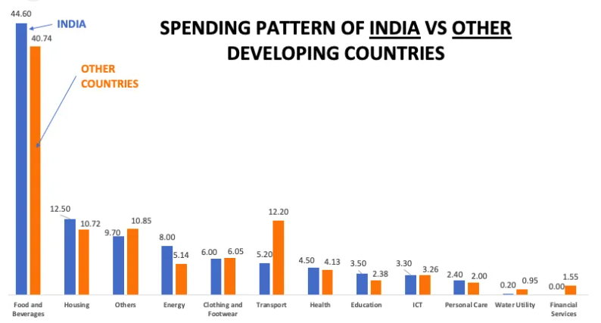
Opportunities for Unilever in India
As raw material costs fall and stabilise, and demand continues to rise, the top consumer goods businesses estimate their profitability to improve for the remainder of the fiscal year, with profits returning to pre-Covid levels(Sonawane, 2021).

Slide 3
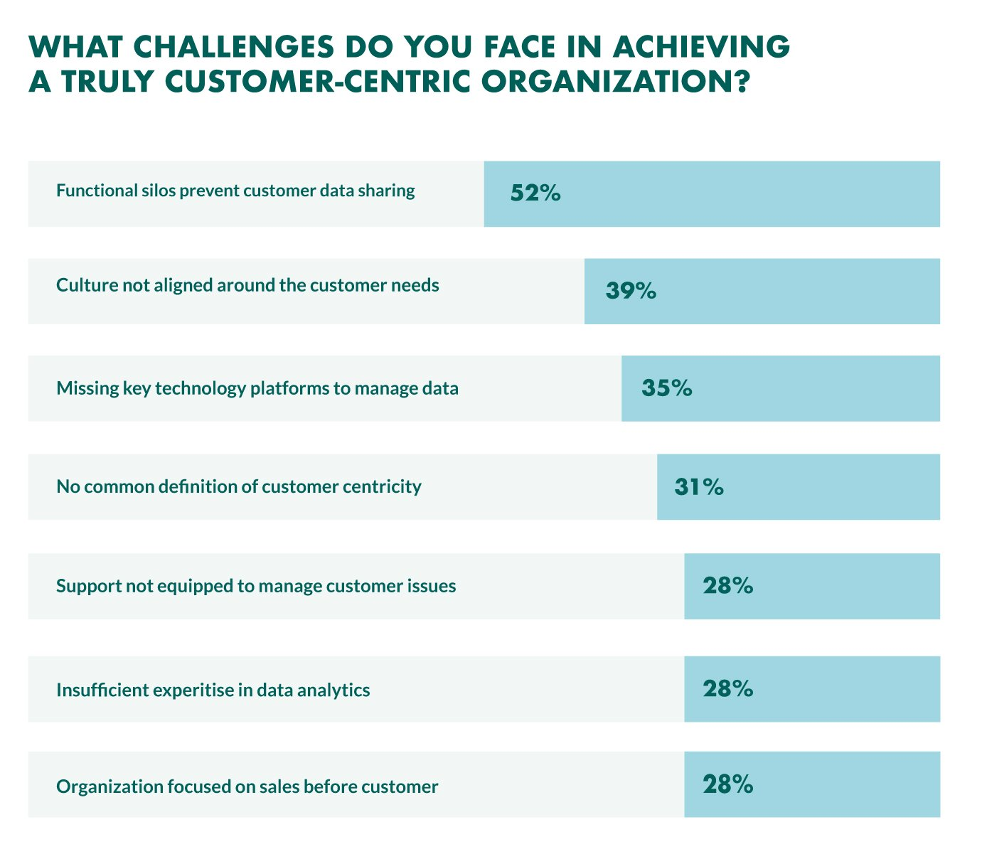
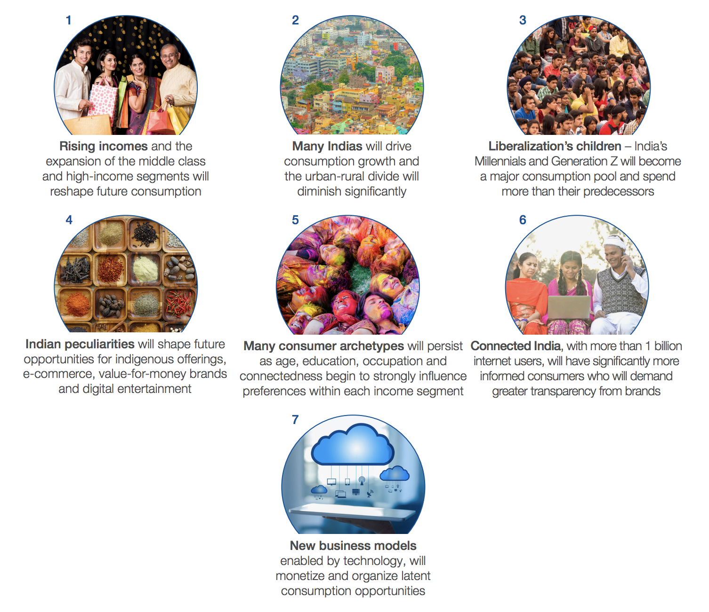
Opportunities for Unilever in India
Expansion of the consumer market
Customers centric

Slide 4
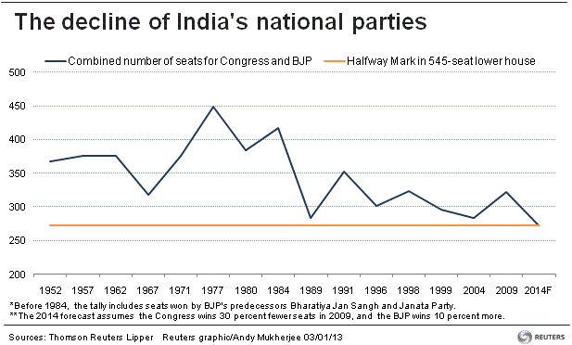
Opportunities for Unilever in India
In a politically stable, economically prosperous, and inflation-controlled economy, people are able to spend more of their hard-earned money on goods and services and adapt to new ways of living(Mitra, 2021).

Slide 5
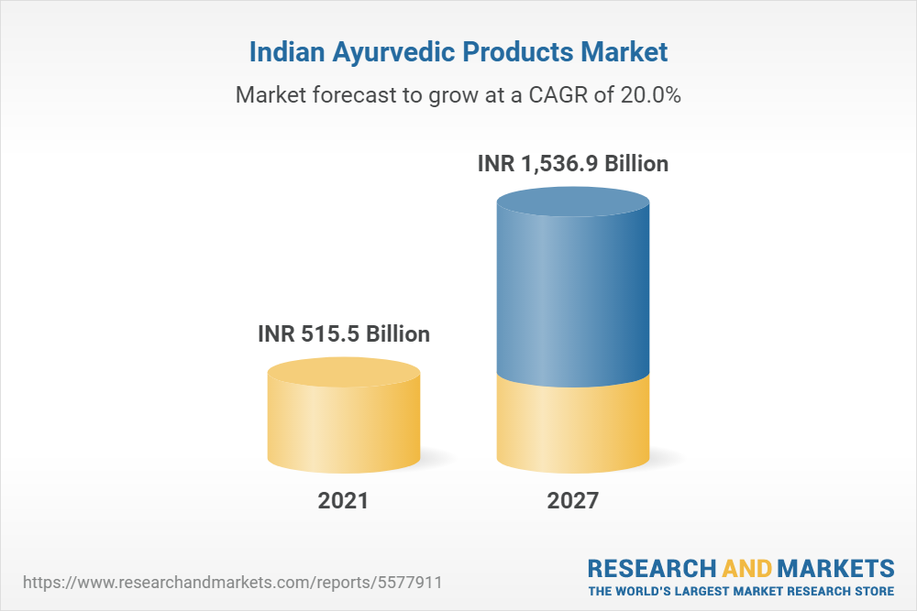
Opportunities for Unilever in India
Products based on the principles of Ayurveda:
Demand and lifestyle shifts grow as people's discretionary income improves as a consequence of political stability, higher levels of education, and controlled inflation(Williams, 2017).

Slide 6
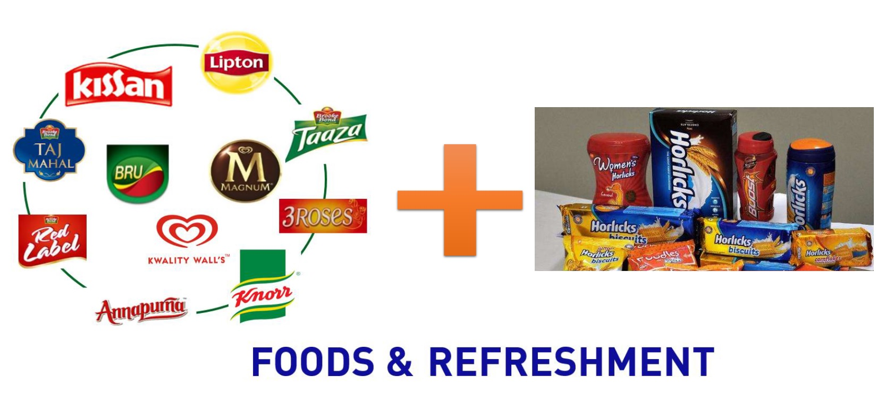
Opportunities for Unilever in India
Mergers and acquisitions

Slide 7
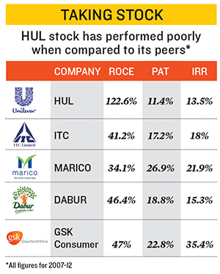
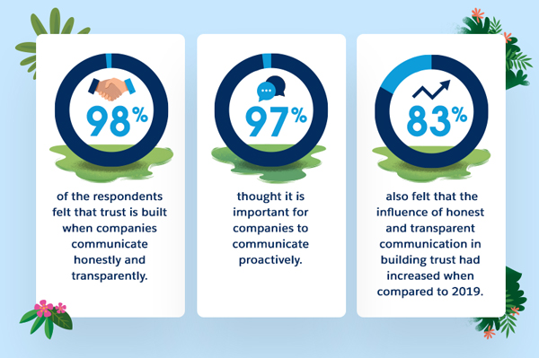
Challenges for Unilever in India
Competition in the market
Cost of raw materials:
Customer Influence
The standards and regulations established by the government(Ramachandran, 2017)

Slide 8

Remedy for the challenges
To be more effective and efficient
Alternative sources of raw material (Cheap and qualified)

Slide 9
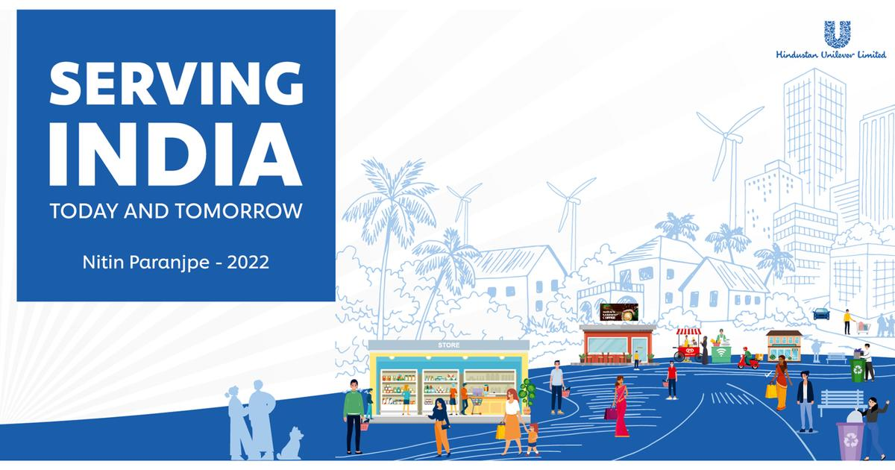
Remedy for the challenges
Focusing on the digital platforms

Slide 10
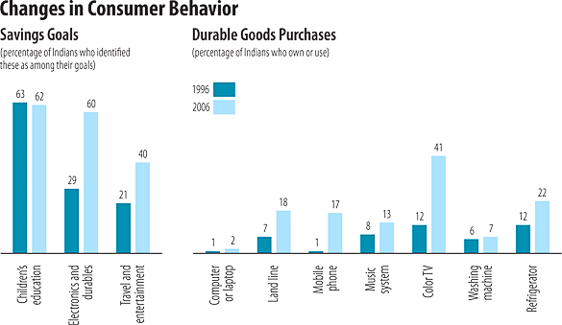
Remedy for the challenges
Customer behaviour analysis

Slide 11
Conclusion
Unilever should consider the opportunity issues in India regarding the challenges and remedies of that challenges and should take further steps to be globally competitive.

Slide 12
References
Escamilla, R., Fransoo, J.C. and Tang, C.S., 2021. Improving agility, adaptability, alignment, accessibility, and affordability in nanostore supply chains. Production and Operations Management, 30(3), pp.676-688.
Kulkarni, L. and Ghosh, A., 2021. Gender disparity in the digitalization of financial services: challenges and promises for women's financial inclusion in India. Gender, Technology and Development, 25(2), pp.233-250.
Sonawane, P.A., 2021. Exploring New Posibilities of Market Expansion in Rural India. Turkish Online Journal of Qualitative Inquiry, 12(8), pp.6114-6124.
Mitra, S.K., 2021. Power, protest and participation: Local elites and the politics of development in India. Routledge.
Jaiswal, Y.S. and Williams, L.L., 2017. A glimpse of Ayurveda–The forgotten history and principles of Indian traditional medicine. Journal of traditional and complementary medicine, 7(1), pp.50-53.
Pant, A. and Ramachandran, J., 2017. Navigating identity duality in multinational subsidiaries: A paradox lens on identity claims at Hindustan Unilever 1959–2015. Journal of International Business Studies, 48(6), pp.664-692.

