Slide 1
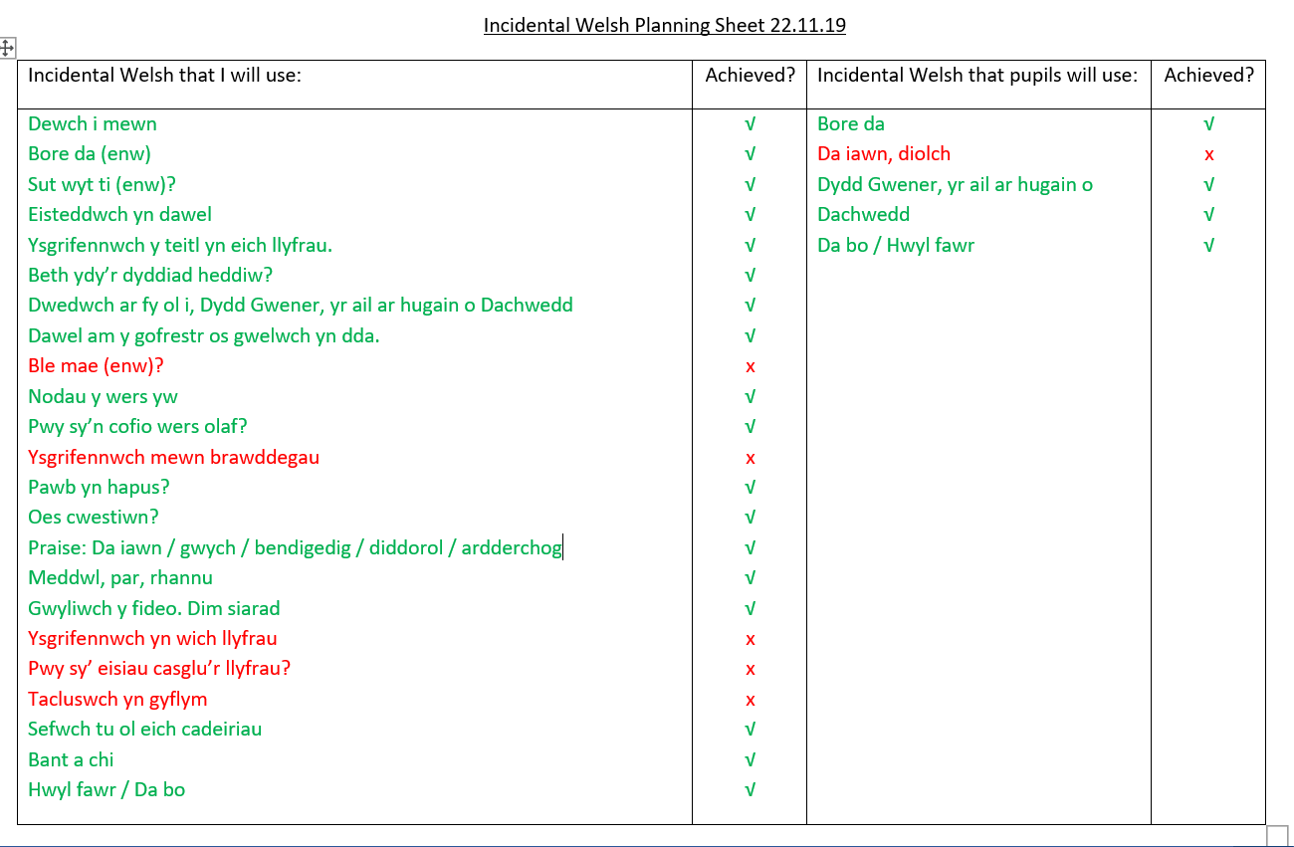

Slide 2
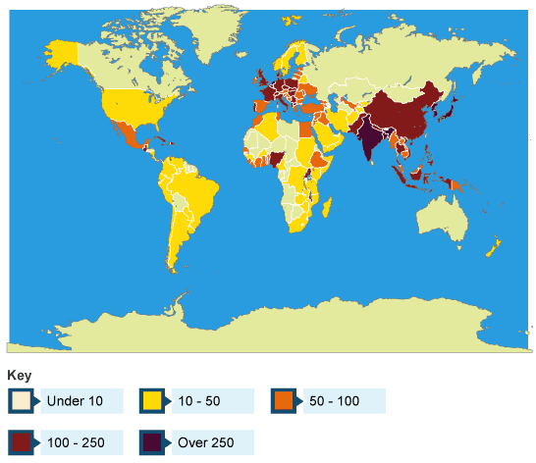
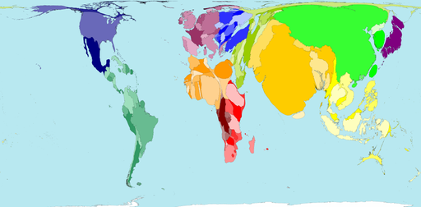
What do you notice from the two maps?
What is the link?
Gwaith Dosbarth ………………………………………….
Population Density Around the World
Persons per sq km
Notes:
Data on specific countries [dense and sparse]
Show map – what the countries would look like if they were represented by their population density

Slide 3
What do you notice from the two maps?
What is the link?
Persons per sq km
Both maps show population density
Notes:
Data on specific countries [dense and sparse]
Show map – what the countries would look like if they were represented by their population density

Slide 4

Where to people live in the world, and why?
Nodau y wers
Identify areas that are densely and sparsely populated on a global scale.
Describe and explain population distribution on a global scale.

Slide 5


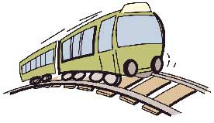


Factors influencing population density
Good Soils
Relief of the land
We categorise these factors into 2 groups.
Human (manmade)
And
Physical (natural)
Good Communication systems
Plentiful Resources
Job opportunities
Transport Links
Facilities (Healthcare, education, water)
Climate
Notes:
15mins

Slide 6
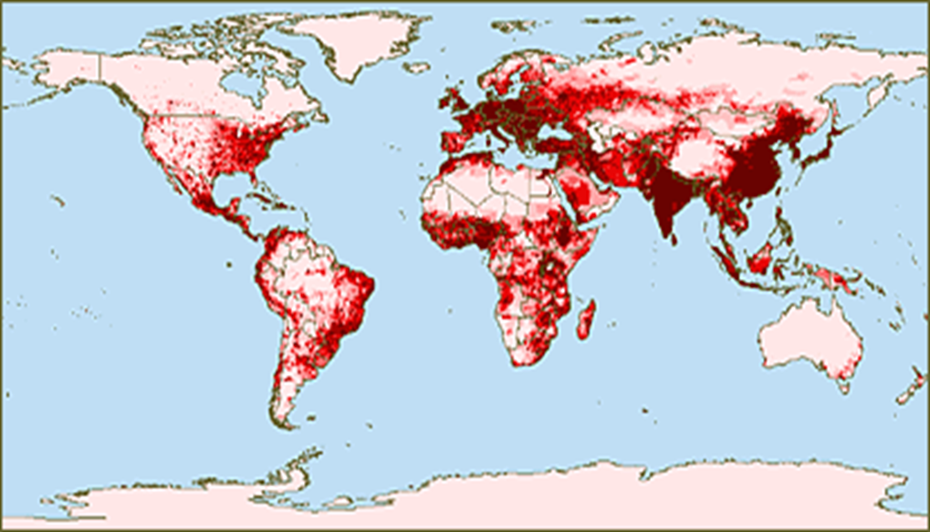
Where do people live in the World?
The darker the colour, the more the people.
The lighter the colour the fewer the people
Notes:
Pupils to stick this into the middle of a double page in their book. They must label the dense areas with 4 stick men and sparse with 1 stick man. They must locate these countries in atlas using 102-103.
Why do you think Australia is sparsely populated? Why do you think India is densely populated?
Canada
USA
UK
India
Australia
Antarctica

Slide 7
Gwaith Dosbarth Dydd Gwener, 22 Tachwedd
Population Density Around the World
Relief of the land
Task –
Glue your map in the middle of a double page.
Using an atlas, pick one country with a high population density.
Label around your map the physical and human factors that influence the high number of people that live there.
Good Soils
Good Communication systems
Plentiful Resources
Transport Links
Job opportunities
Facilities
(Healthcare,
education,
water)
Climate

Slide 8
Gwaith Dosbarth Dydd Gwener, 22 Tachwedd
Population Density Around the World
Relief of the land
Task –
Using an atlas, pick one country with a low population density.
Label around your map the physical and human factors that influence the low number of people that live there.
Good Soils
Good Communication systems
Plentiful Resources
Transport Links
Job opportunities
Facilities
(Healthcare,
education,
water)
Climate

Slide 9
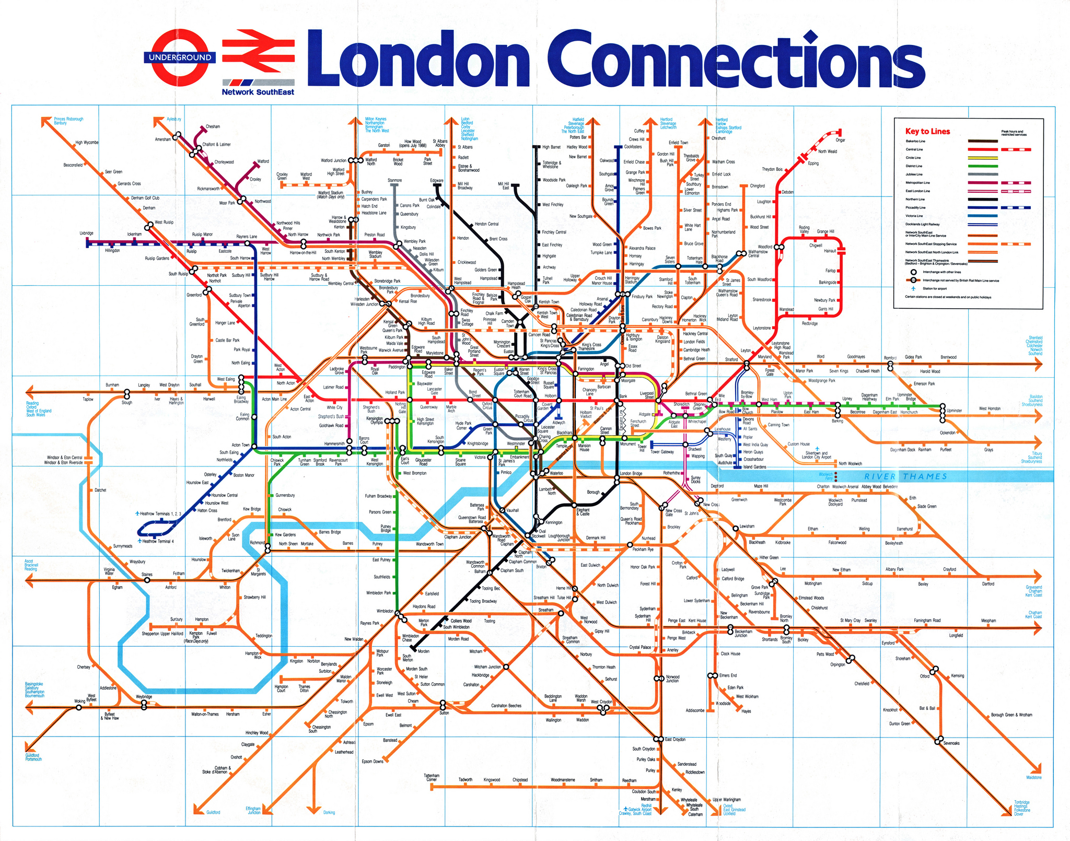
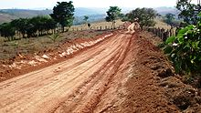
If an area has a lot of transport links such as airports, trains and motorways then it is likely to be densely populated.
This is because people would have easier access to other areas. This means that it is more convenient for people to get to places they need to go making the area more populated.
On the other hand if the area has poor transport links then it is likely to be sparsely populated because not many people can access the location and reach the services that they will need. Therefore, it is not very convenient for a lot of people to live there.

Slide 10
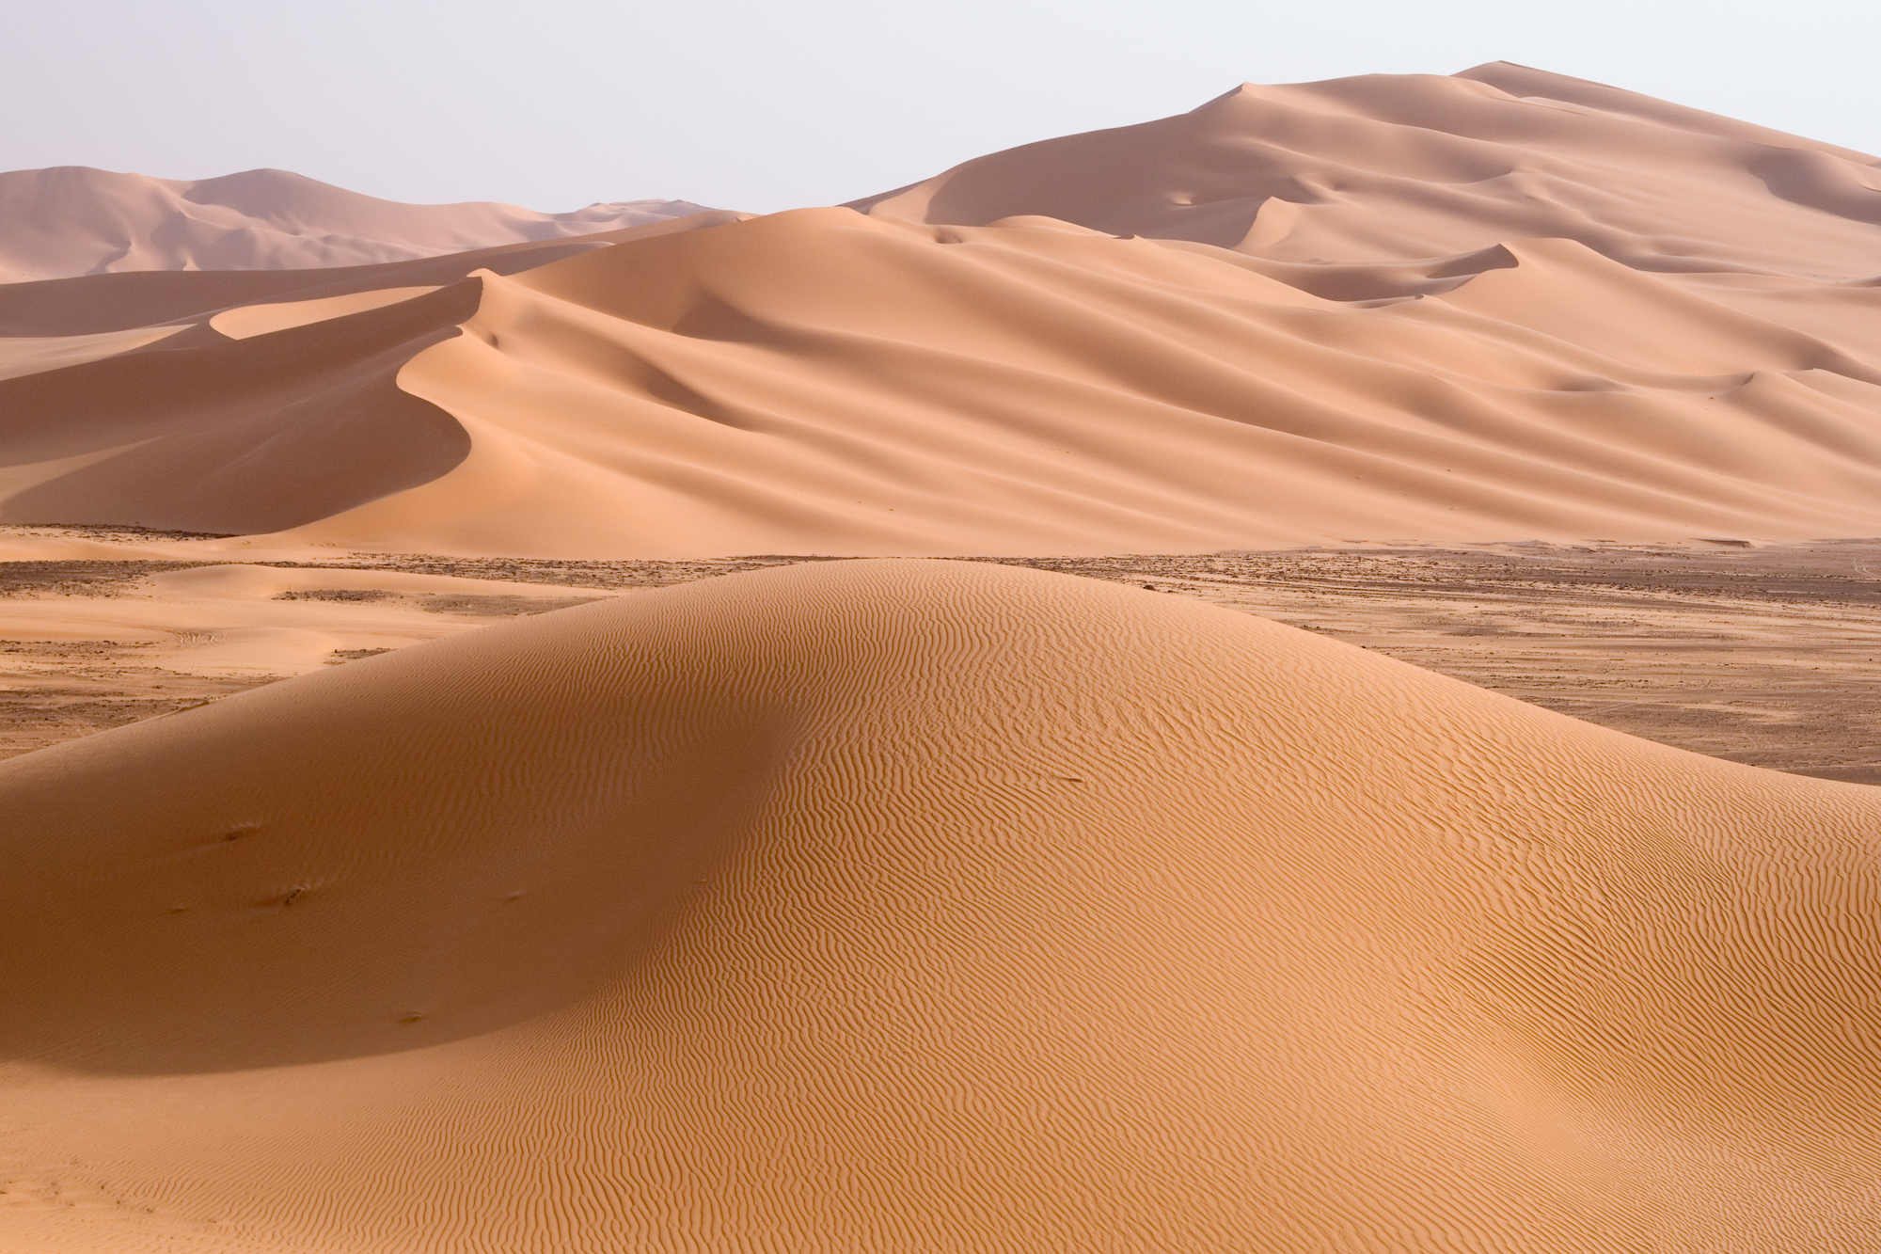
Meddwl-Par-Rhannu
Mystery location:
Do you think it has a high or a low population density?
Arabian Desert
Climate: Hot, desert climate
Summer temperatures = 41 C
Winter temperatures = 24 C
Water resources: Very poor.
No natural rivers.

Slide 11
Mystery location:
Arabian Desert
DUBAI
Population density = 408.18/km2
Water resources: Very poor.
No natural rivers.
Climate: Hot, desert climate
Summer temperatures = 41 C
Winter temperatures = 24 C

Slide 12
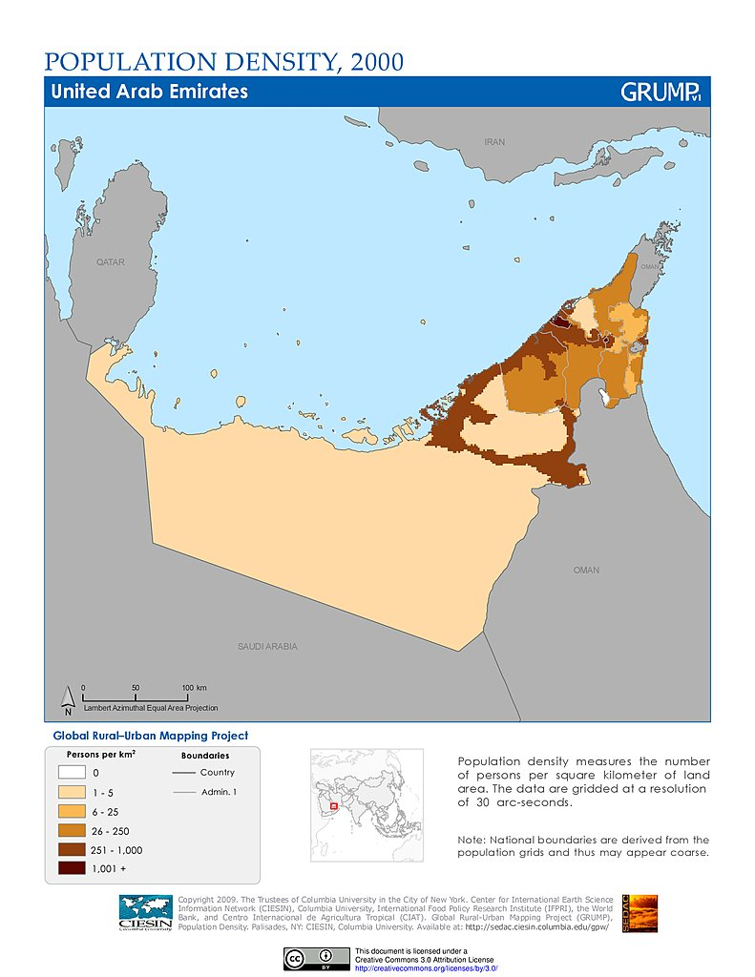
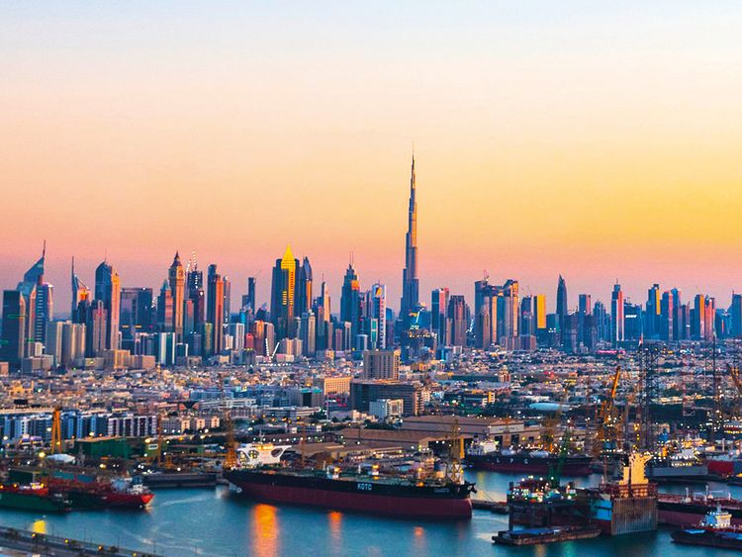
Take notes during the video to explain why Dubai is so unusual.
DUBAI

Slide 13
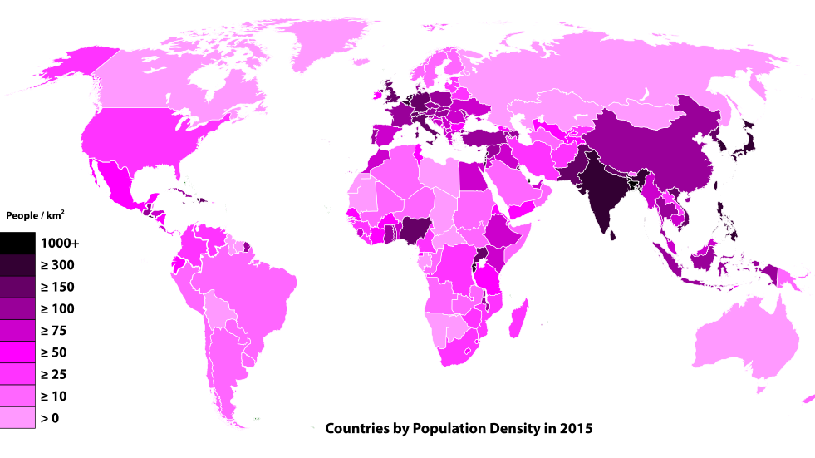
What have you learned today?
In your books, write one interesting thing you learned today, and why you found it interesting.
Please put your books on the edge of your desks for me to collect in.
This Photo by Unknown Author is licensed under CC BY-SA

