Slide 1
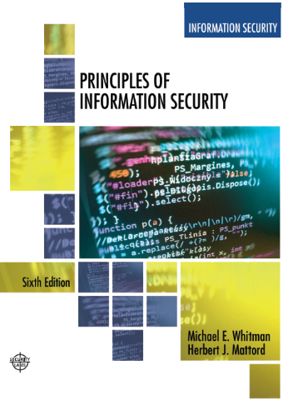
Data Security and Compliance
ACCA5034
Lecture 1
Adapted Text
Information Security : An Introduction

Slide 2
Learning Objectives
Upon completion of this material, you should be able to:
  Define information security
  Define key terms and critical concepts of information security
  Explain the role of security in the systems development life cycle
  Describe the information security roles of professionals within an organization
Notes:
Upon completion of this material, you should be able to:
Define information security
Recount the history of computer security and how it evolved into information security
Define key terms and critical concepts of information security
List the phases of the security systems development life cycle
Describe the information security roles of professionals within an organization
71

Slide 3
Introduction
“Enterprise information security is a critical business capability that needs to be aligned with corporate expectations and culture that provides the leadership and insight to identify risks and implement effective controls.”—Martin Fisher, IT Security Manager, North side Hospital, Atlanta, Georgia ‏
Security professionals must review the origins of this field to understand its impact on our understanding of information security today
Notes:
What Is Information Security?
Information security in today’s enterprise is a “well-informed sense of assurance that the information risks and controls are in balance.” – Jim Anderson, Inovant (2002)‏
Before we can begin analyzing the details of information security, it is necessary to review the origins of this field and its impact on our understanding of information security today.
71

Slide 4
The History of Information Security
Computer security began immediately after the first mainframes were developed
  Groups developing code-breaking computations during World War II created the first modern computers.
  Multiple levels of security were implemented.
Physical controls limiting access to sensitive military locations to authorized personnel
Rudimentary in defending against physical theft, espionage, and sabotage
Notes:
The History Of Information Security
Computer security began immediately after the first mainframes were developed
Groups developing code-breaking computations during World War II created the first modern computers
Multiple levels of security were implemented
Physical controls to limit access to sensitive military locations to authorized personnel
Rudimentary in defending against physical theft, espionage, and sabotage
4

Slide 5
Key Dates in Information Security (1 of 2)
Date | Document
1968 | Maurice Wilkes discusses password security in Time - Sharing Computer Systems.
1970 | Willis H. Ware author the report Security Controls for Computer Systems: Report of Defense Science Board Task Force on Computer Security—RAND R.609 which was not declassified until 1979. I became known as the seminal work identifying the need for computer Security.
1973 | Schell, Downey, and Popek examine the need for additional security in military systems in Preliminary Notes on the Design of Secure Military Computer Systems.
1975 | The Federal Information Processing Standards (FIPS) examines DES (Digital Encryption Standard) In the Federal Register.
1978 | Bisbey and Hollingsworth publish their study “Protection Analysis: Final Report,” which discussed the Protection Analysis project created by ARPA to better understand the vulnerabilities of operating system security and examine the possibility of automated vulnerability detection techniques in existing system software.
Notes:
4

Slide 6
Key Dates in Information Security (2 of 2)
Date | Document
1979 | Dennis Ritchie publishes “On the Security of UNIX” and “Protection of Data File Contents,” which discussed secure user IDs, secure group IDs, and the problems inherent in the systems.
1982 | The US. Department of Defense Computer Security Evaluation Center publishes the first version of the Trusted Computer Security (TCSEC) documents, which came to be known as the Rainbow Series.
1982 | Grampp and Morris write “The UNIX System: UNIX Operating System Security.” In this report the authors examined four “important handles to computer security”: physical control of primes and computer facilities, management commitment to security objectives, education of employees, and administrative procedures aimed at increased security.
1984 | Reeds and Weinberger publish “File Security and the UNIX System Crypt Command.” Their premise was: “No technique can be secure against wiretapping or is equivalent on the computer. Therefore no technique can be secure against the system administrator or other privileged users... the naive user have no chance.”
1992 | Researchers for the Internet Engineering Task force, working at the Naval Research Laboratory, develop the Simple Internet Protocol Plus (SIPP) Security protocols, creating what is now known as IPSEC security.

Slide 7
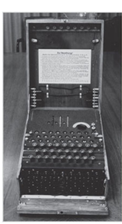
The Enigma (1 of 2)
Source. Bletchley Park Trust. Used with permission.
Notes:
This picture shows a high-visibility artifact associated with the early days of information security – focusing on the confidentiality of information. This artifact is also part of the study of cryptography from Chapter 8.
4

Slide 8
The Enigma (2 of 2)
Earlier versions of the German code machine Enigma were first broken by the Poles in the 1930s. The British and Americans managed to break later, more complex versions during World War II. The increasingly complex versions of the Enigma, especially the submarine or Unterseeboot version of the Enigma, caused considerable anguish to Allied forces before finally being cracked. The information gained from decrypted transmissions was used to anticipate the actions of German armed forces. 'Some ask why, if we were reading the Enigma, we did not win the war earlier. One might ask, instead, when, if ever, we would have won the war if we hadn't read it'

Slide 9
The 1960s
Advanced Research Projects Agency (ARPA) began to examine the feasibility of redundant networked communications.
Larry Roberts developed the ARPANET from its inception.
Notes:
The 1960s
During the 1960s, the Department of Defense’s Advanced Research Procurement Agency (ARPA) began examining the feasibility of a redundant networked communications system designed to support the military’s need to exchange information.
Larry Roberts, known as the founder of the Internet, developed the project from its inception.
4

Slide 10
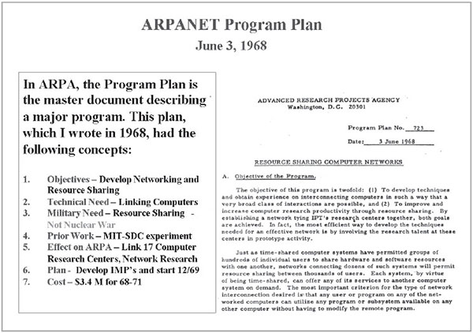
Development of the ARPANET
Source. Courtesy of Dr. Lawrence Roberts. Used with permission.
Notes:
This picture shows a high-visibility artifact associated with the early days of information security – focusing on the confidentiality of information. This artifact is also part of the study of cryptography from Chapter 8.
4

Slide 11
The 1970s and 80s (1 of 2)
ARPANET grew in popularity, as did its potential for misuse.
Fundamental problems with ARPANET security were identified.
  No safety procedures for dial-up connections to ARPANET
  Nonexistent user identification and authorization to system
Notes:
The 1970s and 80s
ARPANET grew in popularity as did its potential for misuse
Fundamental problems with ARPANET security were identified
No safety procedures for dial-up connections to ARPANET
Nonexistent user identification and authorization to system
Late 1970s: microprocessor expanded computing capabilities and security threats
11

Slide 12
The 1970s and 80s (2 of 2)
Information security began with RAND Report R-609 (paper that started the study of computer security and identified the role of management and policy issues in it)‏.
The scope of computer security grew from physical security to include:
  Securing the data
  Limiting random and unauthorized access to data
  Involving personnel from multiple levels of the organization in information security
Notes:
The 1970s and 80s (cont’d.)
Information security began with Rand Report R-609 (paper that started the study of computer security and identified role of management and policy issues in it)‏
Scope of computer security grew from physical security to include:
Securing the data
Limiting random and unauthorized access to data
Involving personnel from multiple levels of the organization in information security
12

Slide 13
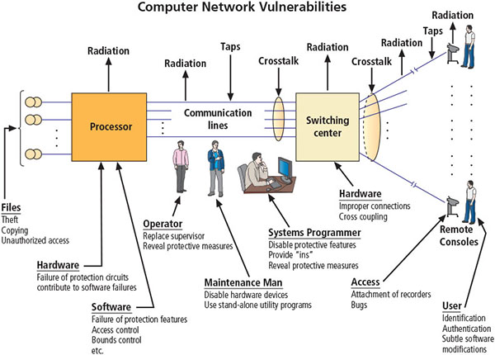
Illustration of computer network vulnerabilities from RAND Report R-609
Source. RAND Report R-609-1. Used with permission.
Notes:
RAND corporation
Much of the early research on computer security centered on a system called Multiplexed Information and Computing Service (MULTICS). Although it is now obsolete,
MULTICS is noteworthy because it was the first operating system to integrate security into its core functions. It was a mainframe, time-sharing operating system developed in the mid-
1960s by a consortium of General Electric (GE), Bell Labs, and the Massachusetts Institute of Technology (MIT).
RAND Report R-609 was the first widely recognized published document to identify the role of management and policy issues in computer security. It noted that the wide use of networking
components in military information systems introduced security risks that could not be mitigated by the routine practices then used to secure these systems. Figure above shows an
illustration of computer network vulnerabilities from the 1979 release of this document.
13

Slide 14
MULTICS (1 of 2)
Early focus of computer security research centered on a system called Multiplexed Information and Computing Service (MULTICS)‏.
First operating system was created with security integrated into core functions.
Mainframe, time-sharing operating system was developed in the mid-1960s by General Electric (GE), Bell Labs, and Massachusetts Institute of Technology (MIT)‏.
Notes:
MULTICS
Early focus of computer security research centered on a system called Multiplexed Information and Computing Service (MULTICS)‏
First operating system created with security integrated into core functions
Mainframe, time-sharing OS developed in mid-1960s by General Electric (GE), Bell Labs, and Massachusetts Institute of Technology (MIT)‏
Several MULTICS key players created UNIX
Primary purpose of UNIX was text processing
Late 1970s: microprocessor expanded computing capabilities and security threats
14

Slide 15
MULTICS (2 of 2)
Several MULTICS key players created UNIX.
  Primary purpose of UNIX was text processing.
Late 1970s: The microprocessor expanded computing capabilities and security threats.

Slide 16
The 1990s
Networks of computers became more common, as did the need to connect them to each other.
Internet became the first global network of networks.
Initially, network connections were based on de facto standards.
In early Internet deployments, security was treated as a low priority.
In 1993, DEFCON conference was established for those interested in information security.
Notes:
The 1990s
Networks of computers became more common; so did the need to connect them to each other
Internet became first global network of networks
Initially based on de facto standards
In early Internet deployments, security was treated as a low priority
In 1993, DEFCON conference established for those interested in information security
The defense readiness condition (DEFCON)
Cyber Operations Condition (CYBERCON)
In 1993, the first DEFCON conference was held in Las Vegas. Originally it was established as a gathering for people interested in information security, including authors, lawyers, government
employees, and law enforcement officials. A compelling topic was the involvement of hackers in creating an interesting venue for the exchange of information between two
adversarial groups—the “white hats” of law enforcement and security professionals and the “black hats” of hackers and computer criminals.
16

Slide 17
2000 to Present
The Internet brings millions of unsecured computer networks into continuous communication with each other.
The ability to secure a computer’s data was influenced by the security of every computer to which it is connected.
Growing threat of cyber attacks has increased the awareness of need for improved security.
  Nation-states engaging in information warfare
Notes:
2000 to Present
The Internet brings millions of unsecured computer networks into continuous communication with each other
Ability to secure a computer’s data influenced by the security of every computer to which it is connected
Growing threat of cyber attacks has increased the awareness of need for improved security
Nation-states engaging in information warfare
17

Slide 18
What Is Security? (1 of 2)
“A state of being secure and free from danger or harm; the actions taken to make someone or something secure.”
A successful organization should have multiple layers of security in place to protect:
  Operations
  Physical infrastructure
  People
  Functions
  Communications
  Information
Notes:
What Is Security?
“A state of being secure and free from danger or harm; the actions taken to make someone or something secure”
A successful organization should have multiple layers of security in place to protect:
Operations
Physical Infrastructure
People
Functions
Communications
Information
Security is protection. Protection from adversaries—those who would do harm, intentionally or otherwise—is the ultimate objective of security. National security, for example, is a multilayered
system that protects the sovereignty of a state, its assets, its resources, and its people.
18

Slide 19
What Is Security? (2 of 2)
The protection of information and its critical elements, including systems and hardware that use, store, and transmit that information
Includes information security management, data security, and network security
C.I.A. triad
  Is a standard based on confidentiality, integrity, and availability, now viewed as inadequate.
  Expanded model consists of a list of critical characteristics of information.
Notes:
What Is Security? (cont’d.)
The protection of information and its critical elements, including systems and hardware that use, store, and transmit that information
Includes information security management, data security, and network security
C.I.A. triangle
Is standard based on confidentiality, integrity, and availability, now viewed as inadequate
Expanded model consists of a list of critical characteristics of information
19

Slide 20
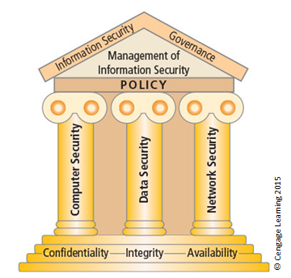
Components of information security (1 of 2)
Notes:
The Committee on National Security Systems (CNSS) defines information security as the protection of information and its critical elements, including the systems and hardware that use, store,
and transmit the information.11 Figure 1-5 shows that information security includes the broad areas of information security management, data security, and network security. The CNSS
model of information security evolved from a concept developed by the computer security industry called the C.I.A. triad. The C.I.A. triad (see Figure 1-6) has been the standard for computer
security in both industry and government since the development of the mainframe. This standard is based on the three characteristics of information that give it value to organizations:
confidentiality, integrity, and availability.
19

Slide 21
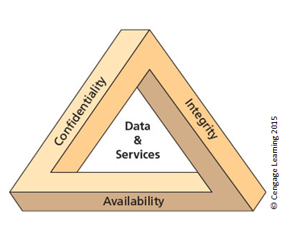
The C.I.A. triad (2 of 2)
Notes:
The C.I.A. triad (see Figure above) has been the standard for computer security in both industry and government since the development of the mainframe. This
standard is based on the three characteristics of information that give it value to organizations: confidentiality, integrity, and availability. The security of these three characteristics is as important
today as it has always been, but the C.I.A.
19

Slide 22
Key Information Security Concepts (1 of 3)
Access
Asset
Attack
Control, safeguard, or countermeasure
Exploit
Exposure
Loss
Protection profile or security posture
Notes:
Key Terms
Access - a subject or object’s ability to use, manipulate, modify, or affect another subject or object.
Asset - the organizational resource that is being protected.
Attack - an intentional or unintentional act that can damage or otherwise compromise information and the systems that support it.
Control, Safeguard, or Countermeasure - Security mechanisms, policies, or procedures that can successfully counter attacks, reduce risk, resolve vulnerabilities, and otherwise improve security within an organization.
Exploit – a technique used to compromise a system.
Exposure - a condition or state of being exposed.
Loss: A single instance of an information asset suffering damage or destruction, unintended or unauthorized modification or disclosure, or denial of use.
Protection Profile or Security Posture-entire set of controls and safeguards that the organization implements to protect the asset.
Risk - the probability of an unwanted occurrence.
Subjects and Objects – a computer can be either an agent entity used to conduct an attack, or the target entity.
Threat - a category of objects, people, or other entities that represents a danger to an asset.
Threat Agent – the specific instance or a component of a threat.
Vulnerability - weaknesses or faults in a system or protection mechanism that expose information to attack or damage.
22

Slide 23
Key Information Security Concepts (2 of 3)
Risk
Subjects and objects of attack
Threat
Threat agent
Threat event
Threat source
Vulnerability

Slide 24
Key Information Security Concepts (3 of 3)
A computer can be the subject of an attack and/or the object of an attack.
  When it is the subject of an attack, the computer is used as an active tool to conduct attack.
  When it is the object of an attack, the computer is the entity being attacked.
Notes:
Key Information Security Concepts
When considering the security of information systems components, it is important to understand the concept of the computer as the subject of an attack as opposed to the computer as the object of an attack.
When a computer is the subject of an attack, it is used as an active tool to conduct the attack. When a computer is the object of an attack, it is the entity being attacked.
22

Slide 25
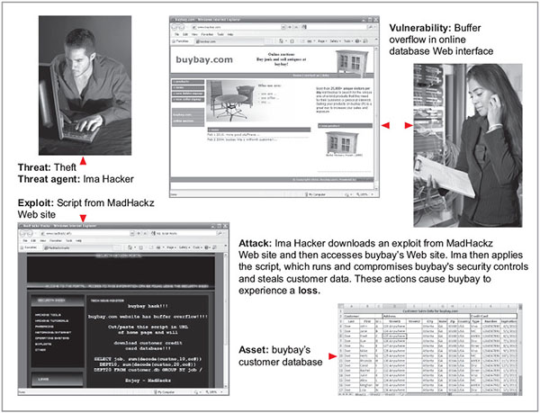
Key concepts in information security
Source. (top left to bottom right): © iStockphoto/tadija, Internet Explorer, © iStockphoto/darrenwise , Internet Explorer, Microsoft Excel.

Slide 26
Critical Characteristics of Information
The value of information comes from the characteristics it possesses:
  Availability
  Accuracy
  Authenticity
  Confidentiality
  Integrity
  Utility
  Possession
Notes:
Critical Characteristics of Information
The value of information comes from the characteristics it possesses.
Availability – Enables users who need to access information to do so without interference or obstruction and in the required format. The information is said to be available to an authorized user when and where needed and in the correct format.
Accuracy – Free from mistake or error and having the value that the end user expects. If information contains a value different from the user’s expectations due to the intentional or unintentional modification of its content, it is no longer accurate.
Authenticity –The quality or state of being genuine or original, rather than a reproduction or fabrication. Information is authentic when it is the information that was originally created, placed, stored, or transferred.
Confidentiality – The quality or state of preventing disclosure or exposure to unauthorized individuals or systems.
Integrity – The quality or state of being whole, complete, and uncorrupted. The integrity of information is threatened when the information is exposed to corruption, damage, destruction, or other disruption of its authentic state.
Utility – The quality or state of having value for some purpose or end. Information has value when it serves a particular purpose. This means that if information is available, but not in a format meaningful to the end user, it is not useful.
Possession – The quality or state of having ownership or control of some object or item. Information is said to be in possession if one obtains it, independent of format or other characteristic. While a breach of confidentiality always results in a breach of possession, a breach of possession does not always result in a breach of confidentiality.
26

Slide 27
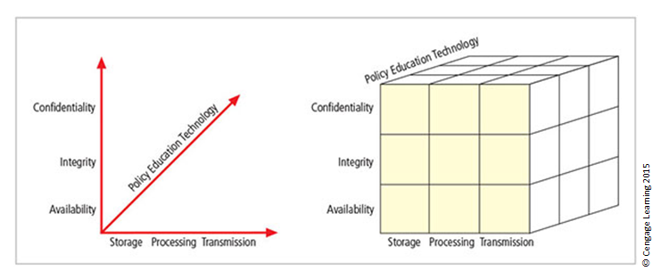
The McCumber Cube
Notes:
This graphic informs the fundamental approach of the chapter and can be used to illustrate the intersection of information states (x-axis), key objectives of C.I.A. (y-axis), and the three primary means to implement (policy, education, and technology).
The model, which was created by John McCumber in 1991, provides a graphical representation of the architectural approach widely used in computer and information security; it
is now known as the McCumber Cube.
26

Slide 28
Components of an Information System
Information system (IS) is the entire set of people, procedures, and technology that enable business to use information.
  Software
  Hardware
  Data
  People
  Procedures
  Networks
Notes:
Components of an Information System
Information system (IS) is entire set of people, procedures, and technology that enable business to use information.
Software
Hardware
Data
People
Procedures
Networks
28

Slide 29
Balancing Information Security and Access
Impossible to obtain perfect information security—it is a process, not a goal.
Security should be considered a balance between protection and availability.
To achieve balance, the level of security must allow reasonable access, yet protect against threats.
Notes:
Security and Access Balancing
When considering information security, it is important to realize that it is impossible to obtain perfect security. Security is not an absolute; it is a process not a goal.
Security should be considered a balance between protection and availability.
To achieve balance, the level of security must allow reasonable access yet protect against threats.
28

Slide 30
Approaches to Information Security Implementation: Bottom-Up Approach
Grassroots effort: Systems administrators attempt to improve security of their systems.
Key advantage: technical expertise of individual administrators
Seldom works, as it lacks a number of critical features:
  Participant support
  Organizational staying power
Notes:
Bottom-up Approach to Security Implementation
Security can begin as a grass-roots effort when systems administrators attempt to improve the security of their systems. This is referred to as the bottom-up approach.
The key advantage of the bottom-up approach is the technical expertise of the individual administrators.
Unfortunately, this approach seldom works, as it lacks a number of critical features, such as participant support and organizational staying power.
28

Slide 31
Approaches to Information Security Implementation: Top-Down Approach
Initiated by upper management
  Issue policy, procedures, and processes
  Dictate goals and expected outcomes of project
  Determine accountability for each required action
The most successful type of top-down approach also involves a formal development strategy referred to as systems development life cycle.
Notes:
Top-down Approach to Security Implementation
An alternative approach, which has a higher probability of success, is called the top-down approach. The project is initiated by upper management who issue policy, procedures, and processes; dictate the goals and expected outcomes of the project; and determine who is accountable for each of the required actions.
The top-down approach has strong upper-management support, a dedicated champion, dedicated funding, clear planning, and the opportunity to influence organizational culture.
The most successful top-down approach also involves a formal development strategy referred to as a systems development life cycle.
28

Slide 32
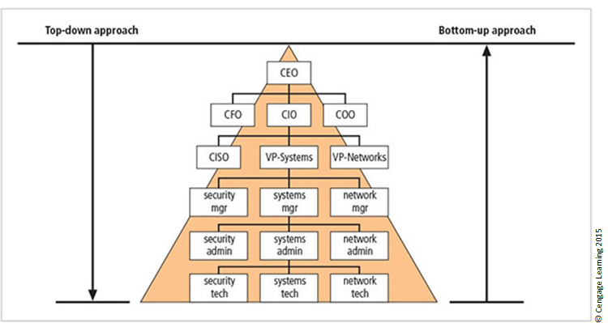
Approaches to information security implementation
Notes:
The key concept here is the direction of the left and right side arrows to show where planning is sourced and from which direction the pressure for success is driven.
28

Slide 33
Security in the Systems Development Life Cycle
Systems development life cycle (SDLC): a methodology for the design and implementation of an information system
Methodology: a formal approach to solving a problem based on a structured sequence of procedures
Using a methodology:
  Ensures a rigorous process with a clearly defined goal
  Increases probability of success
Notes:
The Systems Development Life Cycle
Systems Development Life Cycle (SDLC): methodology for design and implementation of an information system
Methodology: formal approach to solving a problem based on a structured sequence of procedures
Using a methodology:
Ensures a rigorous process with a clearly defined goal
Increases probability of success
Traditional SDLC consists of six general phases
33

Slide 34
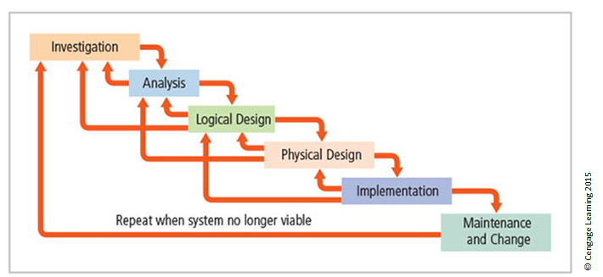
SDLC waterfall methodology
Notes:
Very much a traditional SDLC diagram.
<number>

Slide 35
Investigation
What problem is the system being developed to solve?
Objectives, constraints, and scope of project are specified.
Preliminary cost-benefit analysis is developed.
At the end of all phases, a process is undertaken to assess economic, technical, and behavioural feasibilities and ensure implementation is worth the time and effort.
Notes:
Investigation
What problem is the system being developed to solve?
Objectives, constraints, and scope of project are specified
Preliminary cost-benefit analysis is developed
At the end of all phases, a process is undertaken to assess economic, technical, and behavioral feasibilities and ensure implementation is worth time and effort
<number>

Slide 36
Analysis
Consists of assessments of:
  The organization
  Current systems
  Capability to support proposed systems
Analysts determine what the new system is expected to do and how it will interact with existing systems.
Analysis ends with documentation of findings and an update of feasibility.
Notes:
Analysis
The analysis phase begins with the information learned during the investigation phase.
This phase consists primarily of assessments of the organization, the status of current systems, and the capability to support the proposed systems.
Analysts begin to determine what the new system is expected to do and how it will interact with existing systems.
This phase ends with the documentation of the findings and a feasibility analysis update.
<number>

Slide 37
Logical Design
The first and driving factor is the business need.
  Applications are selected to provide needed services.
Data support and structures capable of providing the needed inputs are identified.
Specific technologies are delineated to implement the physical solution.
Analysts generate estimates of costs and benefits to allow comparison of available options.
Feasibility analysis is performed at the end.
Notes:
Logical Design
First and driving factor is business need
Applications are selected to provide needed services
Data support and structures capable of providing the needed inputs are identified
Specific technologies are delineated to implement the physical solution
Analysts generate estimates of costs and benefits to allow comparison of available options
Feasibility analysis performed at the end
<number>

Slide 38
Physical Design
Specific technologies are selected to support the alternatives identified and evaluated in the logical design.
Selected components are evaluated on make-or-buy decision.
Feasibility analysis is performed.
Entire solution is presented to organization’s management for approval.
Notes:
Physical Design
Specific technologies selected to support the alternatives identified and evaluated in the logical design
Selected components evaluated on make-or-buy decision
Feasibility analysis performed
Entire solution presented to organization’s management for approval
38

Slide 39
Implementation
Needed software is created.
Components are ordered, received, and tested.
Users are trained and supporting documentation created.
Feasibility analysis is prepared.
  Sponsors are presented with the system for a performance review and acceptance test.
Notes:
Implementation
Needed software created
Components ordered, received, and tested
Users trained and supporting documentation created
Feasibility analysis prepared
Sponsors presented with system for performance review and acceptance test
39

Slide 40
Maintenance and Change
Longest and most expensive phase
Consists of the tasks necessary to support and modify the system for the remainder of its useful life
Life cycle continues until the team determines the process should begin again from the investigation phase
When current system can no longer support the organization’s mission, a new project is implemented
Notes:
Maintenance and Change
The maintenance and change phase is the longest and most expensive phase of the process.
This phase consists of the tasks necessary to support and modify the system for the remainder of its useful life cycle.
Even though formal development may conclude during this phase, the life cycle of the project continues until it is determined that the process should begin again from the investigation phase. When the current system can no longer support the changed mission of the organization, the project is terminated and a new project is implemented.
<number>

Slide 41
Software Assurance (1 of 3)
Many organizations recognize the need to include planning for security objectives in the SDLC used to create systems.
  Established procedures to create software that is more capable of being deployed in a secure fashion
This approach is known as software assurance (SA).
A national effort is under way to create a common body of knowledge focused on secure software development.
Notes:
Many organizations recognize need to include planning for security objectives in the SDLC used to create systems
Established procedures to create software more capable of being deployed in a secure fashion
This approach known as software assurance (SA)
Software Assurance Initiative resulted in publication of Secure Software Assurance (SwA) Common Body of Knowledge (CBK)
41

Slide 42
Software Assurance (2 of 3)
U.S. Department of Defense and Department of Homeland Security supported the Software Assurance Initiative, which resulted in the publication of Secure Software Assurance (SwA) Common Body of Knowledge (CBK).
SwA CBK serves as a strongly recommended guide to developing more secure applications.
SwA CBK, which is a work in progress, contains the following sections:
  Nature of Dangers
  Fundamental Concepts and Principles
  Ethics, Law, and Governance
Notes:
SwA CBK is a work in progress, contains following sections:
Nature of Dangers
Fundamental Concepts and Principles
Ethics, Law, and Governance
Secure Software Requirements
Secure Software Design
Secure Software Construction
Secure Software Verification, Validation, and Evaluation
Secure Software Tools and Methods
Secure Software Processes
Secure Software Project Management
Acquisition of Secure Software
Secure Software Sustainment
42

Slide 43
Software Assurance (3 of 3)
  Secure Software Requirements
  Secure Software Design
  Secure Software Construction
  Secure Software Verification, Validation, and Evaluation
  Secure Software Tools and Methods
  Secure Software Processes
  Secure Software Project Management
  Acquisition of Secure Software
  Secure Software Sustainment

Slide 44
Software Design Principles (1 of 2)
Good software development results in secure products that meet all design specifications.
Some commonplace security principles
  Keep design simple and small
  Access decisions by permission not exclusion
  Every access to every object checked for authority
  Design depends on possession of keys/passwords
  Protection mechanisms require two keys to unlock
  Programs/users utilize only necessary privileges

Slide 45
Software Design Principles (2 of 2)
Some commonplace security principles
  Minimize mechanisms common to multiple users
  Human interface must be easy to use so users routinely/automatically use protection mechanisms.

Slide 46
The NIST Approach to Securing the SDLC
NIST Special Publication 800-64, rev. 2, maintains that early integration of security in the SDLC enables agencies to maximize return on investment through:
  Early identification and mitigation of security vulnerabilities and misconfigurations
  Awareness of potential engineering challenges
  Identification of shared security services and reuse of security strategies and tools
  Facilitation of informed executive decision making
Notes:
NIST: National Institute of Standards and Technology
The NIST Approach to Securing the SDLC
NIST Special Publication 800-64 rev. 2 maintains that early integration of security in the SDLC enables agencies to maximize return on investment through:
Early identification and mitigation of security vulnerabilities and misconfigurations
Awareness of potential engineering challenges
Identification of shared security services and reuse of security strategies and tools
Facilitation of informed executive decision making
46

Slide 47
The NIST Approach: Initiation
Security at this point is looked at in terms of business risks, with information security office providing input.
Key security activities include:
  Delineation of business requirements in terms of confidentiality, integrity, and availability
  Determination of information categorization and identification of known special handling requirements to transmit, store, or create information
  Determination of any privacy requirements
Notes:
Initiation
Security at this point looked at in terms of business risks, with information security office providing input
Key security activities include:
Delineation of business requirements in terms of confidentiality, integrity, and availability
Determination of information categorization and identification of known special handling requirements to transmit, store, or create information
Determination of any privacy requirements
<number>

Slide 48
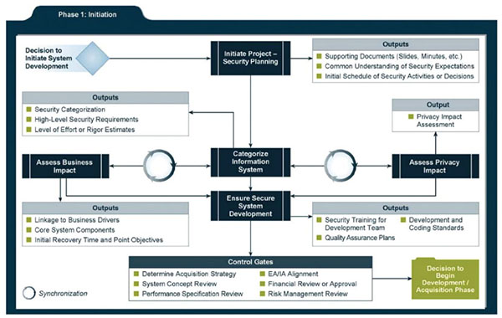
Relating security considerations in the Initiation phase
Source: NIST SP 800-64 Rev. 2: Security Considerations in the System Development Life Cycle.

Slide 49
The NIST Approach: Development/Acquisition
Key security activities include:
  Conducting risk assessment and using results to supplement baseline security controls
  Analyzing security requirements
  Performing functional and security testing
  Preparing initial documents for system certification and accreditation
  Designing security architecture
Notes:
Development/Acquisition
Key security activities include:
Conduct risk assessment and use results to supplement baseline security controls
Analyze security requirements
Perform functional and security testing
Prepare initial documents for system certification and accreditation
Design security architecture
49

Slide 50
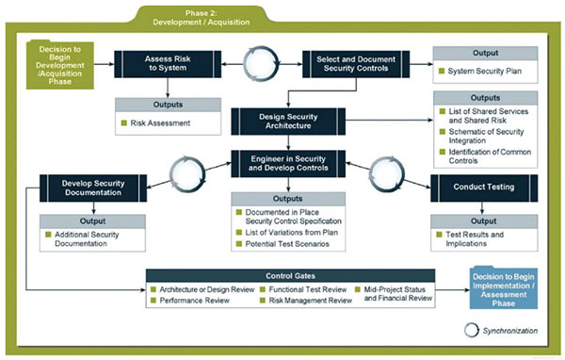
Relating security considerations in the Development/Acquisition phase
Source: NIST SP 800-64 Rev. 2: Security Considerations in the System Development Life Cycle.

Slide 51
The NIST Approach: Implementation/Assessment
System is installed and evaluated in operational environment.
Key security activities include:
  Integrating information system into its environment
  Planning and conducting system certification activities in synchronization with testing of security controls
  Completing system accreditation activities
Notes:
Implementation/Assessment
System installed and evaluated in operational environment
Key security activities include:
Integrate information system into its environment
Plan and conduct system certification activities in synchronization with testing of security controls
Complete system accreditation activities
51

Slide 52
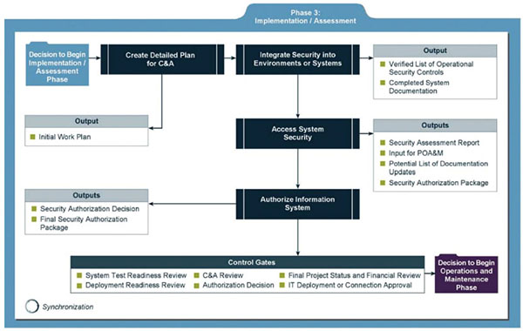
Relating security considerations in the Implementation/Assessment phase
Source: NIST SP 800-64 Rev. 2: Security Considerations in the System Development Life Cycle.

Slide 53
The NIST Approach: Operations and Maintenance
Systems are in place and operating, enhancements and/or modifications to the system are developed and tested, and hardware and/or software are added or replaced.
Key security activities include:
  Conducting operational readiness review
  Managing configuration of system
  Instituting process and procedure for assured operations and continuous monitoring of information system’s security controls
  Performing reauthorization as required
Notes:
Operations and Maintenance:
Systems are in place and operating, enhancements and/or modifications to the system are developed and tested, and hardware and/or software added or replaced
Key security activities include:
Conduct operational readiness review
Manage configuration of system
Institute process and procedure for assured operations and continuous monitoring of information system’s security controls
Perform reauthorization as required
53

Slide 54
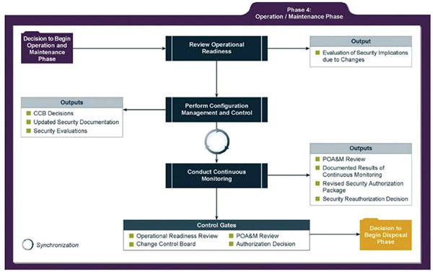
Relating security considerations in the Operation/Maintenance phase
Source: NIST SP 800-64 Rev. 2: Security Considerations in the System Development Life Cycle.

Slide 55
The NIST Approach: Disposal
Provides for disposal of system and closeout of any contracts in place
Key security activities include:
  Building and executing disposal/transition plan
  Archival of critical information
  Sanitization of media
  Disposal of hardware and software
Notes:
Disposal:
Provides for disposal of system and closeout of any contracts in place
Key security activities include:
Building and executing disposal/transition plan
Archival of critical information
Sanitization of media
Disposal of hardware and software
55

Slide 56
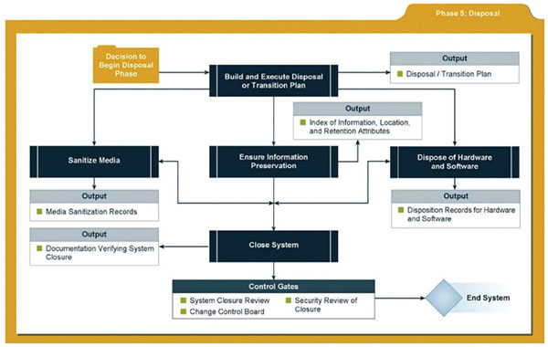
Relating security considerations in the Disposal phase
Source: NIST SP 800-64 Rev. 2: Security Considerations in the System Development Life Cycle.

Slide 57
Microsoft’s SDL (1 of 3)
Training:
  Core security training
  Requirements:
  Establish security requirements
  Create quality gates/bug bars
  Perform security and privacy risk assessments
  Design:
  Establish design requirements
  Perform attack surface analysts/ reduction
  Use threat modeling

Slide 58
Microsoft’s SDL (2 of 3)
  Implementation:
  Use approved tools
  Deprecate unsafe functions
  Perform static analysis
  Veri cation:
  Perform dynamic analysis
  Perform fuzz testing
  Conduct attack surface review

Slide 59
Microsoft’s SDL (3 of 3)
  Release:
  Create an incident response plan
  Conduct nal security review
  Certify release and archive
  Response:
  Execute incident response plan
Source © Microsoft Learning 2015

Slide 60
Security Professionals and the Organization
Wide range of professionals are required to support a diverse information security program.
Senior management is the key component.
Additional administrative support and technical expertise are required to implement details of the IS program.
Notes:
Security Professionals and the Organization
It takes a wide range of professionals to support a diverse information security program.
To develop and execute specific security policies and procedures, additional administrative support and technical expertise is required.
<number>

Slide 61
Senior Management
Chief information officer (CIO)‏
  Senior technology officer
  Primarily responsible for advising the senior executives on strategic planning
Chief information security officer (CISO)‏
  Has primary responsibility for assessment, management, and implementation of IS in the organization
  Usually reports directly to the CIO
Notes:
Senior Management
Chief Information Officer – The senior technology officer, although other titles such as Vice President of Information, VP of Information Technology, and VP of Systems may be used. The CIO is primarily responsible for advising the Chief Executive Officer, President, or company owner on the strategic planning that affects the management of information in the organization.
Chief Information Security Officer – The individual primarily responsible for the assessment, management, and implementation of securing the information in the organization. The CISO may also be referred to as the Manager for Security, the Security Administrator, or a similar title.
<number>

Slide 62
Information Security Project Team
A small functional team of people who are experienced in one or multiple facets of required technical and nontechnical areas:
  Champion
  Team leader
  Security policy developers
  Risk assessment specialists
  Security professionals
  Systems administrators
  End users
Notes:
Security Project Team
A number of individuals who are experienced in one or multiple requirements of both the technical and nontechnical areas.
The champion: A senior executive who promotes the project and ensures its support, both financially and administratively, at the highest levels of the organization.
The team leader: A project manager, who may be a departmental line manager or staff unit manager, who understands project management, personnel management, and information security technical requirements.
Security policy developers: Individuals who understand the organizational culture, policies, and requirements for developing and implementing successful policies.
Risk assessment specialists: People who understand financial risk assessment techniques, the value of organizational assets, and the security methods to be used.
Security professionals: Dedicated, trained, and well-educated specialists in all aspects of information security from both technical and nontechnical standpoints.
Systems administrators: People with the primary responsibility for administering the systems that house the information used by the organization.
End users: Those whom the new system will most directly impact. Ideally, a selection of users from various departments, levels, and degrees of technical knowledge assist the team in focusing on the application of realistic controls applied in ways that do not disrupt the essential business activities they seek to safeguard.
62

Slide 63
Data Responsibilities
Data owners: senior management responsible for the security and use of a particular set of information
Data custodians: responsible for the information and systems that process, transmit, and store it
Data users: individuals with an information security role
Notes:
Data Responsibilities
Data owners: Members of senior management who are responsible for the security and use of a particular set of information. The data owners usually determine the level of data classification (discussed later), as well as the changes to that classification required by organizational change. The data owners work with subordinate managers to oversee the day-to-day administration of the data.
● Data custodians: Working directly with data owners, data custodians are responsible for the information and the systems that process, transmit, and store it. Depending on the size of the organization, this may be a dedicated position, such as the CISO, or it may be an additional responsibility of a systems administrator or other technology manager. The duties of a data custodian often include overseeing data storage and backups, implementing the specific procedures and policies laid out in the security policies and plans, and reporting to the data owner.
● Data users: Everyone in the organization is responsible for the security of data, so data users are included here as individuals with an information security role.
<number>

Slide 64
Communities of Interest
Group of individuals united by similar interests/values within an organization
  Information security management and professionals
  Information technology management and professionals
  Organizational management and professionals
Notes:
Communities of Interest
Each organization develops and maintains its own unique culture and values. Within that corporate culture, there are communities of interest. These include:
Information Security Management and Professionals
Information Technology Management and Professionals
Organizational Management and Professionals
<number>

Slide 65
Information Security: Is It an Art or a Science?
Implementation of information security is often described as a combination of art and science.
“Security artisan” idea: based on the way individuals perceive system technologists and their abilities.
Notes:
Information Security: Is It an Art or a Science?
With the level of complexity in today’s information systems, the implementation of information security has often been described as a combination of art and science.
The concept of the security artisan is based on the way individuals perceived systems technologists since computers became commonplace.
<number>

Slide 66
Security as Art
No hard and fast rules nor many universally accepted complete solutions
No manual for implementing security through entire system
Notes:
Security as Art
There are no hard and fast rules regulating the installation of various security mechanisms.
Nor are there many universally accepted complete solutions.
While there are many manuals to support individual systems, once these systems are interconnected, there is no magic user’s manual for the security of the entire system.
This is especially true with the complex levels of interaction between users, policy, and technology controls.
<number>

Slide 67
Security as Science
Dealing with technology designed for rigorous performance levels.
Specific conditions cause virtually all actions in computer systems.
Almost every fault, security hole, and systems malfunction is a result of interaction of specific hardware and software.
If developers had sufficient time, they could resolve and eliminate faults.
Notes:
Security as Science
We are dealing with technology developed by computer scientists and engineers—technology designed to perform at rigorous levels of performance.
Even with the complexity of the technology, most scientists would agree that specific scientific conditions cause virtually all actions that occur in computer systems.
Almost every fault, security hole, and systems malfunction is a result of the interaction of specific hardware and software.
If the developers had sufficient time, they could resolve and eliminate these faults.
<number>

Slide 68
Security as a Social Science
Social science examines the behaviour of individuals interacting with systems.
Security begins and ends with the people that interact with the system, intentionally or otherwise.
Security administrators can greatly reduce the levels of risk caused by end users and create more acceptable and supportable security profiles.
Notes:
Security as a Social Science
There is a third view: security as a social science.
Social science examines the behavior of individuals as they interact with systems, whether societal systems or in our case information systems.
Security begins and ends with the people inside the organization and the people that interact with the system planned or otherwise.
End users that need the very information the security personnel are trying to protect may be the weakest link in the security chain.
By understanding some of the behavioral aspects of organizational science and change management, security administrators can greatly reduce the levels of risk caused by end users and create more acceptable and supportable security profiles.
<number>

Slide 69
Summary (1 of 2)
Computer security began immediately after the first mainframes were developed.
Successful organizations have multiple layers of security in place: physical, personal, operations, communications, network, and information.
Security should be considered a balance between protection and availability.

Slide 70
Summary (2 of 2)
Information security must be managed similar to any major system implemented in an organization using a methodology like the SDLC.
Implementation of information security is often described as a combination of art and science.

Slide 71
References
Whitman, M.E.,Mattord, H.J., 2018. Principles of Information Security . Cengage Learning 658.
Whitman, ME., Mattord H.J., 2011. Readings and Cases in Information Security Law and Ethics. Cengage

