Slide 1

Writing a report on Financial Management for SC & Logistics Projects
Alex Yesson
26/02/2026
BSc Supply Chain Logistics
Finance Management

Slide 2
Agenda
Introduction
Honeywell Aerospace Yeovil Financial Ratios
Conclusion
Questions
Appendix
References

Slide 3
Introduction
Calculate the Key Financial ratios of Honeywell Aerospace Yeovil and analyse the financial ratios to compare present and previous values.
What is a Financial Statement?
A financial statement is a report that summarises a businesses financial performance, financial position and cash flow activities for a defined period. They provide information about the financial position, financial performance and cash flows of an entity that is useful to a wide range of users in making economic decisions (IASB, 2018)
What is a Financial Ratio?
A financial ratio is used to compare figures from a business's financial statements, that can then be used to evaluate the financial performance, such as profitability, liquidity and efficiency. Financial ratios are calculations that compare two or more figures from a company’s financial statements to measure performance and financial health (Corporate finance, 2025)

Slide 4
Financial Ratios
Profitability Ratios
Profitability ratios show how effective a business is at turning sales, assets and invested capital into profit.
Activity Ratios
Activity ratios shows how a business has used its assets to generate sales and revenue. Activity ratios measure how efficiently a firm utilises its assets in generating sales and managing its operational cycle (Atrill & McLaney, 2022)
Liquidity Ratios
Liquidity ratios show how effectively a business can pay it’s short term debt obligations.
Capital Gearing Ratios
Capital Gearing ratios show how a business can hold their capital structure.
Investors Ratios
Investors ratios show how a business can generate a profitable return from investments.

Slide 5

Honeywell Aerospace Yeovil Financial Ratios
Analysis of Financial Statements from 2022 to 2024

Slide 6
Return on Capital employed ratio
Year | 2024 | 2023 | 2022
Return on Capital Employed | 15.1% | 18.5% | 15.1%
Return on Capital Employed = Income before Tax and Interest / Capital employed x 100
2024 – 8,162,000 / 53,940,000 x 100 = 15.1%
2023 – 7,944,000 / 42,986,000 x 100 = 18.5%
2022 – 7,591,000 / 50,120,000 x 100 = 15.1%
Honeywell displays the highest ROCE in 2023, which is driven by a healthier balance sheet as opposed to a large profit increase. However, as this then goes back down to 15.1%, as shown in 2022, it could be viewed that Honeywell have gone back to an unhealthy ROCE, but I can see this is driven because of heavy reinvestment, not because the business has become less profitable.

Slide 7
Return on Shareholders’ Funds Ratio
Year | 2024 | 2023 | 2022
Return on Shareholders Funds Ratio | 32.1% | 21.7% | 14.7%
Return on Shareholders Funds Ratio = Net Profit After Tax / Shareholders Equity x 100
2024 – 5,705,000 / 17,794,000 x 100 = 32.1%
2023 – 5,658,000 / 26,116,000 x 100 = 21.7%
2022 - 4,966,000 / 33,730,000 = 14.7%
The clear rise year on year from ROSF shows improvements in the efficient use of shareholder’s investments. Honeywell has reduced its equity through buybacks and dividends whilst successfully maintaining a profitable business. The boost year on year in ROSF will be due to Honeywell reducing its equity, but this does increase financial risk for Honeywell.

Slide 8
Gross Profit Margin Ratio
Year | 2024 | 2023 | 2022
Gross Profit Margin Ratio | 38.1% | 37.3% | 37.0%
Gross Profit Margin Ratio = Gross Profit / Revenue x 100
2024 – (38,498,000 – 23,836,000) / 38,498,000 = 38.1%
2023 – (36,662,000 – 22,995,000) / 36,662,000 = 37.3%
2022 – (35,466,000 – 22,347,000) / 35,466,000 = 37.0%
Gross Profit has marginally increased year on year, which suggests Honeywell is managing its inflation effectively and is benefitting from increased efficiency in controlling production costs.

Slide 9
Operating Profit Margin Ratio
Year | 2024 | 2023 | 2022
Operating Profit Margin Ratio | 16.3% | 16.3% | 13.1%
Operating Profit Margin Ratio = Operating Profit / Revenue x 100
2024 – 6,268,000 / 38,498,000 x 100 = 16.3%
2023 – 5,976,000 / 36,662,000 x 100 = 16.3%
2022 – 4,641,000 / 35,466,000 x 100 = 13.1%
Honeywell in 2022 had the weakest Operating Profit Margin in all 3 years, due to higher costs and lower service margins, however going forward to 2023 and 2024 the Operating profit margin improved to 16.3% which represents the improvements in cost control

Slide 10
Sales Revenue to Capital Employed Ratio
Year | 2024 | 2023 | 2022
Sales Revenue to Capital Employed Ratio | 0.72 | 0.85 | 0.73
Sales Revenue to Capital Employed = Revenue / Capital Employed
2024 – 38,498,000 / 53,300,000 = 0.72
2023 – 36,662,000 / 42,986,000 = 0.85
2022 - 33,466,000 / 46,011,000 = 0.73
Honeywell posted the most impressive sales revenue to capital employed in 2023, to then follow up with the worst performing year in 2024 due to the capital employed increasing sharply due to acquisitions of other businesses. This therefore cannot be viewed as a concern, and more an opportunity to further improve.

Slide 11
Inventories Turnover Period Ratio
Year | 2024 | 2023 | 2022
Inventory Turnover Period | 98.6 Days | 98.0 Days | 87.2 Days
Inventory Turnover Period = Average Inventory / Cost of Sales x 100
2024 – (6,442,000 / 23,836,000) x 365 = 98.6 Days
2023 – (6,178,000 / 22,995,000) x 365 = 98.0 Days
2022 – (5,344,000 / 22,347,000) x 365 = 87.2 Days
From the above trends, we can see Honeywell are taking longer to turnover inventory, likely due to supply chain issues or weaker demand from customers. This is not yet an area of concern, but should this trend continue then this needs to be addressed.

Slide 12
Settlement Period for Trade Receivables
Year | 2024 | 2023 | 2022
Settlement Period for Trade Payables | 74.2 Days | 74.9 Days | 82.3 Days
Settlement Period for Trade Payables = Average Trade Payables / Credit Purchases x 365
2024 – (7,819,000 / 38,498,000) x 365 = 74.2 Days
2023 – (7,530,000 / 36,662,000) x 365 = 74.9 Days
2022 – (7,548,000 / 33,466,000) x 365 = 82.3 Days
Honeywell has significantly improved it’s days to receive collections from 2022 and has stabilised this in 2023 and 2024 to around 74 days.

Slide 13
Settlement Period for Trade Payables Ratio
Year | 2024 | 2023 | 2022
Settlement Period for Trade Payables | 105.3 Days | 108.7 Days | 101.8 Days
Settlement Period for Trade Payables = Average Trade Payables / Credit Purchases x 365
2024 – (6,880,000 / 23,836,000) x 365 = 105.3 Days
2023 – (6,849,000 / 22,995,000) x 365 = 108.7 Days
2022 – (6,239,000 / 22,347,000) x 365 = 101.8 Days
Honeywell are showing a long time for payable days, this gives Honeywell a strong leverage over suppliers when requesting expedites or new work.

Slide 14
Current Ratio
Year | 2024 | 2023 | 2022
Current Ratio | 1.27 | 1.27 | 1.28
Current Ratio = Current Assets / Current Liabilities
2024 – 27,908,000 / 21,896,000 = 1.27
2023 – 23,502,000 / 18,539,000 = 1.27
2022 -21,920,000 / 17,064,000 = 1.28
Honeywell’s liquidity is stable, but not extremely impressive. At an average of just over 1.25, it is the typical liquidity for an established industrial business. Due to the value being over 1.0, Honeywell demonstrates sufficient short term assets to cover it’s short term debts.

Slide 15
Acid Test Ratio
Year | 2024 | 2023 | 2022
Acid Test | 0.98 | 0.94 | 0.97
Acid Test = Current Assets – Inventory / Current Liabilities
2024 – (27,908,000 – 6,442,000) / 21,896,000 = 0.98
2023 – (23,502,000 – 6,178,000) / 18,539,000 = 0.94
2022 – (21,920,000 – 5,344,000) / 17,064,000 = 0.97
Honeywell demonstrates a quick liquidity of just under 1.0, meaning they rely heavily on inventory turnover and operating cash flow rather than liquid assets.

Slide 16
Gearing Ratio
Year | 2024 | 2023 | 2022
Gearing Ratio | 133% | 98% | 68%
Gearing Ratio = Debt / Equity x 100
2024 – 25,479,000 / 19,124,000 = 133%
2023 – 16,662,000 / 17,034,000 = 98%
2022 – 15,123,000 / 22,095,000 = 68%
Gearing has increased significantly since 2022, due to debt financed acquisitions, such as procuring smaller suppliers to streamline the supply chain. This does increase Honeywell’s Financial risk marginally.

Slide 17
Interest Cover Ratio
Year | 2024 | 2023 | 2022
Interest Cover | 5.76 times | 7.68 times | 10.1 times
Interest Cover = Operating Profit / Interest Expense
2024 – 6,268,000 / 1,088,000 = 5.76 times
2023 – 5,976,000 / 760,000 = 7.68 times
2022 – 4,641,000 / 461,000 = 10.1 times
Honeywell’s interest cover is falling as their debt is rising. This isn’t a massive concern to the business but the downward trend over recent years should be noted and monitored.

Slide 18
Earnings Per Share Ratio
Year | 2024 | 2023 | 2022
Earnings per Share | $8.76 | $8.47 | $7.27
Earnings per Share = Net Profit Attributable to Shareholders / Weighted Average Number of Shares
2024 – 8.76
2023 – 8.47
2022 – 7.27
Figures are already show in the financial statements. This Earnings per share shows consisten growth year on year.

Slide 19
Conclusion
Honeywell has demonstrated consistent and impressive financial ratios throughout 2024 to 2022.
Margins have improved year on year and returns from capital were strong each year.
Honeywell displayed a strong cash flow position that demonstrates the business steady operational performance.
Honeywell’s leverage has slightly declined to support its ever-growing strategic investment but with a stable cash generation and strong capital allocation this is not a massive issue.
Overall, the three year trend reflects a strong financial and strategic position to support Honeywell’s growth ambitions.

Slide 20
Questions?

Slide 21
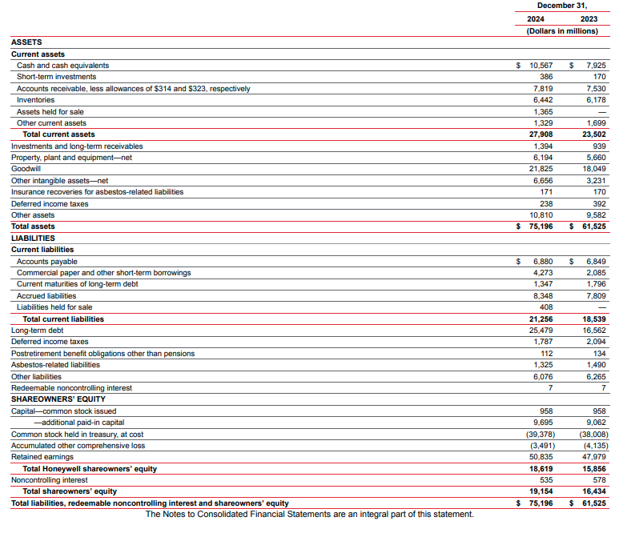
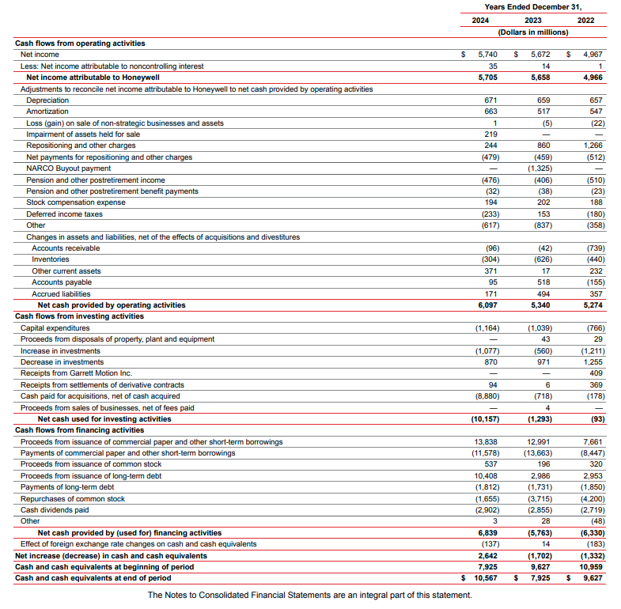
Appendix - 2024

Slide 22
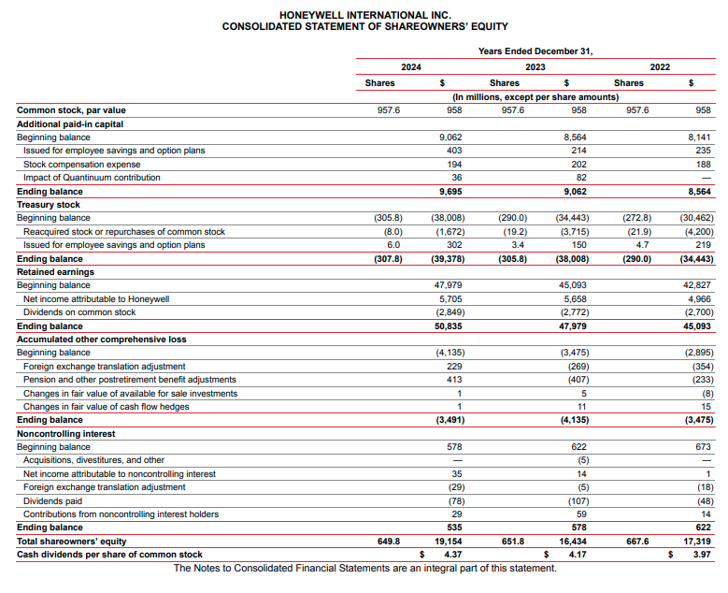
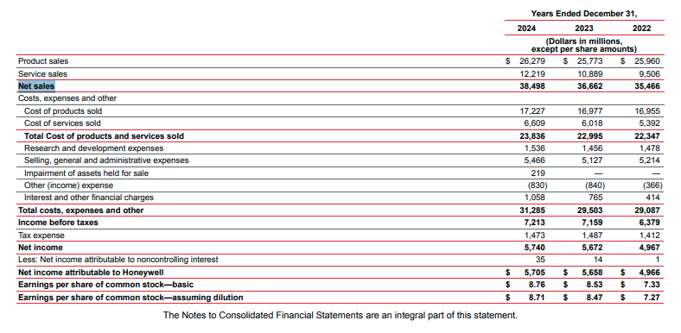
Appendix - 2024

Slide 23
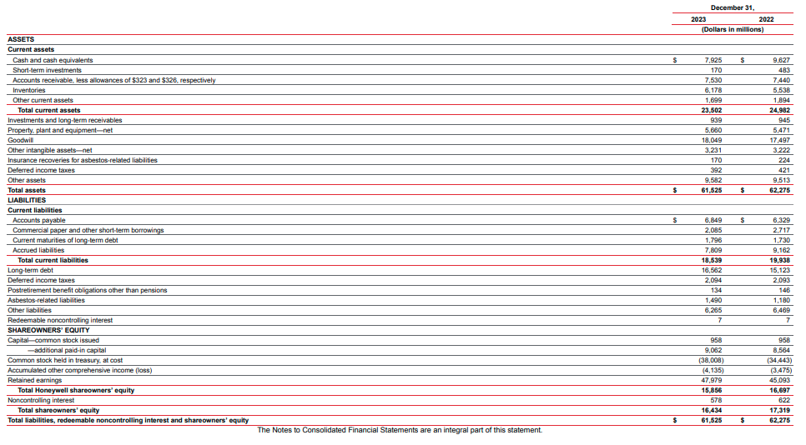
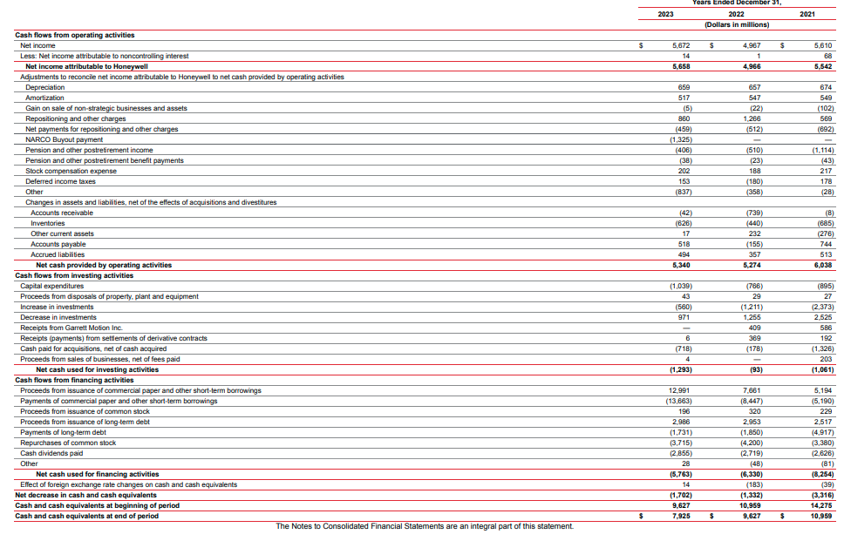
Appendix - 2023

Slide 24
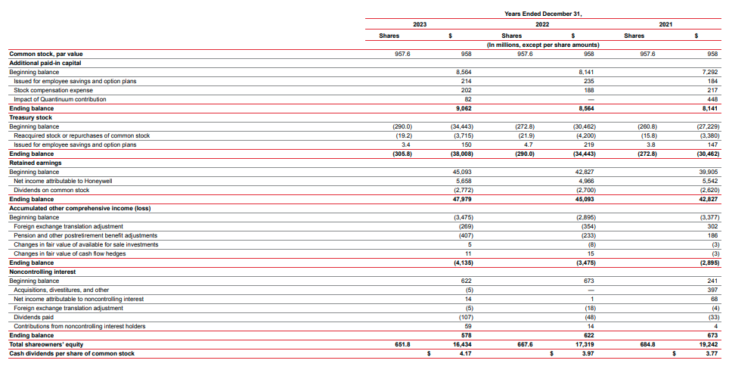
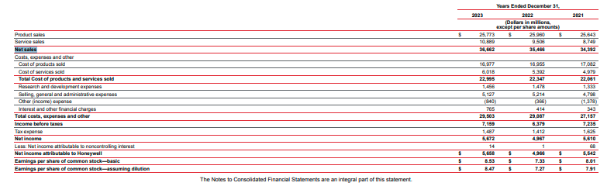
Appendix - 2023

Slide 25
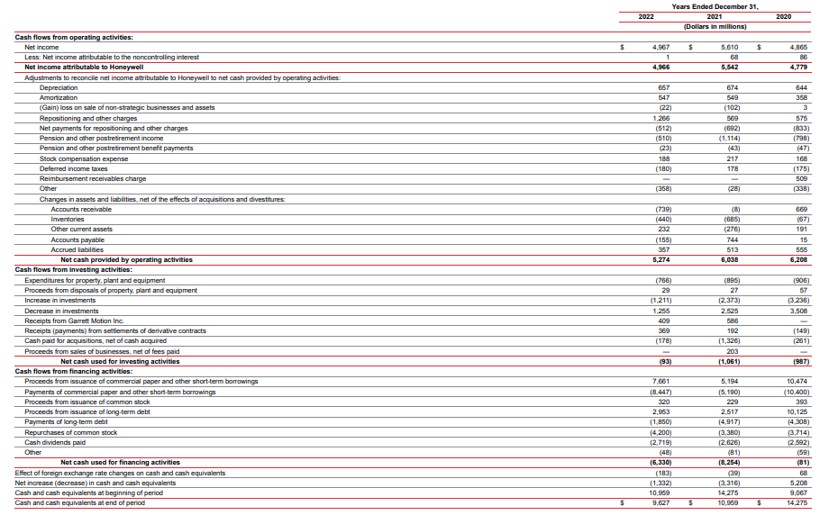
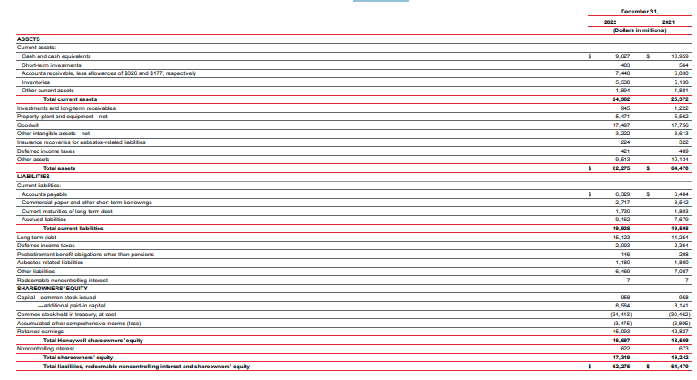
Appendix - 2022

Slide 26
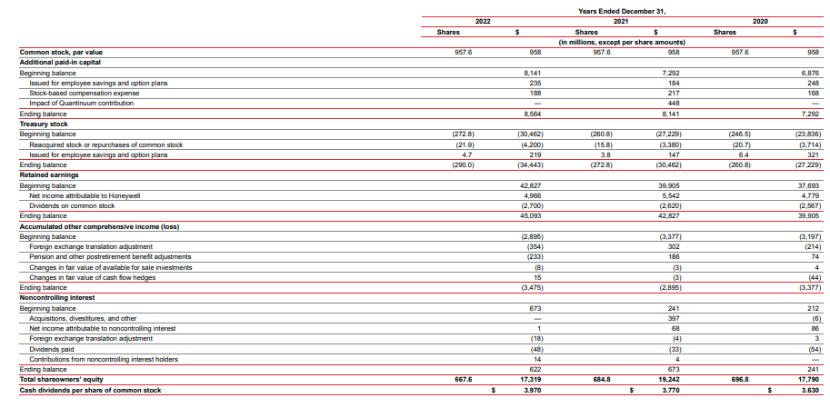
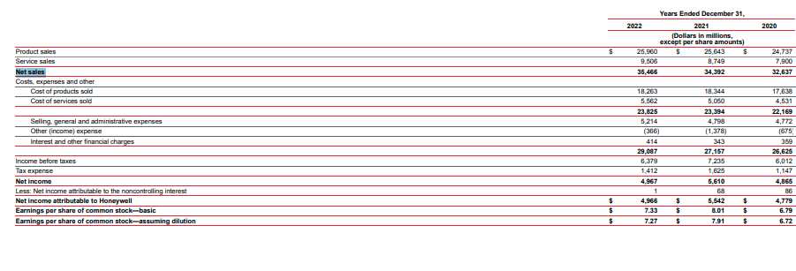
Appendix - 2022

Slide 27
Appendix Overview –
https://honeywellprodgbr-my.sharepoint.com/personal/alex_yesson_honeywell_com/Documents/Documents/Uni/Uni%20-%20Year%202/Finance%20Management/2024%2010K%20Honeywell%20Inc%20Annual%20report.pdf
https://honeywellprodgbr-my.sharepoint.com/personal/alex_yesson_honeywell_com/Documents/Documents/Uni/Uni%20-%20Year%202/Finance%20Management/2023%2010K%20Honeywell%20Inc%20Annual%20report.pdf
https://honeywellprodgbr-my.sharepoint.com/personal/alex_yesson_honeywell_com/Documents/Documents/Uni/Uni%20-%20Year%202/Finance%20Management/2022%2010K%20Honeywell%20Inc%20Annual%20report.pdf

Slide 28
References
IASB (2018) Conceptual Framework for Financial Reporting. London: IFRS Foundation.
Corporate Finance Institute (2025) Financial Ratios: Definition, Types, and Examples.
Atrill, P. & McLaney, E., 2022. Accounting and Finance for Non‑Specialists.

Slide 29
Part B
Jackson PLC questions

