Slide 1

HOW DO STUDENTS USE TECHNOLOGY TO COLLABORATE AT UWTSD?
LECTURE:JULIUS AZASOO
MODULE CODE:LCHS4002
CARMEN KOVACS (2216718)
MYA CODNER (2132442)
JEREMIE ALAMAZANI (2215216)

Slide 2

WHICH DIGITAL TOOL IS MOST USED BY STUDENTS AT UWTSD TO COLLABORATE TOUGHETER?
We live in a digital world that is growing year by year . In university teaching are available a large number of digital tools. In this research we will discover which is the most used by our students for collaboration.

Slide 3
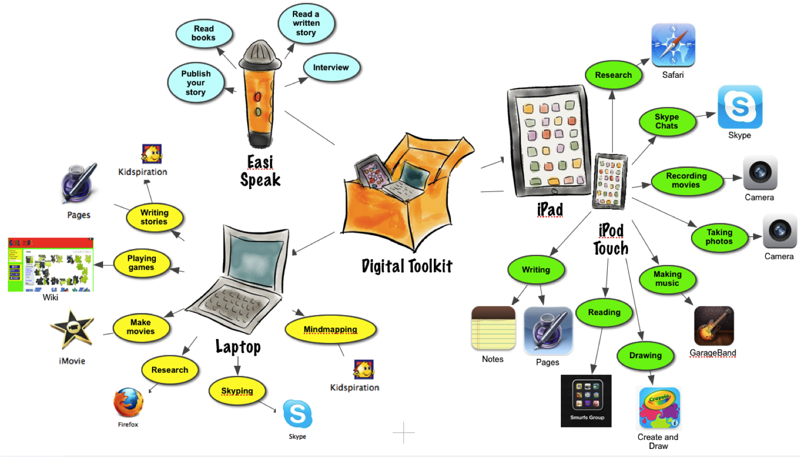
Here are some examples of digital tools students use:
Zoom
Microsoft Team
Moodle
Microsoft Stream
Whats App
Hwb
One Drive

Slide 4
"It is clear that digital tools in university teaching can only deliver added value for study purposes and accepted accordingly by the students themselves.(Beckman2020)
"Social networks are a great tool to promote learning in the community, encourage the participation of students , and generate knowledge discussion".(Moreno ,OrtizColon et al 2021)
Virtual Learning Environement (VLEs) is an important resource for learners at UWTSD, but the number of learners is limited especially in the case of part time distance students.VLE is easier to use on mobile device,an important point as mobile learning becomes increasing widespread.

Slide 5

ETHICAL CONSIDERATION
VOLUNTARY PARTICIPATION
INFORMED CONSENT
ANONIMITY
CONFIDENTIALITY
NO HARM
FREE OF PLAGIARISM
This Photo by Unknown author is licensed under CC BY-SA.

Slide 6
This is our questionnaire to conclude what digital skill is used the most by the students at UWTSD:
https://forms.office.com/Pages/ResponsePage.aspx?id=-REPTm4EBUWcuNshUjEeIQuVYqDlpDxFurjeV5alhpRURDFIRzhTTDhDU1pUWFNSMFFYWTI0UzVUSC4u​​​​​​

Slide 7
Conclusion:
Our hypothesis is digital tools have become important to students in interacting with their peers, we think that digital tools have made our society easier to collaborate, create a space for them to do so, through WhatsApp, zoom, Hwb, and many more. Our students are very confident in using digital tools and finding it helpful to improve their learning and skills

Slide 8
REFERENCES:
Beckmann.A.(2020) Students' views on digital tools in university lectures ; Inted Conference;Valencia,Spain.
Moreno-Rodriguez.J ,Orliz-Colon.A.M ,et al (2021) The influence of digital tools and social network at the digital competence of university students during covid 19; Environement Research and Public Health,Spain.
Davies.C. ,HARRIS.L. , (2016) Engaging professional learners using the Virtual Learning Environement;a case study from social care (vol1,nr1) Wales Journal of Learning and Teaching in Higher Education UWTSD,Carmarthen.

