Slide 1
LCHS4007 DIGITAL SKILLS & RESEARCH METHODS
ASSESSMENT 1
GROUP MEMBERS: NAZMA(2515554), SHAZMA(2515556), GLORIA(2511523), ELIZABETH(2508597)
LECTURER: ANIKA TAHSIN AHMED
TITLE: ENHANCING EFFICIENCY WITH MICROSOFT 365 TOOLS AT SUNRISE RESIDENTIAL CARE HOME

Slide 2

SUNRISE CARE HOME (NHS DIGITAL, 2020)
There are 35 residents at Sunrise, a medium-sized care facility.
Many of the residents suffer from dementia, chronic illnesses, or mobility issues.
Microsoft 365 has been installed in the house to increase efficiency.
Employees include:
Nurses
Carers
Supervisors
Consulting experts
Image of a care home
https://www.google.com/url?sa=i&url=https%3A%2F%2Flottie.org%2Fcare-guides%2Fwhat-is-nursing-care%2F&psig=AOvVaw2SZEeAyBmAY_xz_knyzvAk&ust=1760303910598000&source=images&cd=vfe&opi=89978449&ved=0CBkQjhxqFwoTCOCazKGJnZADFQAAAAAdAAAAABAE

Slide 3
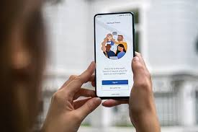

MS TEAMS
(Microsoft, 2023)
Image of MS Teams on a phone
https://www.google.com/url?sa=i&url=https%3A%2F%2Ffocusgroup.co.uk%2Fproducts-and-services%2Fit-solutions%2Fmicrosoft-teams%2F&psig=AOvVaw1_52yuW0UBU1hk6sz45X-1&ust=1760302645579000&source=images&cd=vfe&opi=89978449&ved=0CBkQjhxqFwoTCMiKkeqGnZADFQAAAAAdAAAAABAg
Microsoft Teams is used as a central communication tool for staff.
It supports chat, video calls, and file sharing, and allows staff to connect with families and health professionals.
It allows patients to communicate with health professionals and Family who cannot visit.
Image of MS Teams logo
https://play.google.com/store/apps/details/Microsoft_Teams?id=com.microsoft.teams&hl=en_NZ

Slide 4

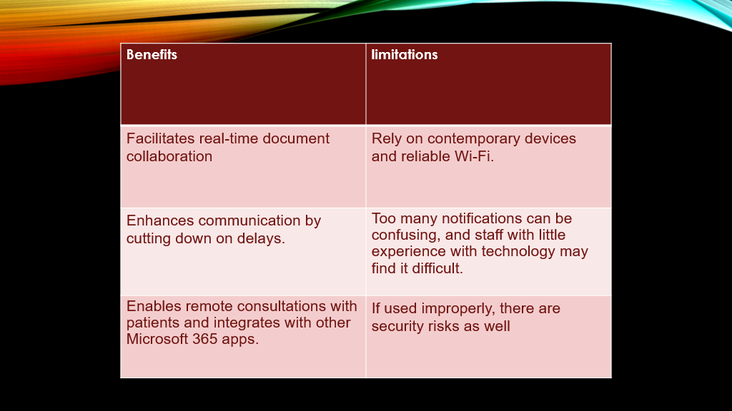
BENEFITS AND LIMITATIONS OF MS TEAMS
Benefits and limitations of MS Teams
One benefit of teams is that teams facilitates real-time document collaboration and enhances communication by cutting down on delays.
Enables remote consultations and integrates with other Microsoft 365 apps.
However, one limitation of this is that teams rely on contemporary devices and reliable Wi-Fi.
Too many notifications can be confusing, and staff with little experience with technology may find it difficult.
If used improperly, there are security risks as well.
(ICO, 2023)
Microsoft. (2019, July 8). https://www.microsoft.com/en-gb/industry/blog/health/2019/07/08/microsoft-teams-healthcare-cost-clinical-time-care/
ClickUp. (2024). https://clickup.com/blog/microsoft-teams-pros-and-cons/
Microsoft Learn. (2024). . https://learn.microsoft.com/en-us/industry/healthcare/architecture/empower-health-team-collaboration
Project Managers Net. (2024).. https://projectmanagers.net/top-10-cons-or-disadvantages-of-microsoft-teams/
WebTechBeam. (2024) https://webtechbeam.com/pros-and-cons-of-microsoft-teams/
PEI. (2024). Microsoft Teams Healthcare Capabilities. https://pei.com/microsoft-teams-healthcare-capabilities/

Slide 5
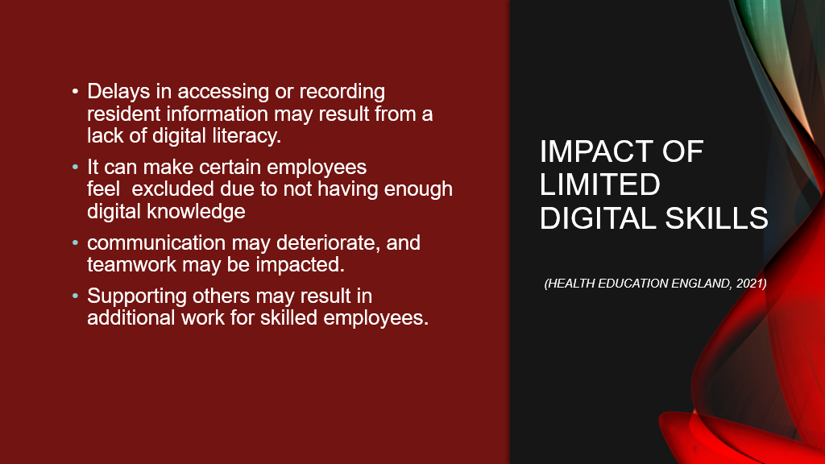
OF MS TEAMS

Slide 6
What is Microsoft Word?
Microsoft Word is part of Microsoft Office and enables the creation, editing and formatting of documents, with features such as spell and grammar checking, inclusion of images, tables and charts, and options for adding a signature to formal documents (The Knowledge Academy, 2025).

Slide 7

MICROSOFT WORD USAGE AT SUNRISE RESIDENTIAL CARE FACILITY
Sunrise Residential Care Home may make extensive use of Microsoft Word, which is a component of the Microsoft 365 suite, to facilitate reporting, communication, and documentation. The application can significantly increase the precision and effectiveness of administrative procedures as well as the provision of care (Microsoft, 2024).

Slide 8

BENEFITS OF WORD AT SUNRISE CARE HOME
Microsoft Word can be available at Sunrise Residential Care Home in several important areas:
• Care Planning and Record Keeping: Nurses and other healthcare professionals can use Microsoft Word to create risk assessments, daily logs, and individual care plans. To guarantee uniformity in documentation and adherence to professional standards, templates might be created (Skills for Care, 2023). This promotes open dialogue regarding residents' need and guarantees person-centred care.
• Policies and protocols: Managers can create, revise, and disseminate internal policies, including safeguarding guidelines, medication management policies, and health and safety protocols, using Word. Digitally preserving these records enables quick updates and convenient access for all employees (Care Quality Commission, 2023).

Slide 9
BENEFITS OF WORD AT SUNRISE - CONTINUED
• Communication and Training: Word can be used to create staff memos, meeting agendas, and training materials. Following that, documents can be shared using OneDrive or Microsoft Teams, fostering regular departmental collaboration (NHS Digital, 2022).
• Reporting to Regulations: Professional reports for outside organisations like the Care Quality Commission (CQC) can also be prepared using Microsoft Word. It is simpler to produce high-quality, compliance papers with features like formatting tools, change tracking, and integrated review mechanisms (Care Quality Commission, 2023).

Slide 10
The limitations of Microsoft Word
At Sunrise Residential Care Home, Word poses a number of difficulties in spite of it's benefits
1. Limited Ability to Manage Data: Word is not appropriate for tracking care trends or evaluating numerical data; these tasks are better handled by Excel or other care management systems (Microsoft, 2024).
2 . Digital Literacy Gaps: According to Skills for Care (2023), some employees lack confidence while using digital tools, which can lead to irregular document formatting or underutilisation of sophisticated capabilities.

Slide 11
The limitations of Microsoft Word -
Continued
3 . Version Control and Connectivity Issues: Staff members may produce several document versions, which could cause confusion, if they save files locally rather than in the cloud. Unreliable internet connectivity increases this risk (NHS Digital, 2022).
4 . Dependency on IT Infrastructure: Reliable devices and network connection are necessary for Word's collaboration tools to function fully, which might occasionally be a drawback in residential care settings (Care Quality Commission, 2023).
Dependency on IT Infrastructure: Reliable devices and network connection are necessary for Word's collaboration tools to function fully, which might occasionally be a drawback in residential care settings (Care Quality Commission, 2023).

Slide 12
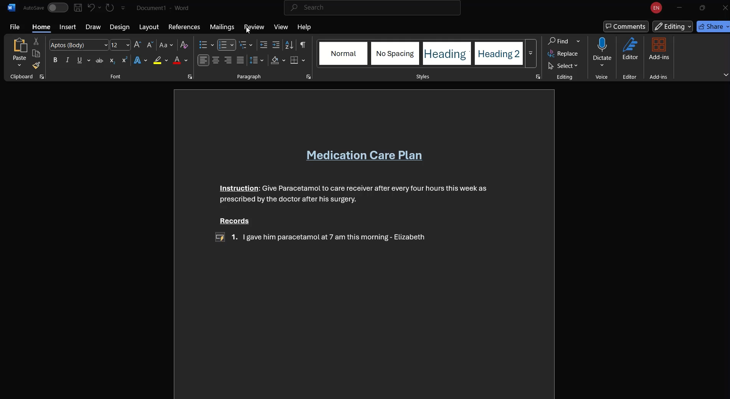
MS WORD IN ACTION
This is a demonstration of MS word “track changes” feature in action.
At Sunrise Residential Care Home, staff often work together on care plans and reports. Using Word’s Track Changes feature helps ensure edits and feedback are visible and traceable, improving accountability and communication among staff.

Slide 13
IMPACT OF LIMITED DIGITAL SKILLS
Effect on the Provision of Care
Effective usage of digital record-keeping tools or electronic care planning systems may be difficult for staff members who lack digital confidence. The quality and continuity of care given to residents may be jeopardised because of insufficient or erroneous care documentation (NHS Digital, 2022).
Delays in recording medication changes or revising care plans, for instance, might lead to irregularities that compromise residents' safety and well-being (Care Quality Commission, 2023)

Slide 14
IMPACT OF LIMITED DIGITAL SKILLS -
continued
Delays in accessing or recording resident information may result from a lack of digital literacy.
If certain employees feel excluded communication may deteriorate, and teamwork may be impacted.
Supporting others may result in additional work for skilled employees. (Health Education England, 2021)

Slide 15
Microsoft Word Checklist
Sunrise Residential Care Home's Checklist of Digital Safety Procedures
The following checklist lists important digital safety procedures that all employees should adhere to guarantee the safe and legal use of digital instruments. In accordance with CQC and NHS Digital guidelines, these procedures promote resident confidentiality, cybersecurity, and data protection. (Skills for Care, 2023; NHS Digital, 2022)
Dependency on IT Infrastructure: Reliable devices and network connection are necessary for Word's collaboration tools to function fully, which might occasionally be a drawback in residential care settings (Care Quality Commission, 2023).

Slide 16
Microsoft Word Checklist - Continued
Area | Best Practice | Purpose / Benefits | Reference
Secure logins | Strong password (Numbers, letters symbols) ie UWA123@/ | Protects system form unauthorised access | NHS DIGITAL (2022)
Email Safety | Verification including links and attachment and report any suspicious email | Prevent Phishing, malware and data breaches | Microsoft (2024)
Safe document Storage | Safe document storage on encrypted cloud storage (eg Sharepoint and one drive) | Ensure secure data acess and version control | Skill for Care (2023)
Confidentiality of Resident Data | Follow GDPR and data protection policies, do not leave device unattended or unlocked. Confidentiality | Protect Resident privacy and uphold professional ethics | Care Quality Commision (2023)
Device security | Keep software updated. Use antivirus and firewalls. Only use authorised device for work task | Minimum risk of cyber threats and system vulnerabilities | NHS DIGITAL (2022)
Staff Training and Awareness | Attend regularly digital literacy and cyber security training. Ensure peer support and mentoring | Build staff confidence and reduce human error in digital practice | Skill for Care (2023)
Dependency on IT Infrastructure: Reliable devices and network connection are necessary for Word's collaboration tools to function fully, which might occasionally be a drawback in residential care settings (Care Quality Commission, 2023).

Slide 17
DIGITAL SAFETY CHECKLIST FOR MST
(ICO, 2023)
To protect sensitive resident information staff must follow these guidelines:
They should have Strong passwords & MFA.
They should avoid clicking suspicious links.
They should Store files in OneDrive/SharePoint.
And should ONLY Share data only with authorised staff.

Slide 18
Conclusion for MS Teams
In summary, Sunrise Residential Care Home significantly depends on Microsoft Teams to facilitate coordination, communication, and teamwork among its employees. The platform makes it possible for employees to hold remote meetings, communicate effectively, and oversee day-to-day care operations in a safe and well-organised way. However, in order to fully realise its potential, the home needs to keep funding staff training, digital literacy, and robust cybersecurity procedures to guarantee that technology is used safely and legally (Microsoft, 2019; Texaport, 2023).

Slide 19
Microsoft Word Conclusion
In conclusion, all things considered, Sunrise Residential Care Home relies heavily on Microsoft Word to facilitate communication, documentation, and compliance. It makes it possible for employees to work effectively and professionally while keeping accurate records for the care of the residents. But to reach its full potential, the home needs to keep spending money on digital literacy, staff training, and safe cloud-based storage solutions (Skills for Care, 2023; NHS Digital, 2022).
Dependency on IT Infrastructure: Reliable devices and network connection are necessary for Word's collaboration tools to function fully, which might occasionally be a drawback in residential care settings (Care Quality Commission, 2023).

Slide 20

Reference list for Microsoft Word
Care Quality Commission (CQC). (2023) Effective use of technology in care homes. Available at: https://www.cqc.org.uk(Accessed: 5 October 2025).
Microsoft. (2024) Microsoft Word: Document creation and collaboration tools. Available at: https://www.microsoft.com/microsoft-365/word (Accessed: 5 October 2025).
NHS Digital. (2022) Digital transformation in social care: A guide for providers. Available at: https://digital.nhs.uk (Accessed: 5 October 2025).
Skills for Care. (2023) Digital working in adult social care. Available at: https://www.skillsforcare.org.uk (Accessed: 5 October 2025).

Slide 21
Reference list for Microsoft Word - Continued
The Knowledge Academy, 2025. What is Microsoft Word: Everything You Need to Know. [online] The Knowledge Academy. Available at: https://www.theknowledgeacademy.com/blog/what-is-microsoft-word/ [Accessed 11 October 2025].

Slide 22
Reference list for Microsoft Teams
(NHS Digital, 2020)
https://digital.nhs.uk/data-and-information/publications/statistical/nhs-workforce-statistics/december-2020?
(Microsoft, 2023)
https://www.microsoft.com/investor/reports/ar23/index.html
(Microsoft, 2023)
HTTPS://WWW.MICROSOFT.COM/INVESTOR/REPORTS/AR23/INDEX.HTML?
(Health Education England, 2021)
https://www.gov.uk/government/publications/health-education-england-mandate-2021-to-2022 ?
(ICO, 2023)

Slide 23
MS Teams references continued.
Microsoft. (2019, July 8).
https://www.microsoft.com/en-gb/industry/blog/health/2019/07/08/microsoft-teams-healthcare-cost-clinical-time-care/
PEI.(2024)
https://pei.com/microsoft-teams-healthcare-capabilities/
Microsoft Learn. (2024).
https://learn.microsoft.com/en-us/industry/healthcare/architecture/empower-health-team-collaboration
Project Managers Net. (2024).
https://projectmanagers.net/top-10-cons-or-disadvantages-of-microsoft-teams/
Insight UK. (2019).
https://uk.insight.com/en_GB/content-and-resources/2019/articles/four-key-barriers-to-using-microsoft-teams.html
Valprovia. (2023).
https://www.valprovia.com/en/blog/challenges-running-microsoft-teams

Slide 24
MS Teams references continued
Image of MS teams logo
https://play.google.com/store/apps/details/Microsoft_Teams?id=com.microsoft.teams&hl=en_NZ​
Image of care home
https://www.google.com/url?sa=i&url=https%3A%2F%2Flottie.org%2Fcare-guides%2Fwhat-is-nursing-care%2F&psig=AOvVaw2SZEeAyBmAY_xz_knyzvAk&ust=1760303910598000&source=images&cd=vfe&opi=89978449&ved=0CBkQjhxqFwoTCOCazKGJnZADFQAAAAAdAAAAABAE​
Image of MS teams on phone
https://www.google.com/url?sa=i&url=https%3A%2F%2Ffocusgroup.co.uk%2Fproducts-and-services%2Fit-solutions%2Fmicrosoft-teams%2F&psig=AOvVaw1_52yuW0UBU1hk6sz45X-1&ust=1760302645579000&source=images&cd=vfe&opi=89978449&ved=0CBkQjhxqFwoTCMiKkeqGnZADFQAAAAAdAAAAABAg​

