Slide 1
Developing Emotional Intelligence Skills
Lecturer: Ms. Nishi Ramsurrun
Student Name: Philia Briones (2317434)

Slide 2

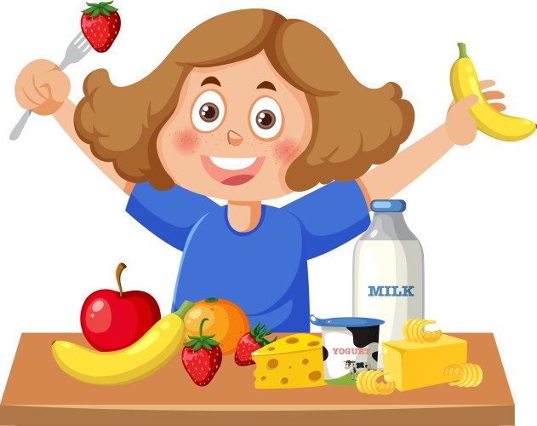
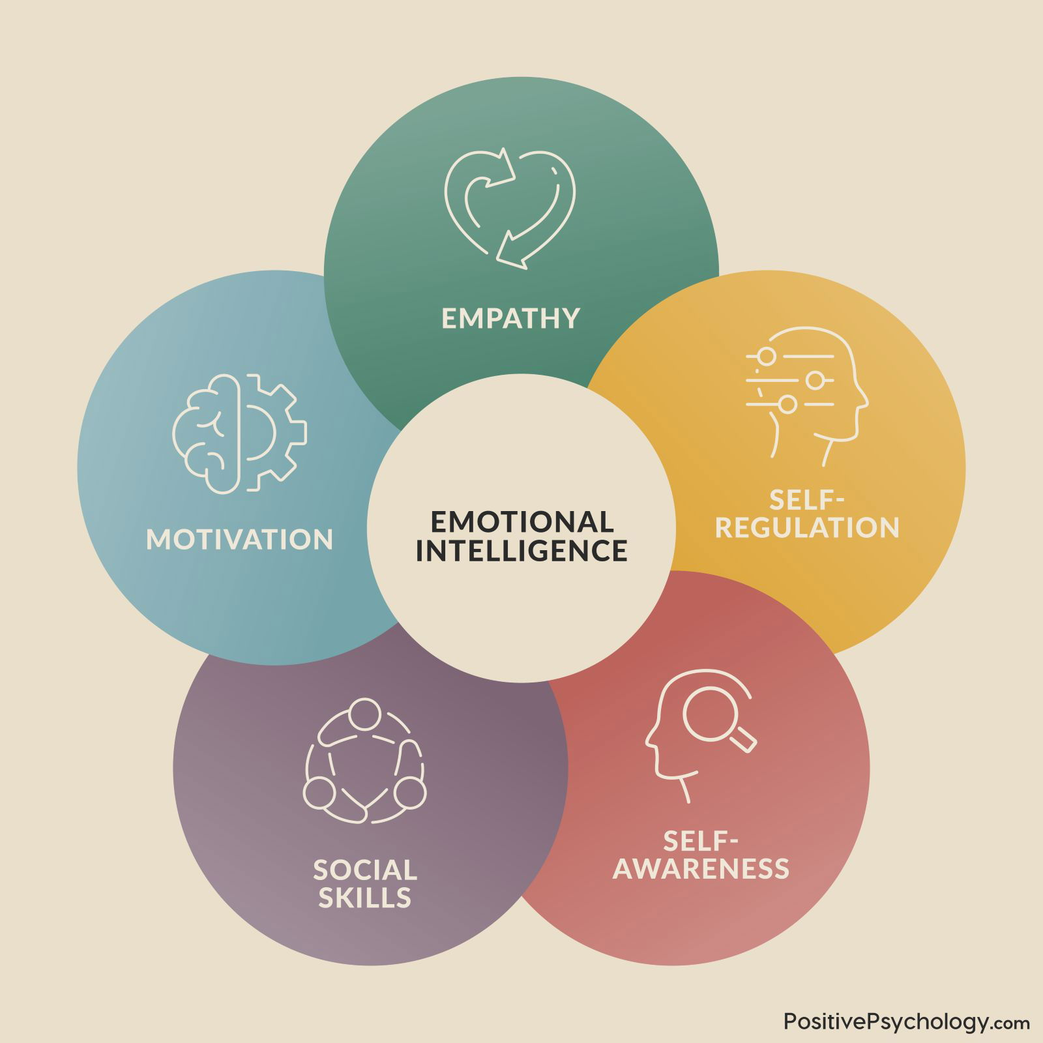

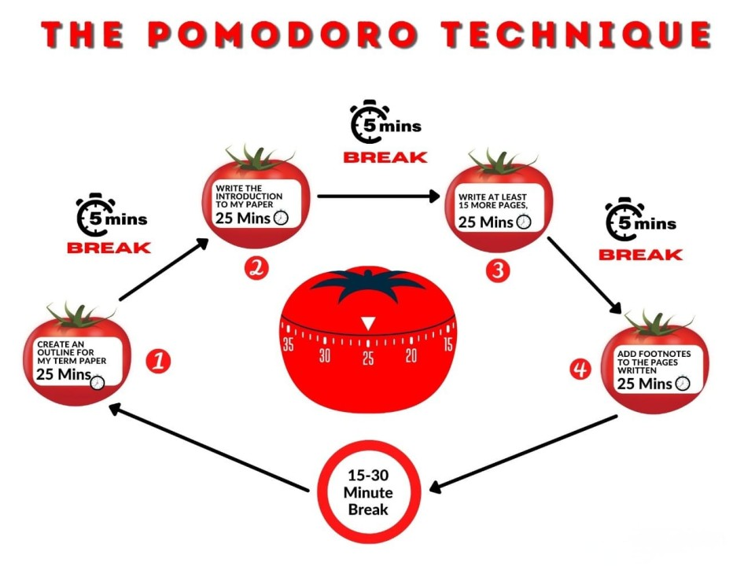


"If you are tuned out of your own emotions, you will be poor at reading them in other people" - Daniel Goleman
1.Time Management
Emotional Intelligence
1.Healthy Eating
2.Walking Outside
2.Study Habits
3.Watching
3.Motivation/Goals

Slide 3
References
Channell, M. (2021). Daniel Goleman’s Emotional Intelligence in Leadership: How to Improve Motivation in Your Team. [online] TSW Training. Available at: https://www.tsw.co.uk/blog/leadership-and-management/daniel-goleman-emotional-intelligence/.
Chowdhury, M. (2019). How To Improve Emotional Intelligence Through Training. [online] PositivePsychology.com. Available at: https://positivepsychology.com/emotional-intelligence-training/.
Scroggs, L. (n.d.). The pomodoro technique — why it works & how to do it. [online] Todoist. Available at: https://www.todoist.com/productivity-methods/pomodoro-technique.
Cherry, K. (2023). Motivation: The driving force behind our actions. [online] Verywell Mind. Available at: https://www.verywellmind.com/what-is-motivation-2795378.
‌Jackson, K. (2022). What Is Time Management? [online] www.mindtools.com. Available at: https://www.mindtools.com/arb6j5a/what-is-time-management.
‌EEF. (2022). EEF guest blog: Building study habits and revision routines. [online] Available at: https://educationendowmentfoundation.org.uk/news/eef-guest-blog-building-study-habits-and-revision-routines.
‌

