Slide 1
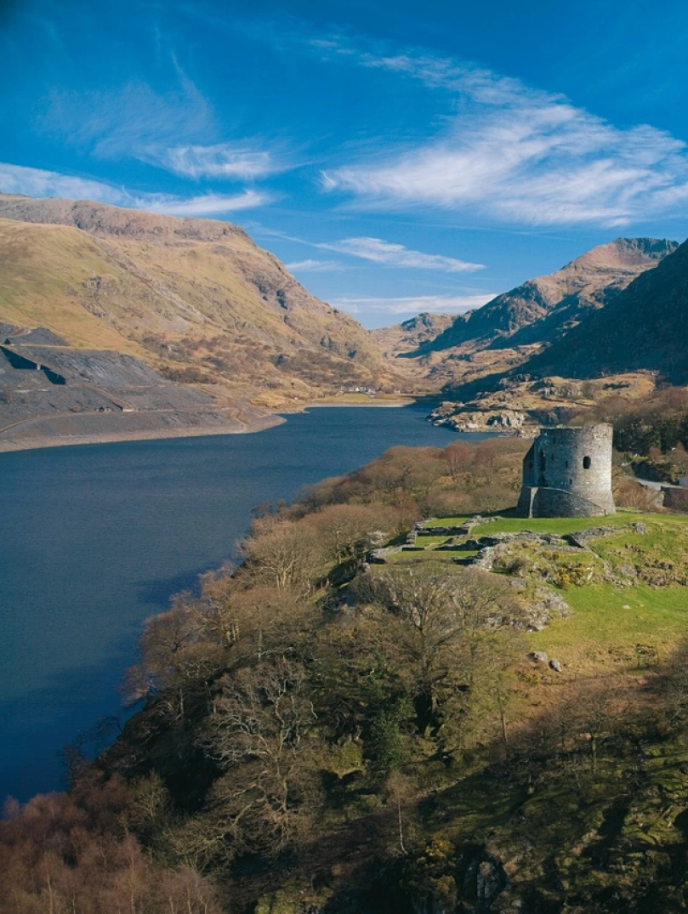
Event: Wales’ Nature and Wildlife Photography Exhibition
Module Code: BMIH6007
International Meetings Management
Danu Mihalachi
2022840
Figure 1: Wales’ Nature
Source: Visit Wales, 2025

Slide 2
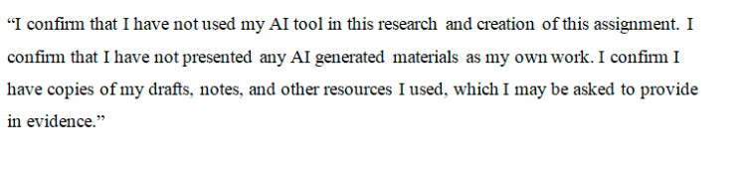
AI Declaration

Slide 3
Introduction
The Wales Nature and Wildlife Photography Exhibition is a unique event that aims to appreciate the beauty of Wales' landscapes and wildlife.
However, the event aims to aid the “Year of Croeso 2025” by welcoming visitors worldwide and presenting the country's nature, culture, and benevolent atmosphere
Therefore, the purpose of this event is to encourage sustainable tourism, preserve the environment and make people feel a closer connection to Wales and its natural wonders.

Slide 4
Event Focus
A photography exhibition showcasing stunning images of Welsh landscapes and wildlife.
Highlights the natural beauty, biodiversity, and heritage of Wales
Location
Snowdonia National Park Known for rugged mountains, rare species, and iconic scenery.
Brecon Beacons A designated Dark Sky Reserve with rich wildlife and rolling hills.
Why the Event Was Selected
Appeals to nature lovers, photographers, tourists, and cultural enthusiasts.
Date
June–July 2025
Aligned with Wales' peak tourist season to maximise attendance and visibility.
Venue Suitability
Outdoor and indoor exhibit spaces available in visitor centres and natural trails.
Event Planning and Strategic Objectives
To pull more than 5,000 local and international visitors between Jun and July 2025.
To raise at least £ 150,000 in ticket sales, branded merchandise and sponsorships.
To obtain three important tourism sponsors by April 2025 for the promotion and backing of the event.
.

Slide 5
SWOT Analysis
Strength Unique, original concept blending art, nature, and tourism (Smith, 2012). Strong alignment with Year of Croeso 2025 and Welsh tourism strategy. Use of iconic, high-traffic locations (Snowdonia & Brecon Beacons). Appeals to a broad market: tourists, nature lovers, and photographers. Promotes sustainable and cultural tourism, enhancing Wales’ global image. | Weakness The outdoor setting may be weather-dependent Limited indoor space at rural venues could restrict exhibit size Logistical challenges in managing events across two national parks. Reliance on sponsorship and grants for financial support. Seasonal timing may limit long-term audience engagement
Opportunity Potential for long-term partnerships with tourism, conservation, and arts. Can attract international media and photography networks. Opportunity to involve local communities and eco-friendly businesses. Expand into digital exhibitions and photo competitions globally. | Threats Potential disruptions from weather or unforeseen events strike (Rogers, 2013). Competition from other summer festivals and outdoor events. Rising costs (inflation) may affect the budget and visitor spending. Environmental risks and preservation regulations may limit event scale.

Slide 6
Market Analysis
Category | Details
Behavioral | Visitors are likely to be environmentally conscious and actively seek sustainable and meaningful travel experiences (O’Toole, 2011). They show strong engagement on social media, are interested in ecotourism, and often participate in cultural events. They are more willing to pay for quality, ethical, and educational experiences.
Psychographics | The target audience values nature, creativity, and conservation. They will likely have strong interests in wildlife, photography, environmental protection, and outdoor adventures (O’Toole, 2011). Many align their leisure choices with personal values such as sustainability, mindfulness, and cultural appreciation.
Demographics | Target groups include adults aged 25–55, typically of middle to upper-middle income. They may be solo travellers, couples, or small families. Occupations include creatives, professionals, academics, and retirees. Education levels are generally above average, with many holding degrees (Getz and Page, 2020).
Geography | The domestic market includes visitors from the UK, particularly urban centres like London, Manchester, Cardiff, and Bristol. The international market includes eco-tourists from Europe, Germany, the Netherlands, Scandinavia, and North America, especially among wildlife photographers (Getz and Page, 2020).
Competitors | Competing events include the Royal Welsh Show, Hay Festival, and Green Man Festival, which attract similar demographics but focus on agriculture, literature, or music (Meredith et al., 2021). However, none specifically offer a focused, nature-based photography exhibition, making this event unique in its theme and format within the Welsh tourism calendar.
The marketing strategy will be centred on digital platforms such as social media campaigns, email newsletters, and event-centred web content.
However, early-bird ticket offers will make people book in advance, while a photography competition will bring enthusiasts and publicity materials (Yen et al., 2023).
Collaborations with Visit Wales and the regional tourism boards will enable us to gain more reach (Ormerod and Wood, 2020).

Slide 7
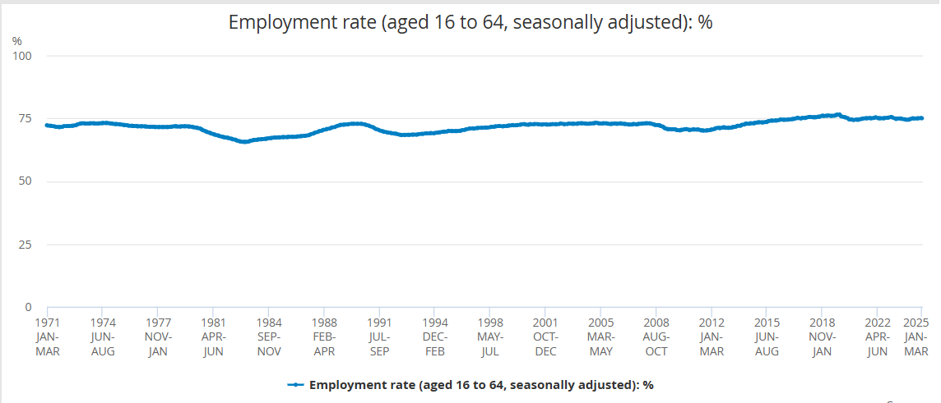
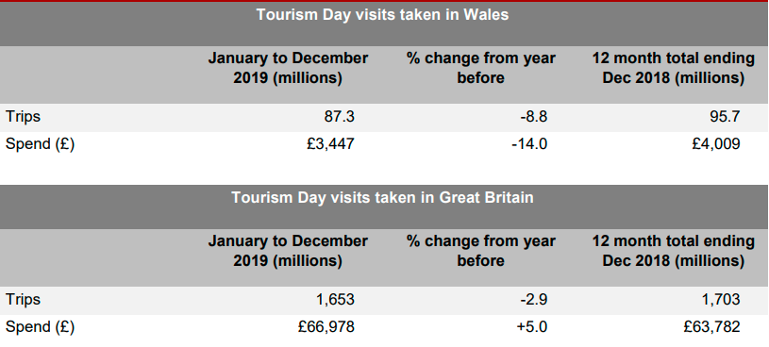
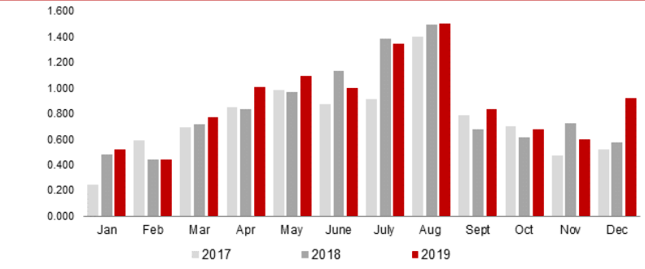
Market Research
The graph shows that the employment rate in the UK gradually increases from 2018 to 2025.
Figure 5: Employment rate in the UK
Source: (Office for National Statistics, 2024)
The table demonstrated that tourism visits in Wales reduced by 8.8% compared to 2018. However, in the context of Great Britain, the trip decreased by 2.9% compared to 2018.
Figure 6: Volume of Trips and Expenditure on Tourism Day Visits
Source: (Gov.Wales, 2019)
The graph demonstrates that the highest visits are in June, July and August as compared to other months respectively.
Figure 7: Monthly volume of overnight trips in Wales
Source: (Gov. Wales, 2019)

Slide 8
Venue and Location Feasibility
The exhibition will be held in Snowdonia National Park and the Brecon Beacons in two famous Welsh locations.
According to Sorrentino et al. (2020), advance permissions from the authorities in parks will be secured.
Moreover, Snowdonia delivers breathtaking mountain views and one-of-a-kind wildlife; the Brecon Beacons offers dark sky status and a beautiful environment

Slide 9
Operational Planning
The number of core staff required for the event is at least 10, including planners, curators, digital managers, and guides.
According to Brady and Prior (2020), coordination in terms of two National Parks will adhere to severe conservation guidelines and health and safety standards.
Moreover, some key resources needed are good exhibition panels, lighting, temporary structures, portable toilets, signage, ticket booths and security
Twenty other volunteer student photographers, including local ambassadors, will help with logistics and visitor interaction (Heimlich, 2020).

Slide 10
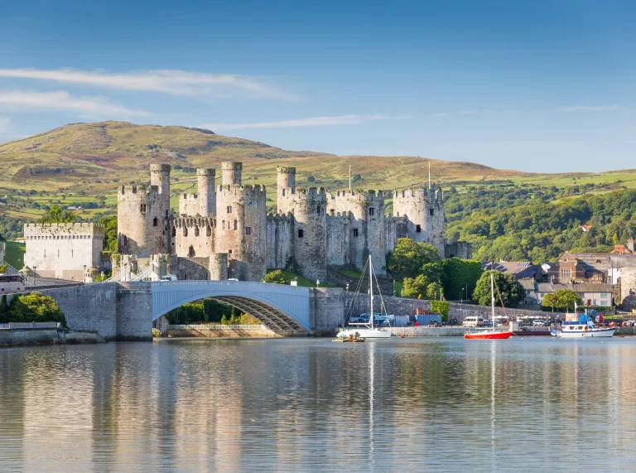
Financial Cost and Budget Breakdown
Revenue Sources
Projected Surplus
Source | Income (£)
Ticket Sales (5,000 x £15) | 75,000
Sponsorship & Grants | 30,000
Merchandise | 12,000
Total Estimated Income | 117,000
£14,700 This surplus provides financial stability, flexibility and contingency provision.
Estimated cost
Category | Cost (£)
Venue Setup & Rentals | 35,000
Staffing | 20,000
Marketing & Promotion | 18,000
Equipment & Tech | 15,000
Permits & Insurance | 5,000
Contingency (10%) | 9,300
Total Estimated Cost | 102,300
Figure 2: Wales’ Nature
Source: Wales.com, 2025

Slide 11
Stakeholder Analysis
Stakeholder Group | Power | Interest | Strategy (Management Approach)
National Park Authorities | High | High | Manage and engage regularly for permits, site access, and environmental compliance.
Visit Wales / Welsh Tourism Board | High | High | Manage the key funders and strategic partners, ensure active collaboration.
Local Councils & Communities | Medium | High | Provide regular updates, and be involved in planning to ensure local support (Fox et al., 2014).
Sponsors (Canon, Nikon, etc.) | High | Medium | Keep satisfied, deliver ROI, and visibility through branding and promotion (Rogers, 2013).
Visitors / Tourists | Low | High | Keep informed by using social media, newsletters, and on-site information.

Slide 12
Conclusion
Conclusively, the Wales’ Nature and Wildlife Photography Exhibition is a well-consistent, culturally significant, and economical event promoting the Year of Croeso 2025
Moreover, using a mixed exploration of ecotourism, art, education, and sustainability provides a unique visitor experience that raises Welsh identity and natural beauty
Subsequently, the event enhances local economies, facilitates environmental consciousness, and provides prospects for coordination in tourism, conservation, and creative spheres

Slide 13
Adnan, N., Rashed, M.F. and Ali, W. (2024). Embracing the metaverse: cultivating sustainable tourism growth on a global scale. Current Issues in Tourism, pp.1–20. doi:https://doi.org/10.1080/13683500.2024.2390678.
Antonio Cavallin Toscani, Luca Vendraminelli and Vinelli, A. (2024). Environmental sustainability in the event industry: a systematic review and a research agenda. Journal of Sustainable Tourism, 32(12), pp.1–35. doi:https://doi.org/10.1080/09669582.2024.2309544.
Brady, E. and Prior, J. (2020). Environmental aesthetics: A synthetic review. People and Nature, [online] 2(2), pp.254–266. doi:https://doi.org/10.1002/pan3.10089.
Brewer, C.A., Hutton, A., Hammad, K.S. and Geale, S.K. (2020). A feasibility study on disaster preparedness in regional and rural emergency departments in New South Wales: Nurses self-assessment of knowledge, skills and preparation for disaster management. Australasian Emergency Care, 23(1), pp.29–36. doi:https://doi.org/10.1016/j.auec.2019.12.005.
Carlisle, S., Zaki, K., Ahmed, M., Dixey, L. and McLoughlin, E. (2021). The imperative to address sustainability skills gaps in tourism in Wales. Sustainability (Switzerland), [online] 13(3), pp.1–19. doi:https://doi.org/10.3390/su13031161.
Feyers, S., Stein, T. and Klizentyte, K. (2019). Bridging Worlds: Utilizing a Multi-Stakeholder Framework to Create Extension–Tourism Partnerships. Sustainability, 12(1), p.80. doi:https://doi.org/10.3390/su12010080.
Fox, D., Gouthro, M.B., Morakabati, Y. and Brackstone, J. (2014). Doing events research: from theory to practice. London: Routledge, Taylor & Francis Group.
Getz, D. and Page, S.J. (2020). Event Studies : theory, Research and Policy for Planned Events. 4th ed. London: Routledge.
gov.wales (2019). Main Points. [online] Available at: https://www.gov.wales/sites/default/files/statistics-and-research/2020-06/wales-tourism-performance-january-to-december-2019-208.pdf.
Heimlich, T. (2020). Romantic Wales and the Imperial Picturesque. Modern Language Quarterly, 81(2), pp.169–192. doi:https://doi.org/10.1215/00267929-8151559.
Hestler, A., Jo-Ann Spilling and Scirri, K. (2020). Wales. Cavendish Square Publishing, LLC.
Higham, G. (2024). Developing personal integration projects through a Welsh language provision for adult migrants in Wales. Routledge eBooks, pp.115–141. doi:https://doi.org/10.4324/9781003342892-6.
Meredith, J.R., Shafer, S.M. and Mantel, S.J. (2021). Project management: a managerial approach. Milton Qld: John Wiley And Son Australia, Ltd.
O’Toole, W. (2011). Event feasibility. Butterworth-Heinemann.
Office for National Statistics (2024). Employment Rate (aged 16 to 64, Seasonally adjusted) - Office for National Statistics. [online] Ons.gov.uk. Available at: https://www.ons.gov.uk/employmentandlabourmarket/peopleinwork/employmentandemployeetypes/timeseries/lf24/lms.
Ormerod, N. and Wood, E.H. (2020). Regional Event Tourism Funding Policies: A Strategic-Relational Critique of Current Practice. Journal of Travel Research, 60(4), p.004728752091363. doi:https://doi.org/10.1177/0047287520913631.
Rogers, T. (2013). Conferences and conventions: a global industry. 3rd ed. Abingdon; New York: Routledge, Cop.
Smith, A. (2012). Events and Urban Regeneration. Routledge.
Sorrentino, A., Fu, X., Romano, R., Quintano, M. and Risitano, M. (2020). Measuring event experience and its behavioral consequences in the context of a sports mega-event. Journal of Hospitality and Tourism Insights, 3(5), pp.589–605. doi:https://doi.org/10.1108/jhti-03-2020-0026.
Visit Wales (2025) Visit Wales. Available at: https://www.visitwales.com/en-us (Accessed: 18 May 2025).
Yen, D.A., Jang, J.-H., Wei, L., Morgan, N. and Pritchard, A. (2023). Leveraging folklore and fantasy to promote small destinations: the case of Visit Wales. Journal of Policy Research in Tourism, Leisure and Events, pp.1–15. doi:https://doi.org/10.1080/19407963.2023.2263860.
Wales.com (2025) Where is Wales?. Available at: https://www.wales.com/about/welcome-wales/where-wales (Accessed: 16 May 2025).

