Slide 1

BUSINESS PLAN
NAME OF THE STUDENTS:
FLORICA SORINA BRATU 2109991
MIHAI NICOLAE TINCU 2109992
IOANA ANDREEA DUMITRU 2025727
GROUP: B
LECTURER NAME: RAJESH KUMAR
MODULE: BMSW4006

Slide 2

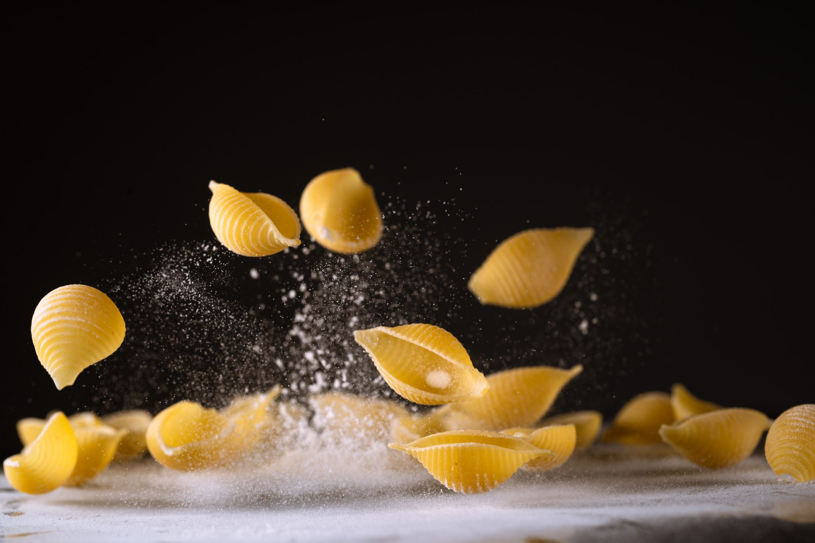

Executive Summary
ENJOY ITALY PASTA BAR :
- freshly cooked pasta
-short cooking time with sauce and pasta at the choice,
- excellent customer service;
- cheerful atmosphere, promoting an energetic lifestyle.
Notes:
We are making the pasta fresh, in front of our customers, making the waiting time more pleasant watching the show.
We offer the opportunity to our customers to chouse the type of the pasta and the type of the sauce to combine them.

Slide 3
Business / Company Overview
Location: Leamington Spa;
Company: ENJOY ITALY PASTA BAR
Mission: to be one of the most successful food trucks in town
Legal structure: General Partenership,
Notes:
1. As entrepreneurs, we want to make a modern change and attract as many young people as possible
2. Mission: to be one of the most successful food trucks in Leamington Spa, entering the market with a point of sale located outside a mall.
We will sell the goods starting from bulk pasta, to pasta cooked in Italian style and we will serve high quality food.
ENJOY ITALY PASTA BAR intend to respond to most of the needs of teenagers and young people such as fast food, tasty food, affordable price.

Slide 4
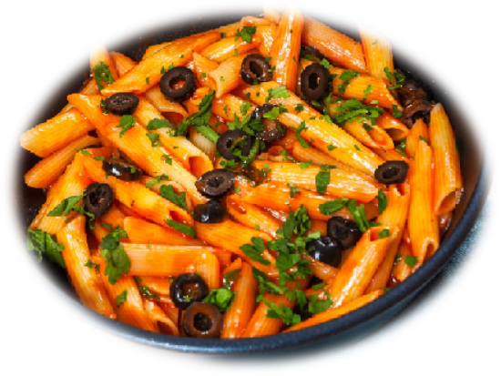
Products and Services
we produce fresh, easy-to-cook pasta.
the only pasta producers and traders in town;
The pasta has a weight of 450 g per portion, the prices are between 10-13 £.
Customers of all ages will buy this product,
Notes:
This product satisfies one of the primary physiological needs of food.
We will be the only pasta producers and traders on an itinerant basis in Leamington Spa.
Compared to other products on the market, we produce fresh, easy-to-cook pasta.
Customers of all ages will buy this product, especially young people being more interested in trying new things.

Slide 5
Market audit-Competitor’s Analysis
Factors | Our company | Competitor A | Competitor B
Products | Fresh pasta at the customer choice, at good price, | Individual price, | Individual price
Key success factors | - well-trained staff; - varied menu;
Past and current strategies | Past: Good price at start, Current: develop our equipment, | Past: Individual price, Current: old on the market, current customers. | Past: small price. Current: bigger prices.
Advertising front | Internet advertising: instagram, facebook, google. | Google | Their own site,
Strengths and weaknesses | S:- prices are advantageous in terms of quality / price compared to competitors' prices; prices are advantageous in terms of quality / price compared to competitors' prices; | S: 10 year on the market, W: the equipment is old, | S: good price, W: waiting time is bigger
Notes:
The competition in the Mall area is threatening, because fast foods around. There are usually at least two fast foods restaurants in the same industry within a one mile radius.
In our case, it does not exist, being the only ones that sell pasta.
ENJOY ITALY PASTA BAR have several advantages over its main competitors:
- prices are advantageous in terms of quality / price compared to competitors' prices;
- there will be a home delivery service for customers, DELIVERO, TAKEAWAY, UBER,
- varied menu;
- well-trained staff;
-in summer we can place an annex to the food truck where we will put tables and chairs for customers

Slide 6
Market Audit-SWOT Analysis
Strength | Weaknesses | Opportunities | Threats
Live cooking | Limited menu | Business development: | Weather,
Fresh pasta | Short life products | -as a franchise, | Bigger developers,
Fast service | Limited space | -as a limited restaurant, | Staff shortages
Notes:
Strength – we are using our services as a live cooking show combined freshly home made pastas together with fast service.
Weaknesses- we use a Limited menu because short life products and limited space.
Opportunities – as a business we might develop our company in the future in to a franchise and an restaurant as well.
Threats – the weather is playing a major role in our food truck business. The people are not attracted to work in a food track and this might cause staff shortages.

Slide 7
Market Audit-PESTLE Analysis
Political: | Economical | Social | Technological | Legal | Environmental
International trading products | Bigger expenses with electricity and petrol, | Not everyone agreed with Italian culture, | This business have the option to use varieties of equipment for speed service, | Hard to get a food and health /safety licence being a food truck. | Using a petrol electricity generator.
Restrictions for future employees, | Minimum wage increased, |  |  |  | Affecting the environment by pollution because of the car.
Notes:
We found out that we might be affected by some external factors such as POLITICAL in terms of international trading (import) or restrictions for future employees caused by the Brexit.
For ECONOMICAL factor we have bigger amount of money spent on electricity and petrol this is caused by prices rise on this section and also the minimum wage has increase to.
SOCIAL because our business is based in a city where people might have different cultures not every one will agree Italian culture.
On the TECHNOLOGICAL this will not be a threat because we consider as a benefit to have the option to use the last equipment on the market for a speed service.
Regarding the LEGAL factor is going to be Hard to get a food and health /safety licence being a food truck comparing with the restaurant kitchen.
Environmental Using a petrol electricity generator we affecting the environment by pollution because of the car emissions.

Slide 8
Target Market
The target market is represented by the potential customers.
Target segment want's: tasty and varied food, fast food, cheerful atmosphere, clean, friendly, and attractive environment.
The ideal customers are between 10-45 years old, they want to try fresh and different flavors in terms of gastronomy. We will live up to their expectations with an adult menu and a special children's menu.
Notes:
We deliver products that everyone with any type of income can afford it, also the kids being accompanied by the adults.
People over 45 in general are more conservators and most of them prefer classic environment of a restaurant.
But some other people over or under the age which are open to try our products are welcome to.

Slide 9
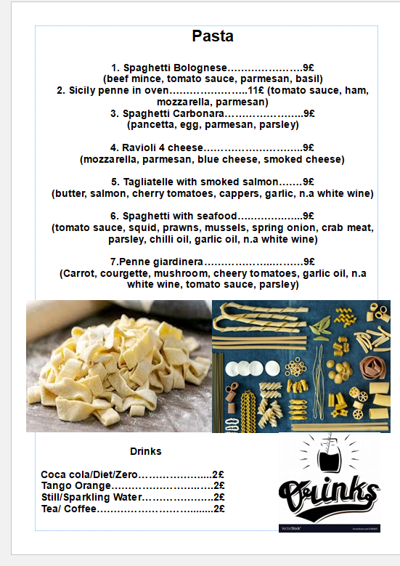

Marketing and sales plan
We offer fast service and fresh products.
We are expecting to sell between 80-100 portions per day.
The regular customers can benefit from discounts on our products.
The customer will find us on Facebook/Instagram/Twitter

Slide 10
Management Team
Operational Manager / Accountant: order products, dealing with suppliers, searching for the best deals and
Chef: Stock management / Cooking fresh food / Following food and safety legislation
Cashier : Manage the transaction with the customers / Ensure prices are accurate / collect payment / Issue receipts (refund/change)
Notes:
Manager/ Accountant: Manager's job is to maintain a good relation with the suppliers, dealing with them for the best prices, answer to all the feedback's satisfied or unsatisfied of the costumers, dealing with all the issues that could appear during the day at workplace, being updated with the competitors offerts and prices.
Chef: Chef must deliver the best dishes all the time, improving and implementing new recipes. He will manage stock after the FIFO method taking care of the products to deliver fresh ingredients all the time, maintaining a clean, sanitize and safe environment in the kitchen.
Cashier: Cashier must to manage the transaction with the customer, need to assist customers to help them choose the best dish for them explaining how it works. Keep reports of all the transactions, issue receipts for transaction card or cash and bagging all the packages and to provide an excellent customer service.

Slide 11
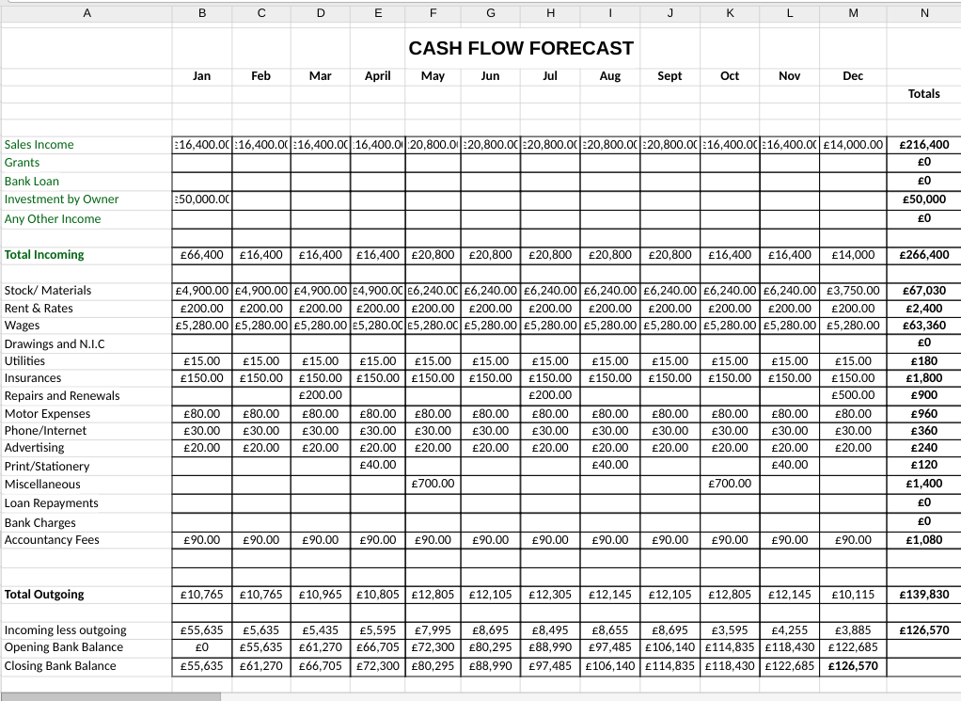
Notes:
From January - April we have an standard income, based on the fact that we are expecting customers between 80-100 for the following months.
From May-September we have forecasting an income based on 100 customers, expecting in October and November to recall an income of 16,400 £ like in the months before, and in December sales it will decrease until 14,000 £ because of Christmas Event when regular customer are spending money for gifts.

Slide 12
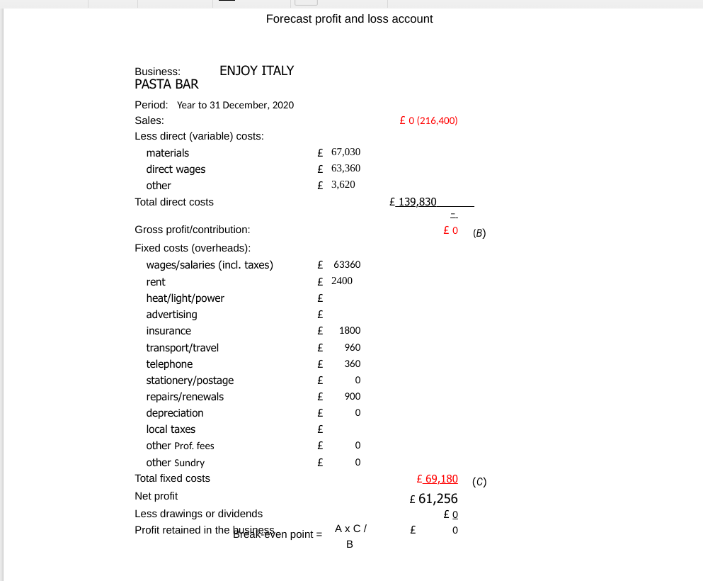

Slide 13



