Slide 1
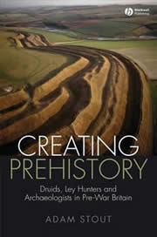
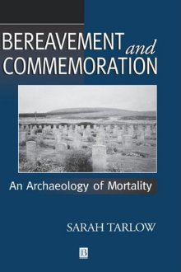
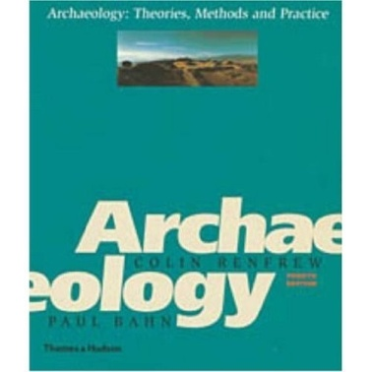
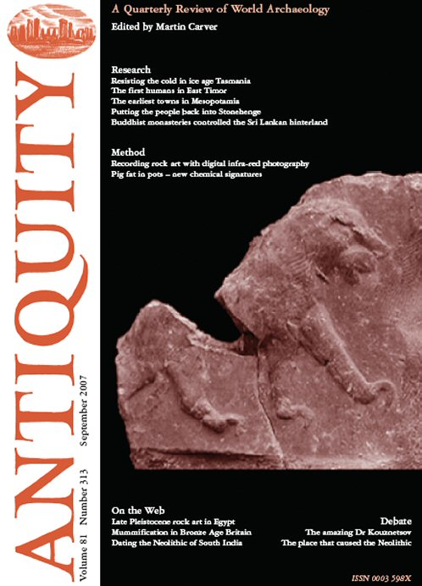
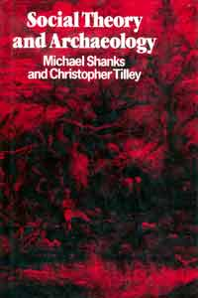
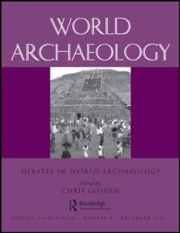
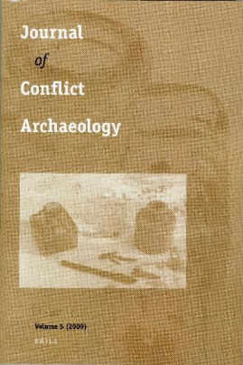
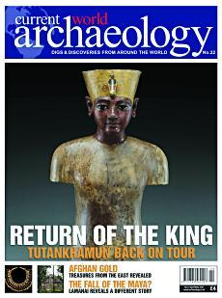
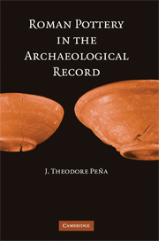
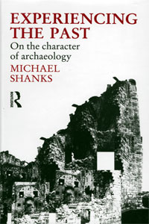
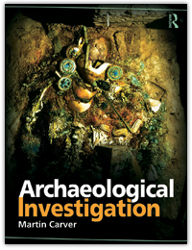
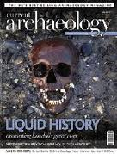
Writing archaeology
increasingly television and the Internet are used to disseminate archaeological work
BUT the basic method remains through print media in pamphlets, journals and books.
archaeological texts come in many different guises, ranging from the amateur to professional and popular to academic.

Slide 2

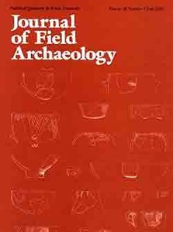
Much of the primary evidence derived from archaeology is published in journals and reports.
Journals range from those published by local archaeological or antiquarian societies through to others with international distributions such as
Antiquity
World Archaeology
Journal of Field Archaeology.
These three are published independently but others with very high profiles are published by interest groups, such as, the Proceedings of the Prehistoric Society or the Journal of the Royal Anthropological Institute, which, despite the title, often publishes articles of archaeological interest (as does Current Anthropology, an American counterpart that is funded by The Wenner-Gren Foundation for Anthropological Research).
Many important papers are published in journals and usually these are rigorously reviewed and edited prior to publication, but this may not be the only source for information about a particular find or site.

Slide 3
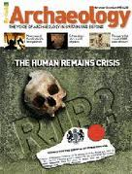
Many archaeologists will publish their research in different places to reach a wide audience so a more popular version of a site report may be found in magazines such as
Current Archaeology (www.archaeology.co.uk )
or
British Archaeology (www.britarch.ac.uk/ba/ba.html).
These can be useful places to find out what the latest news is.

Slide 4
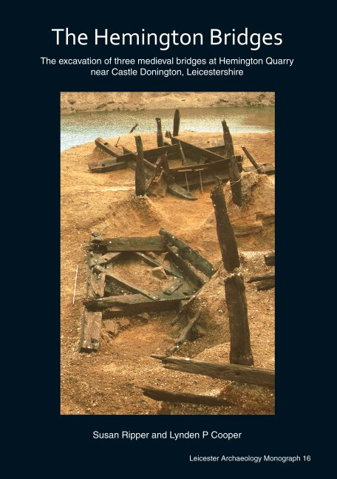
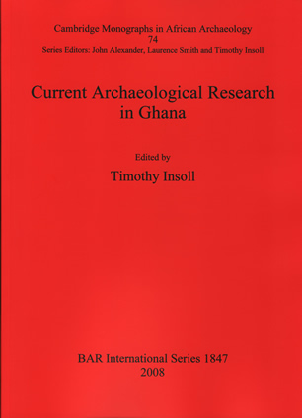
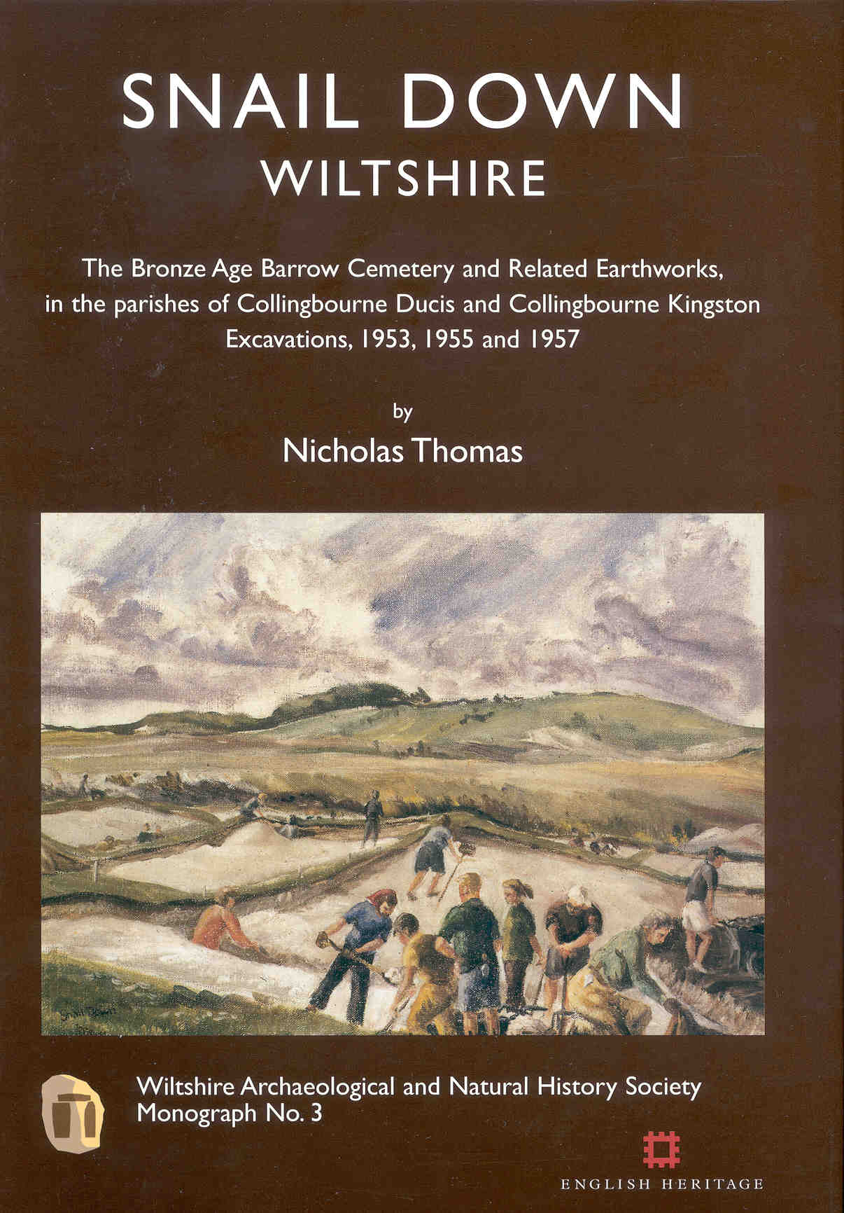
The final site report will often appear as a monograph with all the detail required in a series such as that produced by the Council of British Archaeology (www.britarch.ac.uk) or the British Archaeological Reports series (www.archaeopress.com).

Slide 5
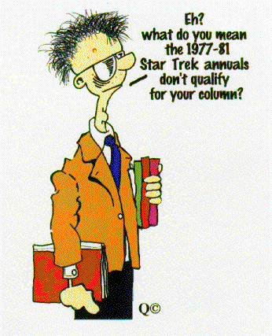
Perhaps one of the most difficult tasks for the discerning student of archaeology is to assess the appropriateness of the masses of books claiming to provide archaeological information and analyses.
There are thousands of titles that at first glance appear to offer the type of detailed accounts and expert analyses that one would expect in a scholarly text, but this is often not the case.
A good indication is the publisher. Check that the volume is produced by an established academic publisher; this is easy to identify if the volume is by a university press, but there are many commercial academic publishers that also have the high standards we would hope for such as Routledge or Blackwell of Oxford.

Slide 6
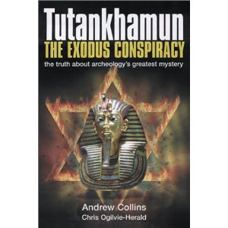
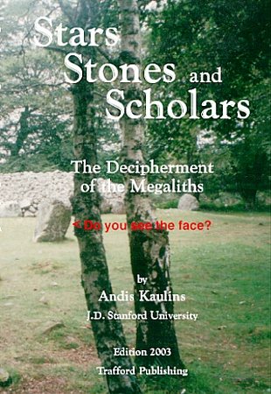
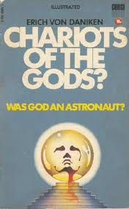
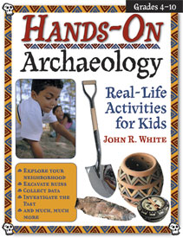
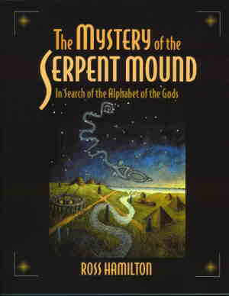
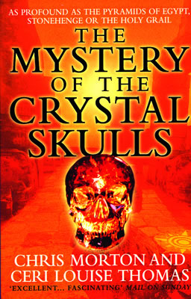
There are also publishers that operate at the more popular end of the market, but publish scholarly work, these include Sutton and Tempus.
An important indication to the value of a work is if there is detailed referencing in the text and full bibliographic information of this referencing either in footnotes, endnotes or separate bibliography.
Books with the terms ‘celtic’, ‘mystery’, ‘mythical’, ‘civilisation(s)’ or ‘lost’ in the titles should be assessed with particular care.

Slide 7
Discourse
There is room for a variety of publications that will suit a variety of readers with different levels of interest and ability.
Archaeological reports are notoriously tough to read and are presented in a conventional style that is written for a professional audience.
Other, academic works can also be written in a way that is difficult for non-archaeologists to understand with specialised terminology and a certain amount of assumed knowledge on the part of the reader.
Such writing is termed discourse, which is the language of the discipline.
Specialised language risks excluding people who are not privy to the language and codes of the particular discourse. However, it also can be argued that specialised language provides easy communication between people in the same discipline.
The television programme Time Team is a good example of archaeological discourse incorporating a greater population where 'geophys', the shorthand term for geophysical surveying, is regularly used and now commonly understood by the regular non-professional audience.

Slide 8
Narrative
Ultimately the main aim of writing in archaeology is the creation of a narrative, which is a structured way of telling a story that has a beginning, middle and end.
If archaeologists use discourse to tell a narrative, then they are generally excluding a non-specialist audience.
The detail required of archaeological research reports means that the actual story of the site, or how it fits into the broader temporal and spatial picture, is often subsumed and difficult to identify.
In order to provide this information archaeologists are required to write works of synthesis that places the archaeological information in a narrative that might tell quite broad or rather more specific narratives.
These might tell stories of a specific artefact type, period or region, e.g., Bronze Age Metalwork, Stone Age Britain and Prehistoric Wales respectively.

Slide 9
The politics of writing in archaeology
The ideal situation is that the archaeological past should be accessible to all those who wish to participate in its understanding, its production and interpretation.
A political decision, whether personal or mandated through an institution or organisation, has to be made to produce not only the reports required by the discourse of the discipline, but also the production of narratives accessible to different levels of audience.
Thus narratives published in pamphlets and books are written for children of different ages and adults from a variety of educational and social backgrounds.
Access to archaeology in the UK is being attempted through community archaeology projects, which aim to enfranchise local people in relation to their archaeology. As with the decisions in relation to the writing of archaeology such projects are inherently, if not explicitly, politically motivated.

