Slide 1
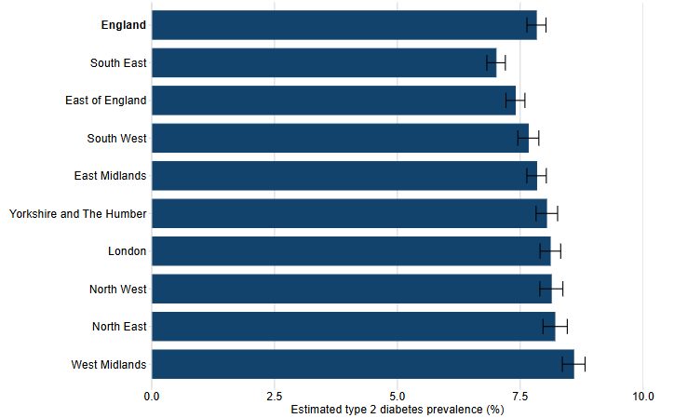
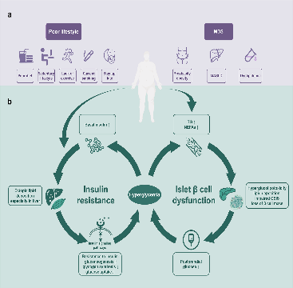
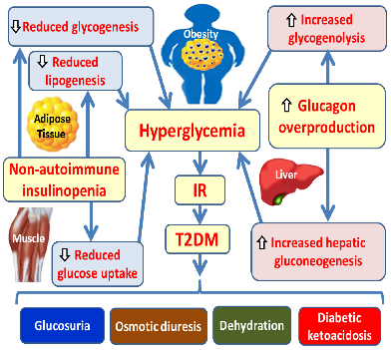
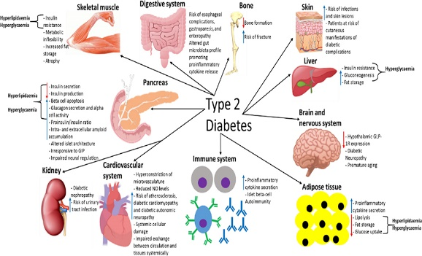
Barriers and Facilitators to Self-Management of Type 2 Diabetes Among Older Adults in UK Primary Care: A Systematic Review
Student Details
Meetkumar Sangani
Student ID : 2435003
Programme: MSc Public Health & Social Care in Practice
Supervisor : Tonia Babalola
Background & Prevalence
Type 2 Diabetes Mellitus (T2DM) is a chronic metabolic condition characterised by insulin resistance and progressive hyperglycaemia, disproportionately affecting older adults. In the UK, primary care supports diabetes management through structured reviews and education (Ernawati, Wihastuti and Utami, 2021). However, older adults above 45 often face age-related and social barriers (Chandrasekaran and Weiskirchen, 2024). The number of people living with diabetes rose from 200 million in 1990 to 830 million in 2022 worldwide (WHO, 2024) and over 4.3 million people in the UK have diabetes, 90% with T2DM, with prevalence highest in those aged 60+ (Diabetes UK, 2023). Poor self-management increases risk of complications and hospital admissions (Luciana Mascarenhas Fonseca et al., 2024).
Research Impact
This systematic review will synthesise evidence on barriers and facilitators to Type 2 diabetes self-management among older adults in UK primary care. Findings will support patient-centred care by highlighting factors that influence adherence to diet, physical activity, medication and glucose monitoring. It will inform primary care services (e.g., tailored education, review processes, social prescribing and multidisciplinary support) and guide professionals to address health literacy, multimorbidity and social isolation. The review may also inform policy and future intervention design to reduce complications, hospital admissions and inequalities (Diabetes UK, 2019).
Rationale for the Study
Although national guidelines provide clear recommendations for diabetes self-management, many older adults experience difficulties sustaining long-term behavioural changes. Existing research often focuses on broader adult populations, with limited emphasis on the specific needs of older adults within UK primary care contexts (Diabetes UK, 2019). Age-related factors such as multimorbidity, cognitive decline, reduced mobility and social isolation may uniquely influence adherence to dietary, medication and monitoring regimens. Furthermore, qualitative insights into older adults’ lived experiences remain fragmented, limiting understanding of how personal, social and healthcare-system factors interact in real-world practice (Smaje et al., 2018).
Research Design
Research Question: What barriers and facilitators influence self-management behaviours among older adults above 45 years with Type 2 diabetes in UK primary care settings?
Aim: To systematically review existing evidence on barriers and facilitators influencing self-management of Type 2 diabetes among older adults in UK primary care.
Objectives:
To identify recommended self-management behaviours for older adults with T2DM.
To examine personal, social and healthcare-system barriers affecting adherence.
To analyse facilitators and support mechanisms that enhance effective management.
To identify gaps in current literature and implications for health and social care practice (Jyoti Jyotsana et al., 2024).
References
Chandrasekaran, P. and Weiskirchen, R. (2024). The role of obesity in type 2 diabetes mellitus—an overview. International Journal of Molecular Sciences, [online] 25(3), pp.1882–1882. doi: https://doi.org/10.3390/ijms25031882.
Dambha-Miller, H., Simpson, G., Hobson, L., Roderick, P., Little, P., Everitt, H. and Santer, M. (2021). Integrated primary care and social services for older adults with multimorbidity in England: a scoping review. BMC Geriatrics, [online] 21(1). doi: https://doi.org/10.1186/s12877-021-02618-8.
Diabetes UK (2019). Diabetes and Emotional Health - a Practical Guide for Healthcare Professionals Supporting Adults with Type 1 and Type 2 Diabetes. [online] Diabetes UK. Available at: https://www.diabetes.org.uk/for-professionals/improving-care/good-practice/psychological-care/emotional-health-professionals-guide.
Diabetes UK (2023). How Many People in the UK Have diabetes? [online] Diabetes UK. Available at: https://www.diabetes.org.uk/about-us/about-the-charity/our-strategy/statistics.
Ernawati, U., Wihastuti, T.A. and Utami, Y.W. (2021). Effectiveness of Diabetes self-management Education (DSME) in Type 2 Diabetes Mellitus (T2DM) patients: Systematic Literature Review. Journal of Public Health Research, 10(2), pp.198–202. doi: https://doi.org/10.4081/jphr.2021.2240.
Jyoti Jyotsana, N., Pandit, N., Sharma, S. and Kumar, L. (2024). Self-care practices and influencing factors among type 2 diabetes mellitus patients: A hospital-based cross-sectional study. Clinical Epidemiology and Global Health, 30, p.101822. doi: https://doi.org/10.1016/j.cegh.2024.101822.
Kozlowska, O., Lumb, A., Tan, G.D. and Rea, R. (2018). Barriers and Facilitators to Integrating Primary and Specialist Healthcare in the United Kingdom: a Narrative Literature Review. Future Healthcare Journal, [online] 5(1), pp.64–80. doi: https://doi.org/10.7861/futurehosp.5-1-64.
Luciana Mascarenhas Fonseca, Schmidt, J., Snoek, F., Weinstock, R., Chaytor, N., Stuckey, H., Ryan, C. and Eelco van Duinkerken (2024). Barriers and Facilitators of Self-Management in Older People with Type 1 Diabetes: A Narrative Review Focusing on Cognitive Impairment. Diabetes, metabolic syndrome and obesity, Volume 17, pp.2403–2417. doi: https://doi.org/10.2147/dmso.s410363.
Smaje, A., Weston-Clark, M., Raj, R., Orlu, M., Davis, D. and Rawle, M. (2018). Factors associated with medication adherence in older patients: A systematic review. Aging Medicine, 1(3), pp.254–266. doi: https://doi.org/10.1002/agm2.12045.
Thomas, S., Fylan, B., Silcock, J. and Rahman, S. (2025). Medication management using technology-based interventions in older people at home care settings: a scoping review protocol (Preprint). JMIR Research Protocols. [online] doi: https://doi.org/10.2196/75200.
Global Burden of Disease Collaborative Network. Global Burden of Disease Study 2021. Results. Institute for Health Metrics and Evaluation. 2024 : https://vizhub.healthdata.org/gbd-results/.

