Slide 1


Social Epidemiology and Public Health Development (LCHS7000)
Component 1 :Group Presentation
Type 2 Diabetes Mellitus (T2DM) Prevention and Early Screening among Adults aged 40-64
Category: Screening
Group Members: DHWANI PATEL
Md. NASIR UDDIN NAHID

Slide 2
Task 1: Introduction & Rationale

Slide 3

Presentation Objectives
This presentation will:
Introduce the importance of diabetes screening for adults aged 40-64.
Apply epidemiological reasoning to justify the target group.
Showcase utilisation of key public health frameworks: Ottawa Charter, HBM, TPB, and Ewles & Simnett.
Present a six-week community-based campaign promoting screening uptake.
Elaborate on how the evaluation will follow Rootman et al.’s (2001) model.
Demonstrate the method in which screening aligns with prevention, equity, and sustainable public health goals.

Slide 4

Understanding Screening
Screening is utilised for identifying individuals with a higher risk of health issues within a healthy population.
It helps in facilitating early treatment and interventions (WHO, 2021).
This approach aims to reduce the incidence or mortality of health problems (WHO, 2021).
The diabetes screening campaign will focus on identifying adults with prediabetes or undiagnosed Type 2 Diabetes.
It will also be promoting regular glucose checks, seeking to encourage proactive health management among adults aged 40-64 and empower them to engage in preventive care.

Slide 5
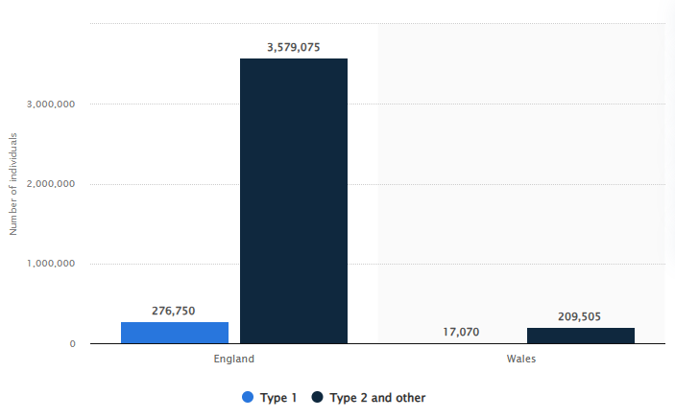
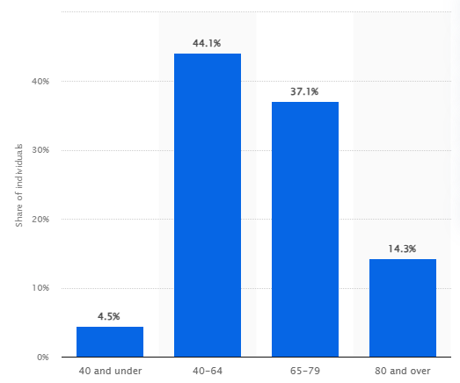
Epidemiological Overview of Type 2 Diabetes
Driven by:
Reduced physical activity
Poor diet
Central obesity
Chronic stress
Socioeconomic deprivation (WHO, 2024)
Of those registered with type 2 diabetes, 44.1% were aged between 40 and 64 years (Gagliardi, 2024b).
More than 3.5 million people in England were recorded with type 2 diabetes between 2023 and 2024 (Gagliardi, 2024a).
Approximately 277 thousand individuals had type 1 diabetes in the same period (Gagliardi, 2024a).
The campaign will apply the epidemiological principles in the first week for targeting a group with high preventive potential:
Incidence
Prevalence
Risk factor analysis

Slide 6
Link Between Epidemiology and Behavioural Health
Epidemiology is a method for reasoning about diseases based on biological inference from observations in population groups (Frérot et al., 2018).
Behavioural science is an interdisciplinary field that studies human behaviour and develops strategies for its modification (OECD, 2024).
Adults aged 40 to 64 years are at heightened risk for Type 2 Diabetes (Gagliardi, 2024b).
Contributing factors include sedentary work, poor dietary access, and stress; hence, it will target adults aged 40-64 years.
The Health Belief Model (HBM), alongside the Theory of Planned Behaviour (TPB), will guide targeted messaging and interventions based on the gathered evidence.
This approach will make sure that the provided prevention strategies are data-driven and behaviorally effective.
The above mentioned models will facilitate effective campaign planning by bridging evidence and actionable strategies.

Slide 7
Public Health Significance
Type 2 Diabetes is a major contributor to cardiovascular disease, kidney failure, blindness, and amputation (WHO, 2024).
In 2021, diabetes and associated kidney disease resulted in over 2 million deaths globally (WHO, 2024).
The direct economic cost of diabetes in the UK for the year 2021/22 was around £10.7 billion
Over 40% of the total expense was allocated to diagnosis and treatment (Hex et al., 2024).
Indirect costs related to diabetes treatment were around £3.3 billion (Hex et al., 2024).
Chronic hyperglycaemia from Type 2 Diabetes, if not treated, has the potential to cause both macrovascular and microvascular complications (Dunn et al., 2025).
A study by Khan et al. (2019) indicates a 58% reduction in new diabetes cases, which was a result after three years due to intensive lifestyle interventions.
“The Balance for Life" will focus on supporting national goals for reducing non-communicable diseases via early detection.
It will focus on reducing non-communicable diseases (NCDs) through early detection. (NHS England, 2023).
It will promote accessible glucose testing, align with the NHS Diabetes Prevention Programme (NDPP) (WHO, 2025).

Slide 8
Social Determinants of Health
Type 2 Diabetes is not random; midlife adults are known to face:
Economic pressures, such as the inability to afford healthy food (UK Parliament, 2023).
Environmental barriers, such as limited green space, along with long commutes (Hill-Briggs, 2020).
Social factors include work stress, along with low health literacy and cultural stigma regarding illness (Kudale et al., 2025).
There are also structural issues such as work shift, childcare, alongside other caring responsibilities.
The campaign will be able to promote equity, along with encouraging inclusive participation by addressing access and awareness in addition to other determinants.

Slide 9
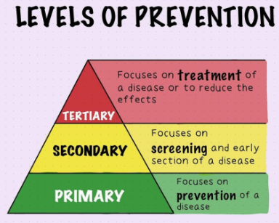
Levels of Prevention
The campaign will mainly operate at the secondary prevention level. This level is based on focusing on detecting early risk through screening (Kisling and Das, 2023).
However, it will also include primary prevention, which will be conducted by providing education on diet, lifestyle change and stress management.
Tertiary prevention will include referring to medical follow-ups.
By combining such levels, the campaign will be able to make sure that such an approach is able to identify risk, along with preventing progression and supporting self-management of prediabetes.

Slide 10


Campaign Rationale & Aims
Rationale
Aims
The campaign will aim to boost diabetes screening participation among individuals aged 45-54.
This age group is identified as being at a metabolic tipping point as it represents a higher risk and greater potential for prevention.
Intervention is cost-effective, reducing the average cost of illness by £605 per detected Type 2 Diabetes case compared to no screening, according to Waugh et al. (2013).
To increase awareness of various diabetes risk factors.
To improve overall screening attendance by 30% within 6 months.
To promote sustained lifestyle change.
Such a combination of epidemiology, behavioural theory, and social determinants will help the campaign to deliver measurable along with equitable impact.

Slide 11
Task 2: Campaign Planning & Design

Slide 12
Ottawa Charter Framework
The Ottawa Charter is known for being based on action to achieve Health for All by the year 2000 and beyond (WHO, 2025b). It will be able to provide a structural backbone to the campaign.
It will help build a healthy public policy by promoting workplace screening.
The campaign will also be developing supportive environments through general along with community partnerships.
Overall, community action will be strengthened by engaging with local volunteers.
Individuals will be able to develop their personal skills through workshops and self-check tools.
Lastly, the campaign will focus on reorienting health services for prioritising preventive screening.
Such actions will help in making sure that the campaign remains empowering, inclusive, and sustainable in nature.

Slide 13
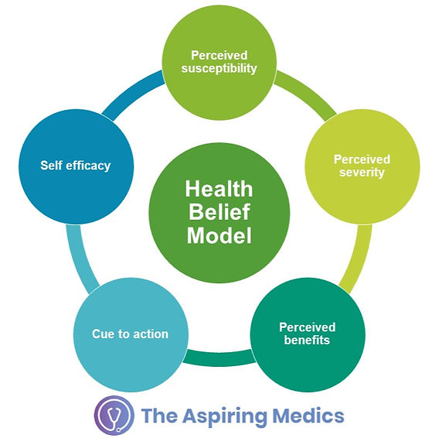
Applying the Health Belief Model (HBM)
The health belief model is basically a foundational framework in health behaviour research. It emphasises on the method in which individuals perceive health threats and decide to act based on the value individuals place on a particular goal and the likelihood that actions taken toward that goal will be successful in achieving the goal (Alyafei and Carr, 2024). This model will help in guiding the campaign message design to shift health beliefs:
Perceived Susceptibility: Campaign materials will highlight personal diabetes risk in midlife (“1 in 3 midlife adults are at risk—could it be you?”)
Perceived Severity: Messaging will explain long-term consequences if left unchecked (“Untreated diabetes can double heart attack risk, causes blindness”)
Perceived Benefits: Emphasise prevention through quick, free screening (“A 5-minute test will be able to prevent years of complications”)
Perceived Barriers: Address fear and time constraints via flexible scheduling.
Cues to Action: Posters, SMS reminders, and GP reminders will prompt participation.
Self-Efficacy: Encourage confidence through peer support and guidance.

Slide 14
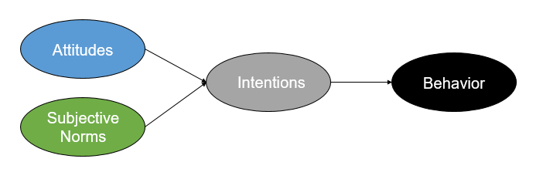
Applying the Theory of Planned Behaviour (TPB)
The Theory of Planned Behaviour distinguishes between three types of beliefs that affect an individual's intention to perform a specific behaviour (Ryan and Carr, 2023):
Behavioural Beliefs: Positive framing, such as “Screening is a smart, responsible choice for my family.”
Normative Beliefs: Peer endorsement and GP encouragement will create supportive social pressure.
Control Beliefs: Simplified booking systems and mobile screening units will make attendance easier.
It will be possible for the campaign to normalise overall screening as a routine health responsibility by improving all three precursors.

Slide 15
Integrating Theories into Practical Design
The campaign will be combining the following theories to create a cohesive, theory-driven design:
The Ottawa Charter principles will be able to be used for guiding structural actions (eg, policy change, supportive environments, and skill-building).
The HBM will be utilised for influencing the method in which messages address risk perception and the benefits of screening.
The TPB will be complementing this by reshaping overall behaviours and social norms around proactive health checks.
Combined together, these models will be able to make sure that the campaign addresses motivation, intention, along with enabling environments. This will also improve the behavioural influence of the campaign, which will enable targeting psychological and environmental determinants effectively.

Slide 16
Ewles & Simnett (2003) Planning Framework
Ewles and Simnett’s six-step framework is mainly used for guiding structured and evidence-based planning, which the campaign will be following (Scriven, 2017).
Identify the population needs via HNA findings (HSE, 2024).
Set aims and SMART objectives.
Choose intervention methods that are evidence-based.
Identify various resources alongside stakeholders.
Planning overall evaluation using Rootman et al.’s framework (Rootman, 2001).
Implement and review with weekly monitoring.
This will help in ensuring overall adaptability, accountability and rigour. It is essential to note that weekly team meetings will be ablet o adjust delivery, based on attendance data.

Slide 17
SMART Objectives
A SMART goal is used to help in guiding goal setting. SMART goals have 5 segments, which the campaign will implement:
Specific | To increase diabetes screening participation among adults in the age group of 45-54.
Measurable | To achieve a 30% increase in overall attendance within 6 months.
Achievable | This will be achievable through community, GP, and workplace collaboration.
Relevant | This will also align with NHS Diabetes Prevention priorities (NHS England, 2023).
Time Bound | The campaign will run for 6 weeks in addition to a 3-month evaluation period.
SMART goals will be able to drive, focus along with accountability and measurability.

Slide 18
Six-Week Campaign Overview
Week | Focus | Activity
1 | Awareness | Risk workshops (community centres)
2 | Engagement | Social media challenge: “Balance for Life.”
3 | Access | Mobile screening booths in workplaces.
4 | Integration | GP open screening days.
5 | Empowerment | Nutrition and activity guidance sessions.
6 | Sustain | Follow-up calls and feedback survey.
The structure of the campaign will make sure that awareness leads to action, which is followed by sustained engagement.

Slide 19
Campaign Activities
Free Blood Glucose Checks with instant results.
There will be various dietitians along with psychologists and physiotherapists, who will provide lifestyle talks.
Participants will be provided printed materials, such as meal plans, risk cards.
If required, they will also receive a results card along with referral information.
These activities will help in bridging overall awareness with accessible preventive services. It will also help in promoting early detection alongside improving overall lifestyle.

Slide 20
Communication & Marketing Plan
Slogan: “Check Today, Protect Tomorrow.”
The campaign messages will be produced with clear alongside motivating language:
Media will include posters, radio, along with social media and newsletters.
Visual branding will include a blue palette with a glucose icon.
Various hashtags will be utilised along with QR codes for booking and providing more information.
Such a unified design will help make diabetes screening much more visible, accessible, along with community-driven.

Slide 21
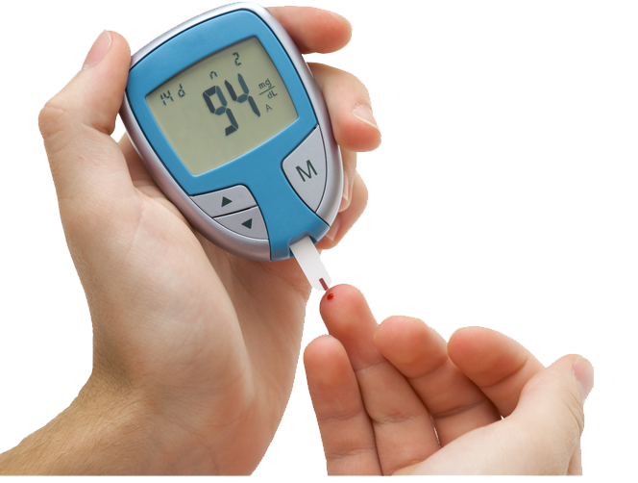
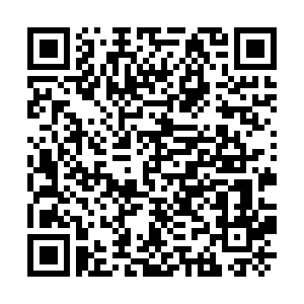


Balance for Life
Diabetes Screening for Adults (45–54 Years)
“Free Glucose Check – 5 Minutes Could Save Your Future.”
Get Your free screening now!
Scan to Learn more

Slide 22
Potential Partners
Diabetes UK is known for being a leading UK charity, which is dedicated to making a world where diabetes can do no harm (Diabetes UK, 2025).
The organisation, Campaign for Better Care, provides support in times of need.
It also funds groundbreaking research into new treatments and a cure.
The National Health Service, commonly known as the NHS, is a publicly funded healthcare system in the UK (NHS, 2023).
More than 2,000 organisations share the NHS’s content, including other NHS websites, local authorities, charities and commercial organisations.
Such partnerships will help in ensuring overall credibility for the campaign.

Slide 23
Implementation Plan & Resources
Timeline | 6 Week Campaign + 3 Month Evaluation.
Budget | (£12,000) Testing kits Staff Venue hire Marketing.
Staff | Public Health Officers GPs Volunteers.
Partners | NHS Diabetes Programme Local employers Charities.
Efficient resource allocation alongside partnership working will help in ensuring smooth delivery along with measurable outcomes.

Slide 24
Task 3: Evaluation & Reflection

Slide 25
Evaluation Framework (Rootman et al., 2001)
Overall evaluation will be conducted using Rootman et al.’s eight-stage cycle framework (Rootman, 2001). The following stages are:
To describe the programme.
To identify stakeholder issues.
To design data collection.
To collect data.
To analyse and interpret findings.
To make recommendations.
To disseminate results.
To take improvement actions.
Such a systematic approach will help in ensuring overall transparency, along with learning and scalability.

Slide 26
Applying HBM to Evaluation
The HBM will help in guiding how behavioural changes are measured after the campaign (Alyafei and Carr, 2024).
Surveys will help in assessing perceived risk awareness (“Do you now believe you’re at risk?”)
It will also assess benefits or barriers (“Was screening easy and worthwhile?”)
Follow-up data will help evaluate whether cues to action is able to increase participation (“Did reminders prompt you to attend?”)
By improving overall self-efficacy along with understanding, it will be possible to showcase success in behaviour change (“Do you feel confident managing your health?”)

Slide 27
Applying TPB to Evaluation
Evaluation will also examine overall attitude shifts toward screening, along with improved peer encouragement and increased control.
There will be subjective norms, such as “Did colleagues/GP encourage you?”
Participants will be told to provide ratings to questions such as “Was booking and attending easy?” on a 1 to 10 scale.
Surveys, along with focus groups and GP feedback, will help in measuring changes in intention and action.
Such an approach will ensure that evaluation is able to capture individual motivation along with environmental support for screening.

Slide 28
Types of Evaluation
Process: Monitors campaign delivery and attendance (Attendance logs, staff feedback)
Impact: Measures change in knowledge and intentions (Pre/post quiz results)
Outcome: Tracks screening uptake and referrals
Summative: Assesses overall effectiveness
Cost-effectiveness: Compares outcomes vs. campaign budget.
Multiple evaluation types will be able to provide a holistic understanding of performance alongside value.

Slide 29
Evaluation Indicators
Quantitative Indicators
Qualitative Indicators
Screening attendance target of more than 30%
The prediabetes detection rate of ~15%
Referral numbers
Participant satisfaction from feedback.
Future screening confidence.
Perceived community support.
These indicators will be able to demonstrate behavioural change along with community impact beyond just numerical results.

Slide 30
Data Collection Methods
Mixed-Method Approach
Pre/post survey (Both online and paper) for awareness.
GP data for screening rates, which will be anonymised.
Focus groups for perceptions.
Observation logs for engagement levels, barriers and staff notes.
Digital analytics such as QR scans, social reach, along with booking data.
Combining quantitative with qualitative methods will help in improving overall validity, along with the credibility of the findings.

Slide 31
Anticipated Biopsychosocial Benefits
The biopsychosocial model is based on understanding that the medical condition of an individual is not just due to biological factors, but also due to the psychological and social factors (Physiopedia, 2023). The anticipated biopsychosocial benefits are as follows:
Biological | Early Detection Reduced complications.
Psychological | Reduced anxiety Increased empowerment Locus of control
Social | Normalised health checks Stronger community ties Peer support
By aligning with the Biopsychosocial Model, overall benefits will span across body, mind and society. Long-term effects will include reduced NHS burden along with improved workforce productivity.

Slide 32
Barriers & Mitigation
Barrier | Mitigation
Lack of Time | Weekend/mobile/workplace slots Drop-in format
Fear of Diagnosis | Reassuring messaging Instant results Counsellor on-site
Low Health Literacy | Visual aids Plain English Multilingual options Teach-back
Access | Transport subsidies Central locations Disability access
Stigma | Normalise via peer stories
Addressing such barriers will ensure equitable access along with inclusive participation across the targeted age group.

Slide 33
Sustainability & Ethical Governance
Ethics
Sustainability
Equity
Informed consent, both verbal and written.
GDPR compliance, such as secure and anonymised data
Voluntary participation
Non-discrimination (age, gender, ethnicity, disability)
Annual screening drives
Digital booking platform (scalable)
Trained volunteer network
Integration into GP QOF targets (NHS, 2025)
Culturally tailored materials
Faith group partnerships
Low-income targeting
Ethical integrity will be able to strengthen overall trust, along with encouraging long-term engagement.

Slide 34
Summary
Early detection saves lives.
“Balance for Life” — Protect Your Future.
The Balance for Life campaign will be able to raise awareness, along with increasing type 2 diabetes screening.
It will also support long-term behaviour change among adults aged 45-54.
The campaign will integrate epidemiology, behavioural theory, and evaluation frameworks.
It will align with national health priorities and ensure measurable community impact.

Slide 35
References
Alyafei, A. and Carr, R.E. (2024). The Health Belief Model of Behavior Change. [online] National Library of Medicine. Available at: https://www.ncbi.nlm.nih.gov/books/NBK606120/ [Accessed 1 Nov. 2025].
Bralić Lang, V., Bergman Marković, B. and Vrdoljak, D. (2015). The association of lifestyle and stress with poor glycemic control in patients with diabetes mellitus type 2: a Croatian nationwide primary care cross-sectional study. Croatian Medical Journal, 56(4), pp.357–365. doi:https://doi.org/10.3325/cmj.2015.56.357.
CFI (2022). SMART Goals. [online] Corporate Finance Institute. Available at: https://corporatefinanceinstitute.com/resources/management/smart-goal/ [Accessed 1 Nov. 2025].
Diabetes UK (2024a). Type 2 Diabetes Prevention Week 2024: Action Needed to Tackle Rising Type 2 Cases among under-40s. [online] Diabetes UK. Available at: https://www.diabetes.org.uk/about-us/news-and-views/diabetes-prevention-week-2024-action-needed-tackle-rising-type-2-cases [Accessed 31 Oct. 2025].
Diabetes UK (2024b). Regional Facts and Stats Dashboard. [online] Diabetes UK. Available at: https://www.diabetes.org.uk/about-us/about-the-charity/our-strategy/statistics/by-area [Accessed 31 Oct. 2025].
Diabetes UK (2025). About us. [online] Diabetes UK. Available at: https://www.diabetes.org.uk/about-us [Accessed 1 Nov. 2025].
Dunn, T.J., Tan, X., Harton, J., Kim, S., Xie, L., Gamble, C. and Rotroff, D. (2025). Macrovascular and microvascular complications in US Medicare enrollees with type 2 diabetes with and without atherosclerotic cardiovascular disease. Diabetes Obesity and Metabolism. doi:https://doi.org/10.1111/dom.16441.
Frérot, M., Lefebvre, A., Aho, S., Callier, P., Astruc, K. and Aho Glélé, L.S., (2018). What is epidemiology? Changing definitions of epidemiology 1978-2017. PloS one, 13(12), p.e0208442.
Gagliardi, J. (2024). Diabetes in England and Wales by type 2019-20. [online] Statista. Available at: https://www.statista.com/statistics/386742/individuals-with-diabetes-by-type-in-england-and-wales/ [Accessed 31 Oct. 2025].
Gagliardi, J. (2024b). England: people with type 2 diabetes, by age 2022/23. [online] Statista. Available at: https://www.statista.com/statistics/387343/individuals-with-type-2-diabetes-by-age-in-england/ [Accessed 31 Oct. 2025].

Slide 36
References
Hex, N., MacDonald, R., Pocock, J., Uzdzinska, B., Taylor, M., Atkin, M., Wild, S.H., Beba, H. and Jones, R. (2024). Estimation of the direct health and indirect societal costs of diabetes in the UK using a cost of illness model. Diabetic medicine, [online] 41(9). doi:https://doi.org/10.1111/dme.15326.
Hill-Briggs, F. (2020). Social determinants of health and diabetes: A scientific review. Diabetes Care, [online] 44(1), pp.258–279. doi:https://doi.org/10.2337/dci20-0053.
HSE (2024). A Framework for Health Needs Assessment. [online] Available at: https://www.hse.ie/eng/services/list/5/publichealth/publichealthdepts/population-planning/hna-framework-v1-0.pdf [Accessed 31 Oct. 2025].
Khan, R.M.M., Chua, Z.J.Y., Tan, J.C., Yang, Y., Liao, Z. and Zhao, Y. (2019). From Pre-Diabetes to Diabetes: Diagnosis, Treatments and Translational Research. Medicina, [online] 55(9), p.546. doi:https://doi.org/10.3390/medicina55090546.
Kisling, L. and Das, J. (2023). Prevention strategies. [online] National Library of Medicine. Available at: https://www.ncbi.nlm.nih.gov/books/NBK537222/ [Accessed 31 Oct. 2025].
Kudale, A.M., Ghawat, M.D., Gopale, A.V., Phutane, M.S. and Joseph, S., (2025). Cultural Aspects of Type-2 Diabetes-related Social Stigma: A Cultural Epidemiological Study among General Community Members in Urban Pune, India. Indian Journal of Community Medicine, 50(1), pp.234-241. DOI: https://doi.org/10.4103/ijcm.ijcm_894_22
Lhachimi, S.K., Bala, M.M. and Vanagas, G. (2016). Evidence-Based Public Health. BioMed Research International, [online] 2016, pp.1–2. doi:https://doi.org/10.1155/2016/5681409.
NHS (2023). About the NHS website. [online] NHS. Available at: https://www.nhs.uk/about-us/about-the-nhs-website/ [Accessed 1 Nov. 2025].
NHS (2025). NHS England» Quality and Outcomes Framework (QOF) guidance for 2023/24. [online] www.england.nhs.uk. Available at: https://www.england.nhs.uk/gp/investment/gp-contract/quality-on-outcomes-framework-qof-changes/ [Accessed 1 Nov. 2025].
NHS England (2023). NHS Diabetes Prevention Programme (NHS DPP). [online] NHS England. Available at: https://www.england.nhs.uk/diabetes/diabetes-prevention/ [Accessed 31 Oct. 2025].
OECD (2024). Behavioural science. [online] OECD. Available at: https://www.oecd.org/en/topics/behavioural-science.html [Accessed 31 Oct. 2025].

Slide 37
References
Osterholm, M.T. and Hedberg, C.W. (2015). Epidemiologic Principles. Mandell, Douglas, and Bennett’s Principles and Practice of Infectious Diseases, [online] 1, pp.146-157.e2. doi:https://doi.org/10.1016/B978-1-4557-4801-3.00013-8.
Physiopedia (2023). Biopsychosocial Model. [online] Physiopedia. Available at: https://www.physio-pedia.com/Biopsychosocial_Model [Accessed 1 Nov. 2025].
Rootman, I. (2001). Evaluation in health promotion: principles and perspectives (No. 92). WHO Regional Office Europe.
Ryan, S. and Carr, A. (2023). Theory of planned behavior - an overview. [online] www.sciencedirect.com. Available at: https://www.sciencedirect.com/topics/medicine-and-dentistry/theory-of-planned-behavior [Accessed 1 Nov. 2025].
Scriven, A., (2017). Promoting health: A practical guide-e-book: Ewles & Simnett. Elsevier Health Sciences.
UK Parliament (2023). DIABETES UK - WRITTEN EVIDENCE (FDO0074). [online] Parliament.uk. Available at: https://committees.parliament.uk/writtenevidence/129467/html/ [Accessed 31 Oct. 2025].
Waugh, N.R., Shyangdan, D., Taylor-Phillips, S., Suri, G. and Hall, B., (2013). Screening for type 2 diabetes: a short report for the National Screening Committee. Health technology assessment, 17(35), pp.1-90.
WHO (2021). Screening. [online] Who.int. Available at: https://www.who.int/europe/teams/ncd-management/screening [Accessed 31 Oct. 2025].
WHO (2024). Diabetes. [online] World Health Organization. Available at: https://www.who.int/news-room/fact-sheets/detail/diabetes [Accessed 31 Oct. 2025].
WHO (2025a). NCD global monitoring framework. [online] www.who.int. Available at: https://www.who.int/teams/ncds/surveillance/monitoring-capacity/gmf [Accessed 31 Oct. 2025].
WHO (2025b). Health promotion action means. [online] World Health Organisation. Available at: https://www.who.int/teams/health-promotion/enhanced-wellbeing/first-global-conference/actions [Accessed 31 Oct. 2025].

