Slide 1
Therapy Assistant Practitioner:
Demonstrating Practice Module
Week one
(Quality Improvement)

Slide 2

What do we mean by quality?
Think of a product or a company you use any why? Is it the quality?

Slide 3

What does quality in care look like?
What examples have you got that support quality of care?
This Photo by Unknown Author is licensed under CC BY-SA-NC

Slide 4
The dimensions of quality in care
What we should aim to provide:
Safe - Avoiding harm to people from care that is intended to help them.
Effective - Providing services based on evidence that produce a clear benefit.
Experience – caring, responsive, person-centered

Slide 5
The dimensions of quality in care
How we should aim to provide it:
Well-led – Staff who are open and committed to learning and improvement.
Sustainable –Staff who use resources responsibly and efficiently, provide fair access to all, and accordance to need of their populations.
Equitable – Staff provide care that does not vary in quality because of a person’s characteristics.

Slide 6
How can we improve quality of care?
What examples do you have of improved quality of care?

Slide 7
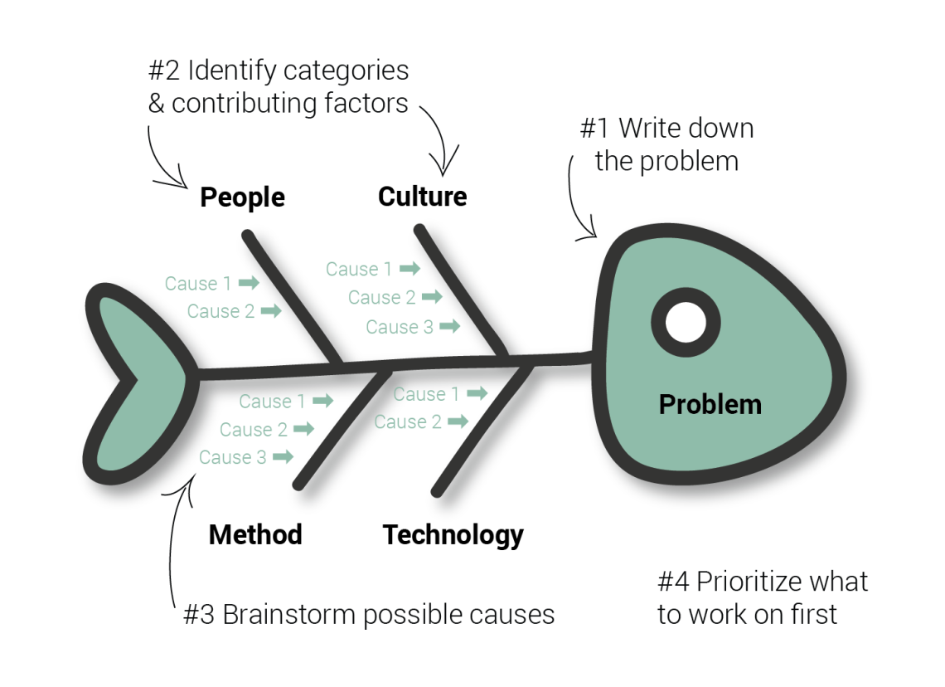
How can we improve quality?
Find the problem –
Use tools to help breakdown the cause and effect of actions take, for example a fishbone model

Slide 8

How can we improve quality?
Understanding the problem from a range of perspectives
What resources do we have already?
What data can we use?

Slide 9
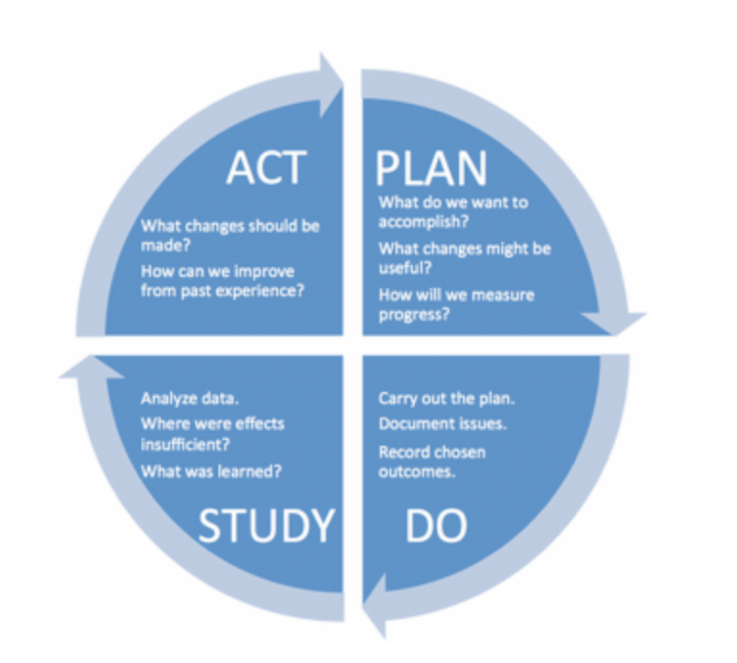
How can we improve quality?
Identifying and test possible solutions by using helpful tools, such as the PDSA Cycle
This Photo by Unknown Author is licensed under CC BY-SA-NC

Slide 10

Individual task:
Think about what challenges you have in work, which impact on the quality of service.
Start planning your own PDSA cycle and see what you come back with.

