Slide 1

Cities: Waste and Place
ACNA6005
Sustainable Urban Communities
Lara Hopkinson

Slide 2

Overview
Cities in context
The waste issue
Waste: Place concerns

Slide 3
Issues with cities?

Slide 4
Issues with waste?

Slide 5
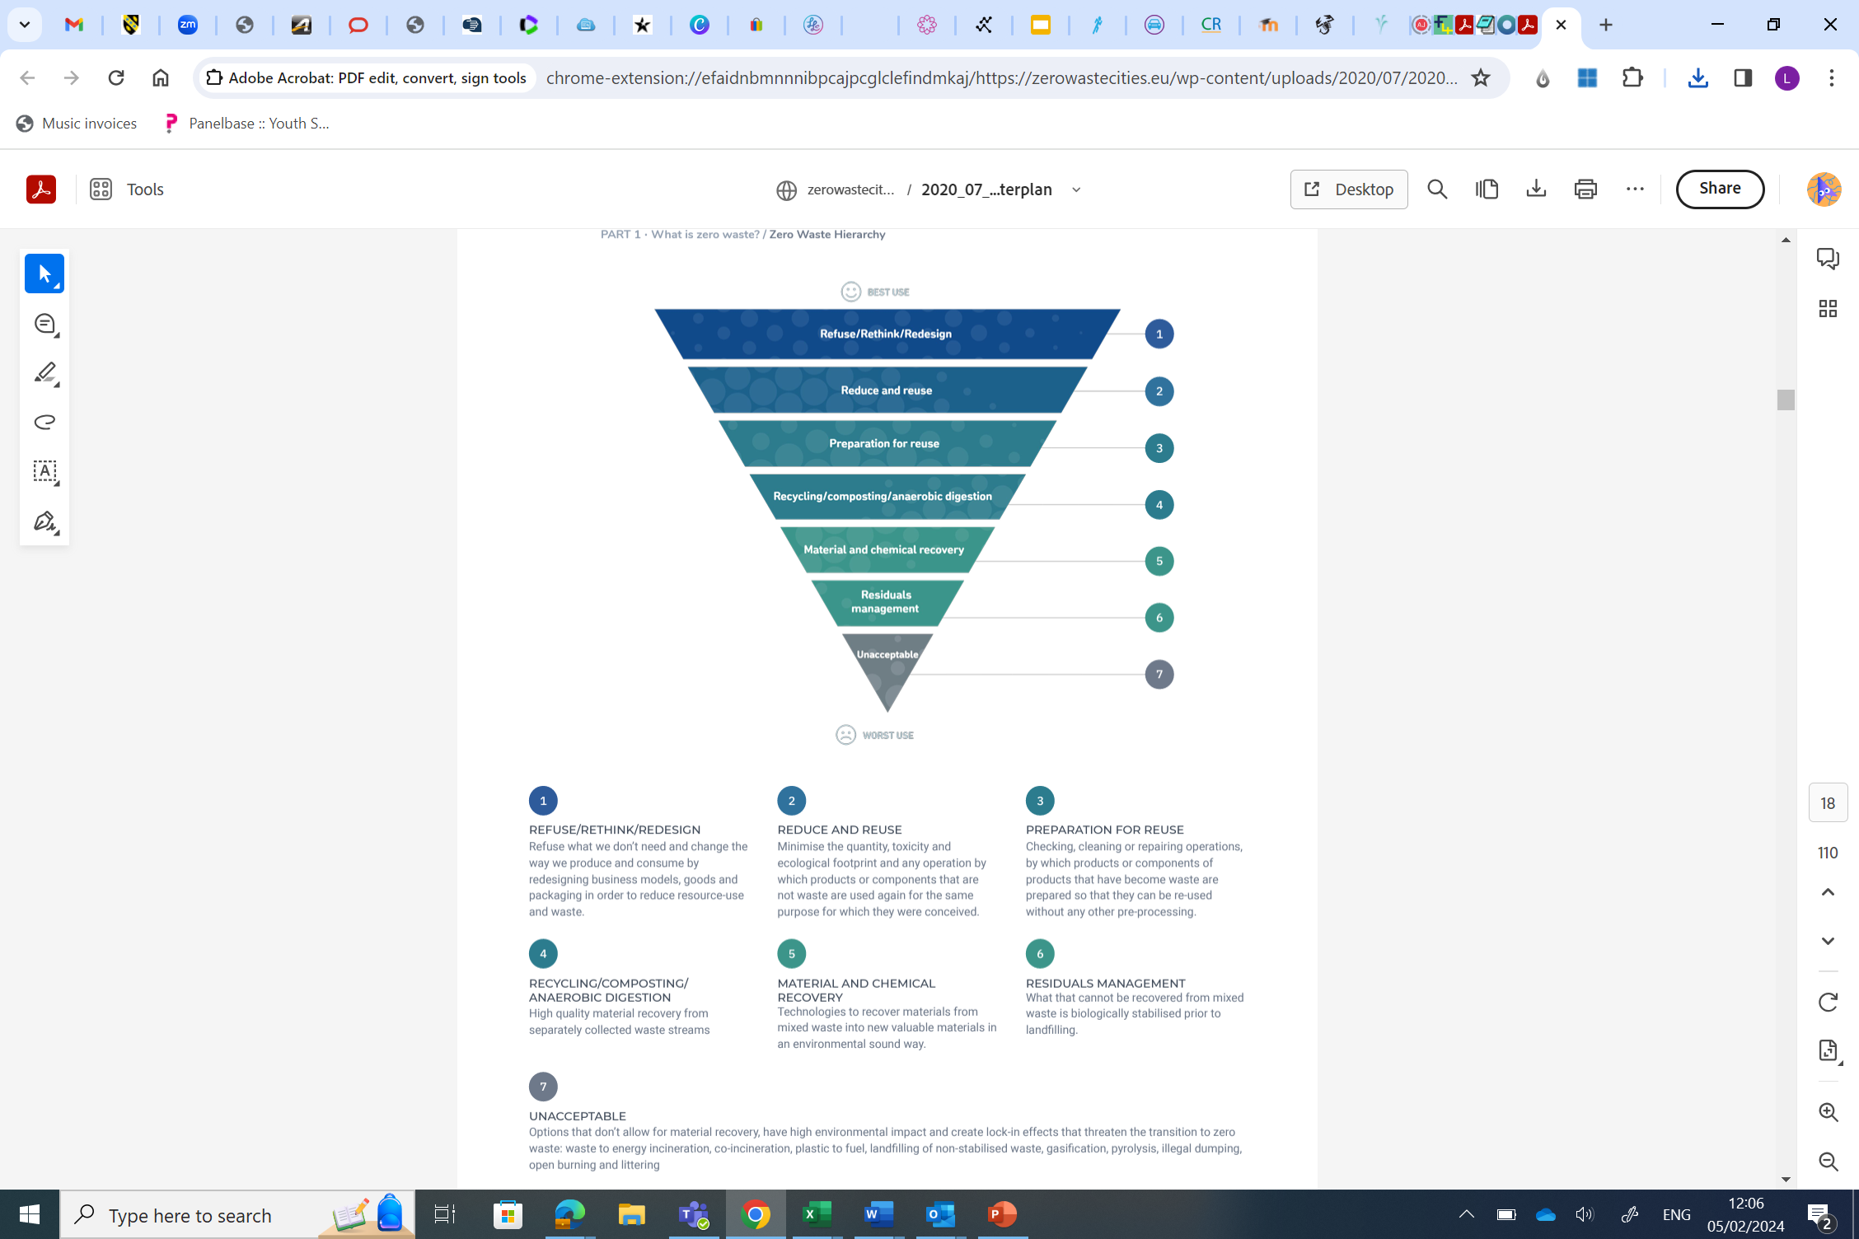
The waste hierarchy
DEFRA, 2011

Slide 6
Rethink
Refuse
Rot
Reuse
Re-gift
Reduce
Repair
Rent
Recycle

Slide 8
Why is waste an issue in cities?

Slide 9
Waste in cities
Considerable impact with emissions (third largest contributor)
Emissions embedded into items purchased / used
Quantities!
Space to deal with materials
Poor material choices
Single-use items (and associated bans)

Slide 10
Three key areas of concern
Sources: The Guardian / EEA / World Bank

Slide 11
Some waste facts…
75% municipal waste consists of discarded consumer goods
  80% is burned, landfilled or dumped (poor design and/or lack of end-of-life collection options)
80% household items are used less than once a month
More than 80% of a products environmental impact is determined at the design stage
(Ellen MacArthur Foundation, nd)

Slide 12
Movement towards zero waste

Slide 13
Benefits of zero waste systems
Protecting local environments
Reducing costs
Increased securities
Creation of jobs
Community cohesion
Natural cycling
Mitigating resource depletion

Slide 15
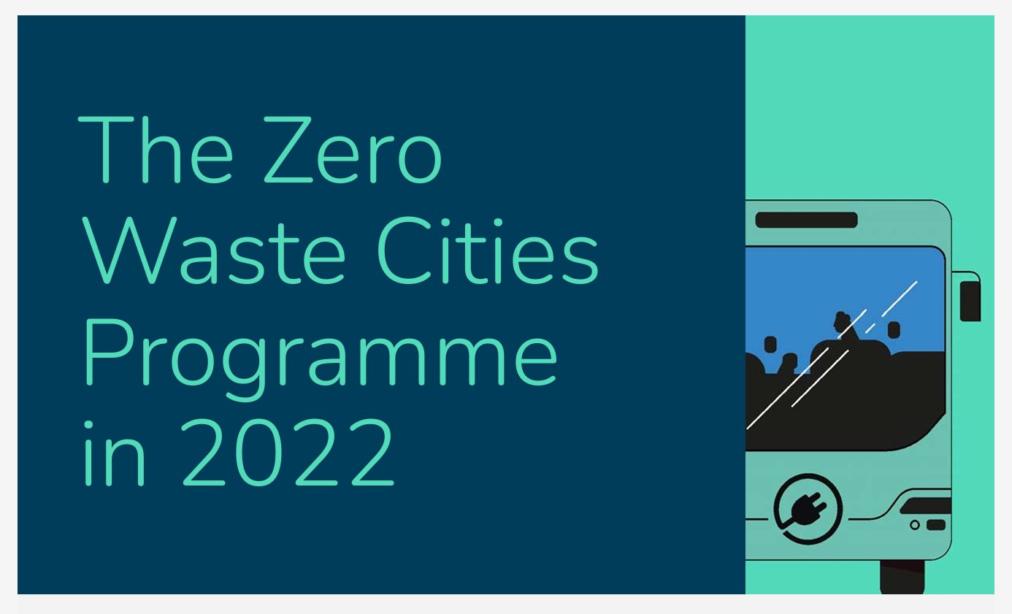

Slide 16
Zero waste to zero emissions 2022
Climate mitigation
Composting is a climate game changer
Transformation to a net negative source of GHG
Source reduction of waste is best way to reduce GHG emissions
Energy recovery is not an effective mitigation technique

Slide 17
Zero waste to zero emissions 2022
Climate adaptation
Bans on single-use plastics are necessary as these exacerbate flooding
Banning single-use plastics and waste minimisation will minimise disease vectors
Composting helps soil resilience

Slide 18
Zero waste to zero emissions 2022
Additional benefits to zero waste systems
Further health and environmental benefits such as:
  Lowering risks of certain illnesses
  Keeping resources within the system
  Protecting ecosystem health
Contribution to a thriving economy via:
  Employment opportunities
  Cost savings
  Entrepreneurship

Slide 19
ZWE, 2020

Slide 20
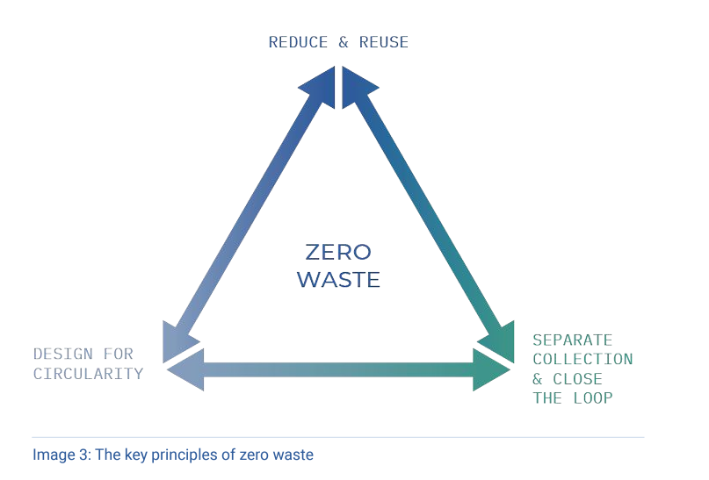
ZWE, 2020

Slide 21
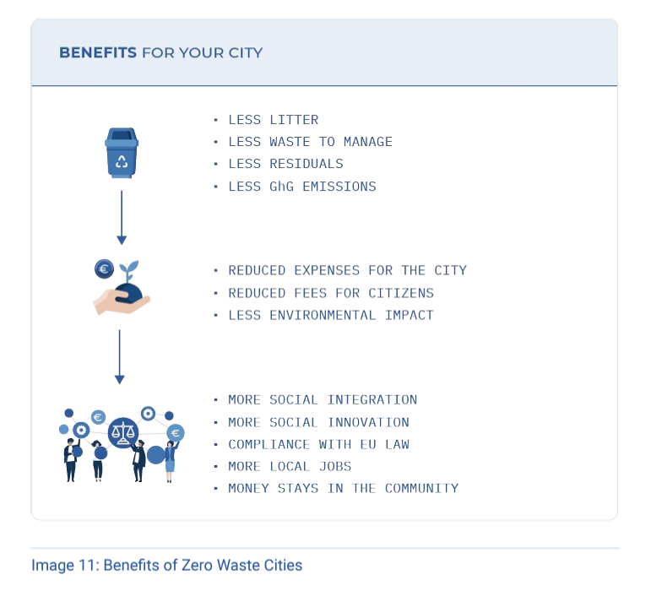
Benefits of adopting zero waste
ZWE, 2020

Slide 22
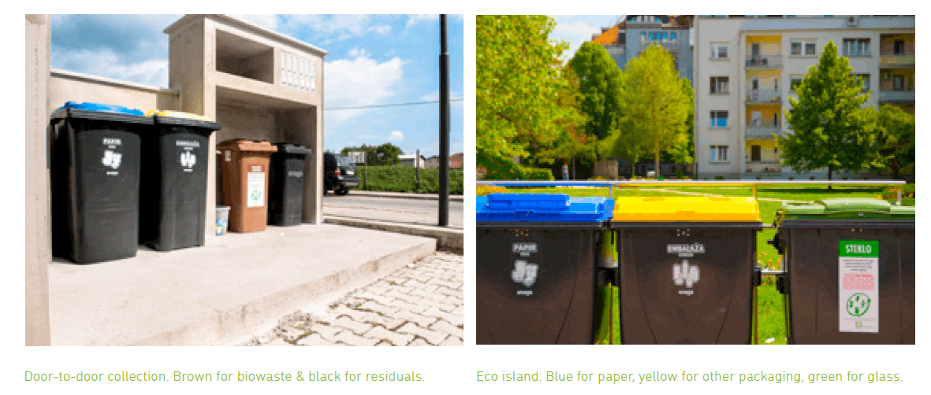
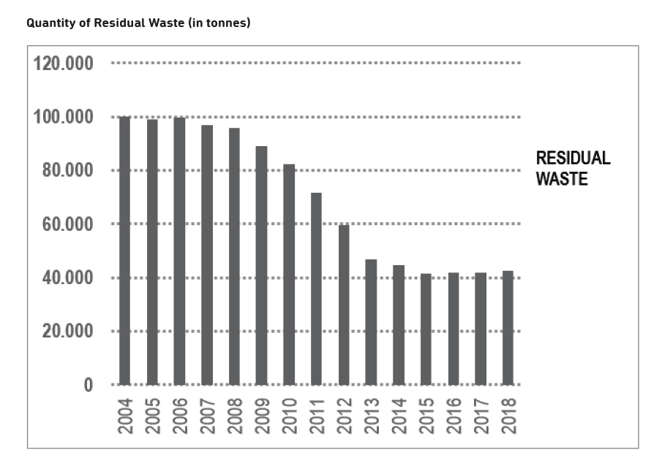
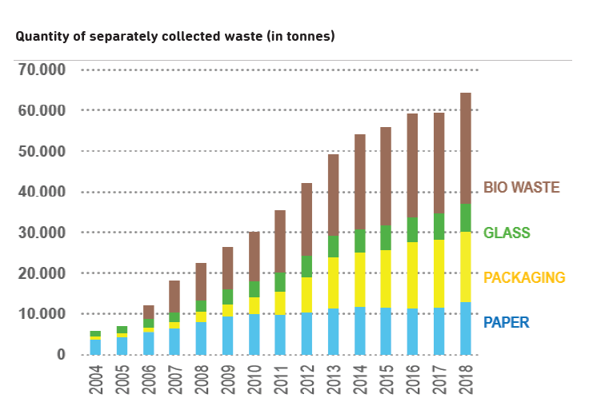
City starting from scratch:
Ljubljana, Slovenia
ZWE, 2020

Slide 23
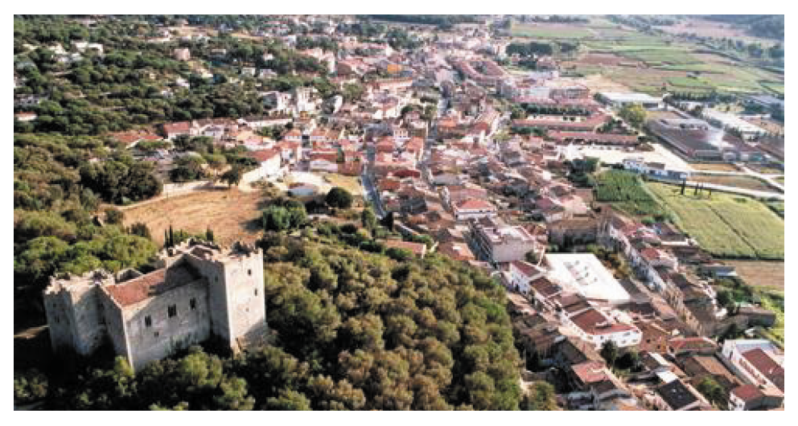
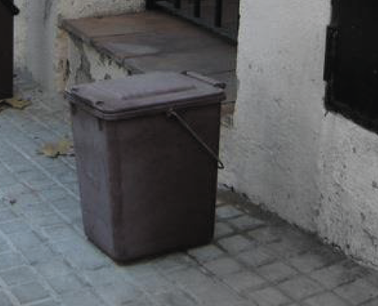
City taking its next steps:
Argentona, Spain

Slide 24
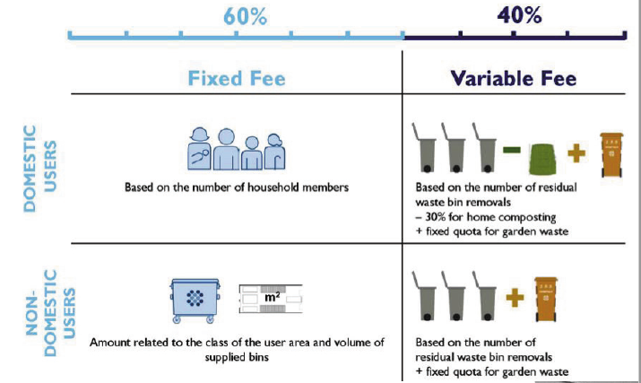
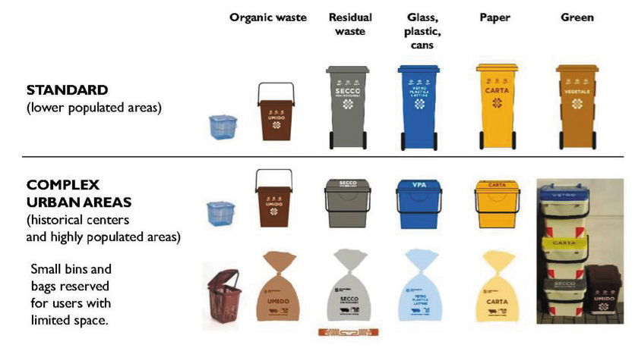
Municipalities wishing to go beyond targets: Veneto, Italy

Slide 25
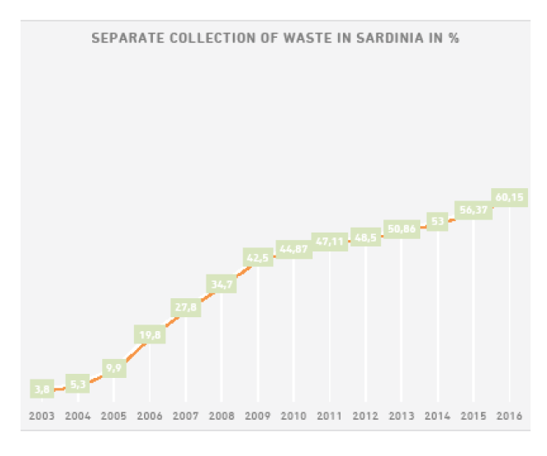
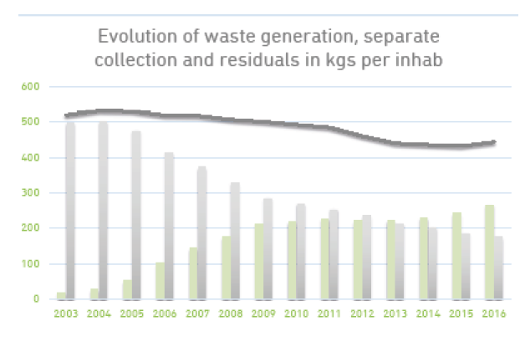
Places that are tourist destinations: Sardinia, Italy

Slide 26
Useful information
C40 Knowledge Hub
Ellen MacArthur Foundation
Zero Waste Europe
GAIA

