Slide 1
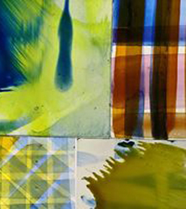
Explorative Research & Praxis 2026
60 credit module

Slide 2
The Exploratory Research and Praxis Module is designed to enable you to develop ideas through practical experimentation and philosophical exploration.
Focus on expansive creative development through
THINKING & DOING

Slide 3
INDIVIDUAL AND INDEPENDENT PRACTICE
THEORETICAL
Own Reading, watching listening
at studio space, at home, library
etc.
Participating in lectures and
Seminars
Attending research talks
Sharing ideas and concepts
informally with staff and
students.
Writing and recording
PRACTICAL
Own practice – at studio space,
at home, on location etc…..
Working within specialism
workshops…..e.g. photography,
glass etc.
Participating in scheduled activities.
Organise collaborative practice
Live briefs or competitions
Optional workshops
(bookable)

Slide 4
A body of either theoretical and/or practical research and development work collated into a ‘portfolio’ (digital and /or analogue) consisting of multiple elements with a clear diagnostic and reflective element that includes references and analysis. This will evidence the on-going investigation, development and definition of the exploratory proposition generated in Semester 1 and may consist of the following as appropriate to the individual student’s medium pathway.
What are we aiming for……..
A substantial body of explorative research that shows developments in thinking and practice………
Practical experimentation –Doing – creating – designing – making-
Philosophical exploration –reading –theorizing – concepts – thinking
The convergence of these things….

Slide 5
WHERE DO WE GO FROM HERE……
Reflect on work so far.
Reflect on last 3 modules and any emerging themes……select some key words….
Reflect on ways of working / processes and thinking…… HOW DO YOU WORK BEST?..... Is the way that you have worked so far successful?
Do you have a good balance of theory and practice so far…………..

Slide 6
Research & Practice
There are circumstances where the best or only way to shed light on a proposition, a principle, a material, a process or a function is to attempt to construct something, or to enact something, calculated to explore, embody or test it’
Bruce Archer (The Nature of Research 1995, p.11)
This is the PRAXIS BIT!!

Slide 7
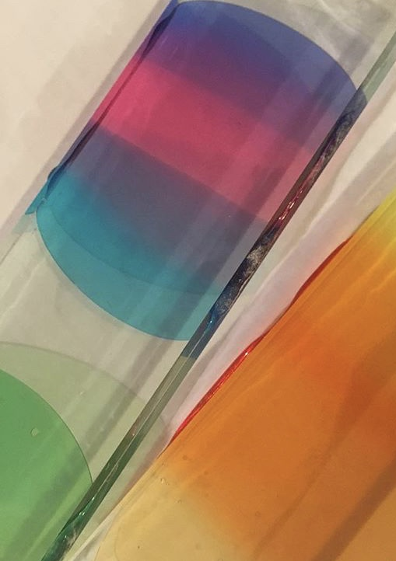
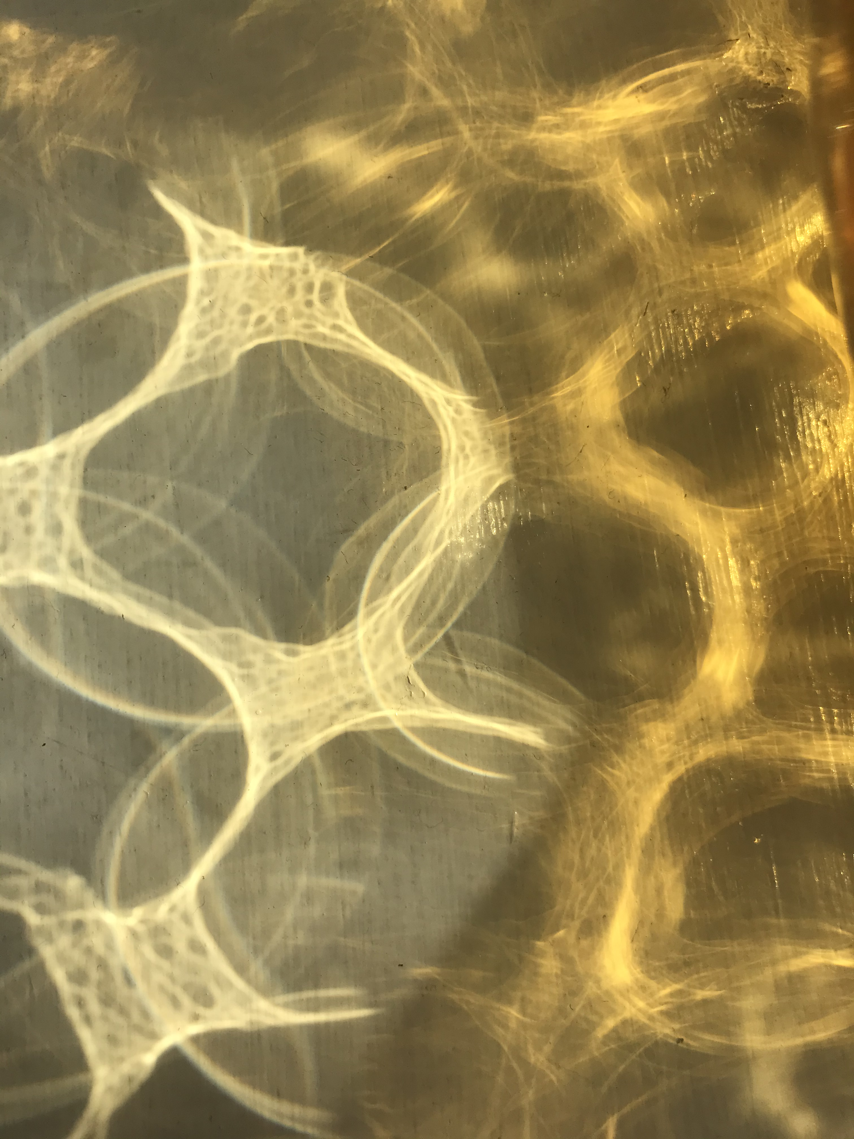
Approach to Experimentation
Space to play – risk taking
Not to have a pre-meditated outcome…… explore…… and record
Everything is relevant…. Can be useful ….. successes and mistakes are as important as each other.
Happy accidents…… e.g. stitching something and then liking the back of your work more !!!
Embracing failure – chance – and then researching this (e.g. link with Rob’s first lecture)
Triggers and freedom….. See this as 3 x size of thought experiment.
lateral thinking – research it and explore it.
Test in as many ways as possible…… short activities and longer tasks
Be productive with time……. Change of pace……organization and multitasking….
Consider working in series……. Several pieces at once….no pressure……. prepare grounds…. material drying time and work with plenty of materials around you.
Innovative materials and inventive….. E.g. using household emulsion on secondhand books to make sketchbooks etc….

Slide 8
lateral thinking and connecting ideas and research.
FLOW between types of research and thinking and doing.
Enjoy successes and mistakes –
Enjoy no pressure to produce finished outcomes unless you choose to.
Think about your intuition and subconscious thought - Self reflection is key.
Useful texts include:
Le Feuvre, L (2010) Failure- Documents of Contemporary Art (2010) White Chapel Gallery.
Bayles, D (2002) Art and Fear

Slide 9
Ways to research…..
Reading
Reading – articles, books, journals….
Watching
Watching films, documentaries…
Seeing
Seeing….. Exhibitions, sites, locations…. Places of interest and other artwork….. Online talks, conferences and gallery tours.
Collecting
Collecting materials and objects to feed ideas….
Drawing, writing and photographing
Drawing, writing and photographing…..
Sampling and playing
Sampling and playing with materials and techniques …..includes individual sampling as well as workshop menu

Slide 10
Research sources and methods
Where from….. Art, design….. Science, history, philosophy, psychology, educational……
Research …..research terms, methods and approaches,
Qualitative, Quantititive, Ontology, Epistemology.

Slide 11
Approaches to the module
Individual plan of action
Collaborative developments
Live briefs or external projects
Consider creating several mini briefs within the module if this motivates you.
Who is your audience?
How do you normally work? / do you want to experiment with something different?

Slide 12
Motivation
This is a large module and requires:
1. Self discipline
2. Good time planning
3. Independent approach to learning
4. Self reflection – what motivates you? (e.g. mini deadlines)

Slide 13
DOCUMENTATION
Large module asking for a ‘body’ of explorative work. (3 x Thought Experiment)
How will you organise your research? Technical file, theory folder, sketchbook, journal, digital folders, blog, material samples (photographed and annotated)
Requires a final DIGITAL submission, but this can be a summary of your key findings and doesn’t mean your whole module is digital.

Slide 14
Keeping a digital documentation of your work
You can do this in a number of ways depending on your discipline and how you work
(again, this is something to explore and reflect on)
If you enjoy and like working digitally and that suits your work and then regularly updating a digital portfolio is straight forward. Just remember to have regular entries to track your process.
If you are a more practical and materials-based person, consider exploring and creating by hand and then photographing and uploading your work on a weekly basis (ideally just before your weekly tutorial)
By doing this you are exploring your material making further, with the play between the real and 3D and the 2D imagery you upload.
There is a lovely contrast between an image of a spontaneously drawn / made / written sketchbook or journal against the crispness of the digital screen.
Or you may wish to work with a combination of theses documentation techniques.

Slide 15
You should document…..
Your creative journey and process and include and refer to all aspects of your research.
DOCUMENT PROCESS……SHOW DEVELOPMENT… CREATIVE JOURNEY
Hard copy sketchbooks, notebooks, journals and artwork could be photographed, scanned or filmed. Think about key pages in your workbooks that you can then discuss and refer to in your final submission.
All reading lists, references and academic dialogue.
Digital files, websites etc.
All artwork…. 2D / 3D / virtual
Film and sound
Collected research… text, imagery, digital or hard copy

Slide 16
Delivery
1:1 Tutorials (mostly Friday afternoon but see your pathway tutor)
Lectures
Seminars
Seminars (student led) could be developed from Collaborative Dialogues connections.
Pairings /collaborative / skills swap opportunities
Research talks
Formative Reviews: Scheduled in core timetable
Optional Workshops scheduled throughout the term.

Slide 17
Recap
For assessment produce a substantial body of explorative research that shows developments in thinking and practice.
Practical experimentation –Doing – creating – designing – making-
Philosophical exploration –reading –theorizing – concepts – thinking
The convergence of these things….PRAXIS
Your final portfolio of work should be digitally presented as PDF or PPT (or other suitable means)

Slide 18
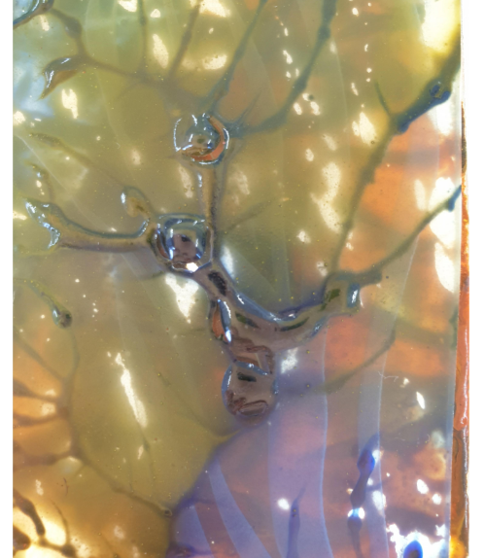
Finally…….Have fun!!!!
Look for newness
Explore
Take risks
Question
Be curious
Stretch yourself
Be innovative
Grow your mind
Develop yourself

Slide 19
WORKSHOP MENU – goes live on Jan 16th
3 BLOCKS OF 3 WEEK WORKSHOPS
AIM FOR 1 or 2 WORKSHOPS PER BLOCK - THIS IS OPTIONAL
IF YOU SIGN UP TO A WORKSHOP YOU MUST COMMIT TO THE SESSIONS
SOME OF THESE WORKSHOPS MAY CLASH WITH SOME OTHER CONTENT BUT YOUR TIMETABLES ARE INDIVIDUAL AND UNIQUE TO YOUR NEEDS.

Slide 20
Module preparation
Reflective tasks – what’s next?
Studio space / working process – what is most efficient for you?
Begin your research…. Don’t wait for the module to start, this is your work!
Collect tools, materials and anything else you might need.
Consider careful choice of workshops and sign up
Consider careful choice of documentation processes, live projects or activities that take you out of your comfort zone.

Slide 21
Reflective questionnaire
In preparation for the next module, reflect and comment on the tasks below.
THIS IS NOT FORMALLY ASSESSED BUT A VERY USEFUL EXERCISE TO GET YOUR MODULE STARTED AND WILL FORM DISCUSSION IN YOUR FIRST SEMINARS AND TUTORIALS
This will form the starting point for your first tutorial.

Slide 22
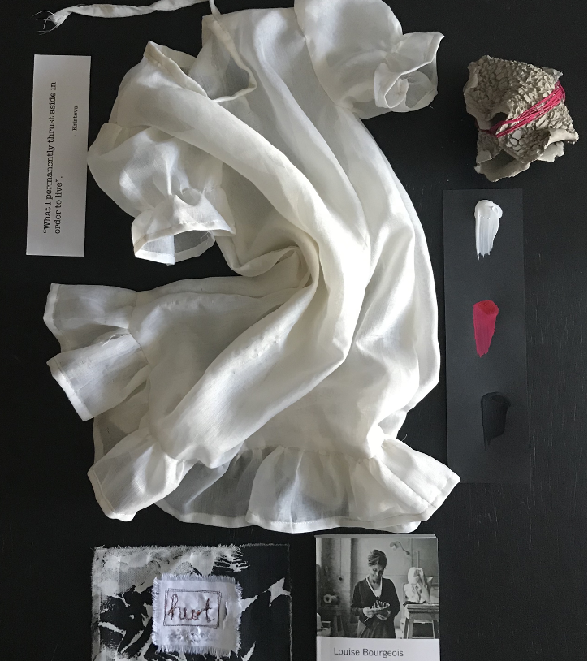
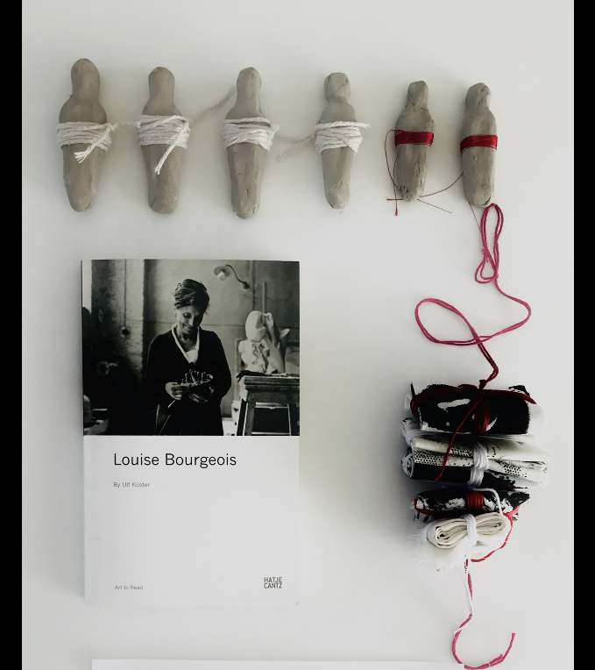
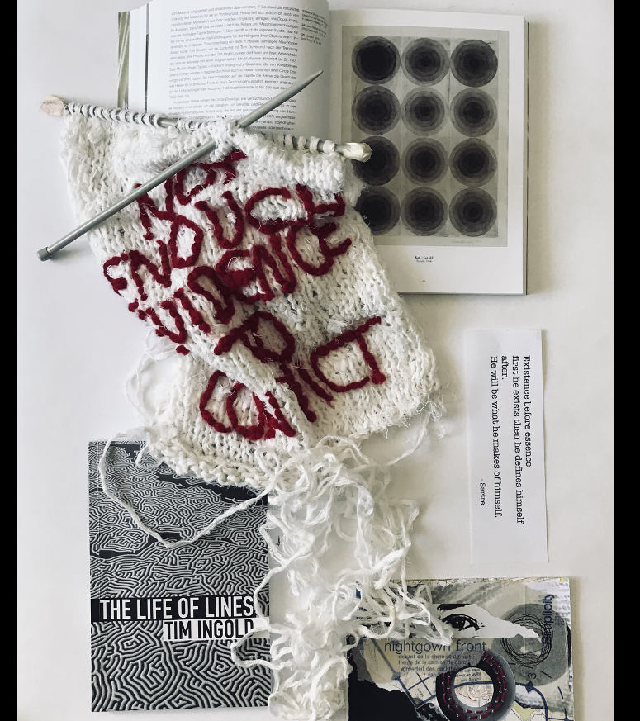
ASSEMBLAGE TASK

