Slide 1
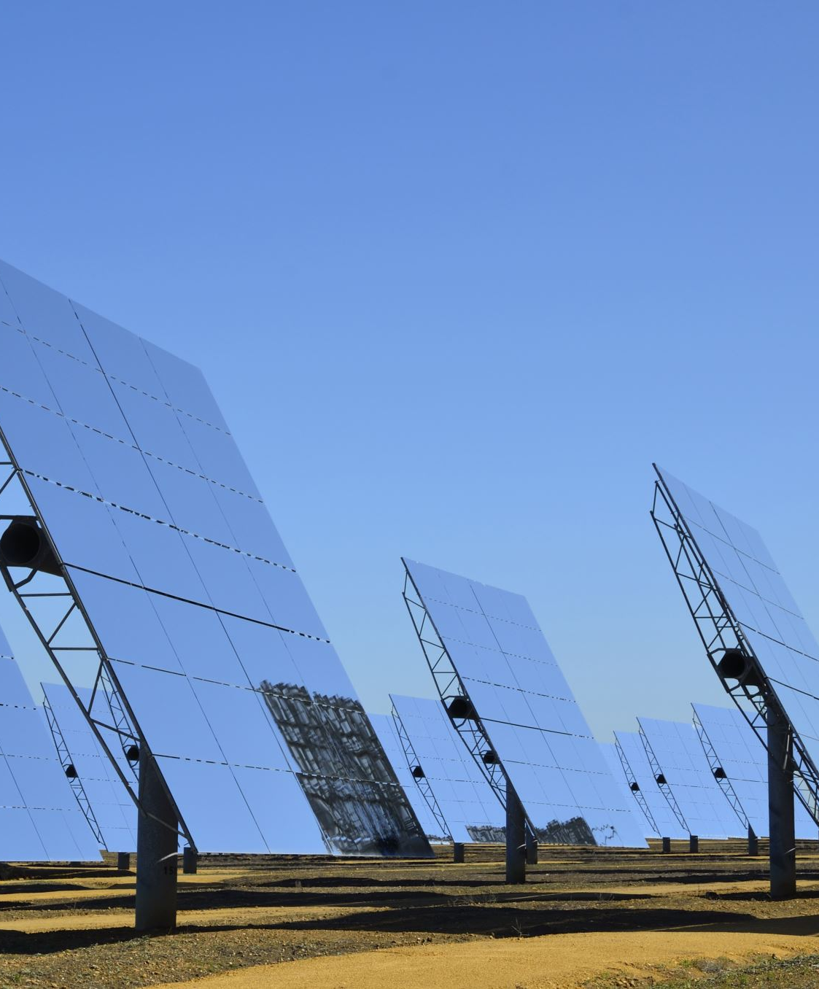
Name – Shivcharan Mistry
Student ID – 2244603
Module Code – LCMB7004
Module – Entrepreneurship
Lecturer’s Name – Vasilios Tavlaridis
Title – Solarfox pitch for investors, seeking £100000 pounds

Slide 2
Table of Contents
Introduction………………………………………………………………………………………………………………………………..1
Using Porters 5 forces for the Solarfox Corporation………………………………………………………………………………….2
Problem worth solving………………………………………………………………………………………………………………....2
Our Solution………………………………………………………………………………………………………………………….....2
Sales & Marketing………………………………………………………………………………………………………………………..3
Sales Channel………………………………………………………………………………………………………………………….3
Using 4Ps of Marketing……………………………………………………………………………………………...........................3
Funding……………………………………………………………………………………………………………………………………4
Financial Projections…………………………………………………………………………………………………………………….5
Traction……………………………………………………………………………………………………………………………….......6
Timeline / Milestones……………………………………………………………………………………………………………………7
Team and Key Members………………………………………………………………………………………………………………..8
List of References……………………………………………………………………………………………………………………….9

Slide 3

Introduction
Solarfox Corporation, headquartered in the United Kingdom, stands as a leading entity in the solar panel industry. Our strategic acquisition of a hectare of land on the outskirts of West Bromwich, Birmingham, determine our commitment to sustainable practices. We are specializing in the installation, maintenance, and repair of solar panels, we prioritize delivering comprehensive customer service to foster a greener future.
Dedicated to offering cost-effective and eco-friendly solutions, our focus extends to both residential and commercial clients. Through our diligent efforts, we not only reduce energy costs for our customers but also contribute to minimizing their carbon footprint. Operating through a dual-channel approach—online platforms and a physical location—we ensure a broad reach to cater to diverse customer needs (govuk, 2023).
Recognizing the significance of convenience and accessibility, our multi-channel distribution strategy ensures that our solar panels are readily available to customers. This accessibility, coupled with our unwavering commitment to customer satisfaction, empowers individuals and businesses alike to easily access and benefit from the energy-saving advantages of our solar solutions.

Slide 4
Using Porters 5 forces for the Solarfox Corporation
Problem worth solving (Berrian and Libal, 2020)excellent study shows, imagine revolutionizing the solar panel industry with a custom-made approach. In a market dominated by one-size-fits-all solutions, what if we offered a customized solar panel service that caters to individual design preferences and architectural features? A solar panel leasing initiative tailored specifically for renters could be a mutually beneficial solution for both the environment and those seeking a lasting solar energy option (Klein, S et al., 2021). | Our Solution Our vision is to provide personalized solar panels, precisely tailored to each customer's unique space. This not only addresses the existing gap in the market for personalized solar solutions but also unlocks opportunities in specialized segments, particularly within the realm of solar energy. Renters could lease solar panels through a monthly subscription model, without having to make a substantial upfront investment. The solar panel system could be designed for easy installation and removal, offering portability and catering to diverse rental properties
Competitors | What Solarfox will offer to customers
Energy Saving Grants | Starting our lease program in the West Midlands.
Evergreen MAC | We are offering complete solutions at affordable price.
Sol Energy LTD | We will offer customized solar panels which none of the competitors doing in the market.

Slide 5
Sales & Marketing
Sales Channel The choice of sales channel should consider for the Solarfox Corporation is the evolving landscape of digital sales channels in the B2B context. Prioritize a strategy that embraces digital sales applications, considering the challenges and contextual factors identified in our research. We will provide all of our services through online and in-store. By strategically incorporating these insights, our sales channel approach can position our company to adapt to the changing dynamics of the B2B market, ensuring both resilience and growth (Bongers, S. et al., 2021). | Using 4Ps of Marketing Product Our company offers a unique service in the UK solar panel industry: we lend solar panels to customers who do not own their homes. This service is particularly valuable in the current economic climate, as electricity prices are high, and inflation is rising. The current rate is 6.7% (BBC, 2023). Price We have kept the price affordable and no downpayment for the solar panels. Place Our company plans to establish a presence on social media platforms such as Instagram, Twitter, and Facebook. Promotion A marketing campaign for a solar panel lending service is being conducted in the West Midlands region through social media and news leaflets.

Slide 6
Funding
We are seeking funding in the form of capital, angel investment, or venture capital to gain traction and launch our business in the UK. We are particularly interested in investors who are aligned with our mission of providing a unique solar panel lending service to customer and move towards government goals for Nat zero till 2050.
Land for lease: The company plans to lease land on the outskirts of West Bromwich, England, for a period of 10 years. The funds raised will be used to register the company and secure the land lease.
Inventory & Equipment: Buying new equipment’s and products from the suppliers for starting the new business.
Sales & Marketing: Putting out advertisement to attract new customers through social media (Facebook, Instagram, and Twitter) and advertising on newspapers throughout the West Midlands.
Labor Team: A company in the solar panel industry is seeking to hire experienced employees and a new manager to handle the team and ensure that customers receive excellent service from start to finish.

Slide 7
Financial Projections

Slide 8
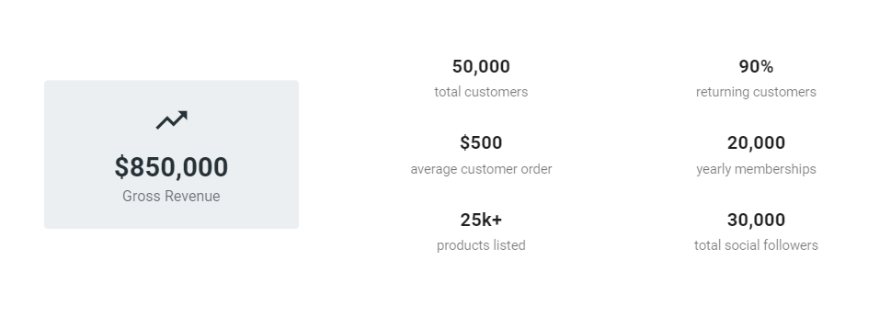
Source – upmetrics.com
Traction

Slide 9
Company setup and finished
30 December 2023
150 Customers in the first month
31st December 2023
First 500 Membership
1st March 2024
Timeline / Milestones

Slide 10
Team and Key Members
Shivcharan Mistry and Dipeeka Mistry Owner After running a successful solar panel business over a decade. Shiv has started the solar panel company he has dreamed about | Paul Jake Plant Manager Paul will serve as the plant manager. He has extensive knowledge and experience in the solar panel industry. | Musad Ibrahim Investors Mausad is a lecturer and a small investor. His experience includes small business growth & expansion

Slide 11
List of references
BBC (2023) What is the UK inflation rate and why is it so high?. Available at: https://www.bbc.co.uk/news/business-12196322 (Accessed: 11 November 2023).
Berrian, D. and Libal, J. (2020) 'A comparison of ray tracing and view factor simulations of locally resolved rear irradiance with the experimental values', Progress in Photovoltaics: Research and Applications, 28(6), pp. 609-620. Available at: https://doi.org/10.1002/pip.3261 (Accessed: 11 November 2023)
Bongers, S. et al. (2021) ‘How the introduction of digital sales channels affects salespeople in business-to-business contexts: a qualitative inquiry’, Journal of Personal Selling and Sales Management, 41(2), pp. 150-166. Available at: https://doi.org/ 10.1080/08853134.2021.1906260
gov.uk (2023) Nat Zero Strategy: Build Back Greener. Available at: https://www.gov.uk/government/publications/net-zero-strategy (Accessed: 11 November 2023).
Klein, S. et al. (2021) 'A financial benefit-cost analysis of different community solar approaches in the Northeastern US', Solar Energy, 213, pp. 225-245. Available at: https://doi.org/10.1016/j.solener.2020.11.031
upmetrics (2023) Create your workspace. Available at: https://app.upmetrics.co/f/b/k4hodq6Pw3xv3Pzfs/a/pitch/create/tGszJxcKyaRQAFaud/s/2yWWfptAx TAdSyocL (Accessed: 11 November 2023).

