Slide 1
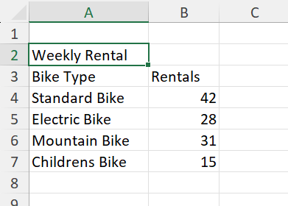
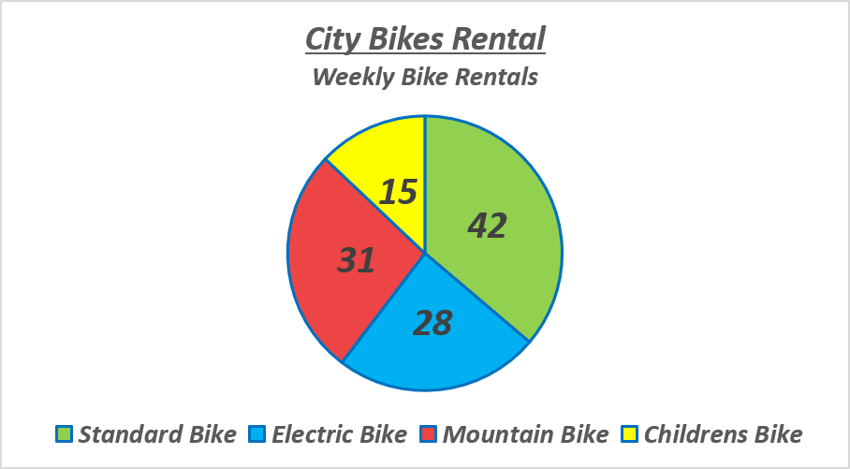
I have created this pie chart, and it shows the weekly bike rentals for each bike type.

