Slide 1

End of Life Care
By Saiqa Bibi 2020850.
Module: Living with Care: The Older Person
Module Code: BMHP6009_BIRM
Lecturer: Joanne Davies

Slide 2
Introduction
This presentation will consist of looking into end-of-life care and palliative care.
The presentation will include discussing the provisions provided in different care settings and what the statistics show where quality of end-of-life care is given.
The gap between need and availability for palliative care will be highlighted and the legislations, theories and policies surrounding end of life will be explored
These factors will give a better understanding into the support and the needs available in the UK today. I will also critically examine the for and against arguments for euthanasia and what the laws state regarding euthanasia compared to other countries
Overall, elderly people are living for longer, this is because there is a focus on a better quality of life and providing quality care for those nearing the end of their lives (gov.uk, no date)
Based on my research recommendations will be given on how end of life care can be improved and what care settings elderly people prefer to spend their last days

Slide 3
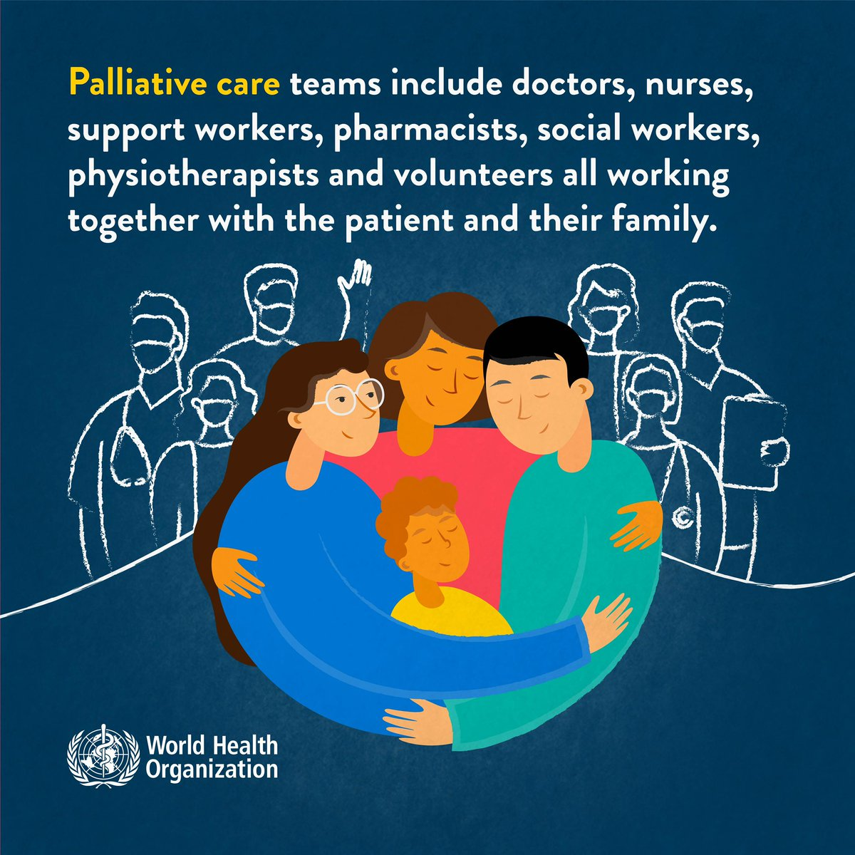
What defines end of life care and palliative care?
End of life care is providing care and support for those reaching the final months or years of life (NHS, 2018)
End of life care can be provided dependent upon a patient's choice or circumstances (NHS, 2018).
End of life care can involve help to manage day to day tasks, physical symptoms, offer emotional support, will writing and funeral planning (Marie Curie, no date)
(World Health Organization, 2021)

Slide 4
What defines end of life care and palliative care?
you may receive end of life care which is a type of palliative care. It is an essential component of an integrated, people-centred healthcare system
A holistic approach towards managing pain and incurable illnesses, (World Health Organization, 2021).
Palliative care provides a system where it aids patients to live as actively as possible until death (World Health Organization, 2020).

Slide 5

Provision available in care homes
Trained staff giving round the clock care
Assisting with day-to-day hygiene care for example, bathing, dressing, providing food
Skilled nursing care in homes for residents
Emotional support provided for the elderly
(nhs.uk, 2018).
(Mitchell, 2019)

Slide 6

Provision available in hospitals
skilled nurses providing 24-hour care
specialized care from palliative care teams that collaborate with and assist the hospitals medical staff including doctors, nurses, and other health and social workers (NHS Choices, 2019)
Expert guidance on managing symptoms and pain (NHS, 2018)
(The Independent, 2015)

Slide 7

Provision available in hospices
Give options of day care visiting the hospice as an outpatient or provide inpatient care in a hospice
Can also have care provided at home when patients are diagnosed with a terminal illness
Extended care provided for loved ones of the patient
After the patient passes away, care can continue for the bereaved (NHS, 2019)
Hospice care is a preferred choice for end-of-life care as it places a great importance on respect, dignity and an individuals wishes who is ill (NICE, no date)
(Hospice UK, no date)

Slide 8

Provision available at home
Home visits from community nurses/palliative care nurses
providing practical and emotional care and support to the patients and those at home around the patient
Advice on managing symptoms and pain
The comfort of spending the last moments in the comfort of your own home
(NHS Choices, 2019)
(Palliative and end of life care, no date)

Slide 9
The gap between need and availability – end of life care
Many people who have a chronic, life-threatening illness either do not receive any palliative care treatments or do so only when their sickness is at its most advanced stage (Hawley, 2017).
Numerous research from various nations demonstrate how palliative care treatments can enhance patient outcomes such as symptom management and better quality of life (CHPCA, 2015).

Slide 10
The gap between need and availability – end of life care
The need for equality in end-of-life care is vital for all backgrounds and all ages. These are the fundamental aspects which every dying person is entitled to receive and their loved ones regardless of their background (NHS England, no date)
In a time when the value of palliative end of life care has been amply demonstrated, the percentage is still not 100% as evidenced by statistics, patients did not make the most of the services provided (Johnston et al., 2008)
Surveys carried out have indicated end of life care services are both under utilized and not readily available,
The UK is one of 80 countries which is the best place for end-of-life care.
This is a result of the availability of skilled palliative care professionals, (Guardian, 2015)

Slide 11

Theories of Ageing
Disengagement theory – when elderly people disengage with society, have reduced interest in social activities.
It is suggested that as people age, they revert to the most effective social structures they have developed over time as they get older
Relating this to end of life care, disengaging can be due to decline of physical and mental abilities, social isolation for the elderly is not only normal but also preferable(Kowalczyk, 2019)
According to Cuming and Henry, (1961) the elderly are seen to reduce their social life spaces to societal demands and to get ready for their final years of life.
It is a mutual disengagement from both older people towards society and society disengages from older people
(Larkin, 2009).
(Conger, 2009)

Slide 12

Activity Theory
Elderly individuals are more likely to be content with their lives when they are active and participating in society
This is the complete parallel view of the disengagement theory (Maulk, 2010).
Erikson was one of the few theorists who focused on development throughout the duration of the full lifespan.
He believed ageing was a natural process of human development (Cherry, 2021).
According to Erickson, as we age and become senior citizens, less productive and consider living a retired life (Mcleod, 2018)
(Princy Francis M, 2018)

Slide 13
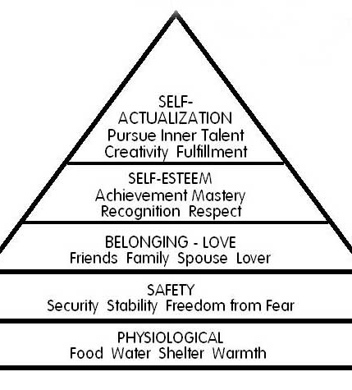
Maslow’s Hierarchy – applying to elderly care
Maslow's hierarchy of requirements serves as a framework for comprehending what drives human behaviour.
Each level is represented by a particular incentive that translates to a different human need.
According to Maslow, humans are motivated to change and find fulfilment through personal development (Carlson and Buskist, 2013).
Applying Maslow's hierarchy of needs to elderly care, it is important for ageing people they also reach the peak of the hierarchy
experience self-actualization in order to live a more fulfilled life
experience purpose and meaning and not be at the bottom of the hierarchy.
(Communication Theory, 2011)

Slide 14
Policy and interventions
The Care Act (2014) establishes the regulatory framework for councils with social obligations to assist people who are nearing the end of their life, along with their carers and families.
Although policy is acknowledged to be a significant factor in determining the success of end-of-life care, there is little research that seeks to investigate how this occurs or to speculate on the mechanisms that connect policy to better results (Barker, et al 2021)
Age is one of the ten protected characteristics of the Equality Act 2010) and doesn’t allow one to be discriminated on because of age (Gov. UK, 2013)
The Human Rights Act, (1998) addresses the rights of elderly people to freedom, respect, equality and dignity (Age UK, 2017)
According to Age UK (2019) the Human Rights Act should be upheld and strengthened for the best interests of the elderly. The current legislation offers a solid foundation for combating abuse of the rights and needs of older people
Walker (2009) believes that in order to comprehend social policy, one must first have a basic understanding of ageing.

Slide 15

Medical model and social model applied to end of life care
According to the medical model, being healthy means not having any disease. WHO defines health as a complete state of well-being, not simply the absence of disease (Swannack and Appleby, 2019).
The social model places a strong focus on the significance of addressing the causes of poor health, such as social problems. This method places more emphasis on the societal causes of sickness than it does on the abnormal body functions (Centre for Better Ageing, 2021)

Slide 16
Medical model and social model applied to end of life care
End of life should be treated with the social model of care as it provides a holistic approach. helps to identify barriers whereas the medical model will focus on treating the pain (Scope, 2014)
A common thread of quality end of life care is advocacy. It is nursing care that incudes symptom and pain management, ethical decision making and support during the death and dying process for the elderly (Hebert, 2011)
The person-centred approach should be at the fore-front of end-of-life care, prioritizing a patients and their families needs and care (Fang and Tanaka, 2022).

Slide 17

Planning for end of life
Lasting power of attorney
If you become incapable of decision making in the future, a legal document designating someone to make decisions concerning your care whilst you are alive(NHS Choices, 2019)
Living Wills
Many people who get to the end of their lives they don’t always have loved ones to make important decisions for them, living wills allows them to express preferences for medical care and to refuse certain treatments in specific circumstances (Age UK, no date)
(Age UK, no date)

Slide 18

Planning for end of life
Making a will
Ensuring your wishes are met and how your assets need to be distributed (Age UK, no date)
DNR’S
An order which allows a terminally ill person to not be resuscitated to save their life (The Guardian, 2019)
(The Guardian, 2019)

Slide 19
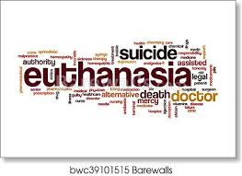
WHAT IS EUTHANASIA?
The (NHS, 2020) states Euthanasia is the deliberate taking of a person’s life to eliminate their suffering. For example, if a doctor was to purposefully administer a drug to a patient with a terminal condition with the intention of ending their life (Holland, 2019)

Slide 20

Types of euthanasia
There are five types of euthanasia
voluntary euthanasia – where a person consciously decides to die and requests assistance in doing so
non voluntary euthanasia – when an ill person can’t consent possibly due to being in a coma and someone else takes a decision on their behalf (NHS, 2020)
Active euthanasia: active patient death, such as administering a deadly amount of a medication through an injection
Passive euthanasia; withholding artificial life support, such as a ventilator or feeding tube, on purpose to causse a patient to pass away (Brassington, 2020)
Assisted suicide: the purposeful aiding of another person in committing suicide (NHS, 2020)
(Brassington, 2020)

Slide 21
Arguments for euthanasia
Supporters of assisted suicide argue that letting individuals pass away with dignity is more compassionate than making them live with suffering (NHS, 2020).
Euthanasia helps to alleviate severe pain
Euthanasia provides an effective way of relief when a person's quality of life is poor (Freeman, 2018)
Many terminally ill patients look towards the medics to aid in dying to relieve the suffering.
According to studies, 13 to 19 per cent of American medics have assisted in ‘physician-assisted suicide’ (Rodriquez, 2001)

Slide 22
Arguments against euthanasia
Opponents of euthanasia contend that if support is given to the rights for dignified death, those with terminal conditions will be removed from our civilized society (Math and Chaturvedi, 2012)
The arguments against euthanasia and assisted suicide is that it will make things worse rather than better since it will place a greater emphasis on individual choice than was previously the case with the entire issue of dying.
People will feel morally bound to get rid of their unwanted presence from their loved ones, it will make death more intolerable. The problems that euthanasia supporters believe it would resolve will only get more severe (Girard, 2022)

Slide 23
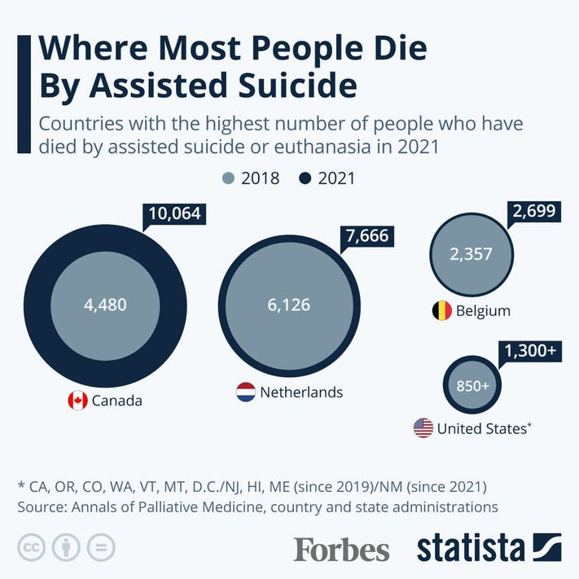
What the law says about euthanasia
Euthanasia is illegal in the UK and can carry a penalty of life imprisonment as it would be seen as manslaughter or murder however it is legal in many other countries including the US where they allow ‘assisted dying’ (NHS, 2020)
The level of care provided to individuals who are terminally ill has significantly decreased in Holland as a result of legalized euthanasia (Math and Chaturvedi,2012)
Acts of euthanasia and assisted suicide are illegal in many countries such as Australia however prosecutions have been very rare. In many cases of euthanasia and assisted suicide the patients suffering unbearably want to ‘die with dignity’ and remain adamant on ending their lives ( Bartels, et al 2010)
(Buchholz, no date)
“We have no control over how we arrive in the world but at the end of life we should have control over how we leave it.” (Stuart, 2022)

Slide 24
Conclusion
To summarize end of life care is providing the care and support for those in their final years. Palliative care is an essential component of an integrated, people centred healthcare system. The most preferred end of life care is hospice care as there is quality one to one care provided dependent on the individuals wishes.
End of life care services are under utilized; the UK is one amongst some countries which offers skilled palliative care. In some cases, palliative care is only provided when sickness is at its most advanced stage. DNR’s and Living wills can be useful for the elderly to ensure their wishes are fulfilled for end of life.
Applying Maslow’s hierarchy theory to end of life care shows the elderly should reach the peak of self actualization.
Applying both the medical model and social model to end of life care, it is the social model that should be treated for end-of-life care, it provides a holistic approach and overcomes barriers that can make life difficult for elderly people.
Advocacy is available in end-of-life care, it is professional nursing care that aids ethical decisions, symptom control and support for the death and dying process
Euthanasia is defined as a deliberate act of taking someone's life to eliminate suffering. The supporter for euthanasia argue that letting individuals pass away with dignity is far better than allowing them to live with suffering
Whereas opponents of euthanasia contend that if support is given to the rights for dignified death, those with terminal conditions will be removed from our civilized society (Math and Chaturvedi, 2012)
Euthanasia is against the law in the UK however in some countries it is legalized where assisted dying is allowed.

Slide 25
recommendations
My recommendations are palliative care should be provided in a hospice setting in order for a better quality of death, hospice care can be provided in a hospice or at home however care is not always provided for due to funding, etc.
In order to overcome this barrier, my recommendation is the third-party sector such as charities like Marie Curie can assist with funding in order to improve palliative care and have it more readily available.
I think its also vital to help engage the elderly people just because people are old, they still have rights as it states in the Human rights Act. however, some people do distance themselves from society as they have no family, friends for support and can be quite lonely
To overcome this, it is important to keep them engaged in society using Maslow's theory this can assist towards reaching the peak of self actualization, my recommendation would be to implement the activity theory maybe set up social clubs at centres to focus on end-of-life care patients
Finally, person centred care approach is essential for end-of-life care, a barrier to this could possibly be training. To overcome this, I recommend it be made a legal requirement for the health and social professionals providing end of life care and it should be continued throughout the end-of-life care just because someone is old, they are still entitled to quality end of life care.

Slide 26
references
Age UK. (no date). End of life planning. Available at: https://www.ageuk.org.uk/information-advice/money-legal/end-of-life-planning/. (Accessed: 2 February 2023)
Bartels, Lorana and Otlowski, Margaret, A Right to Die? Euthanasia and the Law in Australia (2010). Journal of Law and Medicine, 17: pp.532-555, Available at SSRN: https://ssrn.com/abstract=2188732 (Accessed: 24 February 2023)
Buchholz, K. (no.date) Where Most People Die By Assisted Suicide [Infographic]. Forbes. Available at: https://www.forbes.com/sites/katharinabuchholz/2022/08/12/where-most-people-die-by-assisted-suicide-infographic/?sh=609d55af49a3 (Accessed: 24 February2023)
Brassington, I. (2020). What passive euthanasia is. BMC Medical Ethics, 21(1). doi:https://doi.org/10.1186/s12910-020-00481-7.
CARE. (2022). Arguments for and against assisted suicide and euthanasia. Available at: https://care.org.uk/cause/assisted-suicide/arguments-for-and-against-assisted-suicide-and-euthanasia. (Accessed: 24 February 2023)
Centre for Ageing Better (2021) How the social model of disability can help us add life to years Available at: https://ageing-better.org.uk/blogs/how-social-model-disability-can-help-us-add-life-years (Accessed: 7 February 2023).
Cherry, K. (2021). Integrity vs. Despair in Psychosocial Development. Verywell Mind. Available at: https://www.verywellmind.com/integrity-versus-despair-2795738. (Accessed: 24 February 2023)
Communication Theory. (2011). maslow hierarchy of needs diagram. Available at: https://www.communicationtheory.org/maslows-hierarchy-of-needs/maslow-hierarchy-of-needs-diagram/ (Accessed: 24 February 2023)
Gov.UK. (no date). Coronavirus (COVID-19) in the UK. Available at: https://coronavirus.data.gov.uk/deaths (Accessed: 24 February 2023)

Slide 27
End of life care Guide for councils Guidance. (no date) Available at: https://www.local.gov.uk/sites/default/files/documents/22.53%20End%20of%2 (Accessed: 24 February 2023)
Fang, C. and Tanaka, M. (2022). An exploration of person-centred approach in end-of-life care policies in England and Japan. BMC Palliative Care, 21(1). doi:https://doi.org/10.1186/s12904-022-00965-w. (Accessed: 24 February 2023)
GOV.UK (2013). Equality Act 2010. GOV.UK. Available at: https://www.gov.uk/guidance/equality-act-2010-guidance. (Accessed: 24 February 2023)
Greater Manchester Palliative and End of Life Care. (no date) Home. Available at: https://peolc.net (Accessed: 15 February 2023).
Guideline End of life care for adults: service delivery 4. (no date). Available at: https://www.nice.org.uk/guidance/ng142/documents/draft-guideline. (Accessed: 24 February 2023)
Hawley, P. (2017). Barriers to Access to Palliative Care. Palliative Care: Research and Treatment, 10(1), p.117822421668888. doi:10.1177/1178224216688887
Hebert, K., Moore, H. and Rooney, J. (2011). The Nurse Advocate in End-of-Life Care. The Ochsner journal, 11(4), pp.325–9. Available at: https://www.ncbi.nlm.nih.gov/pmc/articles/PMC3241064/.
Holland, K. (2019). Euthanasia: Understanding the Facts. Healthline. Available at: https://www.healthline.com/health/what-is-euthanasia. (Accessed: 24 February 2023)
Hospice UK. (no date) Future of end of life care. Available at: https://www.hospiceuk.org/innovation-hub/future-of-end-of-life-care (Accessed: 15 February 2023).
Human rights of older persons and their comprehensive care. (2017). Available at: https://www.ageuk.org.uk/globalassets/age-uk/documents/reports-and-publications/reports-and-briefings/equality-and-human-rights/age-uk---human-rights-of-older-persons-and-their-comprehensive-care---(July-2017).pdf. (Accessed: 24 February 2023)

Slide 28
Justice. (2021). Types of Power of Attorney UK - confidencewills.co.uk.. Available at: https://confidencewills.co.uk/knowledge-centre/types-of-power-of-attorney-uk/ (Accessed: 1 February 2023).
Johnston, D.L., Nagel, K., Friedman, D.L., Meza, J.L., Hurwitz, C.A. and Friebert, S. (2008). Availability and Use of Palliative Care and End-of-Life Services for Paediatric Oncology Patients. Journal of Clinical Oncology, 26(28), pp.4646–4650. doi:10.1200/jco.2008.16.1562.
Kowalczyk, D. (2019). Psychosocial Theories of Aging: Activity Theory, Continuity Theory & Disengagement Theory - Video & Lesson Transcript | Study.com. Available at: https://study.com/academy/lesson/psychosocial-theories-of-aging-activity-theory-continuity-theory-disengagement-theory.html (Accessed: 24 February 2023)
Larkin, M. (2009) Vulnerable Groups in Health and Social Care. London: Sage Publications Ltd.
Lindsey M. Freeman, Susannah L. Rose, Stuart J. Youngner Poverty: Not a Justification for Banning Physician‐Assisted Death, Hastings Center Report 48, no.66 (Dec 2018): 38–46.https://doi.org/10.1002/hast.937 (Accessed: 24 February 2023)
Marie Curie. (no date.). What is end of life care? Available at: https://www.mariecurie.org.uk/help/support/terminal-illness/preparing/end-of-life-care. (Accessed: 24 February 2023)
Marie Curie. (no date). How specialist training is improving end of life care in care homes. Available at: https://www.mariecurie.org.uk/blog/care-home-training/142250 [Accessed: 15 February 2023).
Math, S.B. and Chaturvedi, S.K. (2012). Euthanasia: right to life vs right to die. The Indian Journal of Medical Research,136(6), pp.899–902. Available at: https://www.ncbi.nlm.nih.gov/pmc/articles/PMC3612319/. (Accessed: 24 February 2023)
Maulk, K. (2010) Gerontological Nursing: Competencies for Care 2nd edn. London: Jones and Bartlett Publishers International.
Mcleod, S. (2018). Erik erikson’s stages of psychosocial development. Simply Psychology. Available at: https://www.simplypsychology.org/Erik-Erikson.html (Accessed: 24 February 2023)

Slide 29
NHS (2018). End of life care. Available at: https://www.nhs.uk/conditions/end-of-life-care/what-it-involves-and-when-it-starts/. (Accessed: 2 February 2023)
Nhs.uk. (2018). Care in a care home. Available at: https://www.nhs.uk/conditions/end-of-life-care/care-in-a-care-home/. (Accessed: 2 February 2023)
NHS Choices (2019). End of life care. Available at: https://www.nhs.uk/conditions/end-of-life-care/where-you-can-receive-care/. (Accessed: 2 February 2023)
NHS Choices (2019). End of life care. Available at: https://www.nhs.uk/conditions/end-of-life-care/hospice-care/. (Accessed: 2 February 2023)
NHS Choices (2019). End of life care.. Available at: https://www.nhs.uk/conditions/end-of-life-care/. (Accessed: 2 February 2023)
NHS Choices (2019). End of life care. Available at: https://www.nhs.uk/conditions/end-of-life-care/. (Accessed: 2 February 2023)
NHS (2020). Euthanasia and Assisted Suicide. Available at: https://www.nhs.uk/conditions/euthanasia-and-assisted-suicide/(Accessed: 1 March 2023)
Neil R. Carlson, William Buskist, Michael E. Enzle, and C. Donald Heth (2018) (authors) Psychology: The Science of Behaviour. Toronto, Ontario: Pearson Education Canada Ltd., 2002, 701 pp., ISBN 0-13-0393606-6. Reviewed by: George Alder.
NHS (2020). Euthanasia and Assisted Suicide. Available at: https://www.nhs.uk/conditions/euthanasia-and-assisted-suicide/. (Accessed: 2 February 2023).

Slide 30
Pierce, M. and Timonen, V., (2010). A discussion paper on theories of ageing and approaches to welfare in Ireland, north and south.
Policy Position Paper Human Rights United Kingdom. (2018). Available at: https://www.ageuk.org.uk/globalassets/age-uk/documents/policy-positions/cross-cutting-issues/human-rights-policy-position-uk---aug-2018.pdf (Accessed: 24 February 2023)
Rodriquez, E. (2001). The Arguments for Euthanasia and Physician-Assisted Suicide: Ethical Reflection. The Linacre Quarterly, 68(3), pp.251–261. doi:10.1080/20508549.2001.11877616.
Science Direct (2016). Disengagement Theory - an overview | ScienceDirect Topics. Available at: https://www.sciencedirect.com/topics/psychology/disengagement-theory. (Accessed: 24 February 2023)
Scope (2014). Social model of disability | Disability charity Scope UK. Available at: https://www.scope.org.uk/about-us/social-model-of-disability/. (Accessed: 1February 2023).
Swannack, M. and Appleby, B. (2019). Models of Health. Simplemed.co.uk. Available at: https://simplemed.co.uk/subjects/population-and-social-science/models-of-health. (Accessed: 24 February 2023)
The Independent. (2015). Making Britain a better place to die. Available at: https://www.independent.co.uk/life-style/health-and-families/features/making-britain-a-better-place-to-die-patients-in-their-final-days-present-a-unique-challenge-to-carers-and-hospices-a6723246.html (Accessed: 15 February 2023).

Slide 31
The Way Forward National Framework: a roadmap for an integrated palliative approach to care, Quality End of Life Care Coalition and CHPCA, Published March, (2015). http://www.hpcintegration.ca/media/60044/TWF-framework-doc-Eng-2015-final-April1.pdf. (Accessed: 24 February 2023)
World Health Organisation (2021). Palliative care. World Health Organisation. Available at: https://www.who.int/health-topics/palliative-care (Accessed: 24 February 2023)
World Health Organization (2020). Palliative care. World Health Organization. Available at: https://www.who.int/news-room/fact-sheets/detail/palliative-care (Accessed: 14 February 2023)
www.england.nhs.uk. (no date). NHS England» Addressing inequalities in end-of-life care. Available at: https://www.england.nhs.uk/eolc/addressing-inequalities-in-end-of-life-care/. (Accessed: 14 February 2023)
www.volunteerguardian.com. (2019). An Overview of DNR Orders | Volunteer Guardian Program. Available at: https://www.volunteerguardian.com/blog/overview-dnr-orders. (Accessed: 14 February 2023)

