Slide 1
Cross Platform Tools to encourage student participation in the secondary education sector
By Adam Martin
Notes:
Speakers notes found within folder and in presentation notes.

Slide 2
Background/Intro
What am I doing?
Develop A cross-platform application to allow student to improve their learning ability and contribute more within a classroom environment
Why did I choose it?
Technology is ever changing within the world so allowing teenagers to get accustomed to new technology and ideas will help prepare them in the future
Client?
The project doesn’t have a primary client but it revolves around the idea of secondary schools and how they use technology to innovate teaching and learning
Notes:
What am I doing?
Develop a cross-platform application to allow student to improve their learning ability and contribute more within a classroom environment. The system is based primarily on EVS (Electronic voting systems)
Why did I choose it?
Technology is ever changing within the world so allowing teenagers to get accustomed to new technology and ideas will help prepare them in the future, in tandem with the fact that some schools don’t have access to large scale technology and this easy system will allow for teachers to allow students to learn in different ways.
Client?
The project doesn’t have a primary client but it revolves around the idea of secondary schools and how they use technology to innovate teaching and learning, the main client can be considered as the UK educational institute ranging from the ages of 11 to 16.

Slide 3
Aims & objectives
To conduct a literature review to research and critically review:
  The Educational structure
  Current Participation tools that are used in secondary education
  Student technology
  Learning styles and teaching methods
To analyse the current educational system
Understand student technology and why they use it.
View participation tools that are current.
Design, develop and implement software using Cross Platform Technology to create an educational tool to help educate and improve student contribution within lessons.

Slide 4
Main finding
What did I find out?
Almost all teenagers aged 11-16 have a mobile device
Learner types are diverse and can deeply affect a students learning capabilities.
Teaching methods while developed sometimes have stayed the same and there is a lack of innovation
Some pupils have a hard time communicating without the use of technology
Participation tools do exist but are quite expensive
Notes:
Almost all teenagers aged 11-16 have a mobile device, according to BBC news around 70% of all teenagers in 2016 have access to a mobile smartphone and use said smartphone almost daily in a variety of different ways from social media to video games and these smartphone have the ability to communicate across world in a number of different ways.
Learner types are diverse and can deeply affect students learning capabilities. Visual, auditory, physical each have fairly different ways of learning and these ways can significantly affect a student’s knowledge based on different subjects.
Teaching methods while developed sometimes have stayed the same and there is a lack of innovation, teaching methods are diverse and have come a long way from the first kind being chalk and talk which is still used today in university’s and is being phased out of schools due to the lack of innovation in the area.
Students sometimes have problems with participation within a classroom environment due to anxiety. These students when called on in class get anxious and break eye contact once called on they tend to freeze up. Pupils may have been paying attention in the lesson and even know the answer, but when they’re called on their anxiety level becomes so heightened that they can’t answer.
Participation tools do exist but are quite expensive, these tools are primarily have in cost and require different types of hardware that can be an excess of £60 per device, while these devices are indeed expensive there are alternatives that are purely online that require students to all be on the same website which is quite hard to accomplish within a large class.

Slide 5
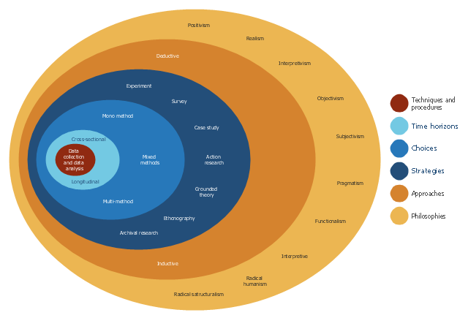
Research Onion
To understand the way the project develops its best to understand the process that the author uses for research.
Philosophy
Approach
Strategy
Time horizon
Data collection methods

Slide 6
Research methods - Philosophy
Phenomenology is the study of experience from the perspective of the individual, phenomenological approaches are based on personal knowledge and subjectivity, and the importance of personal perspective and interpretation.
Flexible changes within research
Allows answers to Why and How questions
Low budget
Different outcomes depending on the research
Data collected is qualitative data
Regards to human behaviour rather than scientific variables

Slide 7
Research methods - Approach
Inductive reasoning begins with specific observations or real examples of events, trends, or social processes and progresses analytically to broader generalizations and theories based on those observed cases
Understanding of events
Understanding of the research context
Collection of qualitative data
Structure to allows changes within research
Researcher is part of the research process
Less concern with the need to generalise

Slide 8
Research methods - Strategy
Case studies are utilized as a research method to investigate contemporary real-life phenomenon through detailed contextual analysis of a limited number of events, conditions, and their relationships
Includes fieldwork, like observations or interviews.
Investigation of single instances of a phenomenon of interest
Why and how, technology Research
Real-life situations, provide understandings into the detailed behaviours of topics
High validity, data is rich

Slide 9
Research methods - Time Horizon
Time horizon is a length of time the investment is going to be held or made before it is liquidated. At the end of time horizon the investment is evaluated for performance and can also be compared to other investment opportunities with same time horizon for return on investment.
A cross-sectional study
Instead of collecting data over time on a single variable, a cross-section is framed
Allows a researcher to see differences among population subsets in several categories.

Slide 10
Research methods - Data Collection
Quantitative data collection methodology can yield representative and broadly generalizable information and this information is usually found within literature style of formatting resulting in detailed data.”
Quantitative data collection
Interviews
Observations
Secondary Data: Documents, lecture notes and governmental admissions.

Slide 11
Development Methodology
Extreme programming (XP) highlights teamwork. Directors, customers, and developers are all equivalent partners. XP uses a simple, environment enabling teams to become more productive. These teams self-organise around issues to solve them.
XP improves a software project in “five ways”
Communication
Simplicity
Feedback
Respect
Courage
XP’s communicate with both customers partners. XP give feedback by testing software. It’s delivered to the system and customers as early as possible and implement changes as suggested.
Greater programmer productivity
Accustomed to change

Slide 12
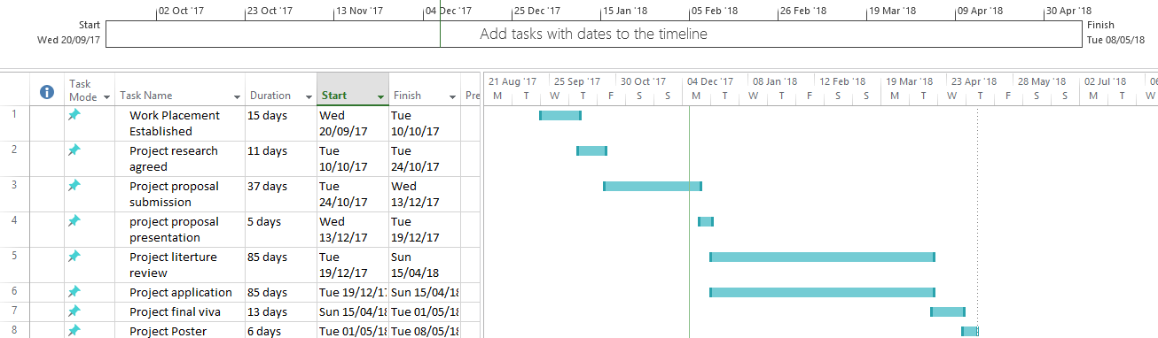
Plan submissions
Plan has two separate versions, the first being research submissions/deliverables

Slide 13
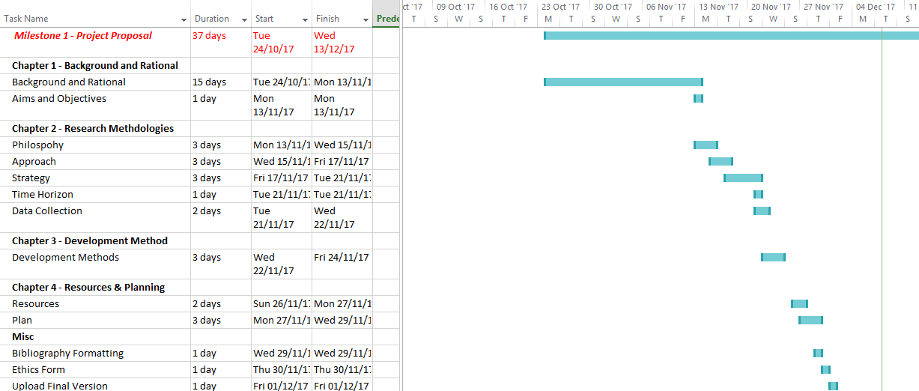
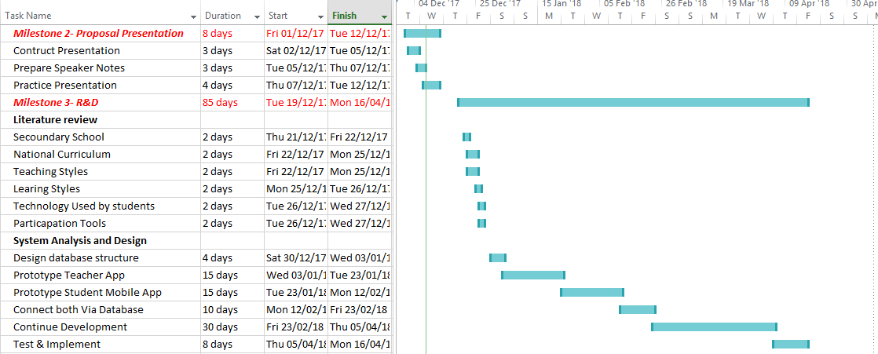
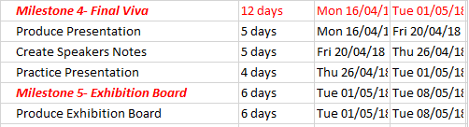
Plan milestones
the second being the entire project and its milestones.

Slide 14
Problems may encounter/ Overcome
Using new type of add-on (xamarin) there maybe connection issues between two applications.
Majority of data being from students, likely that the use of dummy data will increase.
Language problems c # (low use)
Certain journals and documents may be hard to acquire
Notes:
Using new type of add-on, (Xamarin) there maybe connection issues between the applications. To overcome this issue its best to split each of the systems up, one for teacher and one for students then use the database as a connecting point, while this will slow down data acquisition it will in turn allow for an easy and stable connection between the two systems.
Majority of data being from students, likely that the use of dummy data will increase.
Language problems c # (low use), since the author has dealt with C# the least there are large amount of tutorials and online help as well as past projects that can be called upon of important details.
Certain journals and documents may be hard to acquire, to combat this there are large amounts of services within model that allows for the viewing of journals that many normal browsers aren’t capable of viewing.

Slide 15
Hope to find
An increase in students participation through the use of the tool
An increased thirst for knowledge from the competition based system
Learning styles having a positive effect on a student's knowledge
Notes:
An increase in student’s participation through the use of the tool
An increased thirst for knowledge from the competition based system
Learning styles having a positive effect on a student’s knowledge

Slide 16
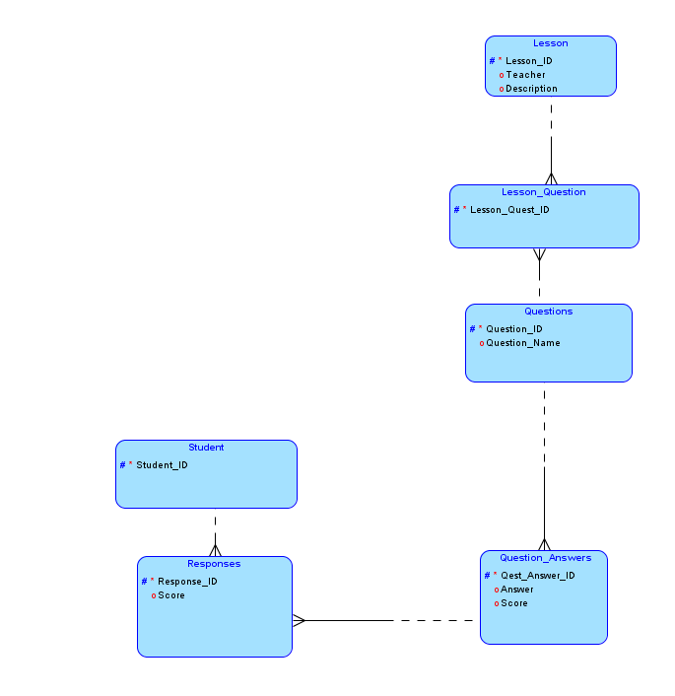
Prototypes – Data Structure
Prototype mockup screens, going to look like this

Slide 17
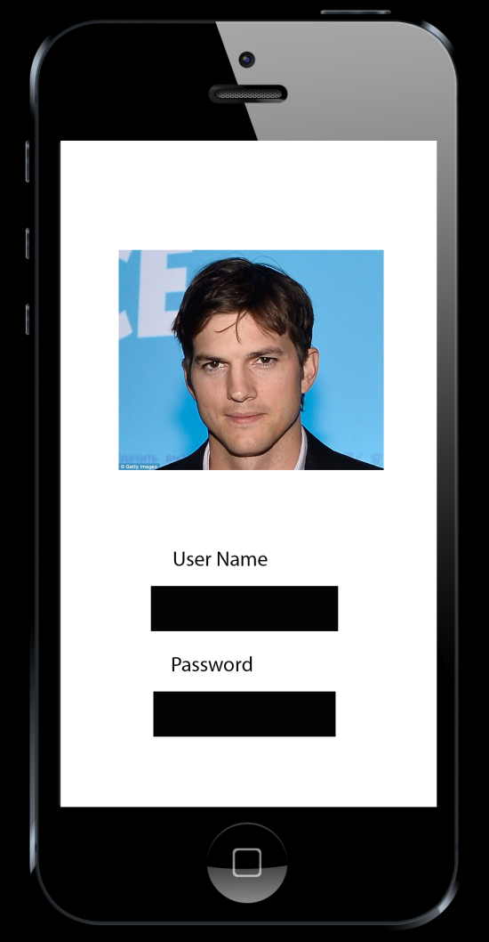
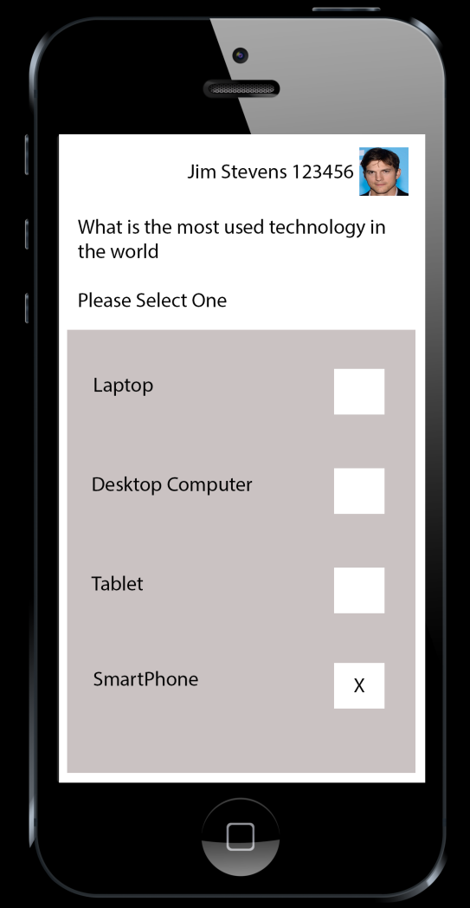
Prototypes – Mockup Mobile
Prototype mockup screens, going to look like this

Slide 18
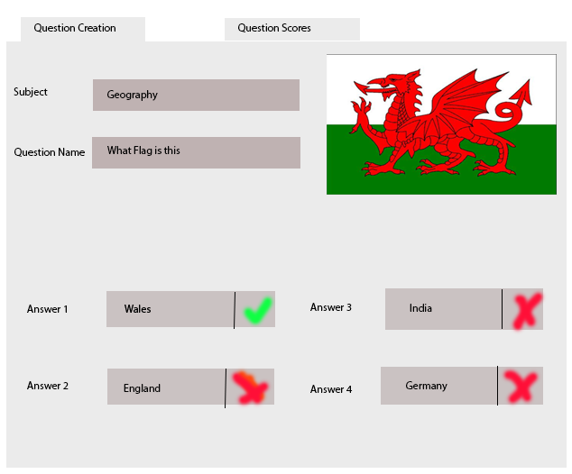
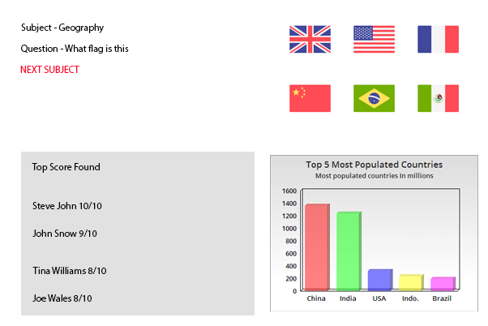
Prototypes – Mockup Desktop
Prototype mockup screens, going to look like this

Slide 19
Any questions?

