Slide 1
Digital Skills &
Personal Branding
Social Media:
LinkedIn
CertHE Skills for the Workplace
BMSK4007

Slide 2

Social Media

Slide 3

LinkedIn

Slide 4
LinkedIn
LinkedIn is a social network for professionals. It is similar to a traditional networking event where you go and meet other professionals in person, talk a little bit about what you do and exchange business cards.
Whether you are a marketing executive at a major company, a business owner who runs a small local shop or a student looking to explore future career options, LinkedIn is for anybody and everybody who is interested in taking their professional lives seriously by finding new opportunities to grow their careers and to connect with other professionals.
Nations, D. (2017) What is LinkedIn and why should you be on it?, [online] available at https://www.lifewire.com/what-is-linkedin-3486382 accessed Mar 2018

Slide 5
LinkedIn
On LinkedIn you add "connections" in the same way as making a friend request on Facebook, you converse via private message (or available contact information) and you have all of your professional experience and achievements laid out in a neatly organised profile to show off to other users.
LinkedIn is very similar to Facebook in terms of its broad feature offering. These features are more specialised because they cater to professionals, but in general, if you know how to use Facebook or any other similar social network, LinkedIn is not that different.
Nations, D. (2017) What is LinkedIn and why should you be on it?, [online] available at https://www.lifewire.com/what-is-linkedin-3486382 accessed Mar 2018

Slide 6
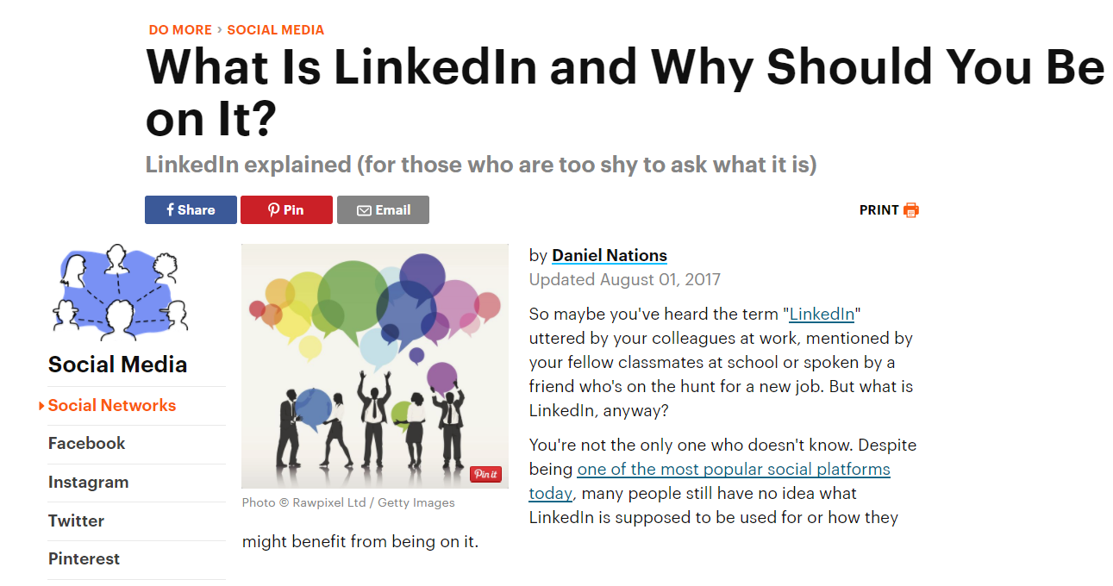
LinkedIn
Nations, D. (2017) What is LinkedIn and why should you be on it?, [online] available at https://www.lifewire.com/what-is-linkedin-3486382 accessed Mar 2018

Slide 7
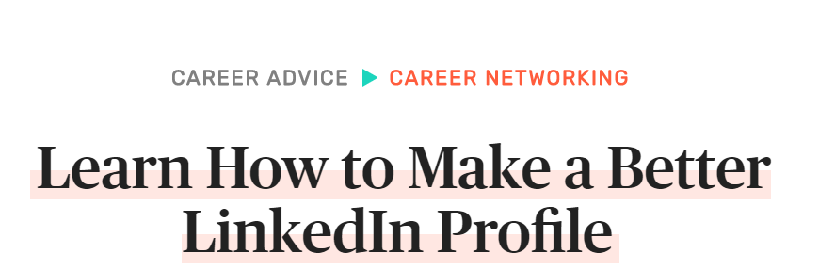
LinkedIn
Doyle, A. (2017) Learn how to make a better LinkedIn Profile, [online] available at https://www.thebalance.com/tips-to-make-a-better-linkedin-profile-2062332 accessed Mar 2018

Slide 8
LinkedIn
All your Tutors have active LinkedIn profiles so let’s begin with taking a quick look at them.
Once you have created your profile you can download a pdf file of it to share with others via email or online message service.
Link to Julia Ault LinkedIn Profile pdf file

Slide 9
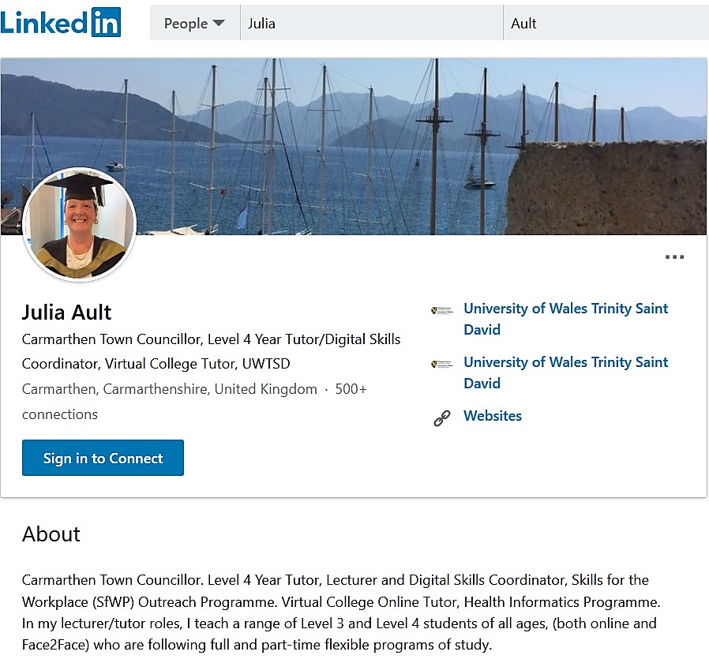
https://www.linkedin.com/in/juliaault/

Slide 10
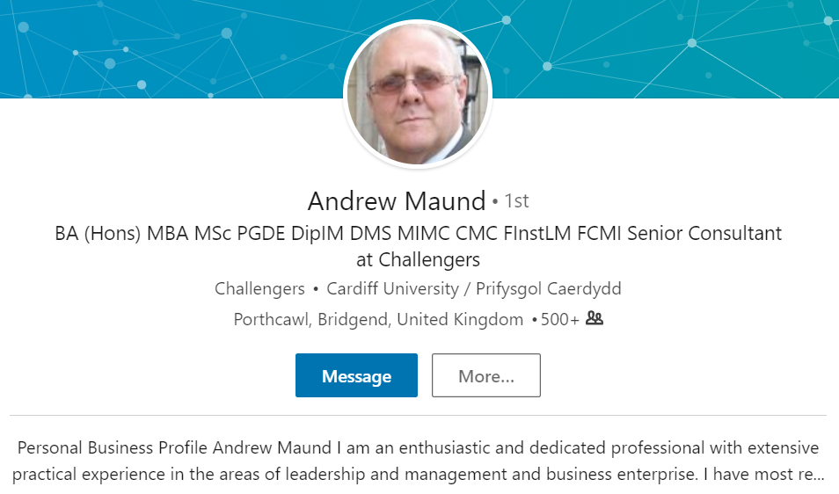
LinkedIn

Slide 11
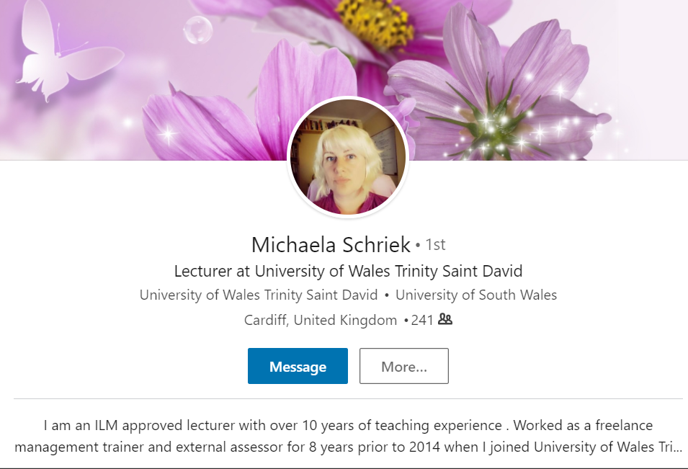
LinkedIn

Slide 12
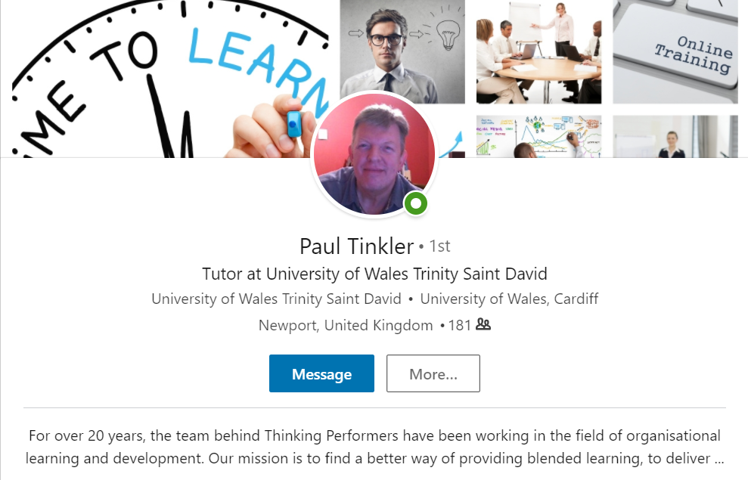
LinkedIn

Slide 13
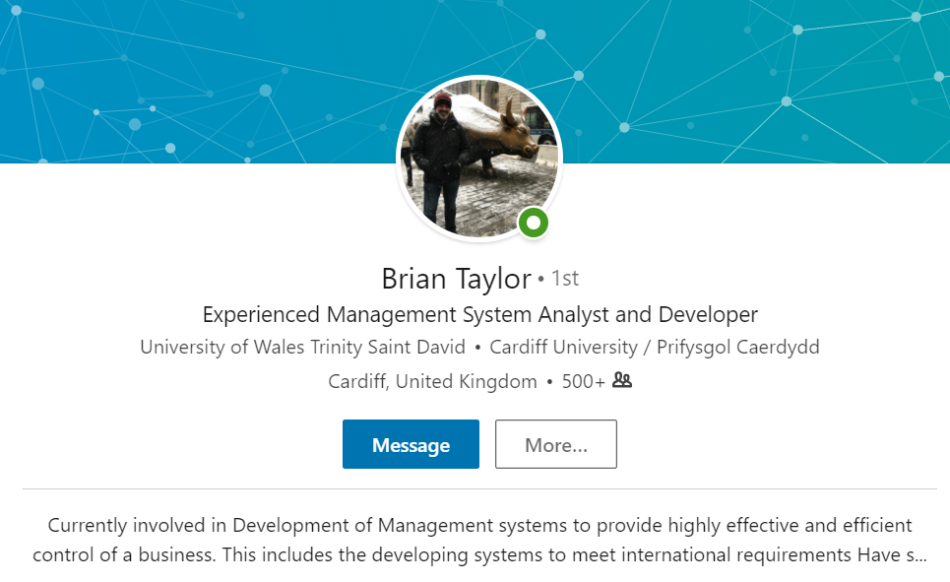
LinkedIn

Slide 14
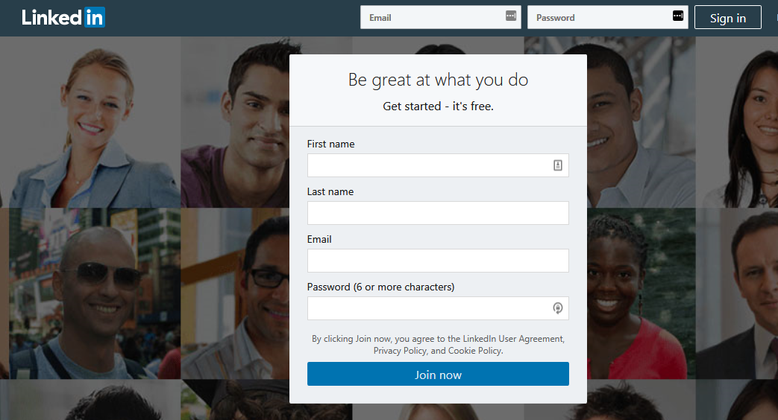
LinkedIn
Notes:
Start page for students to begin creating their own Linkedin profile with support from tutors and each other.

