Slide 1
Developing Relationships and Workplace Achievements
Training and Development needs for an HR officer
Student: LAURA VISan
id: 1918676

Slide 2

Morrisons PLC
Morrisons is part of the leading supermarkets in the United Kingdom.
It has a strong position in the market with more than 500 stores opened with online shopping and home delivery for which it also it has a partnership with Amazon (The Guardian, 2019).
In their stores they offer a variety of services: Morrisons café, photo printing, garden centres, flower shop, pharmacy, car parking, petrol station (Morrisons, 2022).
Notes:
The selected organization is Morrisons which has been selected because of its importance for its industry. It is representative for the supermarket industry and it has a large HR department.

Slide 3


Knowledge and behavior of HR officer
As a HR officer for Morrisons the knowledge related to personel recruitment and selection is used to employ new team members.
Morrisons advertises their job on different specialist online platforms but also uses their own website and have a software named Moribot which helps the applicants with queries (Morrisons, 2022).
Morrisons practices also internal promotion, by giving the opportunity to existing employees for career development.
Notes:
The Human Resources have great significance in the activity of the organisations as it can impact the running of the business and ultimately its success.

Slide 4

The administration and management knowledge refers to concepts such human resources modelling, leadership styles, resource allocation and other elements related to the business.
In the role of HR officer for Morrisons it can be observed that Morrisons values its employees and allocates an important amount of resources to motivate and keep their employees happy.
Morrisons invests in training their managers to lead the teams towards the organization objectives. The organization acknowledges the importance of retaining the best employees and that many times the cost of recruitment and selection is higher than retaining talent (Cappelli, 2009).
Notes:
Because Morrisons is a large organization the HR officer has to have complex knowledge and skills to manage all the aspects involved.

Slide 5

As HR officer is important to have knowledge about legislation regarding such as Employment Law, Discrimination Law, Wages and working hours, benefits laws, immigration law, work and safety laws (Northeastern, 2020).
In Morrisons in their warehouses and stores is important to follow the law regarding numbers of hours worked in a week, to ensure the employees have day off.
It is important to have knowledge on immigration law especially after Brexit and with new rules related to the right to work in the UK.
Also work and safety legislation is very important and training is given in the induction, especially in their warehouses where are used different machines and technologies and the presence of hazards is higher.
Notes:
Morrisons HR department has to have knowledge about the legislation and policies for employment. An organization can be easily sued for breach of contract or other legal aspects if there are any lacks or issues.

Slide 6

The clerical knowledge relates to the administrative procedures required to accomplish the tasks as a HR officer.
In Morrisons it is requested to have good grasp of knowledge for managing files and records as is a large organization and it has a complex system put in place for the Human Resources.
Along with this is also important to have good knowledge to operate computer and be able to use Word, Power Point, Excel and other internal programs used by the management.
Notes:
As HR officer is imperative to have a great set of skills to operate various technologies and software to accomplish the clerical aspects involved.

Slide 7
Skills
As a HR officer for Morrisons is essential to have a variety of skills such as active listening either with management or staff members in order to be able to have effective communication and solve problems and queries.
It is also imperative to have good speaking skills and be able to deliver the information clearly especially for staff where English is not their first language
The HR is not directly motivating the staff, but it has a great role in informing them their benefits, monetary and non-monetary rewards (Armstrong, 2020) .

Slide 8

Other skills include problem solving and decision making, verbal and writing skills, system evaluation for performance appraisal when HR is involved, time management
As HR officer for Morrisons monitoring and instructing skills have great value because of the large size of the business. Is important to have good coordination with the managers to ensure the HR strategies are put in place. That is why managers always consult HR when they have to take decisions regarding legislation or organisational practices (Morrisons, 2022).

Slide 9
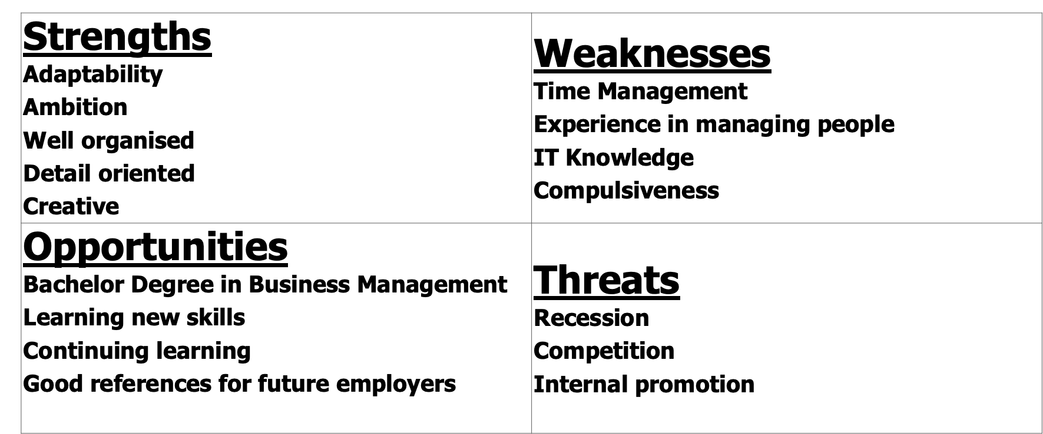
SWOT Analysis
Notes:
The SWOT analysis identified that I have important skills that can be my strengths such as presented above, but I have several gaps in knowledge and skills that can be my weaknesses. Being a student is an opportunity for my development and the sum of the additional opportunities that comes along.

Slide 10

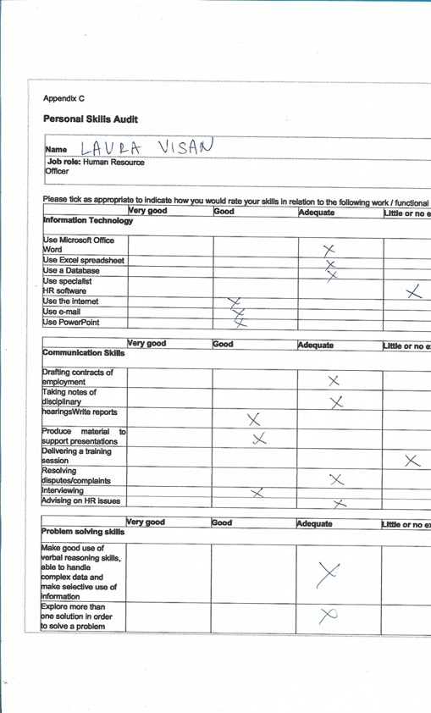
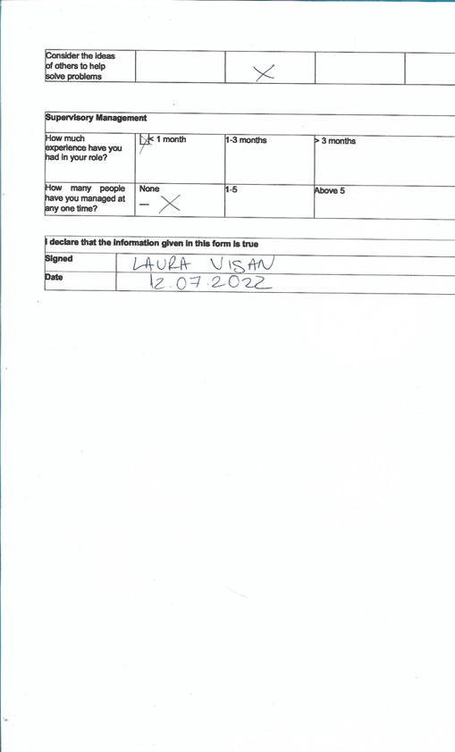



Personal Skills Audit
Notes:
My personal skills audit emphasizes that I don’t have a lot of experience in managing people and that I need to improve my IT skills.

Slide 11
Benefits for Morrisons for individual developing as an HR officer
I consider that it will benefit the organisation to become and HR officer as I have great knowledge and skills towards that.
By receiving training towards IT skills will enable me as an individual to use the specialist HR software
I consider that the lack of experience can be considered as a fresh perspective over old problems and that would contribute to the innovation for the process
Also by getting training for learning how to deliver a training session will be helpful, but I do not consider that is essential for an HR officer.
Notes:
I will be a great asset for Morrisons and by addressing my gaps in knowledge and training will enhance my development and will benefit the organization.

Slide 12
References
Armstrong M. (2020) “Armstrong’s handbook of human resource management practice (15th Ed., p1 online resource (801pages), S. Taylor Ed.), London, New York, New Delhi
Cappelli, P. (2009) Talent on demand-managing talent in an age of uncertainty, Strategic Direction,Vol. 25 No. 3
Morrisons (2022) “jobs” [Online]. Available at: https://www.morrisons.jobs/apply Accessed Accessed 15.07.2022
Morrisons (2022) “Corporate” [Online]. Available at: https://www.morrisons-corporate.com Accessed 15.07.2022
Northeastern (2020) “legislation” [Online]. Available at: https://www.northeastern.edu/graduate/blog/hr-laws-to-know/ Accessed 15.07.2022
The Guardian (2019) “Morrisons" [Online]. Available at: https://www.theguardian.com/business/2019/jun/13/amazon-and-morrisons-expand-same-day-grocery-delivery-service Accessed 15.07.2022

