Slide 1
Network Intrusion Detection System (IDS) Using Machine Learning

Slide 2

Introduction and Background
Overview of IDS: Intrusion Detection System (IDS) is essential to cybersecurity as it is used to monitor network traffic in order to identify and prevent malicious activity.
Significance: In the modern era of cyber threats, the conventional IDS techniques have become less effective [1].
The topic of research: The improved protection of IDS using machine learning to recognize new and previously unknown threats.
(Source: https://www.geeksforgeeks.org/ethical-hacking/intrusion-detection-system-ids )

Slide 3
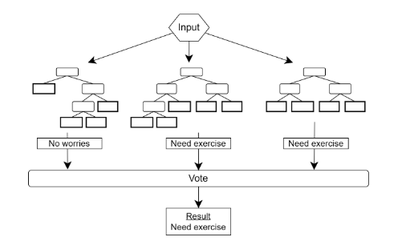
Research Problem
Limitations of current IDS: Traditional IDS are largely rule-based, and do not recognize new threats.
Machine Learning Gap: Although ML can enhance IDS, its implementation has not occurred on a broad scale because of difficulties in model training, unavailable data, and on-the-fly results [2].
Research Gap: A more efficient combination of machine learning algorithms in IDS must be developed to overcome such weaknesses.
(Source: https://eprint.iacr.org/2022/335.pdf )

Slide 4
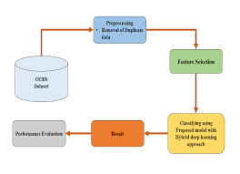
Research Aim & Objectives
Aim: To improve the existing IDS with machine learning algorithms to achieve better threat detection.
Objective 1: Examine existing IDS systems and their limitations [3].
Objective 2: Use machine learning-based models (e.g., SVM, Neural Networks) for IDS to enhance the accuracy of detection.
Objective 3: Test the performance of the suggested IDS based on real-world data and with different evaluation measures (precision, recall, etc.).
(Source: https://ijritcc.org/index.php/ijritcc/article/view/8499 )

Slide 5
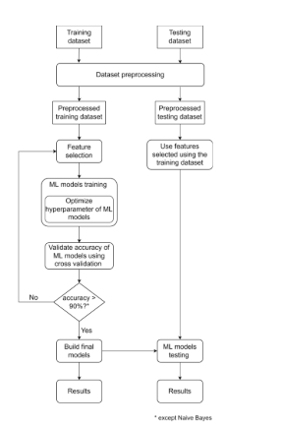
Literature Review & Research Gap
Recent Advances: Several studies appear to have used ML in IDS, although most have devoted attention to particular attack categories (e.g., DoS attacks) as opposed to a more general one.
Limitations: Challenge areas like real-time detection, scalability, or combining multiple machine learning techniques are not well covered by many studies [4].
Gap: An all-inclusive, machine-learning-based IDS capable of addressing various types of attacks and functioning in real-time is required.
(Source: https://eprint.iacr.org/2022/335.pdf )

Slide 6
Research Methodology
Research Design: Machine learning experimental research aimed at enhancing IDS.
Data Collection: Publicly accessible data, such as KDD Cup and UNSW-NB15, are to be used [5].
ML Algorithms: Implement supervised learning algorithms such as Support Vector Machines (SVM), Neural Networks, and Random Forests.
Assessment: Model performance can be assessed using accuracy, precision, recall, and F1-score.
Technologies: Python, Scikit-learn, Tensor Flow.

Slide 7

Timeline
Week 1-2 Literature Review and Research Problem Definition.
Week 3-4: Data Collection, Preprocessing.
Week 5-6: Model Implementation and Training
Week 7-8: Model Assessment and Testing [6].
Week 9: Final Report Writing and Preparation of Presentation.
(Source: Self-created in MS Project)

Slide 8
Impact & Limitations
Impact: The study will enhance the level of accuracy and the detection rates of the IDS, especially on new and unrecognized attacks [4].
Limitations: The model can be challenged with such issues as the imbalance of data, real-time processing, and generalization to another network environment.

Slide 9
Reference list
[1]Vanin, P., Newe, T., Dhirani, L.L., O’Connell, E., O’Shea, D., Lee, B. and Rao, M., 2022. A study of network intrusion detection systems using artificial intelligence/machine learning. Applied Sciences, 12(22), p.11752.
[2]Zhao, F., Li, H., Niu, K., Shi, J. and Song, R., 2024. Application of deep learning-based intrusion detection system (IDS) in network anomaly traffic detection.
[3]Fenjan, A., Almashhadany, M.T.M., Ahmed, S.R., Fadel, H.A., Sekhar, R., Shah, P. and Veena, B.S., 2024, May. Adaptive intrusion detection system using deep learning for network security. In Proceedings of the Cognitive Models and Artificial Intelligence Conference (pp. 279-284).
[4]Bakhsh, S.A., Khan, M.A., Ahmed, F., Alshehri, M.S., Ali, H. and Ahmad, J., 2023. Enhancing IoT network security through deep learning-powered Intrusion Detection System. Internet of Things, 24, p.100936.
[5]Hossain, M.A. and Islam, M.S., 2023. Ensuring network security with a robust intrusion detection system using ensemble-based machine learning. Array, 19, p.100306.
[6]Almutairi, Y.S., Alhazmi, B. and Munshi, A.A., 2022. Network intrusion detection using machine learning techniques. Advances in Science and Technology Research Journal, 16(3), pp.193-206.

