Slide 1
Fundamental Mechanics of Materials

Slide 2
Mechanical properties of materials
Hardness – resistance to indentation or scratching
Strength – resistance to applied forces
Brittleness/toughness – resistance to impact loads
Elasticity/stiffness – temporary deformation under load
Plasticity – permanent deformation under load

Slide 3
Properties of materials
Isotropic
Anisotropic
Orthotropic

Slide 4
Types of loading
Typical loading types including:
Static – non-fluctuating loads
Live – produced by, for example, cars crossing over a bridge
Impact or shock loads caused by sudden blows
Fatigue, fluctuating or alternating loads – the magnitude and sign of the load changing with time

Slide 5
Simple (direct) stress
F
F
Area
Stress σ = F
A
Stress is measured
in Nm⁻² or pascals
(Pa)
F
F
Tension
Compression

Slide 6
Direct strain
F
F
δL
L
Strain ε = change in length = δL
original length L
Strain is a dimensionless ratio i.e. it has no units

Slide 7
Elastic materials – Hooke’s law
Stress = E
Strain
Where E = modulus of elasticity or Young’s modulus
E = stress = P/A = PL
strain δL/L AδL

Slide 8
Typical tensile test
Load or
stress
B
σ_{y} = yield stress
σ_{t} = ultimate tensile strength
σ_{t}
A
σ_{y}
C
Yield point
OA = elastic behaviour
ABC = plastic behaviour
O
Extension or Strain

Slide 9
More tensile curves
Low stiffness, highly elastic
Stiff, brittle
material
High plasticity material
Typical carbon steel

Slide 10
Poisson’s Ratio
P
P
Poisson’s ratio ν = lateral strain .
longitudinal strain

Slide 11
Example 1:
A steel wire AB of length 0.6 m and cross-sectional area 1.5x10⁻⁰⁶ m² is attached at B to a copper wire, BC, of length 0.39m and cross-sectional area 3.0x10⁻⁰⁶ m². The combination is suspended vertically from a fixed point at A, and supports a weight of 250N at C. Find the extension of each section of the wire . (Young’s modulus of steel= 2.0x10¹¹Pa, Young’s modulus of copper=1.3x10¹¹ Pa)
Exercise 1
An aluminium wire of length 0.35 m and radius 0.2mm is stretched by 1.4mm. Young’s modulus of aluminium is 7.0 x10¹⁰ Pa.
Find the strain in the wire.
Find the stress in the wire
Find the cross-sectional area of the wire.
Find the tension of the wire

Slide 12
Sequence of Modules in ABAQUS
File: Set Working Directory
PART - Create individual parts that might be copied multiple times in an assembly
PROPERTY- assign material properties to Sections and assign Sections to regions of parts
ASSEMBLY- create ‘instances’ of each part
INTERACTIONS- eg create contact between two colliding surfaces
STEP- define initial and solver steps - and what type of problem
LOAD- eg add applied forces/tractions to surfaces and add boundary conditions (BCs)
MESH- define a mesh over part and assign finite elements to mesh
JOB- create a job for subsequent submission
VISUALIZER- display results

Slide 13




Beyond the simple bi-linear elastic-plastic stress strain model
For high strain rate (> 103 s-1 ) situations that we commonly find with explosive loading of ductile materials, a very popular model is the Johnson Cook model that is better for modelling plastic behaviour under dynamic loading:

Slide 14


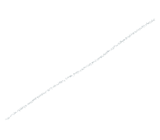
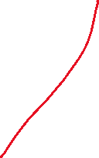
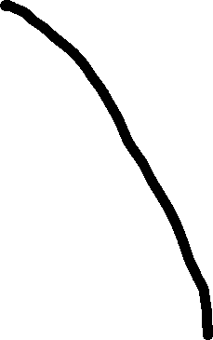



Damage initiation and evolution

Slide 15




J-C damage initiation criterion
When does the plastic strain start the damage?
This will calculate onset of damage

Slide 16
Damage evolution
…can be defined in abaqus as either the displacement or energy required for complete failure after damage initiation

