Slide 1

Demonstrate how learning theories can support effective teaching and learning.
Declan Milton-Harris – 1900817
Chloe Evans – 2105814
Ryan John Green - 2017590

Slide 2
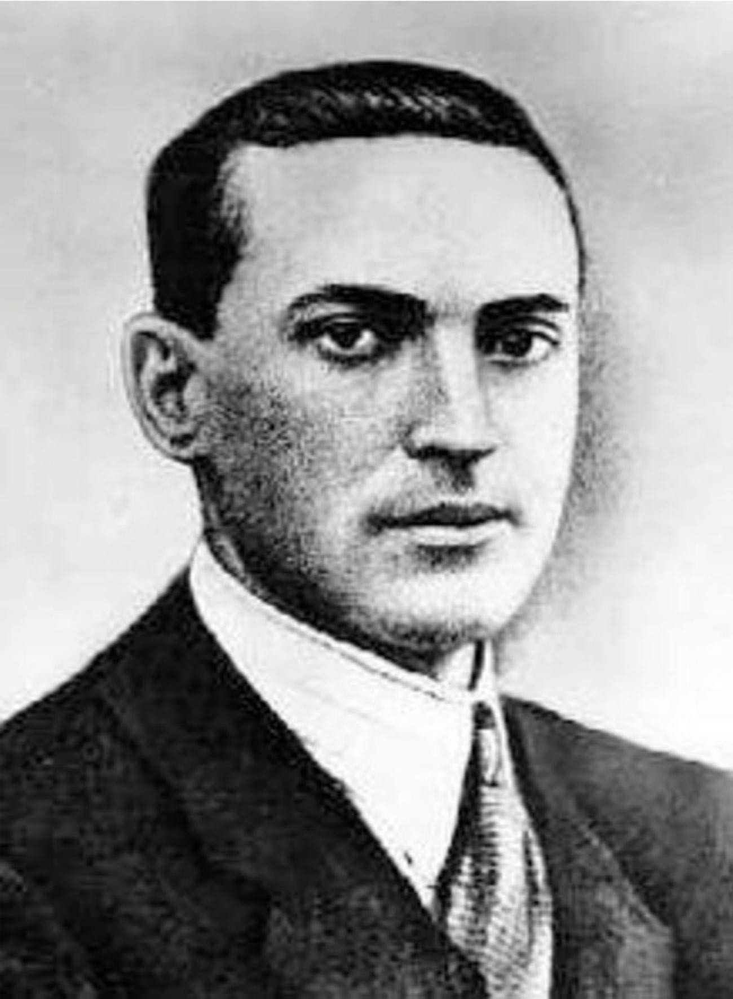
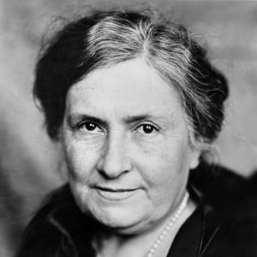
Introduction
Piaget's Theory (Ryan):
Born in Switzerland 1896; Graduated 1918 with a PhD; Worked for Alfred Binet
Believed that children should learn based on their interests (Similar to Montessori)
Children move through Four Stages of Cognitive Development.
Vygotsky’s Theory (Declan)
Socio-cultural factors – language, culture, play. (Newman and Latifi, 2021).
4 stages – "Primitive, Prelinguistic, Egocentric and inner ingrowth speech". (Bee and Boyd, 2019)
Zone of proximal Development and Scaffolding.
Learning assistance to promote learning.
Montessori’s Theory (Chloe)
Independence
Carine Robin (2019) Freedom within limits
Respect for child’s natural development
(Berliner, 2020)
https://www.biography.com/scholar/maria-montessori
Notes:
Ryan - Piaget was born in Switzerland in 1896. He was interested in science from a young age eventually graduated from the University of Neuchâtel in 1918 with a PhD in Zoology. When he completed his studies, he moved into the field of psychoanalysis and accepted a job at a Boy’s School that was run by Alfred Binet, who developed the first ever intelligence test in the world – and Piaget had a role in scoring these tests. He referred to himself as a ‘genetic epistemologist’ which comes under the umbrella of philosophy and looks at the nature, limits and extents of human knowledge. During his involvement with Binet’s intelligence testing he came to the conclusion that children think in a completely different way to adults. Although this idea is widely accepted and understood today, it was ground-breaking at the time, and it was this opinion that inspired him to research and understand how knowledge and understanding progresses throughout childhood and adolescence (Cherry, 2020). Piaget’s theory of intellectual development indicates that children move though four stages of cognitive development which they reach as their capacity for more sophisticated thought increases. Each child will go through the stages in the same order and their development is determined by interaction with the environment and biological maturation.
Declan - Alternatively, to Piaget’s Constructivist theory, Newman and Latifi (2021) suggested Lev Vygotsky believed childhood cognitive development was derived solely from socio-cultural factors such as language, culture, and play. However similarly to Piaget, Bee and Boyd (2019) explain Vygotsky’s theory to be made up of four stages of language development; “Primitive stage, Naïve Psychology stage, Egocentric stage and Ingrowth stage”, these stages allow children to endure the process of maturation and internalisation of their reasoning. Vygotsky’s theory is most renowned for the expressions “Zone of Proximal Development” (ZPD) and “Scaffolding” (Bee and Boyd 2019). For example, a teacher sounding out the alphabet, proceeding the class to imitate and remember the letters. The ZPD allows a learner to broaden their intellectual ability via guided learning, usually by the teacher or peers, as they aid the individual to move from tasks within their capability to more difficult tasks. Although Vygotsky’s work is dated the relevance of his theory is prominent in the studies of effective teaching within early childhood years in the present.
Chloe - Maria Montessori’s teaching theory revolves around the encouragement of children’s natural curiosity and independence. Today, I will discuss how Montessori's theory has supported effective teaching and learning in schools. Montessori believed that children were born with a natural curiosity and desire to learn both independently and with other children. Therefore, the role of the teacher should be to facilitate this by assisting the children during learning rather than leading. Carine Robin (2019) finds there is also an emphasis on freedom within limits for children and this concept embraces the idea that children should explore and learn for themselves within a prepared environment which is simply an environment which is designed to facilitate maximum independent learning. There is a respect for children's natural development in Montessori's theory and so it should be embraced that every child develops differently at various stages. The key principles of the theory are independence, following the child, observation, correcting the child and having a prepared environment.

Slide 3
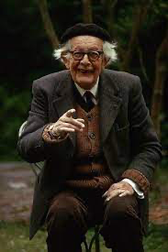
Piaget's Four Stages of Cognitive Development
Stage | Age Achieved | Objective
Sensorimotor | Birth – 24mths | Object Permanence
Pre-operational | 2 – 7yrs | Symbolic Thought
Concrete Operational | 7 – 11yrs | Logical Thought
Formal Operational | Adolescence – Adulthood | Scientific Reasoning
Ryan Green
Notes:
2-7 yrs: Represent the world to themselves through internalised language and mental images, at this stage they can think symbolically about events and objects. Don’t see the world for what it is they see it for how it appears to be. Animism is displayed at this age they give toys identities and think inanimate objects can have feelings. They think egocentrically as their opinions are based on their own view of the world.
7-11 yrs: Logical thinking begins during this stage, and they begin to grasp the concept of conservation which means they start to understand that if something appears to change some things still stay the same. At 6yrs they conserve number, 7yrs they conserve mass, 9yrs they conserve weight and begin to become less egocentric in their thought as they begin to form a more outward view of the world as well as considering the feelings of others.
12+ yrs: At this age children begin to form concrete operations on objects and formal operations on thoughts. They also being to understand abstract concepts and are able to form arguments without considering specific examples. They develop their ability to think about hypothetical situations and developing their scientific reasoning and comprehension of abstract theories (Structural Learning, 2021).
Piaget believes that children adapt to their environments through two key processes, which are assimilation and accommodation. During the process of assimilation something is used or adapted to meet cognitive structures which already exist; whereas with accommodation something is changed to fit the cognitive structures that already exist, which in turn changes the schema for their development (Blake and Pope, 2008).

Slide 4

How Piaget's Theories Can Be Used to Develop Skills & Learning
Benefits both teachers and pupils.
Having a better understanding of the child's thought processes can allow teachers to adapt their teaching strategies.
Teachers should take an active mentoring role towards their pupils
The curriculum being taught is created and implemented by teachers (Garner, 2008).
Hands-on classroom activities allows pupils to experience the content for themselves should supplement traditional teaching.
Giving children responsibilities in the classroom can also aid learning and development.
Recognising that each child has their own unique interests and abilities.
Planning a variety of classroom activities that incorporates all the learning styles (Furth and Wachs, 1975).
Concentrate on both the learning outcomes and the process of learning.
Focus on the steps that need to be taken in order for them to complete a task (Blake and Pope, 2008).
Ryan Green
Notes:
Using Piaget's theories in the classroom would benefit both pupils and teachers in several different ways. Teachers can have a better understanding of the thought processes of the children they teach and can adapt their teaching strategies to align with how their students are learning. It is essential that teachers create opportunities for their pupils to learn in order for them to detect similarities and contrasts at both physical and abstract levels. Examples of this in the classroom could be things like allowing access to play dough which teaches them that although the shape of the dough may change the colour stays the same, a play area in the classroom which allows children to interact with one another such as a shop will give them the chance to develop the necessary skills through role playing. Also giving the children responsibilities such as light chores around the classroom also provides opportunities for them to learn through doing something (Garner, 2008). Piaget believed that teachers should act as mentors to the children they teach and should provide hands-on activities in addition to traditional teaching methods. It is also important that the teacher recognises each child's unique interests, abilities and limitations with the understanding that different children learn at different paces than others and without forcing them to conform to one particular learning style. It is also important to consider the learning outcomes and the process of learning, instead of focusing on a particular answer consider the steps that must be taken to complete a task. An example of this could be during an art lesson if you ask the pupil to think of the way in which they will create their work, some may start from the bottom of the paper whereas others may start from the centre or the corner (Blake and Pope, 2008).

Slide 5

Using Vygotsky's theory to develop skills and learning
Foundation phase education – Key to learning Curriculum.
"To Help children develop communicative, self-regulative and cognitive abilities." (Dolya, 2010)
12 programmes - "freeze game", "artographics" and "buttons for buttonholes". (Dolya, 2010)
The contribution from the teacher to enhance the learning of students.
At ages 3-6 learners and the influence of social interaction and play. (Karpov, 2005)
Pretend play, through dressing up as firemen, policemen or other occupations.
Criticisms of Vygotsky's theory with thoughts of it being "weak and unclear" (Luntley, 2017).
Creation of a continuous question loop, who gained knowledge to educate others first?
(Discover Learning Childhood EDU, 2019)
Declan Milton-Harris
Notes:
Dolya (2010) identifies Vygotsky’s theory to be beneficial to children in the foundation phase of education through the Key to Learning Curriculum in the UK and Europe, where the goal of the curriculum is “to help children develop communicative, self-regulative and cognitive abilities”. Within the curriculum there are 12 programmes that allow children to develop a variety of skills including, arithmetic, language and problem solving, for example; the “freeze game”, “artographics” and “buttons for buttonholes” (Dolya, 2010) are all activities which children partake in for fun and indirectly develop these skills. Throughout the programmes the role of the teacher is essential in facilitating the development of these skills, the teacher is able to lead the class, participate in smaller groups and observe the children within independent play. These techniques allow the teacher to scaffold the children’s learning and aid them in exceeding their ZPD, providing the children with more knowledge and confidence to answer questions and help peers.
Additionally, Karpov (2005) believes self-regulation within children aged 3-6 is accelerated through social interaction and play, this may be through pretend play and dressing up as firemen, policemen or other real life occupations. Play should not be interrupted as it enhances a child’s potential to develop their own cognitive ability by re-enacting adult behaviour through their own eyes.
Controversially, Luntley (2017) questions the reliability and credibility of Vygotsky’s theory by criticising the lack of explanation and the use of description to evaluate learning throughout Vygotsky’s work. The terms “Weak and Unclear” are used by Luntley (2017) to describe Vygotsky’s theory, examining where individuals develop their cognition to socially interact with others, as according to the theory, they would need to be scaffolded by others to learn this knowledge causing a paradox that leads to the question, how did the first individual learn?

Slide 6
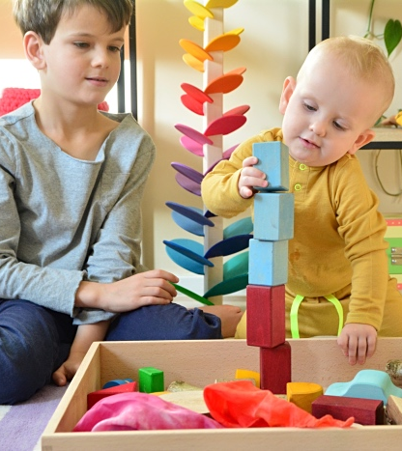
Using Montessori’s theory to develop skills and learning
Having limited but wholly educational objects and materials are said by (Feez, 2010) to be effective as children can "materialize educational knowledge from using these specific objects.
This is supported by (Woods, 1999) who argues that physical features, materials, organization, and climate are key features for a classroom for effective teaching.
An example of educational materials supported by Montessori's theory would be wooden blocks
Hand-eye coordination skills, socialisation and creativity skills are all developed through this type of learning.
A criticism of this comes from (O'Donnell,2013,p.132) who argues that there is potentially not enough materials which limit a child’s resourcefulness which may affect their learning
https://www.howwemontessori.com/how-we-montessori/2019/01/importance-of-toddler-block-play.html
Chloe Evans
Notes:
Montessori’s theory has influenced primary education massively and has been found to be successful in developing skills. To begin with, the use of educational objects being used in classrooms is said to be effective by (Feez, 2010) as the children are then able to “materialize educational knowledge” from playing with these objects and materials. Montessori toys are usually made from natural materials and encourage creativity, independent play, and concentration. Within the classrooms, Montessori believed that there should be a limited number of materials for the children to use, so that only materials that support the child’s development are included. In support of this, Woods (1999) argues that physical features, materials, organization, and climate are key features for a classroom for effective teaching. For example, we see wooden blocks in classrooms for early years children to play with. These wooden blocks are ideal in a learning environment as they help develop hand-eye co-ordination skills, social interaction skills such as sharing and fuel imaginative and creative play. A criticism of the materials allowed in a Montessori classroom is that there actually are not enough materials which limit a child’s resourcefulness which may affect their learning according to (O’Donnell, 2013, p.132).

Slide 7
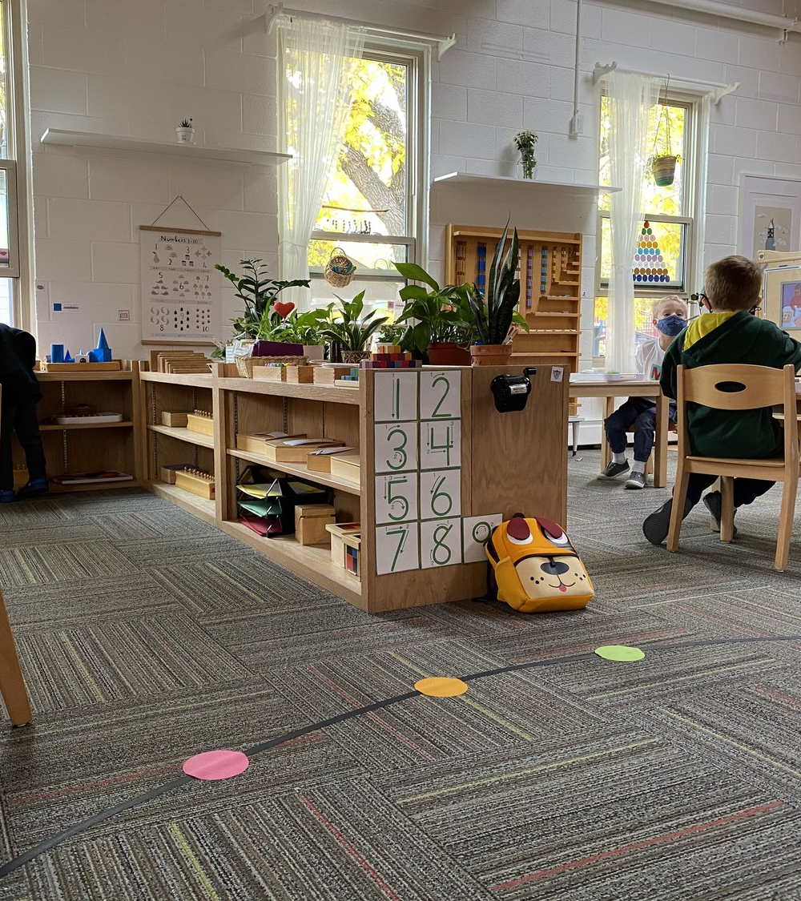
Similarities can be drawn here with Vygotsky's theory as there is an emphasis on developing cognitive skills through hands-on activities where they learn skills indirectly.
Child- led teaching means children have the freedom to learn from their own experiences
(Schneir and Schneir, 1971, pp.71-97) believes that children learn best from "an enriched and carefully planned environment” meaning that the classroom should be designed in such way that the child wants to explore and build independence. For example: shelving that’s in reach for the children.
Mixed age classrooms encourages socialisation. Older children build on leadership skills by helping the younger children whilst younger children have a stronger sense of belonging
(Little, 2001) argues that mixed age classrooms aren't effective because there is too much pressure put on teachers with the extra planning and organistation that is needed.
Karen Disney (2020) supports mixed age classrooms arguing that it develops skills in a more natural environment.
https://www.missymontessori.com/blog
Chloe Evans
Notes:
Similarly, to Vygotsky, there is an emphasis on developing social interaction skills using hands-on activities. However, whilst Vygotsky focuses on the effects of teaching and development, Montessori focuses on the normalisation of natural development.
The strong focus on child-led teaching means that children should move around freely and choose what they want to learn as they learn best from their own experiences. Of course, these freedoms come with limitations from the teacher’s guides. (Schneir and Schneir,1971, pp. 72-97) also believes that children learn best “in an enriched and carefully planned environment” which enables them to learn by themselves and from each other, supporting their natural drive to learn. The learning environment should facilitate this by having shelves and equipment in proportion to the child’s size for them to be able to build life skills themselves e.g., making their own drinks.
Mixed aged classrooms allow social skills between children of different ages to develop naturally. Older children naturally will help the younger children with tasks, and this builds skills for the older children such as leadership skills which increases their level of independence whilst the younger children will have a stronger sense of belonging. Mixed age classrooms aren't supported by everyone, Little 2001 believes that they put increased pressure on teachers because more planning and organisation is needed to be done. However, Karen Disney (2020) describes the positive impact of having mixed aged classrooms and explains that children can work at their own pace, developing skills naturally. The teacher can work with an individual child at their level and provide opportunities for them to observe and be taught by the older children until they then are confident in their understanding. New children will join, and a full circle will happen whereby that child is older and is now tutoring the younger children.

Slide 8
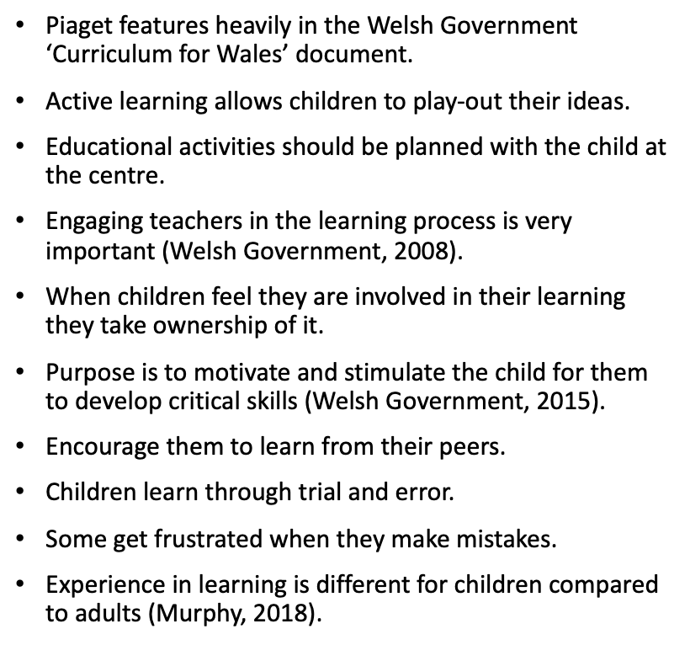
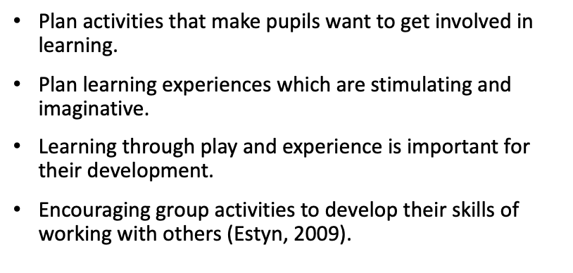
Planning Learning with Piaget's Theory.
Ryan Green
Notes:
In the Curriculum for Wales document which was published by the Welsh Government for Foundation Phase learning, Piaget’s theory features quite heavily in the curriculum framework as it states that children learn through first-hand experiences and the ‘serious business of play’ provides the vehicle for them to learn. This allows them to play-out their ideas, take risks, develop their problem solving skills and they also make decisions individually and in groups. Direct play allows the child to gain a better understanding of their world and how to process information. Educational activities should be planned with the child at the centre of the process and the teacher should be able to inspire and challenge a child’s learning potential. Engaging teachers in children’s learning is especially important when interactions involve open-minded question and thoughts. The value of active learning cannot be emphasised enough – when children feel as though they are involved in their learning they take ownership of it. The purpose of active learning is that it motivates and stimulates the child in a way that allows them to develop their concentration skills and can demonstrate their awareness of recently learned skills (Welsh Government, 2008).
Children should be encouraged to learn from their peers, especially within the Foundation Phase as teaching them to listen intently and to react sensitively to the actions of their peers as well as teaching them to respect different viewpoints will be hugely beneficial to them as they get older. Children should also be allowed to make mistakes as they provide opportunities for further learning. Piaget believed that children learn through trial and error and some children get frustrated when they make mistakes, but it is important that the teacher remains patient with them as mistakes show that the child is actively engaging with the learning environment and trying out new ideas for themselves (Welsh Government, 2015).
Experience in learning is a point of comparison between children and adults as the child will have little or no experience when completing activities so they are heavily influenced by their teachers and they are more likely to listen more during lessons. Children at this stage also have role models in their lives such as, siblings, older cousins, and other members of their families from which they learn their social cues. They also follow levels of instruction in order to progress to the next stage of learning and they learn by subject matter and their motivation to learn is based on external factors such as, peer pressure or competition between peers (Murphy, 2018).
Estyn, 2009 states that teachers and other practitioners should plan activities that make pupils want to get involved in learning and that they need to plan learning experiences which are imaginative and stimulating and ensure they are motivated by and focused on their lessons. It goes on to give examples of activities which can be planned for children to learn through play and experience, including acting out the story of ‘The Three Billy Goats Gruff’ where the children had to pick toys to represent the animals and think of what they could use to build a bridge across a tray of water, choosing items from pebbles – which were too small to building blocks which just floated on the water. Other activities included making a fish tank after a visit to a pet shop and building a model fire engine. There were other activities to stimulate pupils such as ‘Visiting the Doctor’ where it was stated that the children made excellent use of the role play area by turning it into a surgery waiting room.

Slide 9
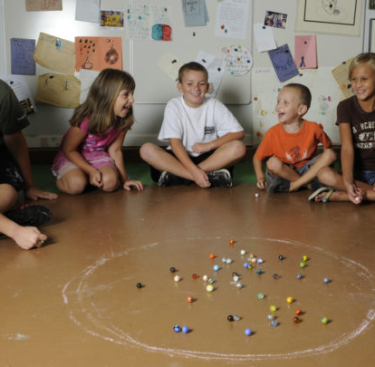
Planning Learning with Vygotsky's theory
Estyn (2009) created a document of case studies to encourage a more detailed delivery of education to foundation phase pupils aged 3-7.
Examples include using areas of learning within the class.
Further development of skills with the influence of the teacher to promote their educational evolution.
Using Vygotsky's theory as a universal tool to learn through "CHAT, Cultural-Historical Activity Theory". (Roth and Lee, 2007).
More kinaesthetic learning, for example; marbles or puppets.
The increased struggle of the building an education for learners through children increasing in diversity. (Eun, 2011).
Cognition of learners begins to plateau, due to the lack of education for practitioners.
(Crupper, 2013)
Declan Milton-Harris
Notes:
Estyn (2009) conducted a report of case studies to improve the teaching practice being delivered to learners aged 3-7 in the foundation phase of education in Wales. Creating specific areas of learning within the classroom is a great example, teachers are able to set up a variety of activities within different zones and allow the children to interact with one another whilst playing. The creation of these zones allow the individuals to develop their social and cultural skills through play, activities including dress up, building blocks and reading books could allow for the development of a wide range of skills. The teacher is able to further scaffold the children’s learning by switching the activities and where the areas of learning take place. This explains Vygotsky’s theory to be evident when using play to plan how the child learns and accelerate their development with the use of effective teaching.
Roth and Lee (2007) recognises the growing difficulty of constructing learning within the education sector due to the varying ability and learning styles between pupils. They found great significance in Vygotsky’s theory in becoming a more rounded and universal way of learning, taking parts of his original theory, which has set the foundation’s for current activity theories including “CHAT, Cultural-historical activity theory” (Roth and Lee, 2007). Practitioners are able to use more hands on play as a means to develop their pupil’s cognitive ability as an alternative to feeling obligated to teach the traditional way at the front of a class. Examples could include, using marbles for mathematics or using puppets for language development.
In contention with Vygotsky’s theory, Eun (2011) clarifies organising learning for early years education is becoming more demanding as the diversification of children increases, resulting in the need to upskill teacher’s education. Furthermore, absence of teacher’s education will consequently lead to the plateau of pupil’s cognitive development. This is problematic and impractical for the future generations, therefore, there must be continuous development of theoretical framework to allow the advancement of cognitive development in foundation phase children.

Slide 10
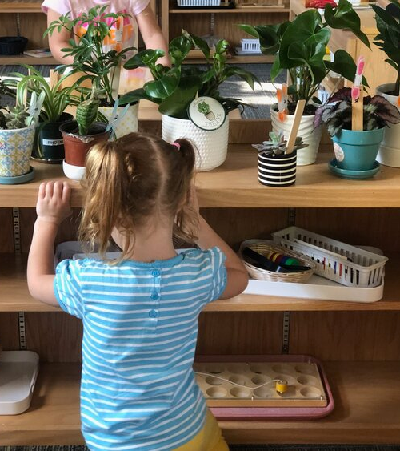
Planning learning with Montessori’s theory
'Prepared environment' - The classroom should be engaging for children where they are able to access all learning materials easily. The classroom should be simplistic in its decoration to avoid distractions. Rea (2014) finds that heavily decorated rooms can distract from learning and that children focus best with fewer visual displays on the walls
To support free movement there should be lots of space at tables and on the floor. This is supported by the Reggio- Emilia approach which designs its classrooms to encourage hands-on learning in open space for uninterrupted independent learning,
To have an effectively prepared environment is vital according to (Gillet, 1969) it “is necessary for the formation of children's intelligence”.
(Isaacs, 2012, p.53) finds that one feature of Montessori's theory allows children to learn new skills through "scaffolding". This is the breaking down of information into smaller, more manageable pieces so that a child can learn in stages. Montessori's theory allows for teachers or peers to assist with this by asking questions, using props or through demonstration.
Lessons should have uninterrupted blocks of work time - This is to help with concentration. This idea differs from the current teaching framework whereby the teacher may stop a lesson after an hour to move onto a different subject.
https://www.missymontessori.com/blog
Chloe Evans
Notes:
To plan and organize a classroom according to the Montessori theory, there should be open shelves and containers which are easily accessible for young children which hold the educational materials that they use. The 'prepared environment' is meant to attract the interest of children and get them to engage with the materials without distractions. Rea (2014) explored the idea that heavily decorated classrooms can distract pupils and that they learn more with less visual displays on walls. Having all the activities displayed and easy for children to reach gives them the opportunity to make their own decisions about what they want to play with and what they will learn. To support free movement, it is encouraged that classrooms have space on the floor and at tables which children can reorganize themselves.
(Isaacs, 2012, p.53) finds that one feature of Montessori's theory allows children to learn new skills through "scaffolding". This concept helps learners understand content by working with someone who has a better understanding of the material that can break down the concept into smaller chunks for them to learn step by step, once they have learnt one part to then expand their knowledge and build on it. This can be done by teachers or peers and in ways such as demonstration, asking questions, using props, or making suggestions to the learner. This feature follows some of the concepts in Vygotsky's theory.
Lessons should have uninterrupted blocks of work time. During this time, teachers are not to interrupt unless asked questions or for assistance. These blocks of time allow children to work at different tasks at their own pace without feeling left behind if a peer has finished one task before them. This differs from traditional teaching styles where the teacher stops the lesson after a while to move on to a different subject. By having blocks of work time, the concentration levels of the pupils improve and make for effective learning.

Slide 11
Piaget Today
Piaget's theory is still relevant today, especially within the Foundation Phase environment because of his belief that children learn through play to construct the knowledge they are learning and build on it to reach the equilibrium stage after passing the schemas.
Both the Welsh Government and Estyn are very clear that learning should mainly take place through play and other fun activities which engage the pupils as opposed to sitting them down with worksheets all day.
Most classrooms in schools today provide stimulating environments for children – both inside and outside – so they have enough activities and opportunities to allow them to develop based on their own interests.
During their inspections, Estyn ensure that the schools and teachers are providing the environment in which children need to learn new skills and develop. They also help to identify areas for improvement within the learning environment so that the teacher or practitioner is able to meet their pupil's learning needs.
Ryan Green

Slide 12
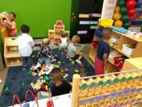
Evidence of Vygotsky's Theory in Foundation phase environment.
Importance of the implementation of a variety of theorists within early years education. (Welsh Assembly Government, 2008).
Through social free-play, visual aids, external educators.
For example, individuals in the local community.
Reinforcement of Vygotsky's theory within Foundation phase framework. (Welsh Government, 2015).
Altering group sizes in activities within or out of the classroom.
Personal experiences as a coach, using games like stuck in the mud.
Implications due to the use of Vygotsky's theory in the classroom.
Lacking acknowledgement of lifelike experiences to develop key skills compared to other theorists. (Yilmaz, 2011).
(Davis,2018)
Declan Miton-Harris
Notes:
Welsh Assembly Government (2008) state the importance of theories in effective teaching throughout education, such as Vygotsky, Piaget, Montessori and Bruner, are implemented into foundation phase classrooms with sufficient support to the individual’s leading the sessions. Vygotsky’s theory is evident within the foundation phase setting by the use of social interaction during free-play activities, visual aids on the walls to allow instructors to scaffold language or mathematical development, or the use of external educators to promote social and cultural recognition. For example, a Vicar from a church holding a talk or role-playing to the children, allowing them to understand the culture behind their profession. Techniques from various theorists allow the cognitive development of children within the foundation phase setting.
Welsh Government (2015) reinforces the evidence of Vygotsky’s work in the foundation phase framework through the children being encouraged by the practitioner to actively participate within activities both in and out of the classroom, in small or large groups. This further promotes the development of their learner’s cognition through social interaction and cultural tools, provide the learner to develop their communication and self awareness with the assistance of the educator. This may be through drawing symbols then learning to write letters. As a rugby coach, Vygotsky’s work is subconsciously implemented into the under 6’s sessions with strong emphasis on playing within teams and developing core rugby skills through demonstrations to scaffold their learning. For example, playing stuck in the mud allows children to progress into making tackles easier, due to learning the movement of grabbing and holding. This use of practice is adequate to take into an educational setting in the future.
Yilmaz (2011) argues that Piaget and Vygotsky’s theory is critical in cognitive development however, the implementation into the classroom environment has significant implications. Educators focus on creating a positive learning atmosphere as oppose to educating children on key life skills or real-life experiences. In-turn this enhances the reliability of other theorists such as Dewey or Montessori that allow for the learning of children to take place through real-life experimentation. To improve teaching practice in the classroom, a variety of theories and educating techniques could be applied to allow for a full understanding of how each individual learns.

Slide 13
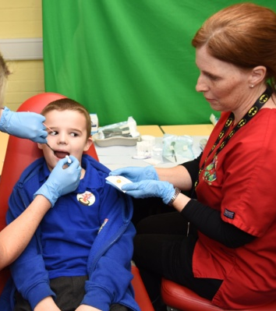
Evidence of Montessori’s theory in Foundation phase environment
Within the professional teaching standards specification posted by (Welsh Government, 2017) there is evidence of Montessori's theory as it claims that the teacher should encourage collaboration amongst learners.
Montessori believed that mixed aged classrooms allowed for children to learn from each other- An (Estyn 2019) report recently commended a Welsh primary school (which has mixed aged classrooms) for enabling their pupils to become independent learners. They achieved this by choosing their own topics each term, peer assessment and goal setting.
Children are encouraged to learn from real-life experiences - the Designed to Smile programme set by (Welsh government, 2017) gets them to brush their teeth every day in school making it an everyday, real-life lesson. This was supported by Swansea Bay University Health Board (2019) that found children who were involved in the programme learnt more because of the socialization involved.
(Welsh Government, 2019) stated in its foundation phase framework that pupils are to show curiosity and a positive attitude towards learning whilst becoming independent thinkers and learners. Interestingly, this mirrors the ideas of Montessori for effective teaching and learning.
(Swansea Bay University Health Board, 2019)
Chloe Evans
Notes:
The standard for collaboration within the professional teaching standards specification posted by (Welsh Government, 2017) shows evidence of Montessori’s theory as it claims that the teacher should encourage collaboration amongst learners to create a climate of mutual support in the classroom. By making an environment safe and respectful, children are more likely to contribute and work together, developing their skills further and supporting effective learning.
Montessori believed that mixed aged classrooms allowed for children to learn from each other- having the younger children learn from and be led by the older children. An (Estyn 2019) report recently commended a Welsh primary school (which has mixed aged classrooms) for enabling their pupils to become independent learners. They found that the school had various strategies such as goal setting and peer assessment which encouraged independence. The pupils also planned and chose topics that they wanted to study each term which is line with Montessori’s beliefs. It was found that the pupils of this school took ownership of their learning whilst maintaining a respect for their environment and culture. In turn, these elements of Montessori’s have met the criteria for effective teaching and learning.
Wherever possible, children are encouraged to have real-life experiences to learn from. This means that children are taught how to use utensils, like scissors and how to drink from glasses. This is all to teach children life skills which in turn makes them more independent learners. In some primary schools in Wales, there are schemes in place which are aimed at making younger children more self-aware and independent. One scheme which is in place as set by (Welsh government, 2017) is the Design to smile programme which is there to teach children how to brush their teeth correctly and then teeth brushing is made a part of the normal school day. It has been found by Swansea Bay University Health Board (2019) that children who partake in this programme are more engaged than they would be at home as they have fun whilst doing it with friends. This is a life skill that is vital and follows the Montessori theory in that it uses socialization to encourage pupils to engage in and enjoy learning.
(Welsh Government, 2019) stated in its foundation phase framework that pupils are to show curiosity and a positive attitude towards learning whilst becoming independent thinkers and learners. Interestingly, this mirrors the ideas of Montessori for effective teaching and learning.

Slide 14
Similarities / Differences | Piaget | Vygotsky | Montessori
How Children learn. | Through being active learners, play and learning from their interests | Children are active in social groups and develop logical thinking through play and scaffolding. | Through being active and developing logical thinking through exploration . The teacher should "follow the child".
How cognitive development happens. | Reaching the equilibrium stage to progress to the next schema or developmental stage. | Social interaction and use of social and cultural factors that scaffold learning to allow a learner to proceed their Zone of Proximal Development. | Through independently choosing learning materials and having the freedom to do what they want within limits.
Structure of the learning environment | There is no formal layout of a classroom such as with Montessori, but children should be able to follow their interests and have plenty of opportunities to play and role-play. | The Teacher or more knowledgeable individual instructs or participates in groups with the children. Activities can have different areas where children interact with each other. | Emphasis on shelving and materials to be easily accessible to the children. Lots of space on floor and at tables. There should be blocks of uninterrupted work time.

Slide 15
Conclusion
Ryan Green:
Piaget's theory is widely used both in Wales and England as guidance for providing a stimulating environment for Early Years pupils. It has also influenced the conversation about 'readiness' meaning that pupils need to reach a particular level in their cognitive development before they can be expected to understand certain concepts. Observations are also important as it helps teachers and practitioners understand each child's interests, learning styles and achievements to adapt their lesson planning and ensure they are providing suitable opportunities for their children to learn and develop. By doing this it is thought that while they are involved in activities and play practitioners will be able to assess how each child is developing and will allow them to gain an understanding of what they are able to do and gather details of their personal learning preferences. It is also thought that Piaget's theory can help teachers to understand children's behaviour – for example if a child will not share then it is likely that they don’t understand conservation (PACEY, 2016)
Declan Milton-Harris:
The effectiveness of Vygotsky's theory is supported through the works of Dolya (2010) and Welsh Government (2015) to distinguish how effective teaching is promoted in a foundation phase setting. Eun (2011) and Yilmaz (2011) raises concern over the relevancy of the theory in effective teaching for the future as it is limited with no real-life experiences. I believe Vygotsky's theory is partially evident within early years education to support effective learning, however support from other theoretical frameworks are needed.
Chloe Evans:
Elements of Montessori's theory can be found in effective teaching and learning practice. Children learn through socialisation with other children and through independent exploration. This is encouraged in primary schools with the assistance of educational toys and materials. The foundation framework by the (Welsh Government, 2019) sets out that a well-planned curriculum strikes a balance between child-initiated activities, but also structured activities directed by teachers. This concludes that parts of Montessori's theory are present in schools, backing that her theory does support effective teaching and learning.
Notes:
Ryan – Piaget's theory is widely used both in Wales and England as guidance for providing a stimulating environment for Early Years pupils. It has also influenced the conversation about 'readiness' meaning that pupils need to reach a particular level in their cognitive development before they can be expected to understand certain concepts. Observations are also important as it helps teachers and practitioners understand each child's interests, learning styles and achievements to adapt their lesson planning and ensure they are providing suitable opportunities for their children to learn and develop. By doing this it is thought that while they are involved in activities and play practitioners will be able to assess how each child is developing and will allow them to gain an understanding of what they are able to do and gather details of their personal learning preferences. It is also thought that Piaget's theory can help teachers to understand children's behaviour – for example if a child will not share then it is likely that they don’t understand conservation (PACEY, 2016) The research methods of Piaget have been criticised as a huge source for his inspiration was his own children, and even when he added other children to his research group it was considered to be relatively small and they were all well educated and from wealthy families. Because of this it is difficult to generalise his conclusions over a larger population who may not be of the same socio-economic status. Most of his work also has no statistics to demonstrate his findings and he also failed to measure objectively how variables may change and failed to specifically define any developmental variations (Cherry, 2019).
Declan - To conclude, Vygotsky’s theory is distinguished in supporting effective teaching and learning, Dolya (2010) and The foundation framework from Welsh Government (2015) provide policy of his work in the foundation phase of education as we know it today. The theory, alongside many others, underpins our current teaching practice and provides practitioners with the correct knowledge and tools to be able to successfully develop a child’s cognition. The Zone of proximal development and Scaffolding are integrated into everyday teaching via activities and play, to promote skills and language development. However, there are implications that may hinder the use of Vygotsky’s theory within pedagogy in the future. As argued by Eun (2011), the continuous evolvement of learners and education will result in practitioners needing to constantly develop. With the possibility of new theories and practice being introduced, brings concern to the relevancy of current theorists in effective teaching for the future. Furthermore, Yilmaz (2011) suggests the use of Vygotsky’s theory is unrealistic, with no lifelike practice taking place. The use of a variety of theorists is more important to engage the diversity of all abilities within learners throughout effective pedagogy. I believe that parts of Vygotsky's theory is useful throughout the current foundation phase teaching environment however, the use of a variety of theorists is more important to engage the diversity of all abilities within learners and create a more effective pedagogical environment.
Chloe – I believe that elements of Montessori's theory can be found in effective teaching and learning practice. Children learn through socialisation with other children and through independent exploration. This is encouraged in primary schools with the assistance of educational toys and materials. The foundation framework by the (Welsh Government, 2019) sets out that a well-planned curriculum strikes a balance between child-initiated activities, but also structured activities directed by teachers. This concludes that parts of Montessori's theory are present in schools, backing that her theory does support effective teaching and learning.

Slide 16
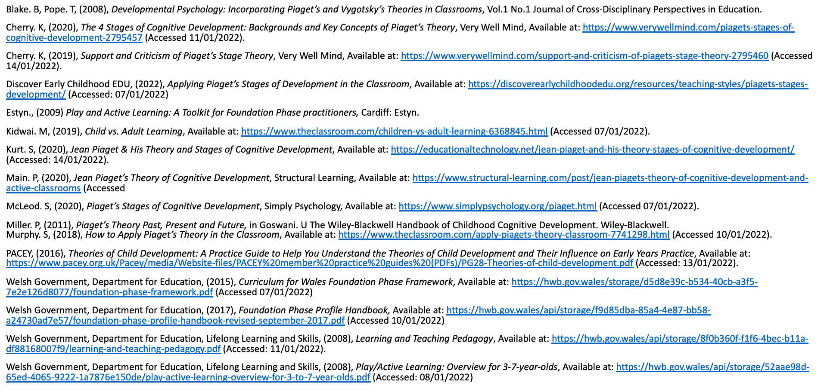
Ryan's References

Slide 17
Declan's References
Bee, H. and Boyd, D., (2019) Lifespan Development. 8 ed. Harlow: Pearson Education.
Berliner, Y., (2020) 'Mozart of psychology': How Lev Vygotsky helped shape modern thinking. [Online] Available at: ‘Mozart of psychology': How Lev Vygotsky helped shape modern thinking - Russia Beyond (rbth.com) [Accessed 14 January 2022].
Crupper, C., (2013) Simple Marbles Games. [Online] Available at: Simple Marbles Games - American Profile [Accessed 14 January 2022]
Davis, K., (2018) Twenty Pittsburgh kids to attend Pre-K at the Carnegie Science Center. [Online] Twenty Pittsburgh Kids To Attend Pre-K At The Carnegie Science Center | 90.5 WESA [Accessed 14 January 2022]
Discover Learning Childhood EDU., (2019) Lev Vygotsky's social development theory. [Online] Available at: Lev Vygotsky’s Social Development Theory – Discover Early Childhood EDU (wordpress.com) [Accessed 14 January 2022].
Dolya, G., (2010) Vygotsky in action in the early years the key to learning curriculum. London: Routledge.
Estyn., (2009) Play and Active Learning: A Toolkit for Foundation Phase practitioners, Cardiff: Estyn.
Eun, B., (2011) A Vygotskian theory‐based professional development: implications for culturally diverse classrooms. Professional Development in Education, 37(3), pp. 319-333.
Karpov, Y., (2005) The neo-Vygotskian approach to child development. Cambridge: Cambridge University Press.
Luntley, M., (2017) Forgetski Vygotsky: Or, a plea for bootstrapping accounts of learning. Educational Philosophy and Theory, 49(10), pp. 957-970.
Newman, S. and Latifi, A., (2021) Vygotsky, Education and teacher education. Journal of education for teaching, 47(1), pp. 4-17.
Roth, W.-M. and Lee, Y. J., (2007) "Vygotsky's Neglected Legacy": Cultural-Historical Activity Theory. Review of educational research, 77(2), pp. 186-232.
Welsh Assembly Government., (2008) Foundation phase framework. [Online] Available at: https://hwb.gov.wales/storage/8f0b360f-f1f6-4bec-b11a-df88168007f9/learning-and-teaching-pedagogy.pdf [Accessed 10 January 2022].
Welsh Government., (2015) Learning and Teaching Pedagogy. [Online] Available at: https://gov.wales/sites/default/files/publications/2018-02/foundation-phase-framework-revised-2015.pdf [Accessed 10 January 2022].
Yilmaz, K., (2011) The Cognitive Perspective on Learning: Its Theoretical Underpinnings and Implications for Classroom Practices. The Clearing house, 84(5), pp. 204-212.

Slide 18
Chloe's reference list:
Disney, K. (2020) ‘Why are Montessori classes mixed age’, Children’s House Montessori School of Reston [blog] 21 January. Available at: https://childrenshouse-montessori.com/2020/01/21/why-are-montessori-classrooms-mixed-age/
Estyn (2019) Effective Practice Available at: https://www.estyn.gov.wales/effective-practice/enabling-pupils-become-independent-learners
Feez, S. (2010) Montessori and Early Childhood: A Guide for Students. Los Angeles: Sage Publications Ltd.
Gillet, A. M. (1969) Introduction to Biology. Bergama: Montessori Conference.
Isaacs, B. (2012) Understanding the Montessori approach: early years. Routledge
Little, W. (2001). 'Multigrade teaching: towards an international research and policy agenda'. International Journal of Educational Development. 21, 481-497.
O'Donnell M. (2013) A critical introduction to key themes and debates. Bloomsbury publishing.
Rea, S. (2014) Press Release: Heavily Decorated Classrooms Disrupt Attention and Learning In Young Children, According To New Carnegie Mellon Research. Available at: https://www.cmu.edu/news/stories/archives/2014/may/may27_decoratedclassrooms.html
Robin, C. (2019) ‘What is a prepared environment’ Montessori Family [Blog]. August 23. Available at: https://themontessorifamily.com/?s=prepared+environment (Accessed: 11 January 2021)
Schneir, W. and Schneir M. (1971) ‘The Joy of Learning – in the open corridor’. New York Magazine, pp. 72-97.
Swansea Bay University Health Board (2017) Designed to smile. Available at: https://sbuhb.nhs.wales/news/swansea-bay-health-news/designed-to-smile
Swansea Bay University Health Board (2017) Designed to smile. Available at: https://sbuhb.nhs.wales/news/swansea-bay-health-news/designed-to-smile
Welsh Government (2017) An introduction to the professional standards for teaching .leadership. Available at: https://hwb.gov.wales/api/storage/932d8940-56f5-4660-aa85-afb4e87560a9/an-introduction-to-the-professional-standards-for-teaching-and-leadership.pdf
Welsh Government (2017) Designed to Smile child oral health improvement programme. Available at: https://gov.wales/designed-smile-child-oral-health-improvement-programme-whc201723
Welsh Government (2019) Foundation phase Framework. Available at: https://gov.wales/foundation-phase-framework
Wood, M. (1999) Essentials of classroom Teaching: Elementary Language Arts. 2nd edn. Boston: Allyn and Bacon.

