Slide 1
OME Electromagnetic Radiation
Lecture 2
Electricity

Slide 2
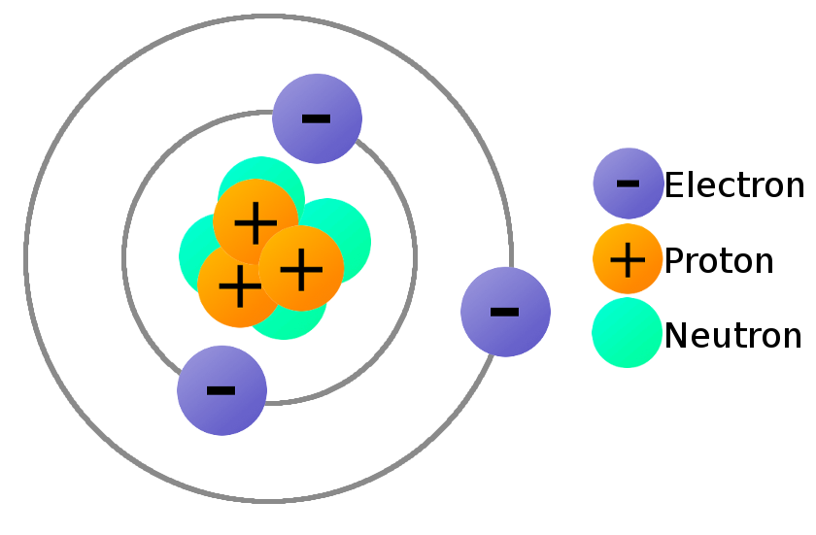
Bohr atomic model of the atom

Slide 3
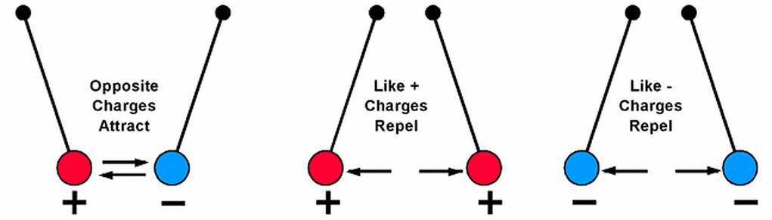

Slide 4
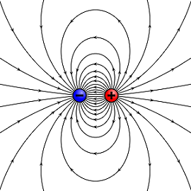
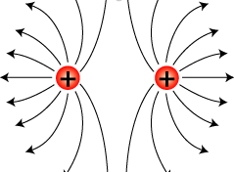
Electric fields surrounding charged particles
A field is a region where each point has a physical quantity represented by a number.
An electric field is the physical field that surrounds electrically charged particles and exerts force on all other charged particles in the field, either attracting or repelling them.
Charged particles in an electric field would be subject to a force with magnitude and direction.

Slide 5
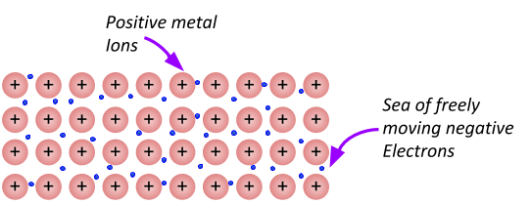
Conducting materials

Slide 6
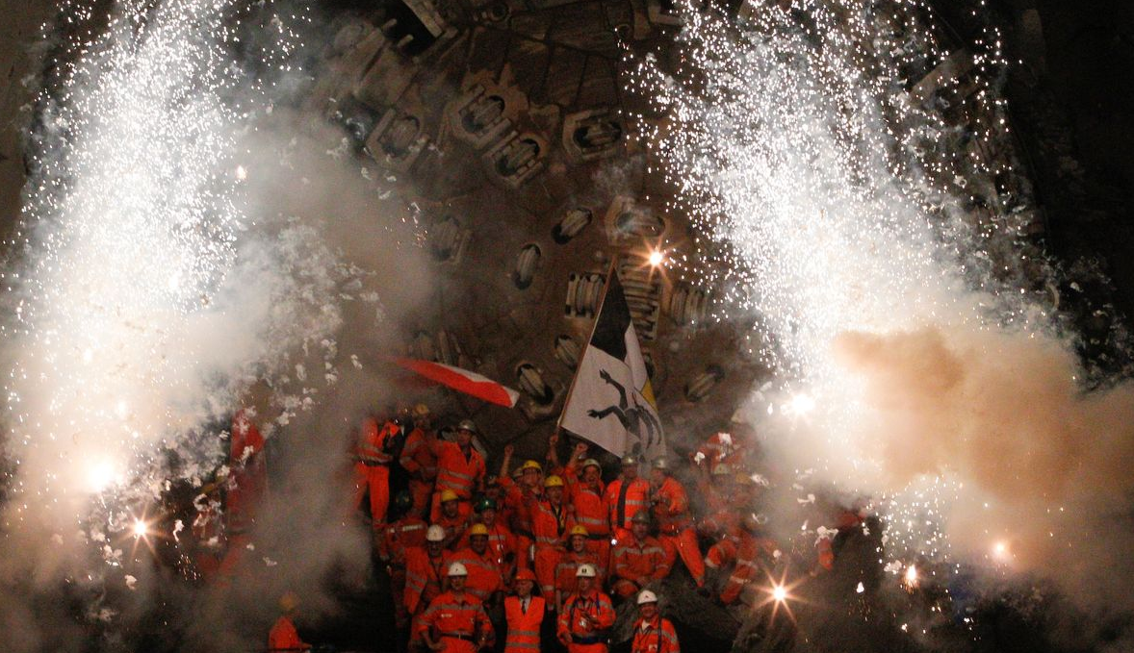
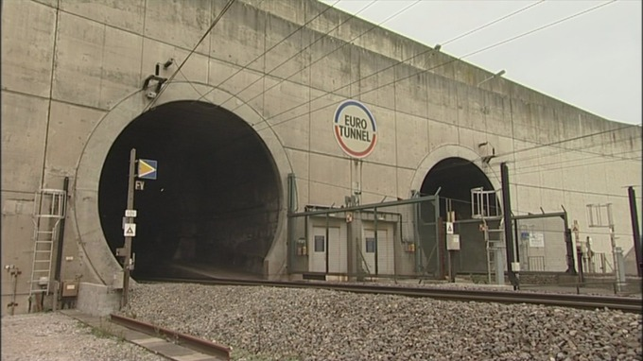
Conducting materials

Slide 7
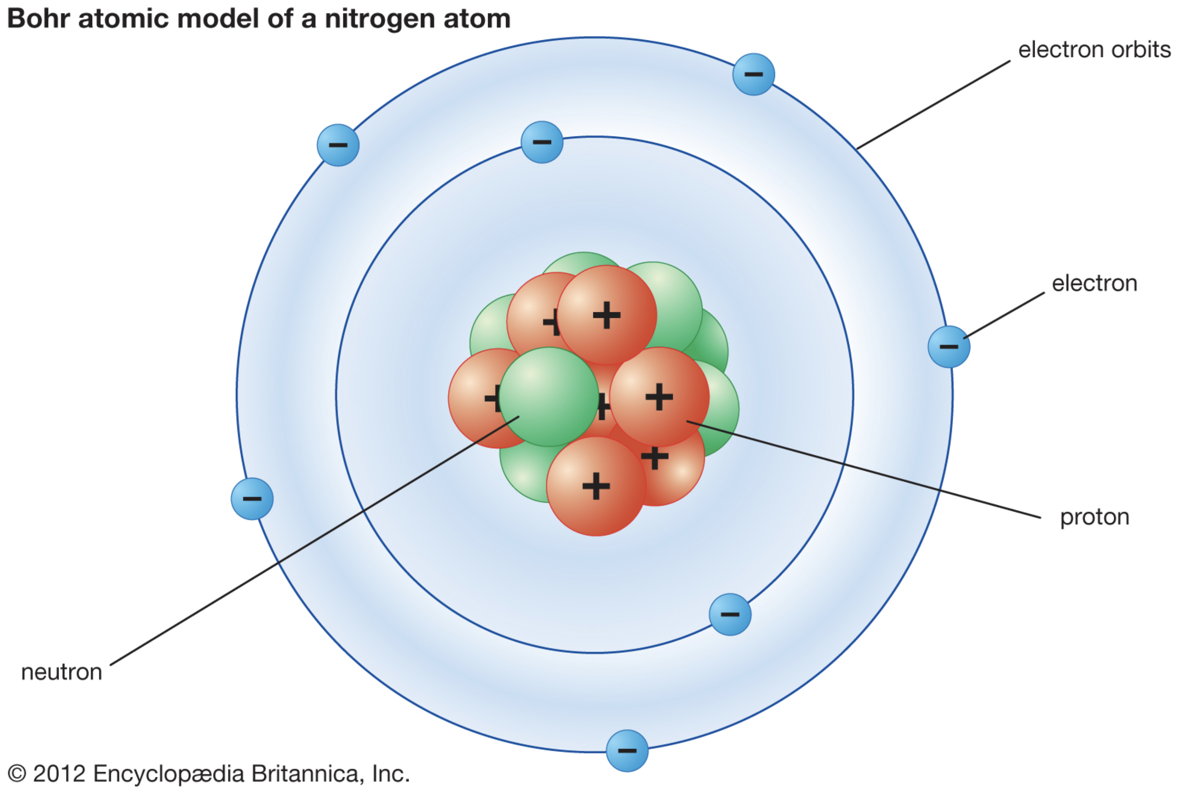

Slide 8
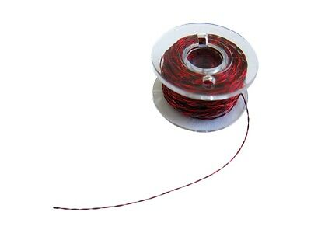
Ionisation probes
V_{i}
V_{o}
R1
+
C
R2
R3
R4
R5
S1
S2
S3
S4

Slide 9
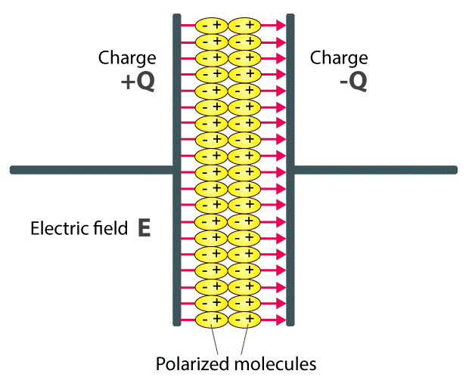
Dielectric materials – insulators which can be polarised

Slide 10
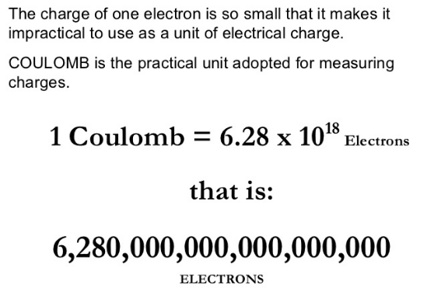
Units of electric charge

Slide 11
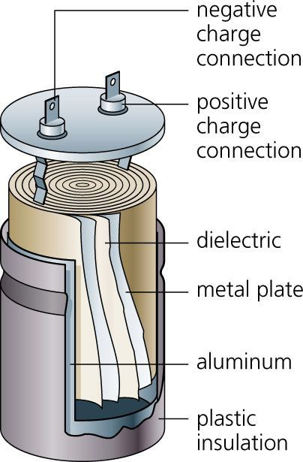
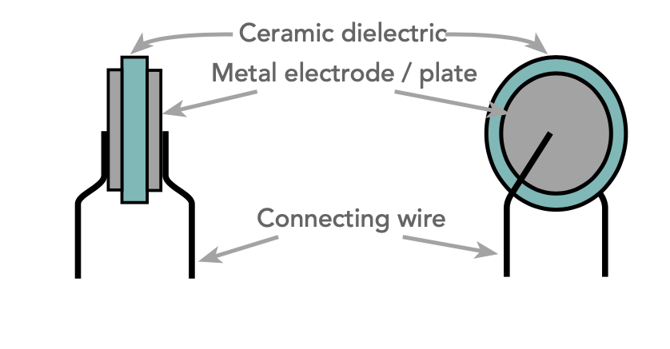
Charge storage - capacitors
Ceramic capacitor
Electrolytic capacitor

Slide 12
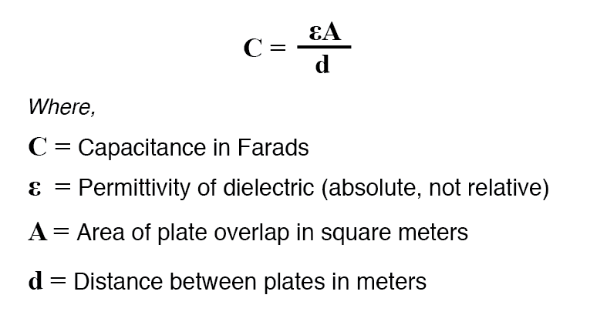
Capacitance
Energy stored in a capacitor U = ½ CV²

Slide 13
Exercise
HBW detonator
Describe how a hot bridge-wire detonator produces a detonative output, naming the components of the detonator, their function and the materials they are made from. Describe the electrical circuit of an EBW fire-set and how it functions.
EBW detonator
Describe how an exploding bridge-wire detonator produces a detonative output, naming the components of the detonator, their function and the materials they are made from. Describe the electrical circuit of an EBW fire-set and how it functions.
EFI detonator
Describe how an exploding foil initiator produces a detonative output, naming the components of the detonator, their function and the materials they are made from. Describe the electrical circuit of an EFI fire-set and how it functions.

Slide 14
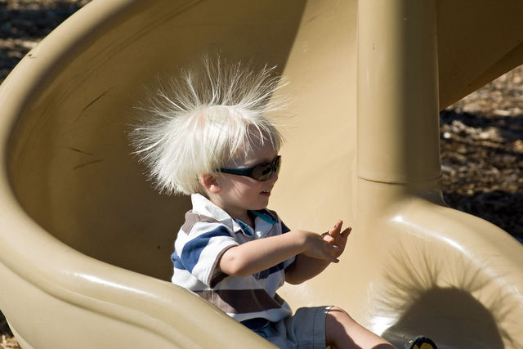
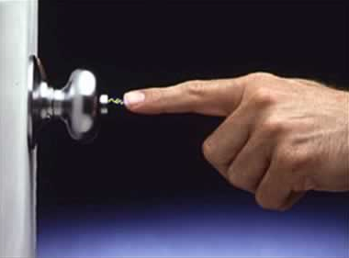

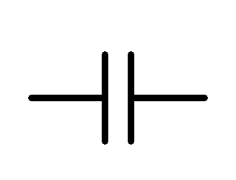

Threats from electrostatic charge
Electrons are transferred when different types of insulator rub together - tribocharging.
200pF

Slide 15
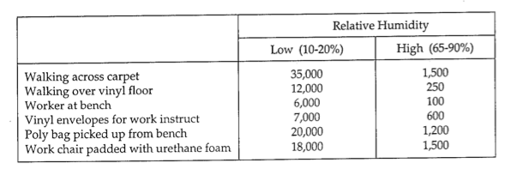
Threats from electrostatic charge
Worst case for human body: 200pF charged to 25,000V. Stored energy is ½ CV² = 0.0625J
This is just too small to fire initiators but could in theory cause very sensitive explosives to initiate.
However, 35,000 V = 0.245 J
Fisher, R J. A severe human ESD (electrostatic discharge) model for safety and high reliability system
qualification testing. United States: N. p., 1989.
Billon , Horace. The Protection of Electro-Explosive Devices (EEDs) and Electronics from Electrostatic Discharge
(ESD) Hazards. DSTO Aeronautical and Maritime Research Laboratory, Australia, Dec 1994.

Slide 16
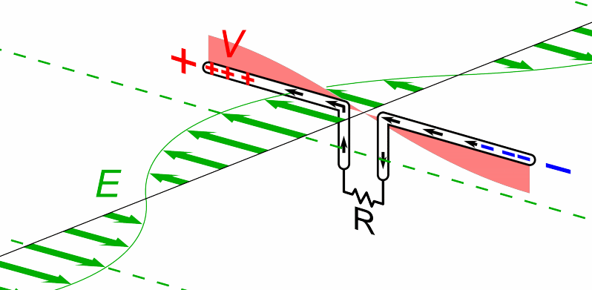
Threats from electric fields
For example: high power radar
Currents induced in dipole antenna. If R is a detonator bridgewire, then it could be heated and caused to function

Slide 17
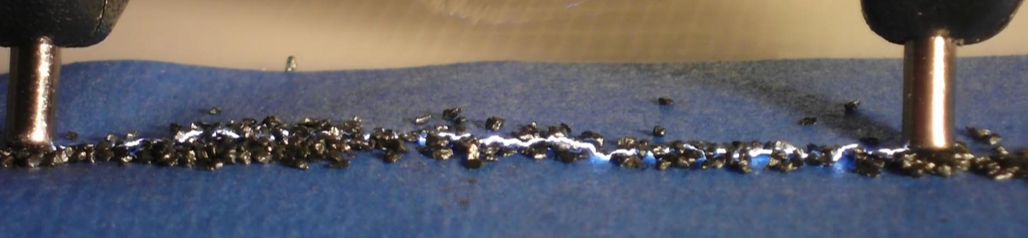
Threats from uncontrolled electrical sources
Uncontrolled electric fields, magnetic fields, and electrostatic charges can cause current to flow in unprotected circuits with the potential to unintentionally supply heat to an explosive, e.g. primary explosive.
(demonstration)

Slide 18
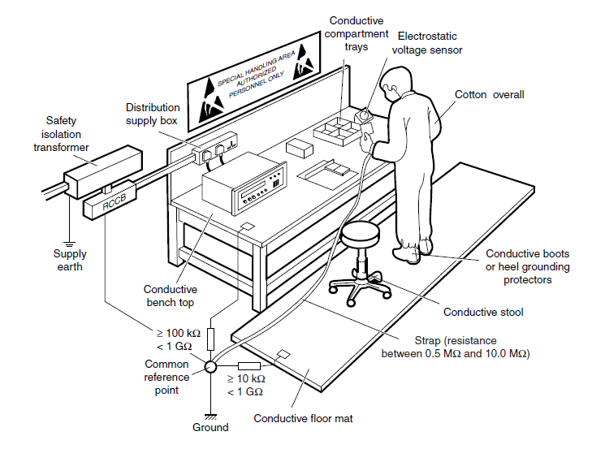
Protection against electrical threats

Slide 19
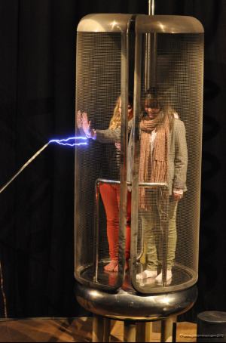
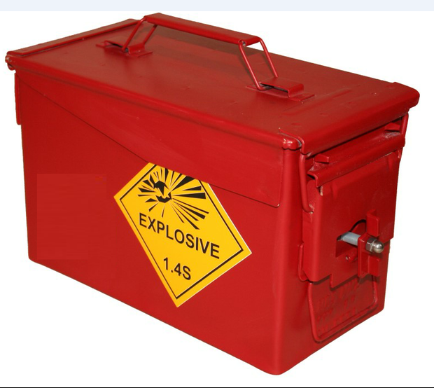
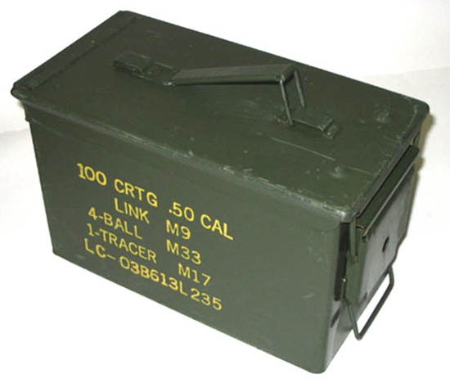
Protection against electrical threats
‘Faraday Cage’
Faraday Cage
H83 ammunition container

Slide 20
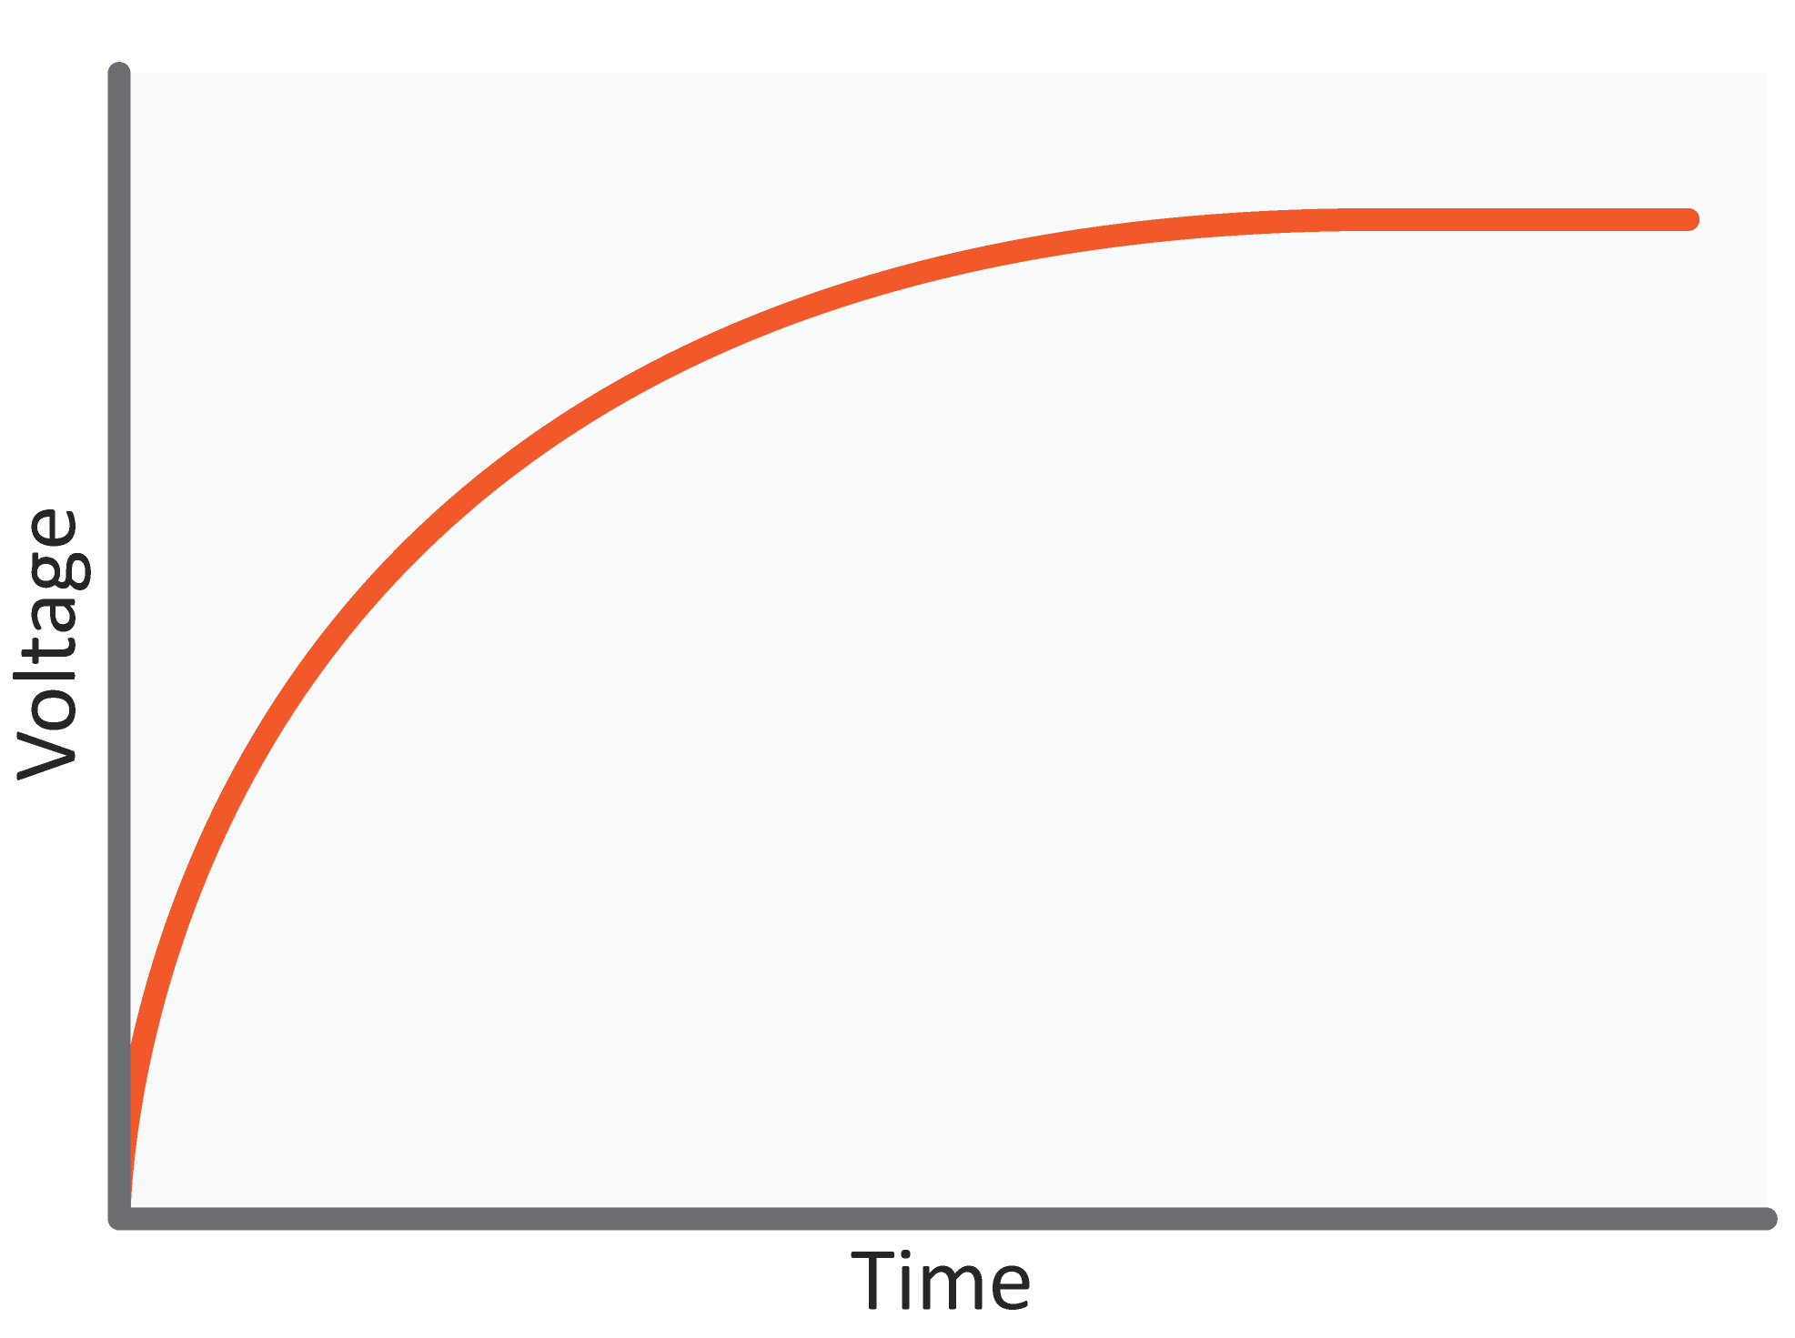
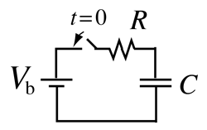
Capacitance

Slide 21
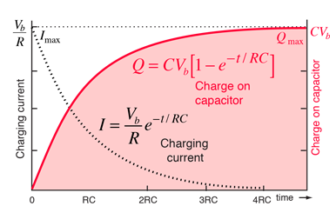
Charging a capacitor

Slide 22
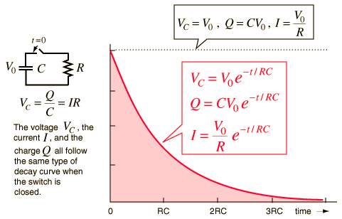

Discharging a capacitor
V_{C} = V₀ e^{-t/RC}
I = (V₀ /R) e^{-t/RC}
Note: RC sometime referred to as the ‘time constant’

Slide 23
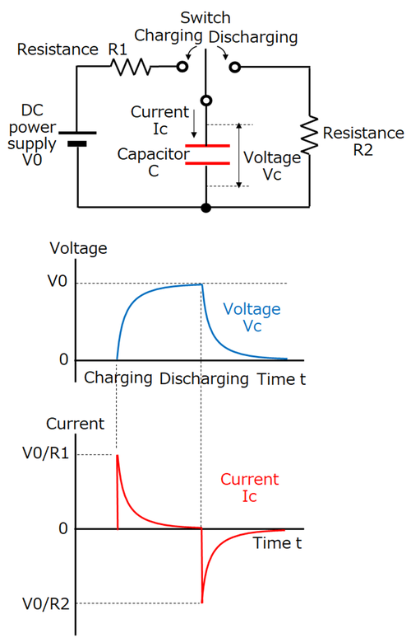
Current leading voltage

Slide 24
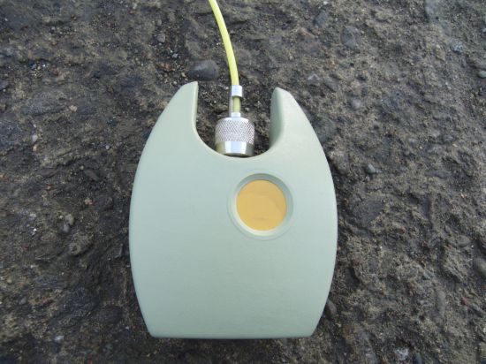
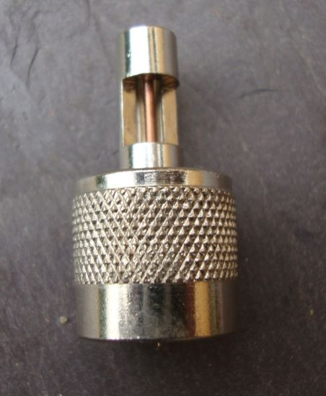
Air breakdown voltage ~ 3kVmm⁻¹

Slide 25
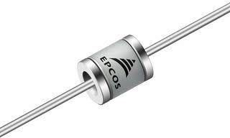
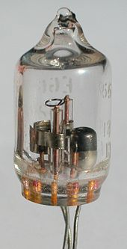
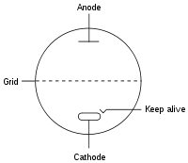
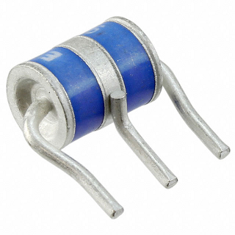
Gas discharge switches – EBW and EFI triggers
Kryton switch
Self-ionising discharge switches

Slide 26
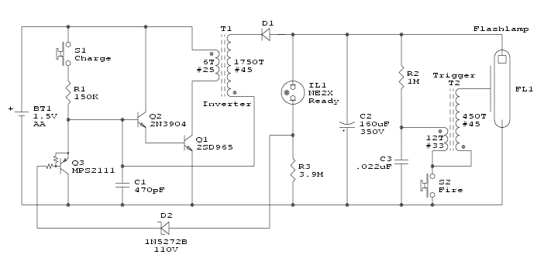


Slide 27
Questions
How many joules are required to fire the following detonators?
HBW
EBW
EFI

Slide 28
Definitions
The SI unit of charge is the Coulomb [C] equal to a charge of 6.28 x 10¹⁸ electrons.
The SI unit of electrical capacitance is the Farad [F], equal to the capacitance of a capacitor in which one coulomb of charge causes a potential difference of one volt.
The SI unit of electrical current is the Ampere [A], equal to the current produced by the flow of one Coulomb of charge per second.
The SI unit of electric potential is the Volt [A], equal to the electric potential between two points of a conducting wire when an electric current of one ampere dissipates one watt of power between those points.

Slide 29
Example exam question (open book and access on-line)
A missile warhead is detonated by a hot-bridgewire detonator which requires 10 mJ of energy to function. The missile launches at 250 ms⁻¹. A micro turbo-generator which supplies 10 mA at 40 V is used to charge a firing capacitor. The detonator is switched across the firing capacitor to detonate the warhead when the missile reaches its target.
Q1. What is the minimum capacitance required for the capacitor?
Q2. At what distance does the missile warhead arm?
Q3. Suppose a capacitor of 22 µF is chosen for the firing circuit, again charged to 40 V. A bleed resistor of 1 M Ω is added to sterilise the fuze, in case the missile misses its target. Estimate the time after launch at which the fuze will no longer function.

Slide 30
Example exam question (open book and access on-line)
A missile warhead is detonated by a hot-bridgewire detonator which requires 10 mJ of energy to function. The missile launches at 250 ms⁻¹. A micro turbo-generator which supplies 10 mA at 40 V is used to charge a firing capacitor. The detonator is switched across the firing capacitor to detonate the warhead when the missile reaches its target.
Q1. What is the minimum capacitance required for the capacitor?
(U = ½ CV², C=2U/V², C= 12.5 µF)
Q2. At what distance does the missile warhead arm?
(energy = power x time, t = U/P, t = 0.01/0.01 x 40 = 0.005 s. 250 m x 0.005 = 6.25 m)
Q3. Suppose a capacitor of 22 µF is chosen for the firing circuit, again charged to 40 V. A bleed resistor of 1 M Ω is added to sterilise the fuze, in case the missile misses its target. Estimate the time after launch at which the fuze will no longer function.
(Using U = ½ CV², V² = 2U/C, V = 30. 1 V - the voltage at which the capacitor can just fire.
V_{C} = V₀ e^{-t/RC}, log V_{C} = -t/RC x log V₀, 1,000,000 x 0.000022 x 1.48/1.60 = 20 s)

