Slide 1

Theory and its uses: Who offends and why?
Laura Knight

Slide 2

Learning objectives
By the end of this session you should be able to:
-Explain who offends
- Identify some of the problems surrounding criminological theory
Explain the ‘blocks of theory’ proposed by Murphy (2023)

Slide 3

Who offends?
Why is this important?

Slide 4
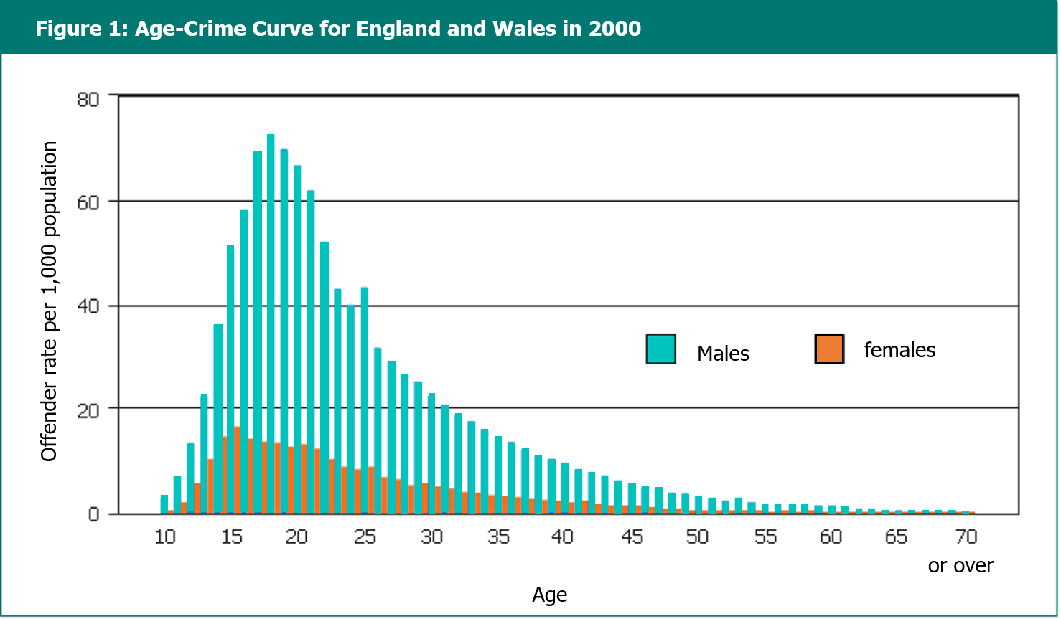
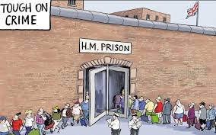
The age-offending curve
Figure 2.1 Age–crime curve for England and Wales in 2000 (HM Inspectorate of Probation, 2021)

Slide 5

TASK: Critical thinking
Choose one of the following offences and research the offenders - domestic abuse, fraud, anti-social behaviour, child sexual abuse.
What does a ‘typical’ offender for this crime encapsulate? What do the conviction rates say?
If you can identify a ‘typical’ offender, why is it that this crime type attracts itself to this type of offender?
Can anything done to help change this picture?

Slide 6
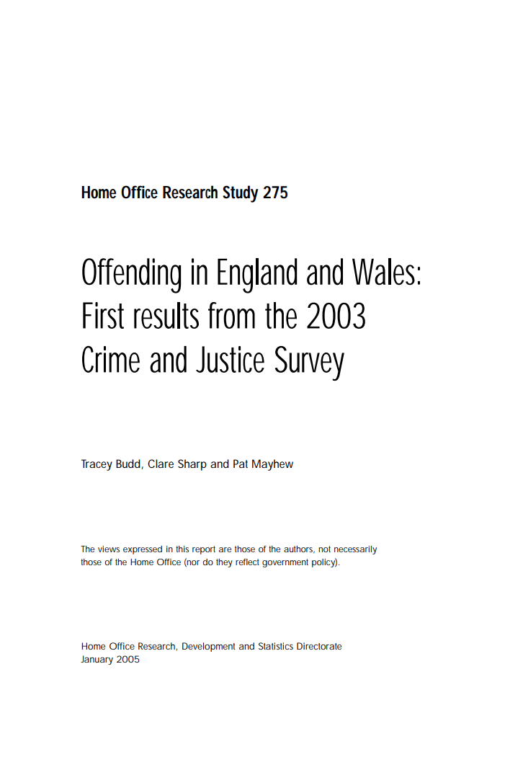
Common issues offenders experience prior to offending
Freeze (2019) has identified 10 different types of experience, which if an individual is exposed to prior to the age of 18 impacts their future:
1.emotional abuse
2.physical abuse;
3.sexual abuse;
4.emotional neglect;
5.physical neglect;
6.domestic violence towards their mother;
7.household substance use;
8.household mental illness
9.parental separation;
10.household member with prison history
Budd et al (2005) looked at self-reported offenders and highlighted some common areas:
Early exit from full-time education
Care experienced
Unstable accommodation
Alcohol use
Drug use

Slide 7


Look on any police force’s social media account or WalesOnline at a post where the force has shown a conviction of an offender and review the comments.
Based on what is written, what is your impression of the offender?
• How many people categorise the offender on the offence type?
Does anyone stand up for the offender or provide background to their offending?
Based on the information on the post and the attached police article, if there is one, formulate a profile for the offender.
If you were to re-write the post, what information could you include to improve the discussion about the offender?
Dickety,2024

Slide 8
Theory and its uses

Slide 9

A ‘black letter law’ approach to defining crime
Criminal behaviour can be understood in terms of those actions/non-actions that do not comply with existing legal codes – NARROW PERSPECTTIVE?
Problematic when the legal codes prohibit certain behaviours.
Becomes further complicated when the huge differences in enforcement are considered. Focus is on harm caused to individuals and societies, yet harm is not always reflected in law.

Slide 10

Theory: What is it?
‘An explanation, or a model, or framework for understanding particular events or processes.’
- Useful in understanding the nature of offending – why people engage in crime
- Aetiological theories of crime are concerned with the causes of crime.
- Theory can help us consider and understand a range of different issues connected to crime, law and order, and the broader nature of society.

Slide 11

TASK
SOME OF THE KEY QUESTIONS MAY BE:
What is crime?
How are laws made and what purpose do they serve?
Who commits crime, and why?
What is the nature of the world around us, including the State and the criminal justice system?
Is society fair? How does this relate to crime and law and order processes?
Who becomes a victim of crime, and why?
How is victimisation experienced? Is this different across groups?
Why do we punish? How is this done?
What should be done about crime?
How do offenders stop offending?
What are the connections between the media and crime?
What role do politics play within law and order issues?
How can we know about/research law and order issues?
Pick a criminological issue of your choice, for example, domestic abuse victimisation.
Think about the questions you would want to explore as a criminologist? For example, prevalence of the crime, who is being victimised, is there a difference in victimisation between different groups?

Slide 12

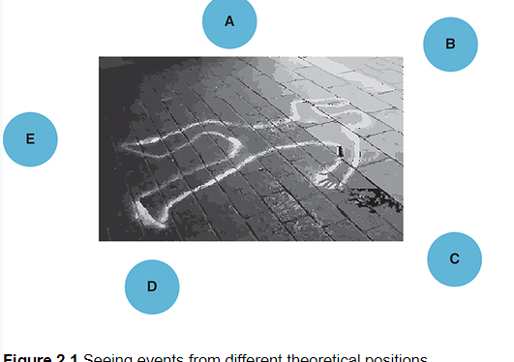
The ‘problems’ with theory
Theories are often presented in a black and white manner.
‘Heuristic’ tools – they are mental short cuts or simplifications for making sense of something which allow for understanding by offering different viewpoints from which to look at the matters of crime and justice.
Murphy, 2023

Slide 13

SYNTHESIS OF THEORY
Simplification
simplification
SYNTHESIS
- Criminological theories can be used together to overcome the fact they are simplifications.
- Different theories might help us to understand different aspects of events and processes.
- Commentators take previous theories and have added to them or amended them to make more sense of events.
E.G. Rational choice models – writers have recognised that the assumptions of early writers did not take into account the full complexity of human behaviour and the decision making process.

Slide 14

THEORIES IN CRIMINOLOGY…THE STARTING POINT
Early thinkers still influence criminologists today.
Classicism
Positivism
Individual
Sociological
- View offending as a consequence of people choosing to commit crime.
- Rational actor
- People engage in offending because they are influenced by forces outside their own control.

Slide 15

THEORIES IN CRIMINOLOGY…
CRITICAL CRIMINOLOGY
Marxism: crime emerges as those at the bottom contend for equality.
Challenge the status quo and question the role of the State, laws and the CJS.
Highlight conflict in society and inequalities based upon class, ethnicity and gender.

Slide 16
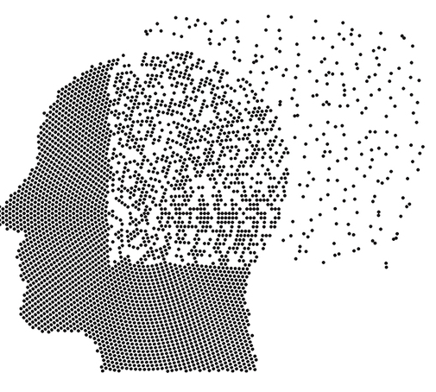
The blocks of theory (Murphy, 2023)
Combined elements from other blocks
Wider social processes such as inequality, class and power
BLOCK FIVE:
INTEGRATED ACCOUNTS
External influences such as community and culture
BLOCK FOUR:
CRITICAL APPROACHES
Offending is a result of biological or psychological abnormalities
BLOCK THREE:
SOCIAL PATHOLOGIES
Classicism
BLOCK TWO: INDIVIDUAL PATHOLOGIES
BLOCK ONE: CHOICE AND DECISION MAKING

Slide 17
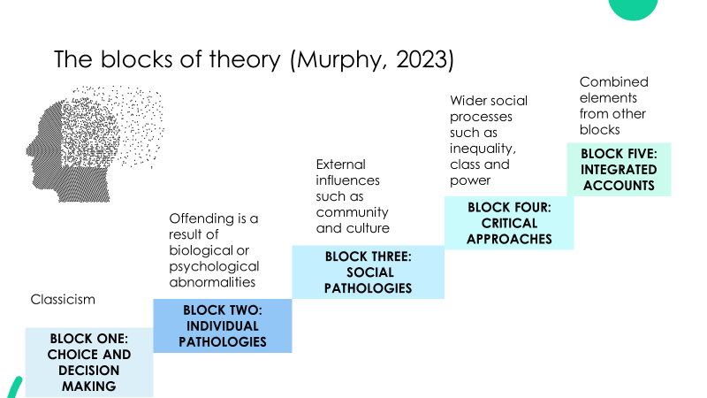

RESEARCH TASK
Find an example of a theory/theories for each of the blocks.
Try to use a different credible source for each example provided.
Explain what the theory says and find one limitation of it.
Remember to include a reference

Slide 18

Watch the short clip and think about how gang membership is explained, and therefore the responses needed to tackle the problem of gangs. This demonstrates a link between theory and policy.

Slide 19

THINKPOINT QUESTIONS: SELF ASSESSMENT
What words or phrases can be used instead of the term ‘theory’?
2. Explain the five blocks of theory and what are the main features of them that mean they can be bunched together?
3. Explain the link between theory and questions, concepts, research and evidence?

