Slide 1
Response Policing Part 1

Slide 2
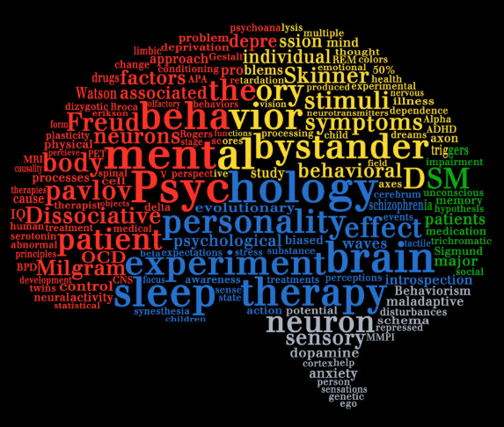
Theories of the psychology of human behaviour.
Introducing emotional intelligence.
Emotional Influence.
Crowd psychology.

Slide 3
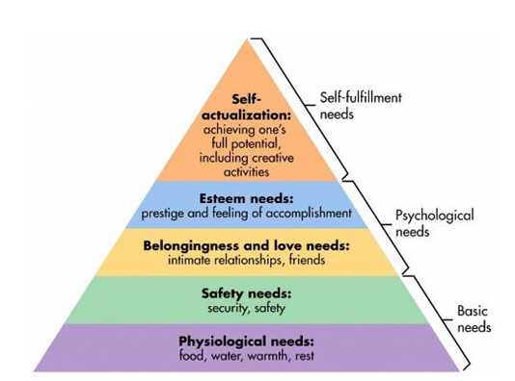
Maslow's Hierarchy of Needs
Notes:
Maslow (1943, 1954) stated that people are motivated to achieve certain needs and that some needs take precedence over others.
Our most basic need is for physical survival, and this will be the first thing that motivates our behaviour. Once that level is fulfilled the next level up is what motivates us, and so on.

Slide 4
Physiological needs: These are the most basic of human needs, e.g., food and shelter.
Safety needs; Once an individual's physiological needs have been met, the need for security becomes prevalent. Individuals need to feel control of their lives and understand what is happening to them. An example of this is achieving financial security via employment.
Love and belongingness needs: The third level is the need to belong. Individuals will seek interpersonal relationships; this will motivate human behaviour. Examples of this includes receiving love and support from family or being accepted into a group of people.
Esteem needs: Maslow split this level into two categories;
1; Self-esteem (independence, achievement)
2; Respect from others.
Self-actualization needs: Individuals are focused on themselves and achieving their full potential, they will be motivated to seek personal growth.
Maslow continued to refine the theory and noted that it may be flexible depending on the individual.

Slide 5
"McLeod, 2020 states, "Every person is capable and has the desire to move up the hierarchy toward a level of self-actualization. Unfortunately, progress is often disrupted by a failure to meet lower level needs. Life experiences, including divorce and loss of a job, may cause an individual to fluctuate between levels of the hierarchy"
Think about different response situations where Maslow's theory could be applied. Please read the Frontiers in psychology which will introduce you to more theories in relation to motivation.

Slide 6

Emotional Intelligence (EI)
Is an individual's ability to control, understand and evaluate emotions.
An essential skill required by Police Officers, in order to recognise emotions expressed by others.
EI is needed in order to successfully communicate and empathize with others.
EI allows us to "read" peoples signals and react appropriately to them.
When negotiating EI is a key skill for individuals to build rapport.

Slide 7
Five Categories of Emotional Intelligence
1: Self- awareness. Being emotionally aware of your own feelings. Recognizing your own emotions and how they affect your behaviour.
2: Self-regulation: Having the ability to control your own emotions. i.e.: when you feel angry taking a going to the gym may help to control that emotion.
3: Motivation: Recognizing negative emotion and adjusting your thought process to a more positive mindset to regain motivation.
4: Empathy: Reconizing and understanding how other individuals are feeling. Having the ability to read signals and then adapting how you communicate with that individual.
5: Social Skills: Good interpersonal skills are essential for response officers in order to communicate effectively.
Notes:
Good social skills help manage conflict. Influence people using negotiation skills.
Teamworking, and inspiring others.
These skills can be used to influence others. Emotional influence is a social skill, being able to self regulate and recognize the feelings of others is an appealing attribute.

Slide 8
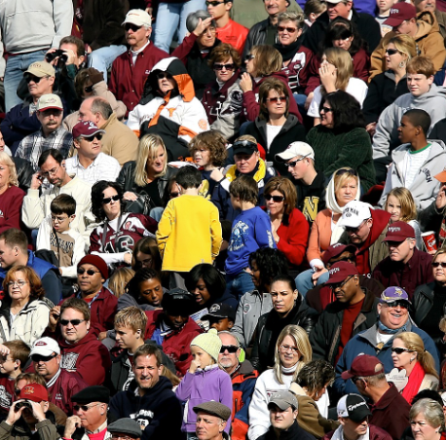
Crowd psychology
Crowd psychology relates to how individuals behave when influenced by a crowd.
People become anonymous in a crowd. They are provided with a sense of security.
The impact of possible consequences of actions are lost.
When in a crowd acts become contagious with individual's copying behaviour of others.
Please watch "How people are controlled by crowd psychology" Link in Moodle.

Slide 9
Bibliography
C. Dominik Güss, Madison Lee Burger & Dietrich Dörner, 2017. The Role of Motivation in Complex Problem Solving. Frontiers in psychology, 8(MAY), p.851
Mcloed, S, 2020. 'Maslow's Hierarchy of Needs' available at: https://www.simplypsychology.org/maslow.html
Stott, C. & Radburn, M., 2020. Understanding crowd conflict: social context, psychology and policing. Current Opinion in Psychology, 35, pp.76–80
Akers, M. & Grover P, 2018 'What is Emotional Intelligence (EQ) available at: https://psychocentral.com/lib/what-is-emotional-intelligence-eq/
Roberts, Richard D, Matthews, Gerald & Zeidner, Moshe, 2007. The science of emotional intelligence : knowns and unknowns, Oxford: Oxford University Press.
Stott, C. & Drury, J., 2017. Contemporary understanding of riots: Classical crowd psychology, ideology and the social identity approach. Public Understanding of Science, 26(1), pp.2–14

