Slide 1
Personnel Resourcing and Development
Level 5 IHM Lecture 3
Samantha Birdsell

Slide 2

Recruitment

Slide 3
Video ClickView
Appreciating Diversity

Slide 4
Recruitment and Selection
Millmore (2007) suggests three interdependent primary features are needed for strategic recruitment & selection
  Recruitment & selection should reflect strategic plans
  A long term focus should be apparent
  A bridging mechanism for making long term resourcing & selection plans happen e.g. Human Resource Planning

Slide 5

What is Recruitment ?
“Recruitment is the process of having the right person, in the right place, at the right time. It is crucial to organisational performance”
Source CIPD factsheet 2011- recruitment, an overview

Slide 6

Defining Recruitment
Recruitment is the process of seeking and attracting internal and external candidates for current organisation job vacancies.
It links to:
Selection
Training and Development
HR Manpower Planning
Job Design, Job Description and
Person Specification

Slide 7

Recruitment Goals
Achieve Cost Efficiency- Limit Recruitment Costs
Use recruitment methods to – Attract, Capture and Stimulate potential candidates interest in the vacancy
Help ensure employee retention
Comply with employment legislation
Create a diverse workforce

Slide 8

Group Activity
In small groups list the methods that can be used to undertake recruitment
Having completed your list discuss and provide examples of the advantages and disadvantages of each method

Slide 9







Recruitment Sources

Slide 10


Slide 11



Glassdoor

Slide 12


Slide 13
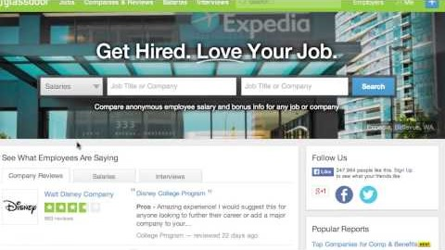

Slide 14

Do your research… Is this the right employer for you..?
The Interview- a chance for both sides to be interviewed !

Slide 15


Slide 16
The Marriott Platform
Where will Your Journey Take YOU …

Slide 17

Marriott

Slide 18

Careers at Marriott

Slide 19

Go the Distance….

Slide 20

Preparing Your Resume….

Slide 21

Internal Recruiting
Advantages:
Can be cost efficient- Vacancy filled, Expenses, Training
Candidates are known to the organisation- skills, attitude
Candidates are familiar with organisation culture
Internal promotion may provide motivation to staff

Slide 22

Internal Recruiting
Disadvantages:
Internal candidates not successful maybe resentful- become unproductive, de-motivated
New lower level vacancy created
No new ‘blood’

Slide 23

Recruitment Process
Do you need to recruit?
Can the tasks be allocated elsewhere?
Could you ‘outsource’ the work?
If you need to recruit make your organisation/ job vacancy information clear- attract the right candidates and use the right recruitment methods

Slide 24

Selection
Process of choosing from a group of applicants the individual best suited for a particular position and organization
Goal of selection process is to properly match people with jobs and organizations
Selecting wrong person for any job can be costly
Costs an average of 2.5 times individuals salary to replace an employee who does not work out

Slide 25
Metrics for Evaluating Recruitment/Selection Effectiveness
Turnover Rate – Number of times in average employees have to be replaced during a year
Recruiting costs- cost per hire determined by dividing recruiting expenses by number of recruits hired
Selection rate – number of applicants hired from a group of candidates expressed as percentage
Acceptance rate – number of applicants who accepted the job divided by number who were offered the job

Slide 26

Metrics for Evaluating Recruitment and Selection Effectiveness
Yield Rate – Percentage of applicants from a particular source and method that make it to next stage of selection process.
Cost / Benefit of Recruitment Sources and Methods - For each method there is a cost. For each method there should be a benefit.
Time Required to Hire – time required to fill a job is critical

Slide 27
Recruitment & Selection
Article on Moodle

Slide 28
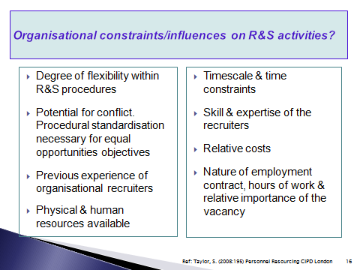
Recruitment and Selection Factors

Slide 29
Recruitment Pathway

Slide 30

Internet Recruitment
Several options are available:
Employer websites.
On line agencies.
Jobsites linked to newspapers and journals.
Jobsites operated by employment agencies.

Slide 31
Internet Recruitment
Advantages:
It is Easy
It Reaches a Wider Audience
It is Cost Effective
You can make your Ad more Dynamic
It is Flexible
Disadvantages:
High volume of responses
Logistical problems
Technology issues
Poor website
Too Impersonal

Slide 32
Assignment Review Task 1 and Task 2
Task 1 - Compile a PESTLE analysis of the External Environment (Location you have chosen) related to the Hotel (Brand you have chosen) that demonstrates a Critical Understanding of the Management and Business Environment within which personnel professionals work.
Task 1 Homework-
PESTLE Analysis - Swansea Marriott
Task 2 - Using examples from the Hotel Industry discuss the importance of an effective Recruitment and Selection process in order to sustain competitive advantage.
Task 2 Homework-
SWOT Analysis for Recruitment and Selection – Swansea Marriott

Slide 33
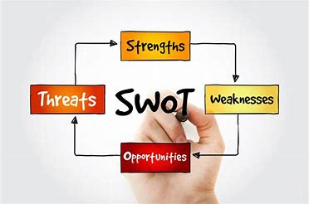
SWOT Analysis and Recruitment
Article on Moodle to help with Homework

Slide 34
Video SWOT
Video on Moodle

Slide 35
Video PESTLE
Video on Moodle

