Slide 2
Enterprise Network Security
WEEK 2
Understanding Networks
Applied Computing - WISA

Slide 3
  Module Induction
  Understanding Networks
    Components
    Architectures
    IP Addressing
    Servers
  Network Operating Systems
During this session, we shall start discussing about the details of our module (Lectures, Tutorials, Assessments etc.
We shall discuss various Networking Components, functionalities and Operations, Architectures and the enhancements in Network Operating systems
Lab/ Tutorials
Research: IP Address, Network Communication, Network Components.

Slide 4
I - Introduction
What is a?
  Computer Network
  Types of Network
  Resources in a Network
  Components in a Network
  Hosts and Nodes – Are they the same?

Slide 5
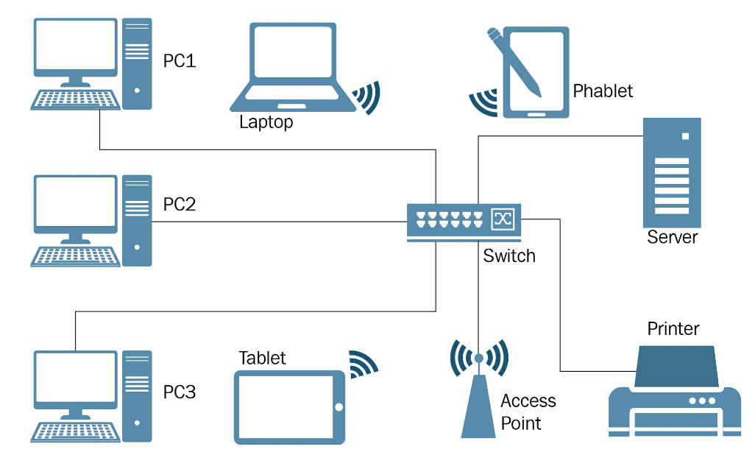
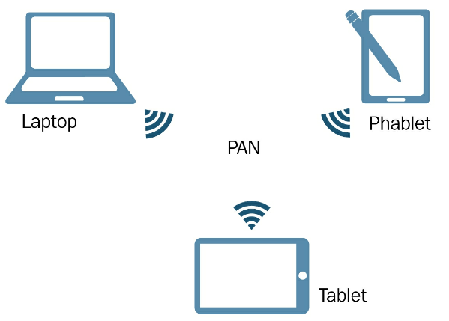
II – Understanding Networks
What is a Computer Network?
  A computer network is a group of computers connected to each other in order to share resources. The resources are usually data, network services, and peripheral devices
Types of Computer Network?
  PAN / Home area Network (HAN)
  LAN
  MAN
  WAN

Slide 6
III – Components
Like PCs have components, computer networks also have their own components.
Usually, while PCs and peripheral devices are known to most people, components such as networking devices, networking media, and network operating systems (NOS) are mostly known by Technicians/ IT Professionals.

Slide 7
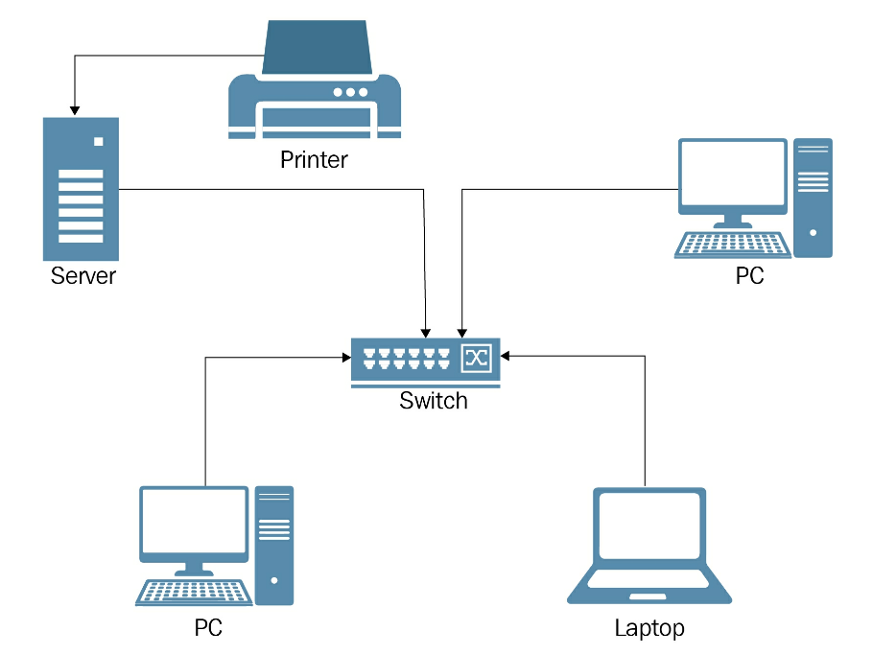
IV - Architecture
The word servers comes from the word serve. It means to provide services that benefit or help.
From that, we can think of a server in a computer network as the computer that provides services to clients. In conclusion, the server serves the clients.
Let's assume that the network resource is the point of reference for both clients and servers. Clients request access to resources and servers are responsible for providing resources and managing access to those resources.
Both clients and servers play an active role in the computer network.

Slide 8
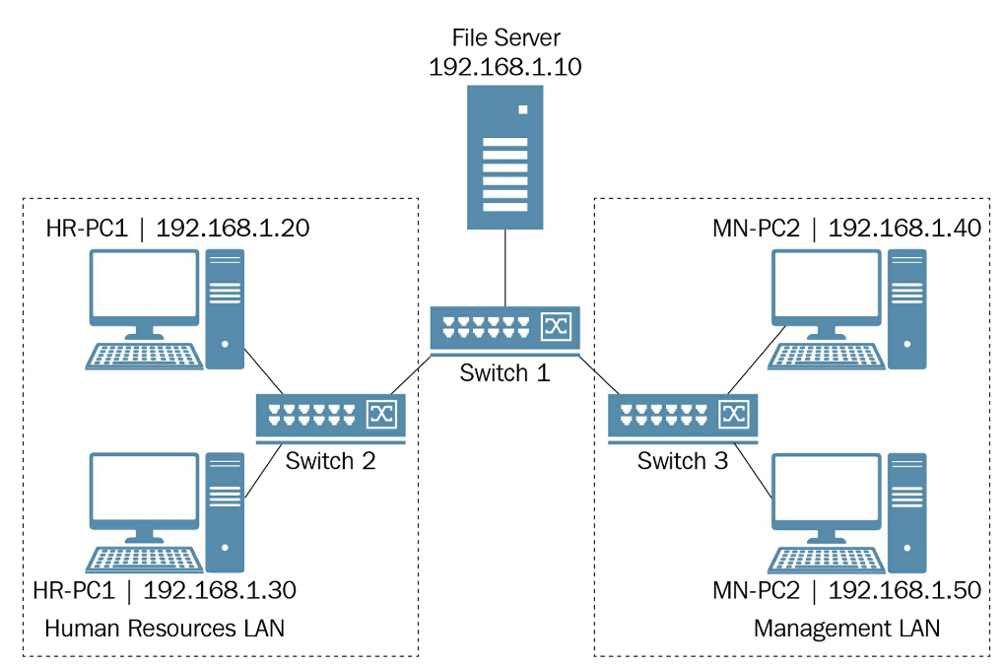
IV – Architecture
Although clients and servers are the most important elements of a computer network, it depends upon hosts and nodes. Are they the same thing?
No, they are not!
While all hosts can be nodes, not every node can act as a host.
A host is any device with an IP address assigned to its network interface that requests or provides networking resources on the network. (Eg. clients, servers, and routers).
A node is any device that can receive and transmit the networking resources on the network. Nodes have a network interface that is used for their management.(e.g Switch, Repeater, Moderm)

Slide 9
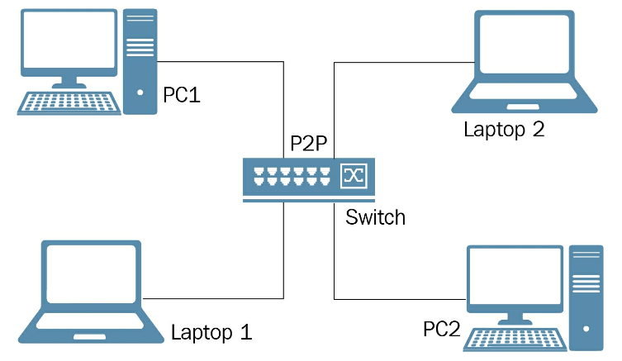
IV – Architecture
Architecture:
  Peer to Peer (P2P)
    Peer-to-Peer (P2P) network architecture refers to a network model in which hosts or computers are equal in terms of capabilities and responsibilities.
    Depending on the circumstances, each host may be a client or server depending on whether it requests or provides services in that network.
  Client/ Server
    A client/server, often known as a domain-based network, is a computer network in which hosts have a predefined role.
    Hosts that request resources act as clients, whereas hosts that provide resources act as servers.
    In general, the client/server network architecture is a network with dedicated servers.
    Usually, LANs, MANs, and WANs represent the best examples of client/server computer networks.

Slide 10

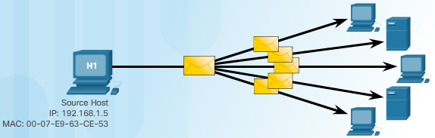
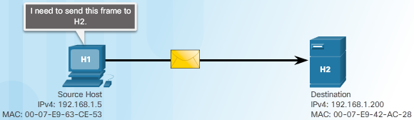
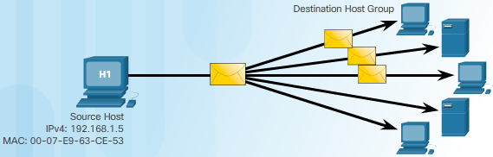
V – IP Addressing: IPv4
  Is a logical network address that identifies a particular host. It is associated with a network interface card and It is unique on the network for communications
  32 Bit | Dotted Decimal Notation (DDN) |
  8 Bit Each (Decimal Octets) | 0 to 255 (4 Octets)
  Public and Private Addresses
    The Public addresses are used in the Internet
    The Private Addresses are used only within Lan’s
    The Private Addresses could not be routed in Internet
  Unicast The Packets are sent to only one device
  Multicast The Packets are sent to many devices
  Broadcast The Packets are sent to all devices in the Network

Slide 11
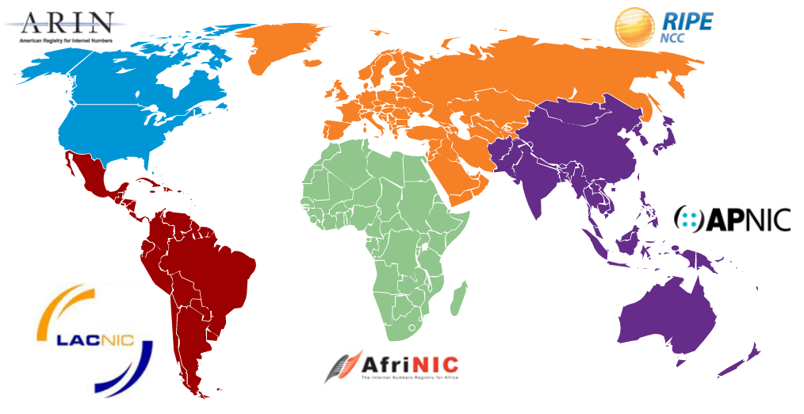
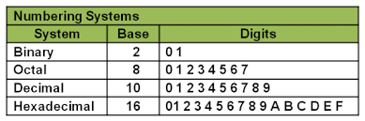
V – IP Addressing – Using Number Systems
An Internet Protocol address, popularly known as an IP address, is a logical element comprised of numbers that is assigned to host's network interface in order to identify it in a computer network.
  Network address helps the router identify a path within the whole network (e.g. the Internet). This number is assigned by the American Registry for Internet Numbers (ARIN) (or an ISP).
  Host address is assigned by the network administrator according to some internetworking address plan. Host addresses can be assigned dynamically.
  All hosts on the same network will have the same network number but each host is uniquely identified by its own host number.

Slide 12
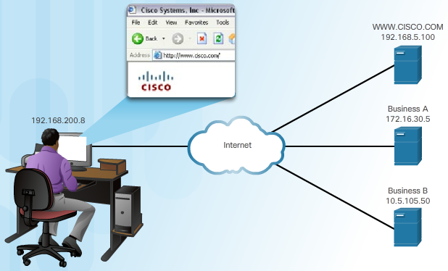
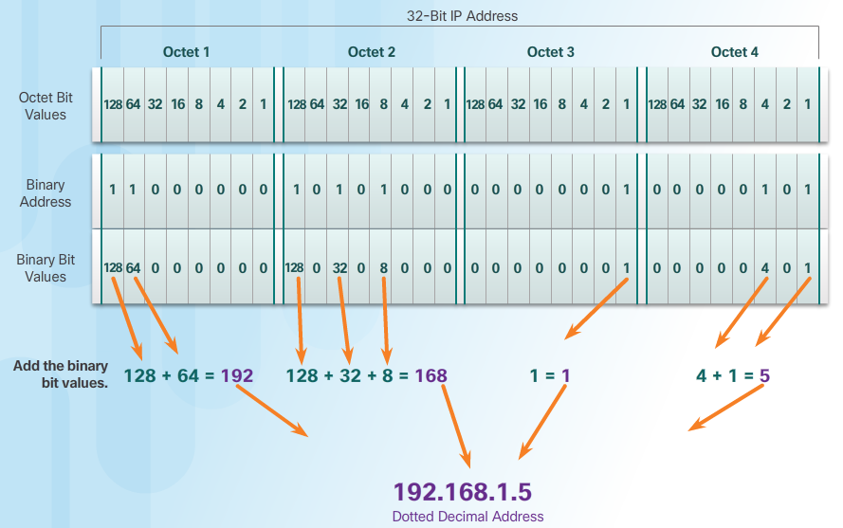
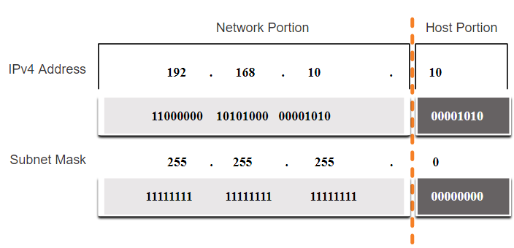
V – IP Addressing: IPv4 Subnet mask
A subnet mask is used to determine the network and host portions.

Slide 13
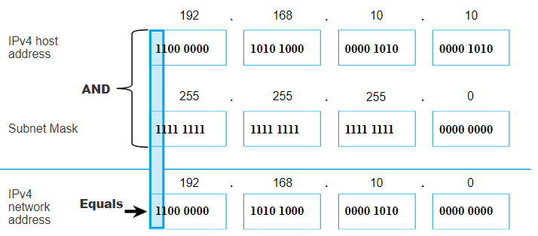
V – IP Addressing: IPv4 Subnet mask
The actual process used to identify the network and host portions is called ANDing.
  1 AND 1 = 1,
  0 AND 1 = 0,
  1 AND 0 = 0,
  0 AND 0 = 0
  1 = True
  0 = False

Slide 14
V – IP Addressing: IPv4 Structure
The prefix length is the number of bits set to 1 in the subnet mask.
It is written in “slash notation” therefore, count the number of bits in the subnet mask and prepend it with a slash.
A prefix length is a less cumbersome method used to identify a subnet mask address.
Within each network are three types of IP addresses:
  Network address
  Host addresses
  Broadcast address
Subnet Mask | 32-bit Address | Prefix Length
255.0.0.0 | 11111111.00000000.00000000.00000000 | /8
255.255.0.0 | 11111111.11111111.00000000.00000000 | /16
255.255.255.0 | 11111111.11111111.11111111.00000000 | /24
255.255.255.128 | 11111111.11111111.11111111.10000000 | /25
255.255.255.192 | 11111111.11111111.11111111.11000000 | /26
255.255.255.224 | 11111111.11111111.11111111.11100000 | /27
255.255.255.240 | 11111111.11111111.11111111.11110000 | /28
255.255.255.248 | 11111111.11111111.11111111.11111000 | /29
255.255.255.252 | 11111111.11111111.11111111.11111100 | /30

Slide 15
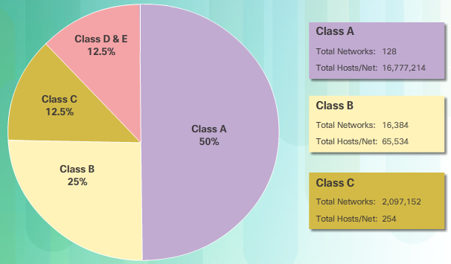
V – IP Addressing: IPv4 Classes
Classful Addressing
  Class A (0.0.0.0/8 to 127.0.0.0/8) supports extremely large networks.
  Class B (128.0.0.0 /16 – 191.255.0.0 /16)
  supports the needs of moderate to large size networks.
  Class C (192.0.0.0 /24 – 223.255.255.0 /24)
  supports small networks with a maximum of 254 hosts.
Classless Addressing
  IPv4 addresses allocated on any address bit boundary
  Delays the depletion and exhaustion of IPv4 addresses
  Classless Inter-Domain Routing (CIDR)

Slide 16
V – IP Addressing: IPv4 Special Addresses
Loopback addresses
127.0.0.0 /8 (127.0.0.1 to 127.255.255.254)
Commonly identified as only 127.0.0.1
Used on a host to test if TCP/IP is operational.
Link-Local addresses
169.254.0.0 /16 (169.254.0.1 to 169.254.255.254)
Commonly known as the Automatic Private IP Addressing (APIPA) addresses or self-assigned addresses.
Used by Windows DHCP clients to self-configure when no DHCP servers are available.

Slide 17
V – IP Addressing: IPv4 Assigning Addresses
Assigning Addresses
Can be done statically or dynamically
Assign an IPv4 address, subnet mask, default gateway and other necessary info for network communications
Static IPv4 addresses
Hosts, such as servers and printers, that need particular addresses
Can be time consuming and error prone
Need to maintain an accurate list of which IPv4 addresses
  Dynamic IPv4 Address Assignment
  Dynamic Host Configuration Protocol (DHCP) allows for automatic assignment of addressing information
  Preferred method of assignment for a large network
  IP addresses can be reallocated when they become available

Slide 18
V – IP Addressing: IPv6 Address
What is an IPv6 Address?
Also the same as IPv4 (in the perspective of functioning) but with advantages. Both IPv4 and IPv6 will coexist in the near future and the transition will take several years.
IPv6 addresses are 128 bits in length and written in hexadecimal. It is not case-sensitive and can be written in either lowercase or uppercase.
The preferred format for writing an IPv6 address is x:x:x:x:x:x:x:x, with each “x” consisting of four hexadecimal values. In IPv6, a hextet is the unofficial term used to refer to a segment of 16 bits, or four hexadecimal values.
Examples of IPv6 addresses in the preferred format:
        2001:0db8:0000:1111:0000:0000:0000:0200
        2001:0db8:0000:00a3:abcd:0000:0000:1234

Slide 19
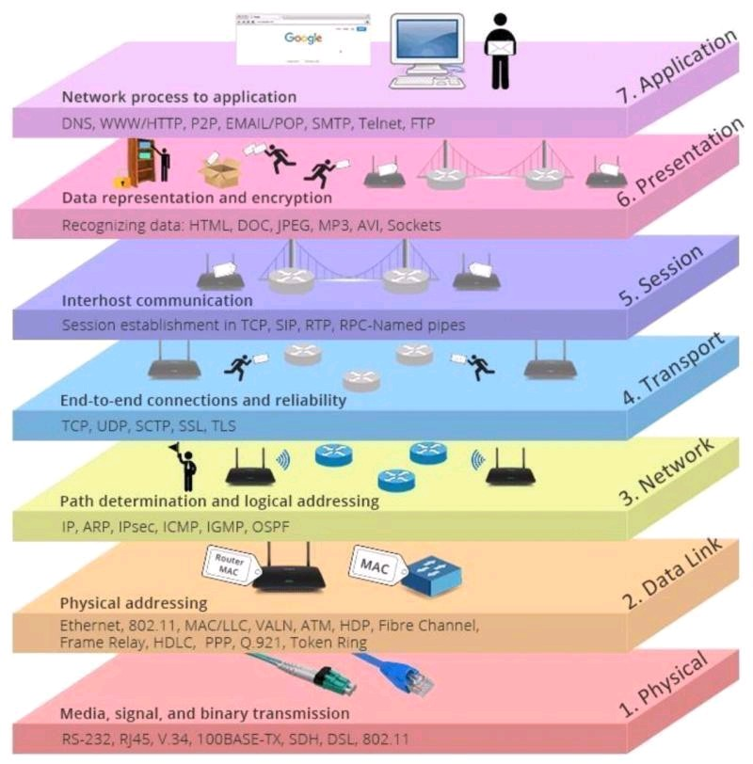
VI – Infrastructure: Standards
Protocol Model | Reference Model
TCP/IP Model | Open Systems Interconnection (OSI) Model
Protocol Model | Reference Model
TCP/IP Model | Open Systems Interconnection (OSI) Model
FTP, SMTP, HTTP, POP3…
FTP, SMTP, HTTP, POP3…
4. APPLICATION
3. TRANSPORT
2. INTERNET
1. NETWORK INTERFACE
7. APPLICATION
6. PRESENTATION
5. SESSION
4. TRANSPORT
3. NETWORK
2. DATA LINK
1. PHYSICAL
TCP & UDP
TCP & UDP
IP
Ethernet
OSI/ TCP-IP Protocol Suite

Slide 20
VI – Infrastructure: Devices
Main routing components include:
ROUTERS
Routers are Layer 3 devices
A router makes routing (best path) decisions based on Network Addresses.
It examines packets and chooses the best path for them through the network.
Routing is sometimes known as Layer 3 switching.
Routing interface
Routing protocol
Routing table
Router types | Example
Hardware router | A device that performs routing as a dedicated function
Software router | A router that is not dedicated to performing routing only, but performs routing as one of multiple processes running on the router computer

Slide 21
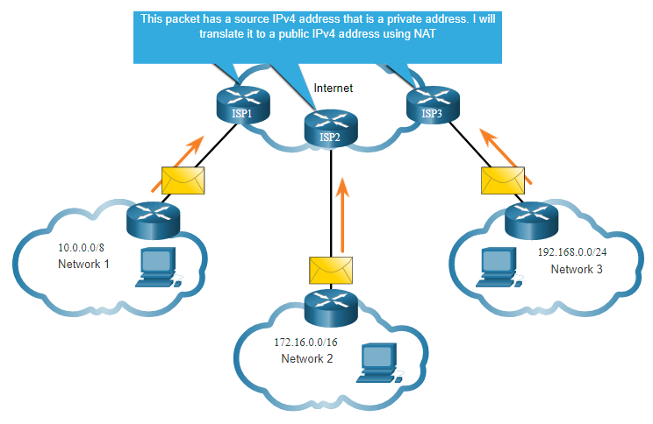
VI – Infrastructure: Operations
Network Address Translation (NAT) translates private IPv4 addresses to public IPv4 addresses.
NAT is typically enabled on the edge router connecting to the internet.
It translates the internal private address to a public global IP address.
Different NAT Methods are Static NAT, Dynamic NAT, and Port Address Translation.
Port Address Translation (PAT)
  Translates multiple local IP addresses to a single external IP address supplied by ISP
  Remembers source port number used by local machine when requesting a network service (e.g. web)
  Responses are routed to correct local machine by looking up port number → now the destination port

Slide 22
VII – Servers
  Windows Server has evolved from a simple file server to an operating system that is capable of handling network services in complex environments such as corporate networks.
  Windows Server can provide network services such as domain controllers, web servers, print servers, and file servers.
  It often acts as a separate platform in which enterprise applications such as Exchange Server, SQL Server, SharePoint Server, and others are executed.
  With its robust performance and advanced security, nowadays, Windows Server is shaping cloud computing.
Notes:
Windows Server is a server operating system that manages users, resources, security, and network services, while also providing a platform for enterprise applications such as Exchange Server, SQL Server, and SharePoint Server.

Slide 23
VII – Servers: Hardware & Software
  Computer hardware represents physical component of a server and software represents logical component of a server.
  The primary role of the server is to provide network services to the clients, a server requires powerful hardware too, because software such as Windows Server is designed to process large workloads.
  The hardware is required to be durable and made of high-quality materials so it can continually deliver services and support network-based operations. Hence, distinguishing it from the ordinary computer, a server needs a higher Spec hardware.
  Servers are also specific to the types of services it provides like; a database server requires more memory and storage space.
  The CPU, memory, disk, and network are known to be the key system components that affect the overall performance of your servers.

Slide 24
VII – Servers: Hardware - CPU
  A Central Processing Unit (CPU), or processor, is a chip on a server's motherboard. (computer's brain). It is a component that does all the processing and calculations.
  Intel and AMD are the biggest CPU manufacturers for PCs and servers. Their newest CPUs on the market are based on 64-bit architecture, which differs from 32-bit architecture-based processors.
  In 64-bit architecture, 64 bits of data are exchanged between the CPU and RAM in each communication session. On the other hand, in 32-bit architecture, only 32 bits of data are exchanged per communication session between RAM and CPU. That is half as less data being communicated via 32-bit architecture as compared to a 64-bit architecture.
  In order to give out the performance, the CPU depend on RAM.

Slide 25
VII – Servers: Hardware – Memory, Disk
  RAM represents the server's working memory, which is used by Windows Server 2022 and server applications. Thus, the more RAM on the server, the more applications can run simultaneously.
  Data is usually stored on a disk. In servers, they mostly have more than one disk, which is referred to as the server's disk sub-system. As for disk performance, read/write speed is an element that must be taken into consideration, because the faster the disk's throughput, the higher the performance of your disk sub-system.

Slide 26
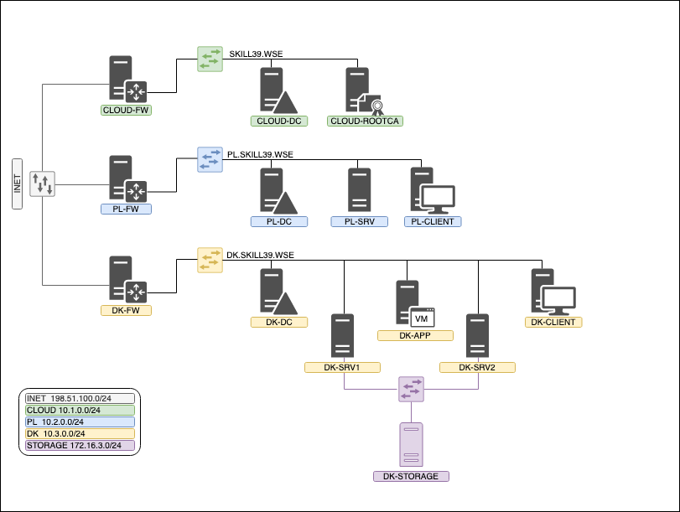
VIII – Network Operating Systems
  A Network Operating System (NOS) is software
    manage, maintains and provides resources in a network.
    manage, maintains and provides access to resources.
    shares files and applications and provides web services.
    administers users, computers and provides tools for configuration, maintaining and providing resources, as well as other functions related to network resources.
  An NOS could be a Windows Server, Linux Server, and macOS Server as all of them are capable of providing network services.
  A NOS is an important component when it comes to managing computer network resources.

Slide 27
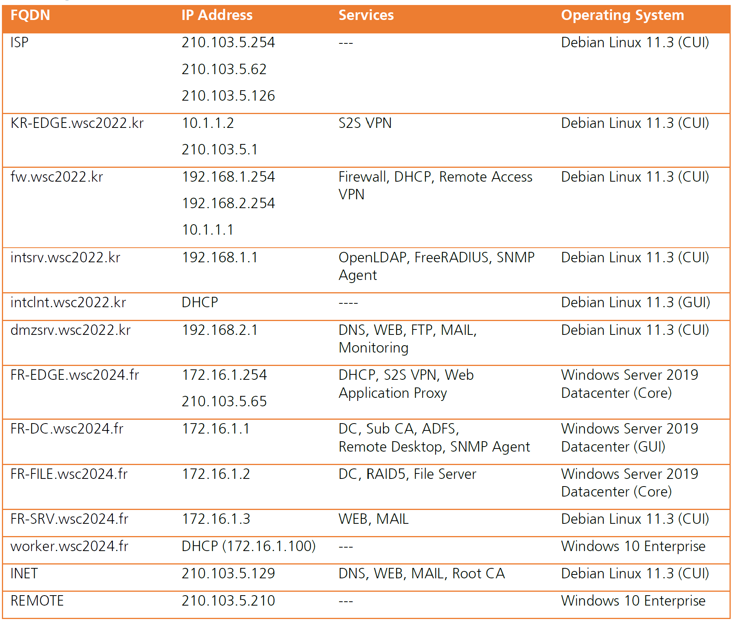
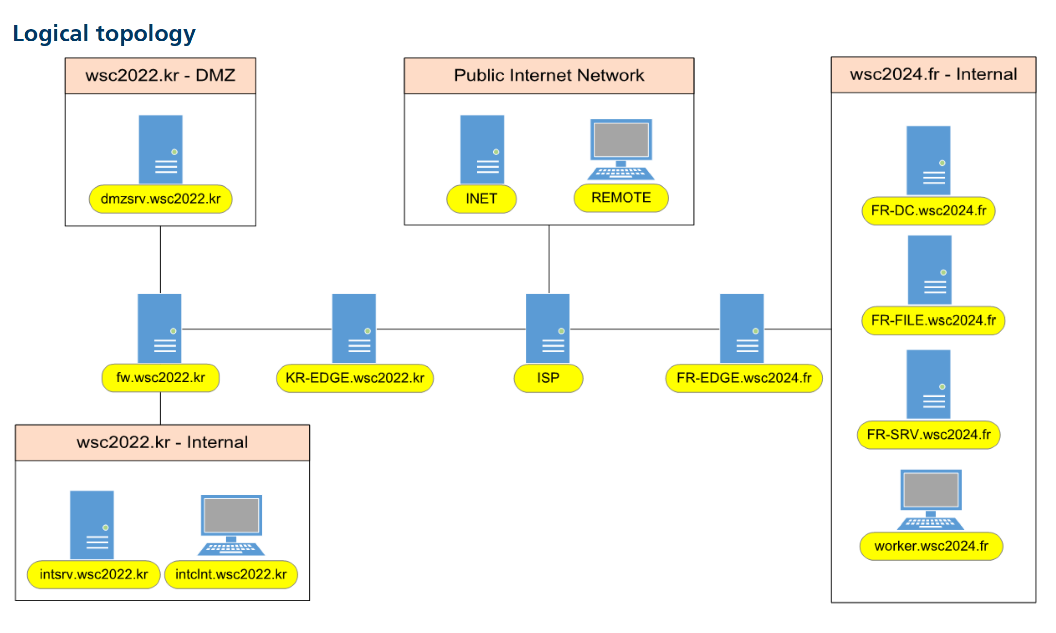
VIII – Network Operating Systems

Slide 28
Summary
Networks Components
Architecture
IP Addressing
Infrastructure
Servers,
Server hardware and size(CPU, memory, disk, network interface)

Slide 29
Any Questions?
Enterprise Network Security
(ACCA7032)

