Slide 1

River Fitness
Gym To Fit

Slide 2
Decision Taken & Change Log
Power Point is considered relevant because its individual slides give a single meaning to my findings .It gives a clear vision of the customer survey. A well explained result with strong decision will be a takeaway for the log creation. The guide from the University Digital Skill website on uses of power point and simple bar chart helped my choice .

Slide 3
Gym Customer Survey Summary-Last Month.

Slide 4
Information used :
A simple Digital summary of last months gym Feedback as illustrated above.
Customer Feedback summary – Last month:
Total Responses 75
Satisfied 46
Neutral 18
Not Satisfied 11

Slide 5
Steps I used to create my Artefact-Power point.
New Slides: Click insert new slides…”Title and Content”
Title : Gym Customer Survey Summary – Last Month.
Add the Bar Chart using the pictures of selected image above.
Insert the feedback data on the excel table with choice colours.
Font sizes ware decided to give a clearer vision .
An informative takeaway was decided under the chart which gives an overview of :-65% as Satisfied members.
-24% as Neutral members and
-15% are members Not Satisfied.

Slide 6
Changes I Made :
Created the Gym Logo and a Customer Motivation "Gym To Fit”.
My work were rearranged to give more clarity and vision.
I gave customers responses of last month in percentage of total feedback.
I suggested that member should be considered free registration with a casual salad fresh meals that feeds them with Gym healthy food, like it is in Tossed.

Slide 7
Feedback:
My son advised me on the layout pattern and the tutor encouraged the use of simple, clear sentences. My classmate assisted on the original chart before I generated the simple bar chart above.

Slide 8
Final Explanation :
How the artefact will improve gym services to attract more customers satisfaction in the future. Introduced new logo and a clear decision – making chart. Management should consider members free registration with Tossed for healthy food for fitness. Also, their bar code were provided for easy registration.

Slide 9
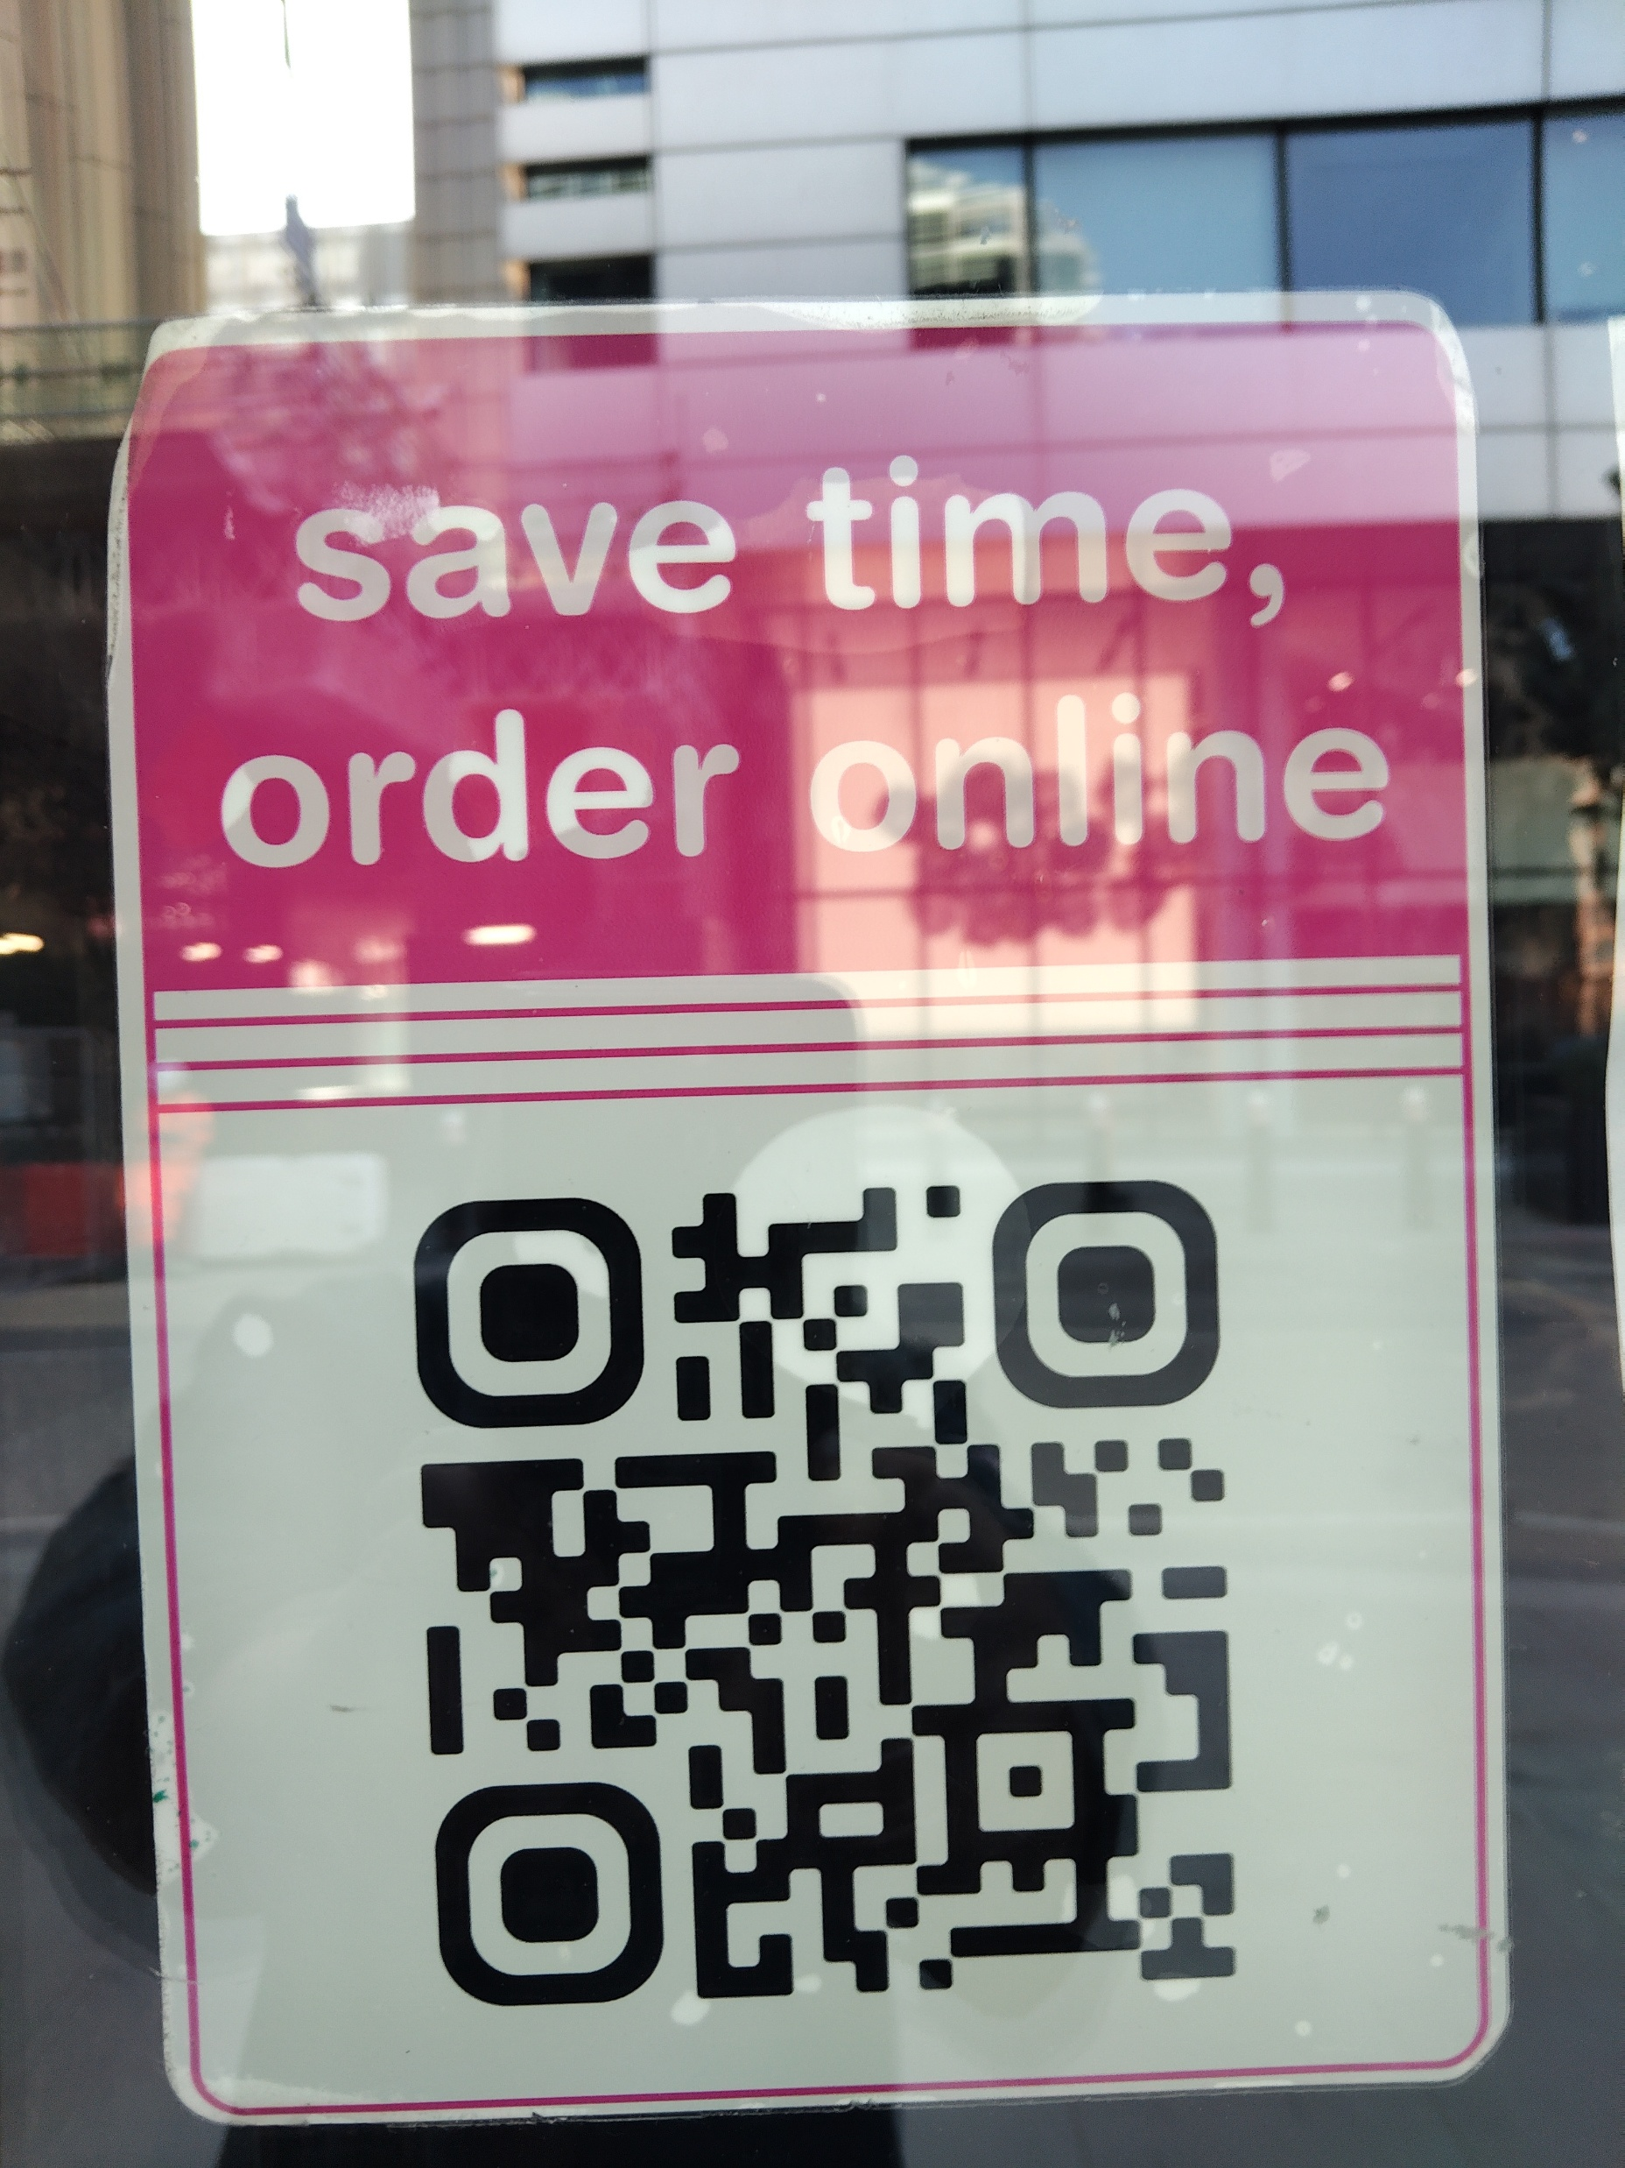
Tossed Barcode :

