Slide 1
Health, Wellbeing and Sustainable Development (BMHP6030)
WEEK 4– Global and National Initiatives for Sustainable Development Goals: Impact on Health and Social Care (HSC) Practices

Slide 2
Lesson Objectives
By the end of this lesson, students will be able to:
Identify key global and national initiatives aimed at achieving health-related Sustainable Development Goals (SDGs).
Evaluate the impact of these initiatives on Health and Social Care (HSC) practices.
Recognise the challenges and shortfalls in the implementation of SDG initiatives and discuss potential solutions.

Slide 3

Sustainable Development Goals
The 17 SDGs are a global framework to achieve a better and more sustainable future by 2030. They address global challenges, including poverty, inequality, climate change, and health.
Good Health and Well-being, which aims to ensure healthy lives and promote well-being for all at all ages. SDG 3 includes targets on reducing maternal mortality, ending epidemics, and achieving universal health coverage (UHC).
Health and well-being are linked to other goals, such as SDG 1 (No Poverty) and SDG 5 (Gender Equality). Progress in health drives progress in other areas, and vice versa.
(United Nations, 2024)
Notes:
Emphasize that while SDGs are globally recognized, their implementation varies by region, with different challenges and successes.
Successes:
Reduction in Child Mortality: Significant progress has been made in reducing under-5 mortality rates globally, largely due to improved access to healthcare and vaccination programs.
Combatting Diseases: Efforts like the Global Polio Eradication Initiative have nearly eradicated polio, and HIV/AIDS-related deaths have decreased due to better treatment and prevention programs.
Universal Health Coverage (UHC): Some countries have made substantial progress in extending healthcare coverage, ensuring that more people have access to essential health services without financial hardship.
Challenges:
Health Inequities: Despite progress, significant disparities remain between and within countries. For example, maternal mortality rates are still high in certain regions, particularly in sub-Saharan Africa.
Non-Communicable Diseases (NCDs): The global rise in NCDs, such as diabetes and heart disease, presents a growing challenge, especially in low- and middle-income countries where healthcare systems are often ill-equipped to handle these conditions.
Pandemics and Health Crises: The COVID-19 pandemic has highlighted vulnerabilities in global health systems, disrupting progress towards SDG 3 and exacerbating existing inequalities.
Funding and Resources: Many low-income countries struggle with inadequate healthcare infrastructure and lack the resources needed to meet the targets set by SDG 3, including access to medicines, trained health workers, and health facilities.

Slide 4

Sustainable Development Goals
While SDGs are globally recognised, their implementation varies by region, with different challenges and successes.
What successes and challenges can you think of related to meeting the SDG's?
How do you see the relationship between health and other SDGs, like poverty and gender equality?
Discuss in pairs and share your thoughts with the group
Notes:
SChallenges and Successes:
Successes:
Reduction in Child Mortality: Under-5 mortality rates have decreased globally due to improved healthcare access, vaccination programs, and better nutrition.
Combatting Diseases: Initiatives like the Global Polio Eradication Initiative have led to a dramatic decrease in polio cases. Similarly, global efforts have reduced HIV/AIDS-related deaths through widespread access to antiretroviral therapy.
Improved Maternal Health: In many regions, maternal mortality rates have decreased due to better access to skilled care during childbirth and increased availability of emergency obstetric services.
Challenges:
Health Inequities: Persistent inequalities in health outcomes are observed between and within countries. For example, maternal mortality remains high in low-income countries, particularly in sub-Saharan Africa.
Non-Communicable Diseases (NCDs): The global rise in NCDs, such as cardiovascular diseases, cancer, and diabetes, presents a significant challenge, especially in low- and middle-income countries where healthcare systems are under-resourced.
Pandemics and Health Crises: The COVID-19 pandemic exposed vulnerabilities in global health systems, disrupting progress towards SDG 3 and exacerbating existing health disparities.
Resource Constraints: Many countries face significant challenges in healthcare funding, infrastructure, and workforce capacity, limiting their ability to achieve health-related SDG targets.

Slide 5
How does SDG 3 Impact the Health and Wellbeing of Citizens
Fighting Diseases It focuses on combatting diseases like AIDS, tuberculosis, and malaria, leading to fewer deaths and better disease management.
Enhancing Mental Health By emphasizing mental health care, SDG 3 leads to better access to services, reduced stigma, and improved mental well-being.
Ensuring Access to Care The goal aims for universal health coverage, making essential health services accessible to more people, reducing inequalities, and enhancing economic security.
Reducing Mortality SDG 3 targets preventable deaths in children and mothers, helping to increase life expectancy and improve family health.
Addressing Chronic Illnesses The goal promotes prevention and treatment of non-communicable diseases like heart disease and diabetes, improving overall quality of life.
Strengthening Health Systems SDG 3 supports the development of stronger healthcare infrastructure, ensuring better quality and efficiency in healthcare services.
Promoting Healthy Lifestyles Through public health campaigns, it encourages healthier lifestyle choices, contributing to better physical and mental health.
Notes:
SChallenges and Successes:
Successes:
Reduction in Child Mortality: Under-5 mortality rates have decreased globally due to improved healthcare access, vaccination programs, and better nutrition.
Combatting Diseases: Initiatives like the Global Polio Eradication Initiative have led to a dramatic decrease in polio cases. Similarly, global efforts have reduced HIV/AIDS-related deaths through widespread access to antiretroviral therapy.
Improved Maternal Health: In many regions, maternal mortality rates have decreased due to better access to skilled care during childbirth and increased availability of emergency obstetric services.
Challenges:
Health Inequities: Persistent inequalities in health outcomes are observed between and within countries. For example, maternal mortality remains high in low-income countries, particularly in sub-Saharan Africa.
Non-Communicable Diseases (NCDs): The global rise in NCDs, such as cardiovascular diseases, cancer, and diabetes, presents a significant challenge, especially in low- and middle-income countries where healthcare systems are under-resourced.
Pandemics and Health Crises: The COVID-19 pandemic exposed vulnerabilities in global health systems, disrupting progress towards SDG 3 and exacerbating existing health disparities.
Resource Constraints: Many countries face significant challenges in healthcare funding, infrastructure, and workforce capacity, limiting their ability to achieve health-related SDG targets.

Slide 6
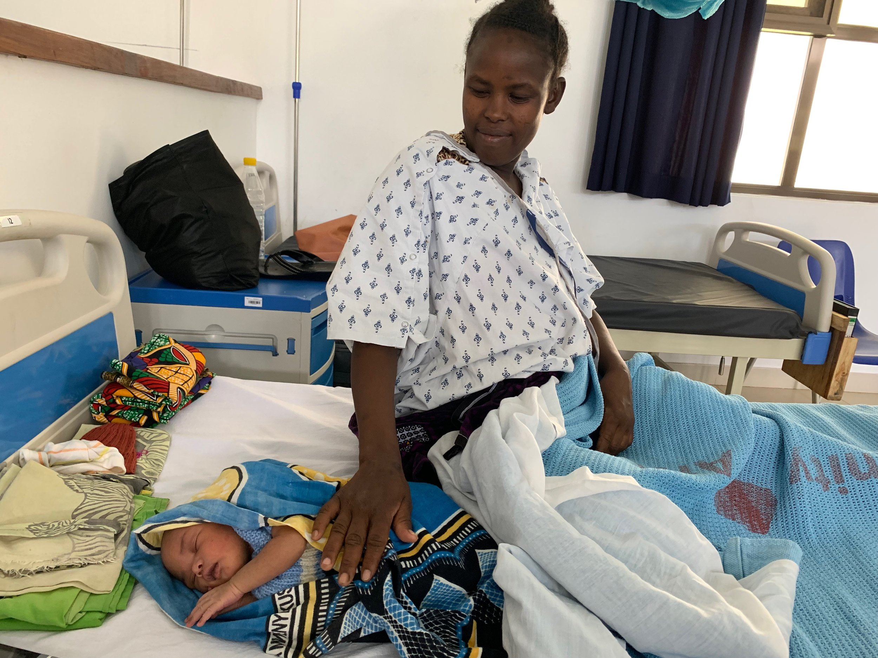
Successes
  Reduction in Child Mortality - Under-5 mortality rates have decreased globally due to improved healthcare access, vaccination programs, and better nutrition.
  Combatting Diseases - Initiatives like the Global Polio Eradication Initiative have led to a dramatic decrease in polio cases. Similarly, global efforts have reduced HIV/AIDS-related deaths through widespread access to antiretroviral therapy.
  Improved Maternal Health - In many regions, maternal mortality rates have decreased due to better access to skilled care during childbirth and increased availability of emergency obstetric services.
Notes:
SChallenges and Successes:
Successes:
Reduction in Child Mortality: Under-5 mortality rates have decreased globally due to improved healthcare access, vaccination programs, and better nutrition.
Combatting Diseases: Initiatives like the Global Polio Eradication Initiative have led to a dramatic decrease in polio cases. Similarly, global efforts have reduced HIV/AIDS-related deaths through widespread access to antiretroviral therapy.
Improved Maternal Health: In many regions, maternal mortality rates have decreased due to better access to skilled care during childbirth and increased availability of emergency obstetric services.
Challenges:
Health Inequities: Persistent inequalities in health outcomes are observed between and within countries. For example, maternal mortality remains high in low-income countries, particularly in sub-Saharan Africa.
Non-Communicable Diseases (NCDs): The global rise in NCDs, such as cardiovascular diseases, cancer, and diabetes, presents a significant challenge, especially in low- and middle-income countries where healthcare systems are under-resourced.
Pandemics and Health Crises: The COVID-19 pandemic exposed vulnerabilities in global health systems, disrupting progress towards SDG 3 and exacerbating existing health disparities.
Resource Constraints: Many countries face significant challenges in healthcare funding, infrastructure, and workforce capacity, limiting their ability to achieve health-related SDG targets.

Slide 7
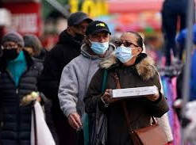
Challenges
  Health Inequities - Persistent inequalities in health outcomes are observed between and within countries. For example, maternal mortality remains high in low-income countries, particularly in sub-Saharan Africa.
  Non-Communicable Diseases (NCDs) - The global rise in NCDs, such as cardiovascular diseases, cancer, and diabetes, presents a significant challenge, especially in low- and middle-income countries where healthcare systems are under-resourced.
  Pandemics and Health Crises - The COVID-19 pandemic exposed vulnerabilities in global health systems, disrupting progress towards SDG 3 and exacerbating existing health disparities.
  Resource Constraints - Many countries face significant challenges in healthcare funding, infrastructure, and workforce capacity, limiting their ability to achieve health-related SDG targets.
Notes:
SChallenges and Successes:
Successes:
Reduction in Child Mortality: Under-5 mortality rates have decreased globally due to improved healthcare access, vaccination programs, and better nutrition.
Combatting Diseases: Initiatives like the Global Polio Eradication Initiative have led to a dramatic decrease in polio cases. Similarly, global efforts have reduced HIV/AIDS-related deaths through widespread access to antiretroviral therapy.
Improved Maternal Health: In many regions, maternal mortality rates have decreased due to better access to skilled care during childbirth and increased availability of emergency obstetric services.
Challenges:
Health Inequities: Persistent inequalities in health outcomes are observed between and within countries. For example, maternal mortality remains high in low-income countries, particularly in sub-Saharan Africa.
Non-Communicable Diseases (NCDs): The global rise in NCDs, such as cardiovascular diseases, cancer, and diabetes, presents a significant challenge, especially in low- and middle-income countries where healthcare systems are under-resourced.
Pandemics and Health Crises: The COVID-19 pandemic exposed vulnerabilities in global health systems, disrupting progress towards SDG 3 and exacerbating existing health disparities.
Resource Constraints: Many countries face significant challenges in healthcare funding, infrastructure, and workforce capacity, limiting their ability to achieve health-related SDG targets.

Slide 8
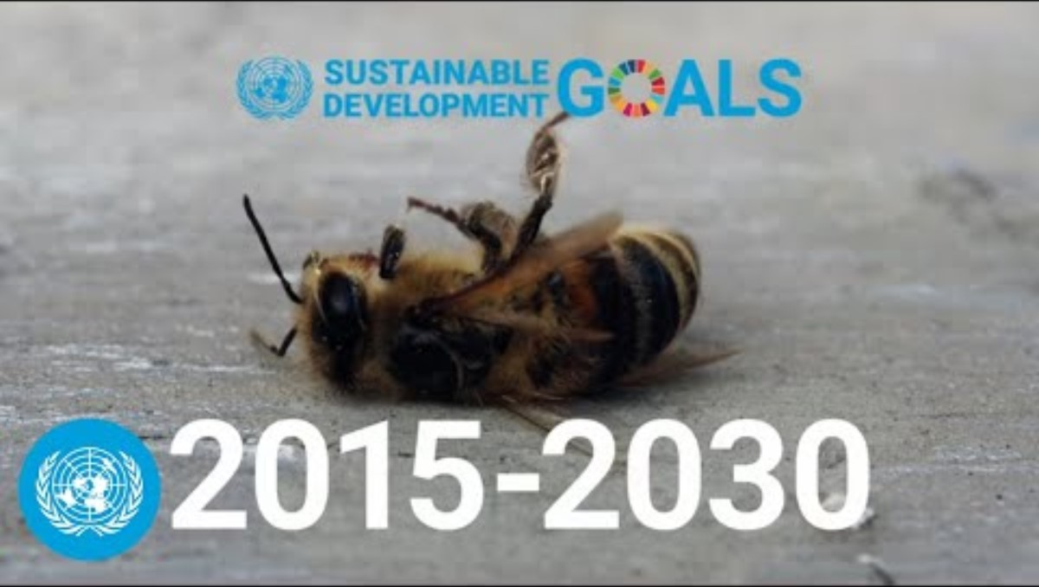
Notes:
Successes:
Significant progress has been made in reducing under-5 mortality rates globally, largely due to improved access to healthcare and vaccination programs.
Efforts like the Global Polio Eradication Initiative have nearly eradicated polio, and HIV/AIDS-related deaths have decreased due to better treatment and prevention programs.
Some countries have made substantial progress in extending healthcare coverage, ensuring that more people have access to essential health services without financial hardship.
Challenges:
Despite progress, significant disparities remain between and within countries. For example, maternal mortality rates are still high in certain regions, particularly in sub-Saharan Africa.
he global rise in NCDs, such as diabetes and heart disease, presents a growing challenge, especially in low- and middle-income countries where healthcare systems are often ill-equipped to handle these conditions.
Pandemics and Health Crises: The COVID-19 pandemic has highlighted vulnerabilities in global health systems, disrupting progress towards SDG 3 and exacerbating existing inequalities.
Funding and Resources: Many low-income countries struggle with inadequate healthcare infrastructure and lack the resources needed to meet the targets set by SDG 3, including access to medicines, trained health workers, and health facilities.

Slide 9
Global Initiatives Towards SDG 3
Click the links to research these global initiatives
https://www.who.int/initiatives/sdg3-global-action-plan
https://www.theglobalfund.org/en/about-the-global-fund/
https://www.undp.org/stories/promise-health-all
https://www.ncbi.nlm.nih.gov/pmc/articles/PMC10208367/
Notes:
WHO Global Action Plan: Aims to accelerate progress on health-related SDGs by promoting partnerships across sectors. Focus areas include UHC, communicable diseases, and health emergencies.
The Global Fund: Invests in the fight against AIDS, TB, and Malaria, contributing to a significant reduction in these diseases, particularly in low-income countries.
UNDP Health Projects: Supports countries in developing health policies that are aligned with SDGs, emphasizing equity and access.

Slide 10
Global Initiatives Towards SDG 3
Small Group Discussion (15 minutes):
Discuss one of the global initiatives mentioned. Focus on evaluating its goals, successes, and ongoing challenges. Prepare a brief summary/poster to share with the class.

Slide 11
International Agencies-OECD’s role in global health promotion
The Organisation for Economic Co-operation and Development (OECD) is an international organisation that works to build better policies for better lives
Their goal is to shape policies that foster prosperity, equality, opportunity and well-being for all.
They draw on 60 years of experience and insights to better prepare the world of tomorrow.
Together with governments, policy makers and citizens, OECD work on establishing evidence-based international standards and finding solutions to a range of social, economic and environmental challenges.

Slide 12
International Agencies-United Nations role in building a sustainable future
UN is committed to building a better and sustainable world by-
Promoting Development-The United Nations has devoted its attention and resources to promoting living standards and human skills and potential throughout the world. Since 2000, this work has been guided by the Millennium Development Goals. Virtually all funds for UN development assistance come from contributions donated by countries. For instance, the UN Development Programme (UNDP), with staff in 170 countries, supports more than 4,800 projects to reduce poverty, promote good governance, address crises and preserve the environment.
The UN Children's Fund (UNICEF) works in more than 150 countries, primarily on child protection, immunization, girls' education and emergency aid. The UN Conference on Trade and Development (UNCTAD) helps developing countries make the most of their trade opportunities.

Slide 13
International Agencies-United Nations role in building a Sustainable Future
2)Supporting Industry-The UN Industrial Development Organization (UNIDO) serves as a “matchmaker” for North-South and South-South industrial cooperation, promoting entrepreneurship, investment, technology transfer and cost-effective and sustainable industrial development. It helps countries to manage the process of globalization smoothly and to reduce poverty.
3)Fighting Hunger-The Food and Agriculture Organization of the UN (FAO) leads global efforts to defeat hunger. The goal of universal food security —where people everywhere have regular access to enough high-quality food to lead active, healthy lives—is at the heart of its work. FAO acts as a neutral forum, where all nations meet as equals to negotiate agreements and debate policy. FAO also helps developing countries to modernize and improve agriculture, forestry and fisheries practices in ways that conserve natural resources and improve nutrition.

Slide 14
International Agencies-United Nations role in building a Sustainable Future
4-Improving Global Trade-The UN Conference on Trade and Development (UNCTAD) has helped developing countries to negotiate trade agreements and win preferential treatment for their exports. It has negotiated international commodity agreements to ensure fair prices for developing countries, improved the efficiency of their trade infrastructure and helped them to diversify their production and to integrate into the global economy.
5-Promoting Economic Reform-The International Monetary Fund (IMF) and the World Bank have helped many countries to improve their economic management, provided temporary financial assistance to countries to help ease balance-of-payment difficulties and offered training for government finance officials.

Slide 15
UN’s role in building a Sustainable Future
6)Protecting the Environment-The United Nations is working to solve global environmental problems. As an international forum for building consensus and negotiating agreements, the UN is tackling global problems such as ozone layer depletion, toxic waste, loss of forests and species, and air and water pollution. Unless these problems are addressed, markets and economies will not be sustainable in the long term, as environmental losses are depleting the natural capital on which growth and human survival are based.
7)Combating International Crime-The UN Office on Drugs and Crime (UNODC) works with countries and organizations to counter transnational organized crime by providing legal and technical assistance to fight corruption, money-laundering, drug trafficking and smuggling of migrants, as well as by strengthening criminal justice systems. It helps countries to prevent terrorism, it is a leader in the global fight against trafficking in persons and, together with the World Bank, it helps countries to recover assets stolen by corrupt leaders.

Slide 16
National Initiatives - NHS Long Term Plan (2019)
This plan sets out key priorities for the NHS over the next decade, aiming to improve prevention, enhance digital health, and reduce health inequalities across the UK.
Prevention - Focus on preventing health problems before they start, including expanding screening programs, promoting healthy lifestyles, and reducing smoking and obesity.
Digital Health - Invest in digital tools to improve patient access to care and enable remote management of chronic conditions. This includes expanding access to online GP consultations and utilizing health apps.
Reducing Health Inequalities - Targeted efforts to address disparities in health outcomes, particularly in underserved communities. This includes increasing access to mental health services and addressing the social determinants of health.

Slide 17
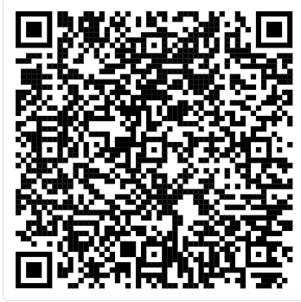
National Initiatives - Public Health England
Public Health England (PHE) - Now replaced by the UK Health Security Agency (UKHSA) and Office for Health Improvement and Disparities (OHID). These agencies focus on health protection and improvement, tackling key public health issues such as smoking, obesity, and mental health.
Access the Local Government Association and Browse through the case studies to see the many innovative programmes councils are involved in.
https://www.local.gov.uk/case-studies?keys=obesity&from=&to=&sort_by=created&sort_order=DESC

Slide 18
National Initiatives -Five Year Forward View for Mental Health
Five Year Forward View for Mental Health
Published by NHS England, this document provides a vision for mental health services and sets out priorities for improving care over five years.
Key Focus Areas:
  Access to Services - Improve access to mental health services for all age groups, including children and young people.
  Integration - Promote integration of mental health services with physical health services to provide holistic care.
  Funding - Increase funding for mental health services to support the expansion and improvement of care.
  Mental Health Promotion - Invest in prevention and early intervention strategies.

Slide 19
National Initiatives -Five Year Forward View for Mental Health Analysis
Task - Find three research articles related to current challenges in UK mental health care and synthesise findings
What does this mean?
Find three research articles that focus on the current challenges facing mental health care in the UK. After identifying these articles, you are expected to read and analyse them, then combine (or synthesise) their findings into a cohesive summary. This synthesis should highlight common themes, differences, and insights that emerge from the research, providing a clear understanding of the issues in UK mental health care as discussed in the selected articles.

Slide 20
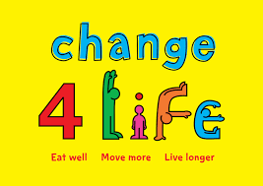
National Initiatives -Change4life
The Change4Life programme, led by Public Health England, supports SDG 3 (Good Health and Well-being) by promoting healthier eating, increasing physical activity, reducing sugar intake, and providing family support. Its impact is evident in improved dietary habits, enhanced physical activity, reduced sugar consumption, and strengthened family health dynamics.
https://www.youtube.com/watch?v=5T0D_8OwvOk
Is this initative effective?
Check out how Change4Life has been implemented in Birmingham https://www.youtube.com/watch?v=-UnWGz-IGhk
Notes:
However, to maximise its effectiveness, the programme should expand outreach to underserved communities, enhance digital engagement through interactive tools, integrate with school programs, collaborate with local organizations, and implement robust monitoring and evaluation. Addressing potential barriers such as resource constraints and varying levels of digital access will be crucial for its continued success

Slide 21




National Initiatives – Covid-19 vaccination Programme
COVID-19 Vaccination Program - A key initiative under the NHS Long Term Plan, aimed at providing equitable access to vaccines across the population. This program played a crucial role in controlling the pandemic in the UK.
How effective was this initiative? Your class must split into two and debate for and against the effectiveness of the Covid-19 vaccination programme using data and credible research.

Slide 22
Evaluating Impact on HSC Practices
https://www.youtube.com/watch?v=z_jjX-i45hU
Using the information in the video, Discuss in groups how national initiatives related to SDG 3 and another SDG of choice have impacted HSC practices in the UK. Share your ideas with the class.

Slide 23

Recognising Shortfalls and Proposing Improvements to meet SDG's
Access the Moodle Page word document that provides a strategy to effectively recognise shortfalls and propose improvements – this will be useful for your second assignment.

Slide 24

Knowledge Check!
Name two global initiatives aimed at achieving health-related SDGs and briefly describe their primary focus.
Explain one way in which the UK’s national health policies have contributed to the achievement of SDG 3.
Identify one challenge in implementing SDG initiatives in the UK and propose a potential solution to address this challenge.
How can Health and Social Care (HSC) practices be improved to better align with the goals of SDG 3? Provide one specific recommendation.

Slide 25
Bibliography
Lee, S.E., Greene, S.A., Burns, C.C., Tallis, G., Wassilak, S.G.F. and Bolu, O. (2023). Progress Toward Poliomyelitis Eradication - Worldwide, January 2021-March 2023. MMWR. Morbidity and mortality weekly report, [online] 72(19), pp.517–522. doi:https://doi.org/10.15585/mmwr.mm7219a3.
The Global Fund (2022). About the Global Fund. [online] www.theglobalfund.org. Available at: https://www.theglobalfund.org/en/about-the-global-fund/ (Accessed: 22 August 2024).
UNDP (2024). The promise of health for all | United Nations Development Programme. [online] UNDP. Available at: https://www.undp.org/stories/promise-health-all (Accessed: 22 August 2024).
United Nations (2024). The 17 Sustainable Development Goals. [online] United Nations. Available at: https://sdgs.un.org/goals (Accessed: 22 August 2024).
World Health Organization (2024). Sustainable Development Goals 3 - The Global Action Plan for Healthy Lives and Well-being for All. [online] www.who.int. Available at: https://www.who.int/initiatives/sdg3-global-action-plan (Accessed 22 August 2024).

