Slide 1
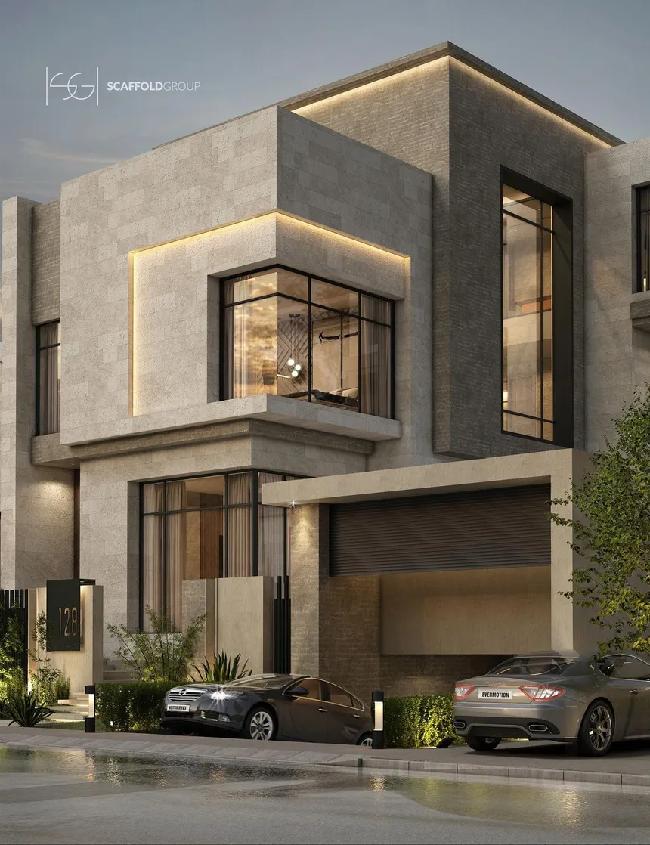
Modern Walls and their evolution

Slide 2
2 Types of Walls
Structural (Load Bearing)
Partition (Non Load Bearing)

Slide 3
Introduction
There are many different ways walls can be built, terms like Traditional and Modern can indicate how a wall was built. But care must be taken as these terms can mean different things in different localities.
In the UK a traditionally built wall would be considered stone or brick, whilst a Timber frame is more common in North America or Northern Europe where wood is more readily available.

Slide 4
Somewhat confusingly, while the term‘traditional build’ can refer to solid masonry walls, it is also sometimes used to describe a structure where the internal load bearing leaf of the walling is of masonry construction and tied with stainless steel ties to an outer leaf of either brick or stone.

Slide 5
Cavity wall construction 1920-Present
In the latter part of the 19th century a number of houses were built with cavity walls. It was not, however, until 1920 that this became the standard form of construction.
Cavity walls were cheaper to build than their solid wall counterparts. In addition, they offer improved thermal insulation and better weather protection. Most walls comprised two half-brick leaves with a 50mm cavity. The two halves of the wall were tied at regular intervals with steel or wrought iron wall ties.

Slide 6
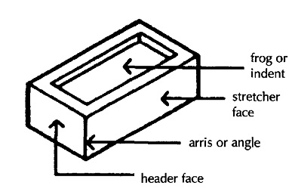
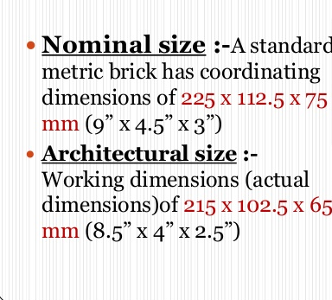
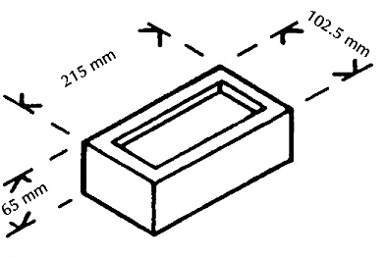
SOLID WALLS
Brickwork Materials
https://www.scottishbrickhistory.co.uk/brick-frog-origins-of-use/

Slide 7
Materials required to build half brick walls
  Half-brick walls will need half bricks to create stopped ends.
  Bricks will need to be cut using a lump hammer and bolster chisel to create half bats.
The length of this half will be the same as the width of a brick:
102.5mm.

Slide 8
Materials required to build half brick walls
Brick types
There are many types of specialists bricks available for a variety of situations, however typically bricks can be put into the following categories:
  Facing Bricks
  Common Bricks
  Engineering Bricks

Slide 9
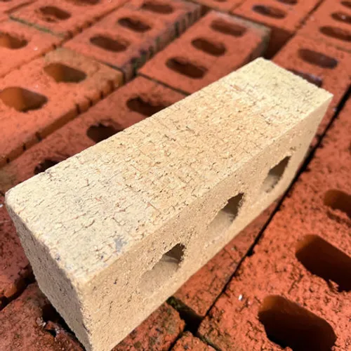
Materials required to build half brick walls
Brick types
Facing Bricks - primarily chosen for their aesthetic qualities and are used for the external walls of buildings.
They are available in various styles and manufacturing methods.

Slide 10
Materials required to build half brick walls
Brick types
  Common bricks - tend to be used where work will not be seen, such as below ground or where surfaces will be finished with plaster.
  They are not usually made as accurately as facing bricks and are usually cheaper to buy.

Slide 11
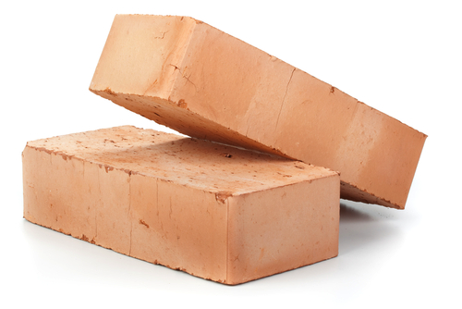
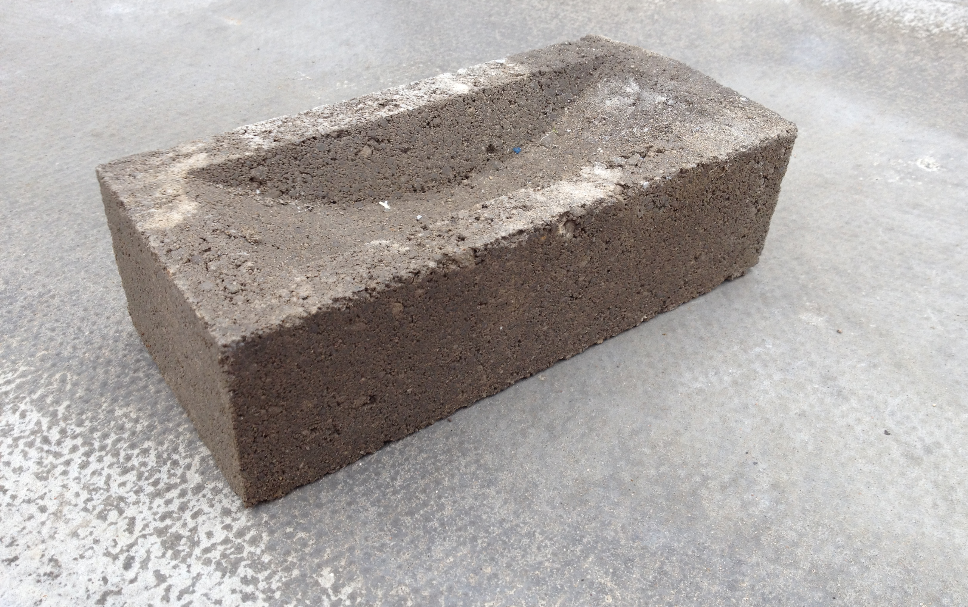
Materials required to build half brick walls
  Common bricks are of lower quality than facing bricks
  in terms of:
  Size Surface
  Shape Finish Colour
Common bricks (clay)
Common brick (concrete)

Slide 12
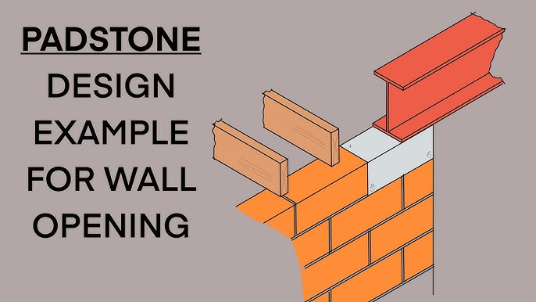
Materials required to build half brick walls
Brick types
  Engineering bricks - are selected for their technical attributes rather than appearance, valued for their high compressive strength and low water absorption.
  Used in applications requiring durability and resistance to water, frost, and chemicals, such as sewers, retaining walls, manholes, and ground works.

Slide 13
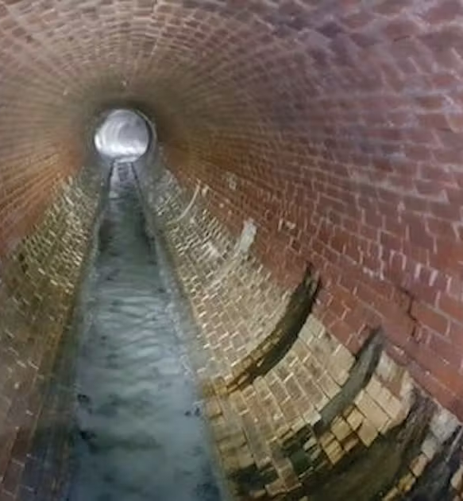
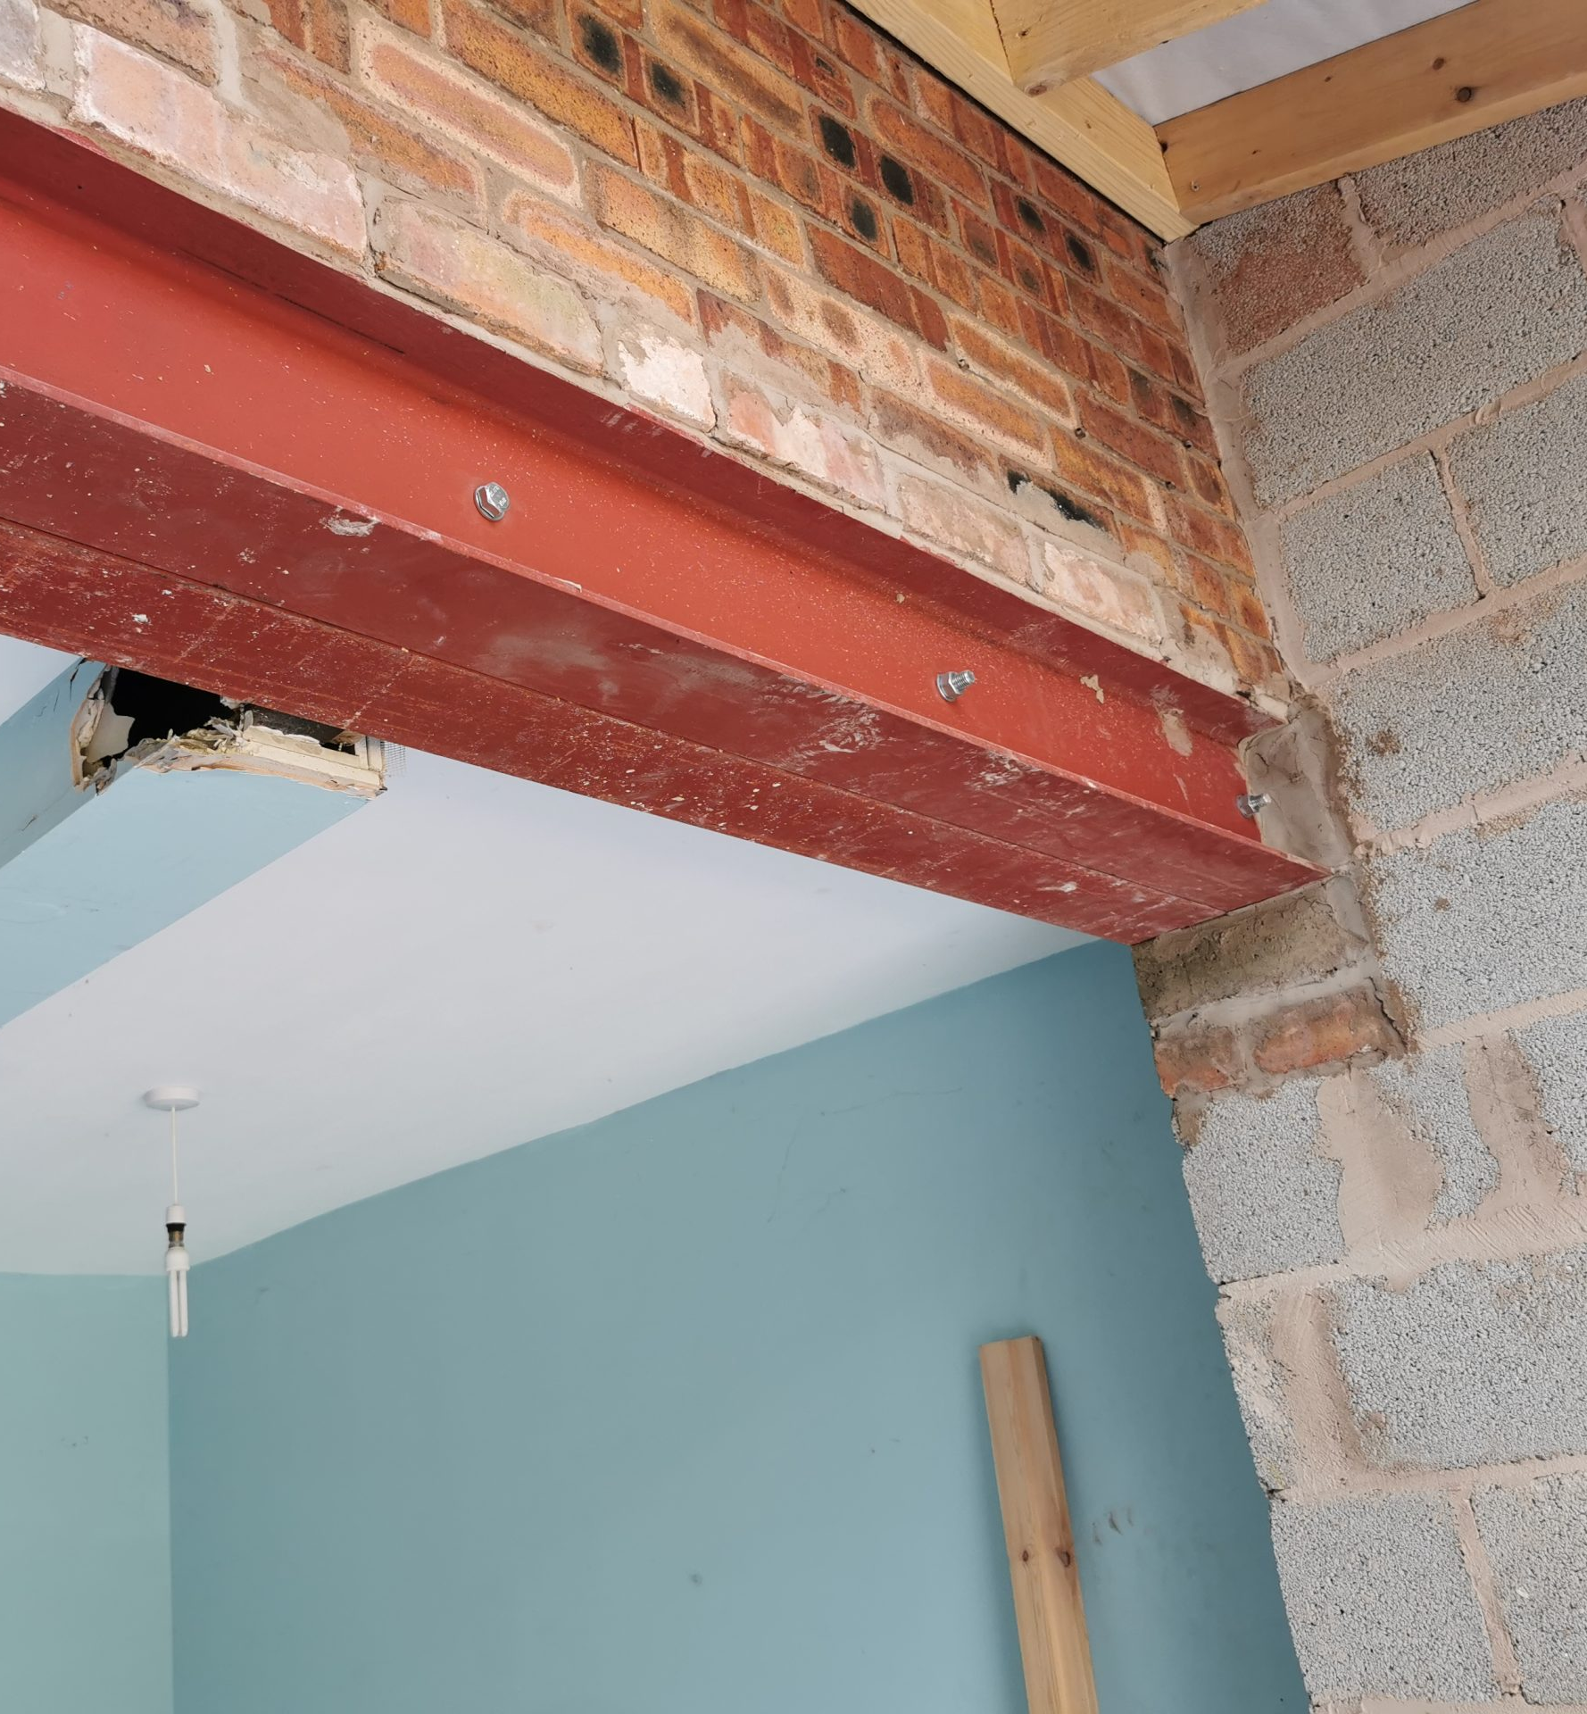

Slide 14
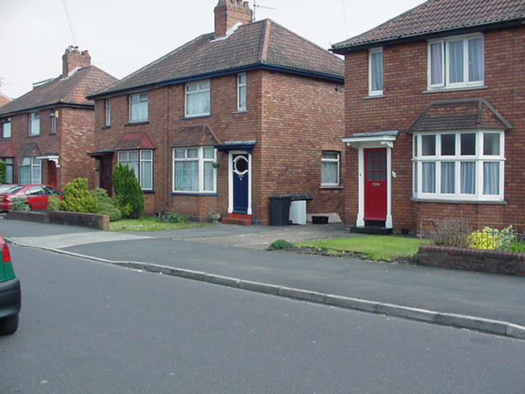
Early Cavity walls - c1920
Elevation
DPC
Wall ties
This is a cavity wall in Stretcher Bond. It’s made from two leaves, or skins, of brickwork, each a half-brick thick. The internal leaf was usually built from commons rather than facings.
Wall 250mm or 10 inches thick
Next slide...

Slide 15
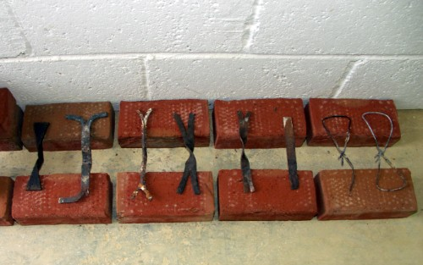
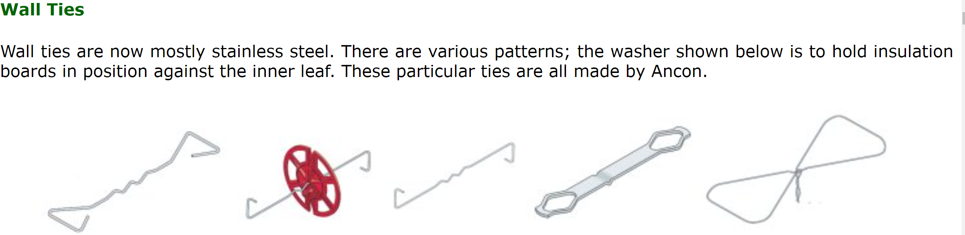
The corrosion of wall ties was first officially recognised in the 1960s in South Wales. At first, it was thought to be due to a combination of poor tie protection and exposure to the elements. Time has shown that many of the early ties and mortars were just more susceptible to corrosion.
Mild steel ties initially were either left unprotected or given a bitumen coating, but in the early 1930s zinc coatings or galvanising became accepted.
More information on early Wall Ties and defects

Slide 16
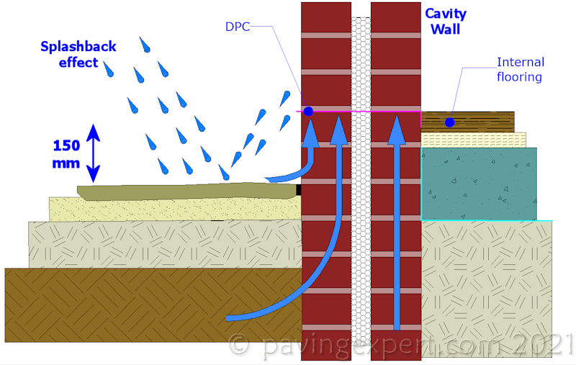
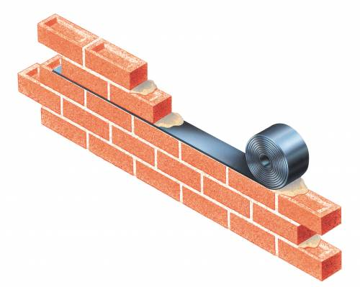
DPC – Damp Proof Coursing

Slide 17
By 1875, the inclusion of a DPC became compulsory in properties being built in London. This would generally be a single, or double layer of slate built into the structural walls, at the correct position above external ground level.
Slate is a very effective form of DPC, although could be cracked, or damaged over time (possibly due to structural movement in the property, which could result in areas of rising damp from the ground.
Edwardian properties (1901 – 1910) tended to still be solid wall construction with the DPC being either bitumen, slate or sometimes engineering bricks.
Between the 1920s and 1980s the most common types of DPC’s being built into walls, were bitumen and felt based, with polypropylene (PP) DPC’s being introduced in the 1960’s – 1970s.

Slide 18
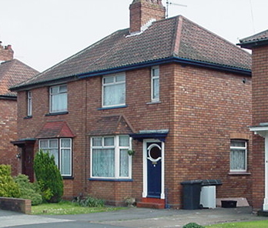
Early Cavity walls - c1930
DPC
Wall ties
By the 1930s, or so, some internal leaves were being built in blockwork. This was cheaper than brickwork. A standard block is 3 bricks high. Blocks were made from a variety of aggregates, some of them no longer available.
Next slide...

Slide 19
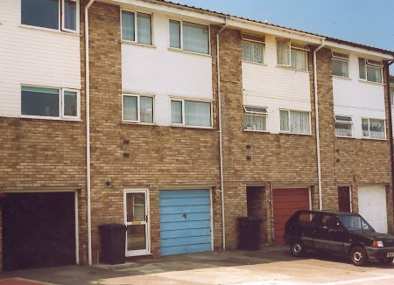
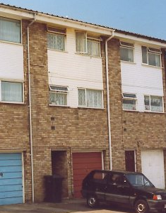
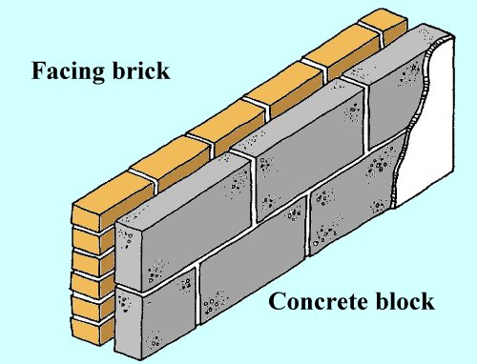
Cavity walls - c1960s and 1970s
Lightweight blocks were originally made from lightweight aggregates such as clinker or pumice. These were slowly replaced with aerated concrete blocks such as Celcon and Thermalite.
By the 1970s, or so, very little had changed. Cavity walls were still basically brickwork in the external leaf and blockwork in the internal leaf. However, lightweight blocks were becoming the norm to provide improved thermal insulation.
Next slide...

Slide 20
1970-80’s
In the 1970s insulation standards slowly improved. A maximum 'U' value of 1.70 was introduced in 1972 (a measure of the wall’s ability to transmit heat). Achieving this standard was relatively easy; a brick external leaf, a 50mm cavity, and a dense block inner leaf just made the 1.7 threshold.
In 1980 the maximum U value dropped to 1; this required lightweight blockwork in the inner leaf. From this period to the present day most lightweight blocks have been made from aerated concrete.

Slide 21
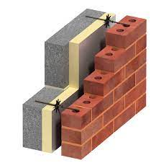
In the 1990s the maximum U value dropped to 0.45; this normally required a very thick lightweight inner leaf or cavity insulation.
By 2006 the U-Value was 0.3 which is 5-6 times more than a 1920’s equivalent cavity wall.
This type of construction still accounts for around 70% of new build houses in the UK

Slide 22
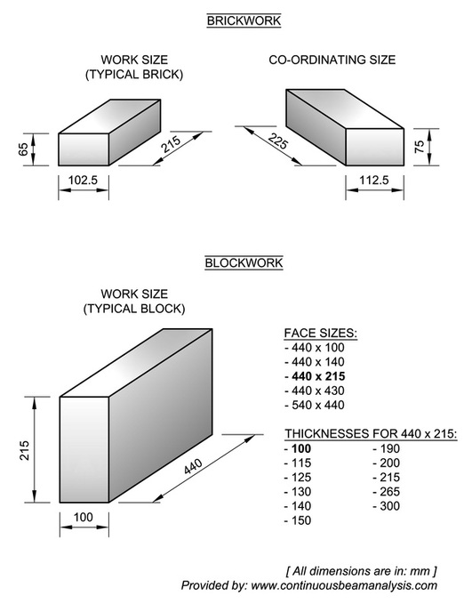
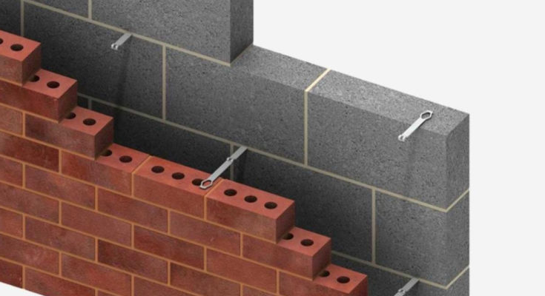
To obtain the co-ordinating dimensions add the specified joint thickness (normally 10mm) to the height and length of the block

Slide 23
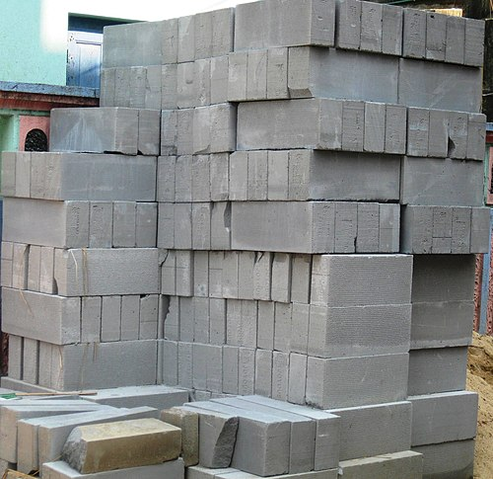
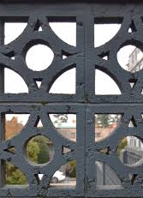
Blocks
Terminology can vary based on country so be careful when researching.
Concrete block - is a more common modern term
Breeze Block – UK term still in use but comes from “breeze”, referring to the small cinders and cinder-dust that are created by partially burned coal. This was used as the aggregate for early concrete blocks
In the US the term Breeze block refers to decorative blocks which allow shade and airflow
There the more common name for our breeze block would be cinder block

Slide 24
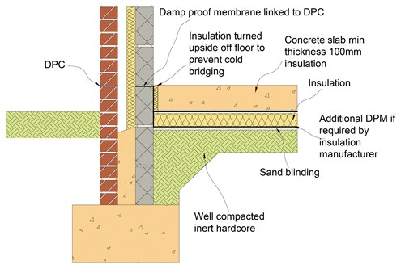
CAVITY WALLS
Damp Proof Membrane
Application in floors

Slide 25
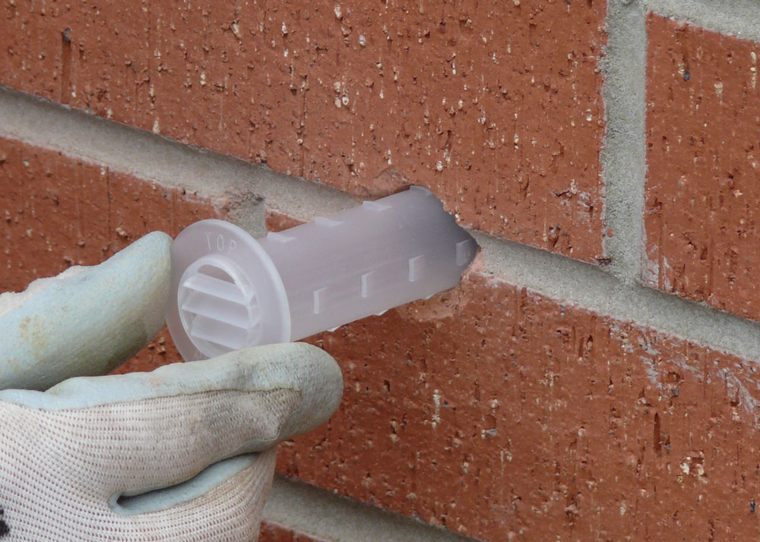
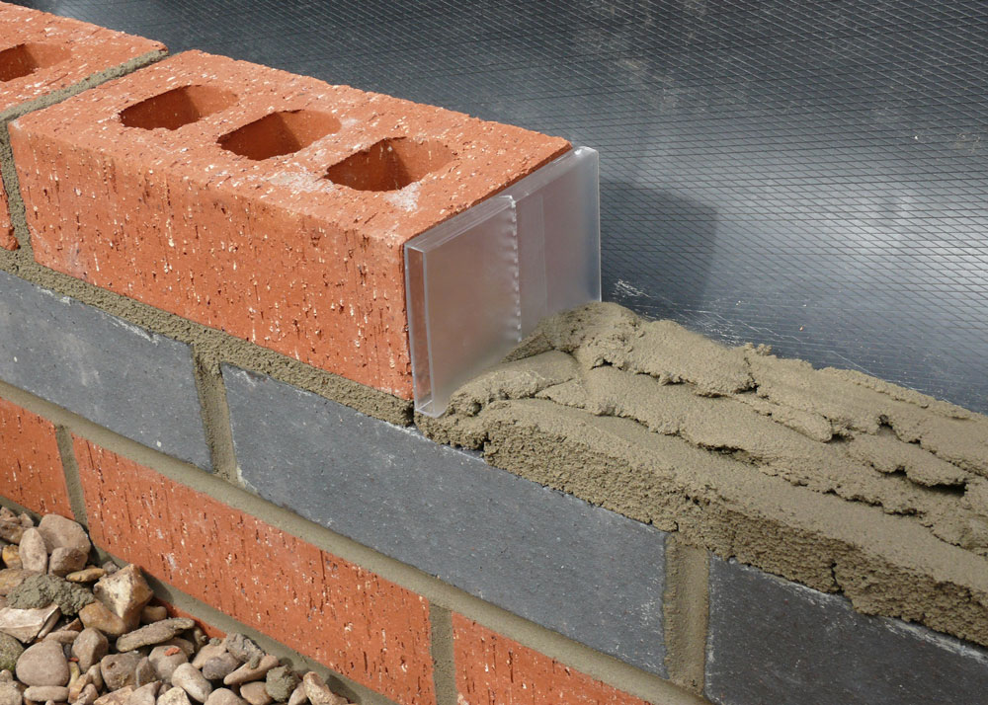
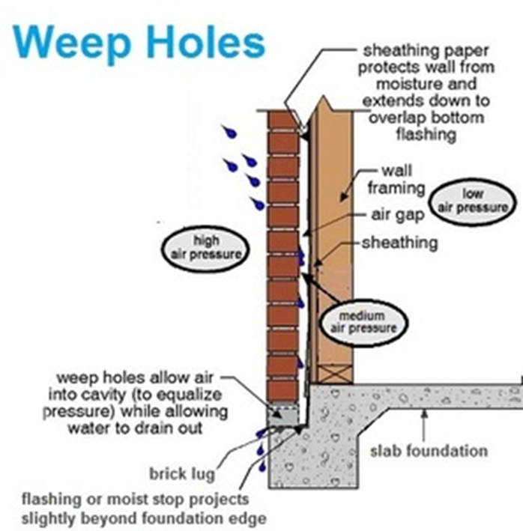
CAVITY WALLS
Cavity drainage

Slide 26
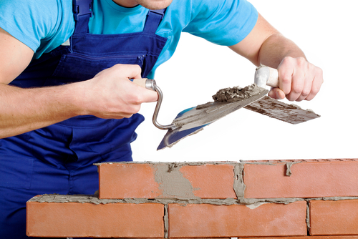
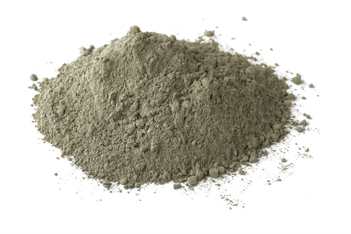
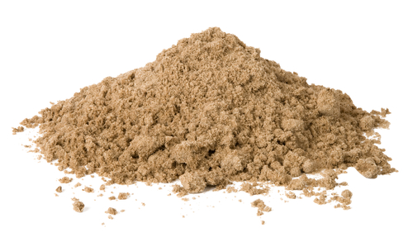
Materials required to build half brick walls
  Mortar is the material used
  to hold the bricks together and is made up of.
  sand (washed)
  cement
  water (clean).
Sand
Cement

Slide 27
  When sand and cement are mixed together, it is important to mix the correct ratio.
  Ratio is the quantity of each material.
  Ratios are used to make sure the strength and colour are the same throughout the building project.
  A typical mortar mix would use a ratio of:
  1 : 4
  1 part cement : 4 parts sand
  *Other ratios are used depending on the characteristics of the blocks/bricks being used

Slide 28
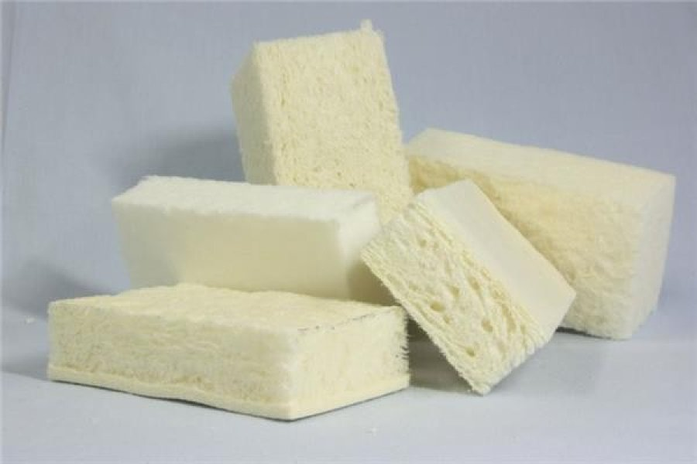
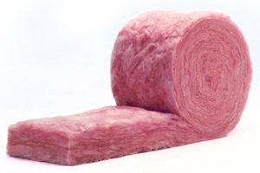
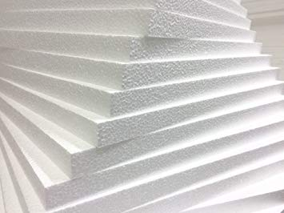
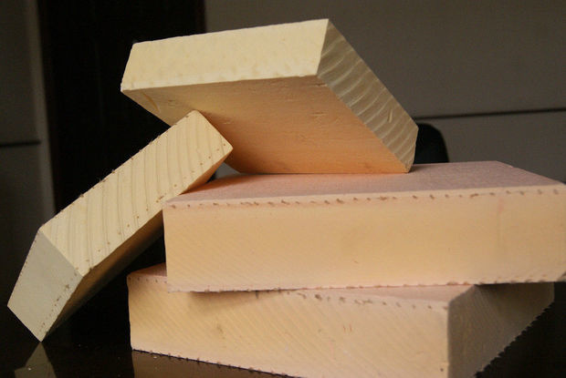
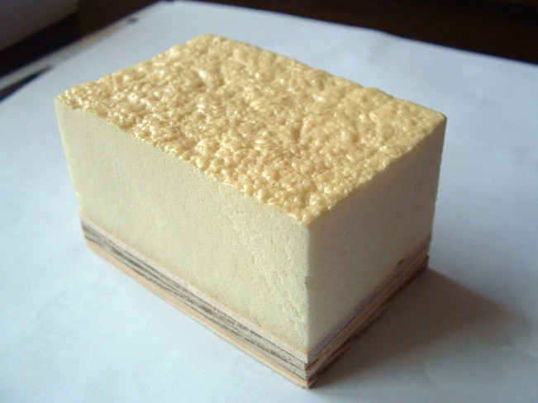
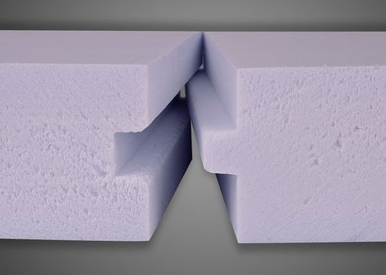
CAVITY WALLS
Insulation. Some types
Rock mineral wool
Glass mineral wool
Expanded polystyrene
Phenolic foam
Polyurethane foam
Extruded polystyrene

Slide 29
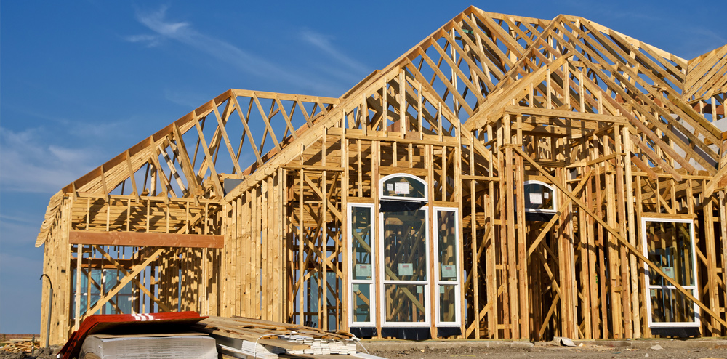
Cavity wall with timber frame inner wall
Known as Timber Frame Construction
The second most popular
technique for new home
construction in the UK and,
according to the UK Timber Frame Association, the fastest growing method of construction in the UK.
Traditionally used in areas rich in timber resources such as North America and Scandinavia, it comes with some good environmental credentials.

Slide 30
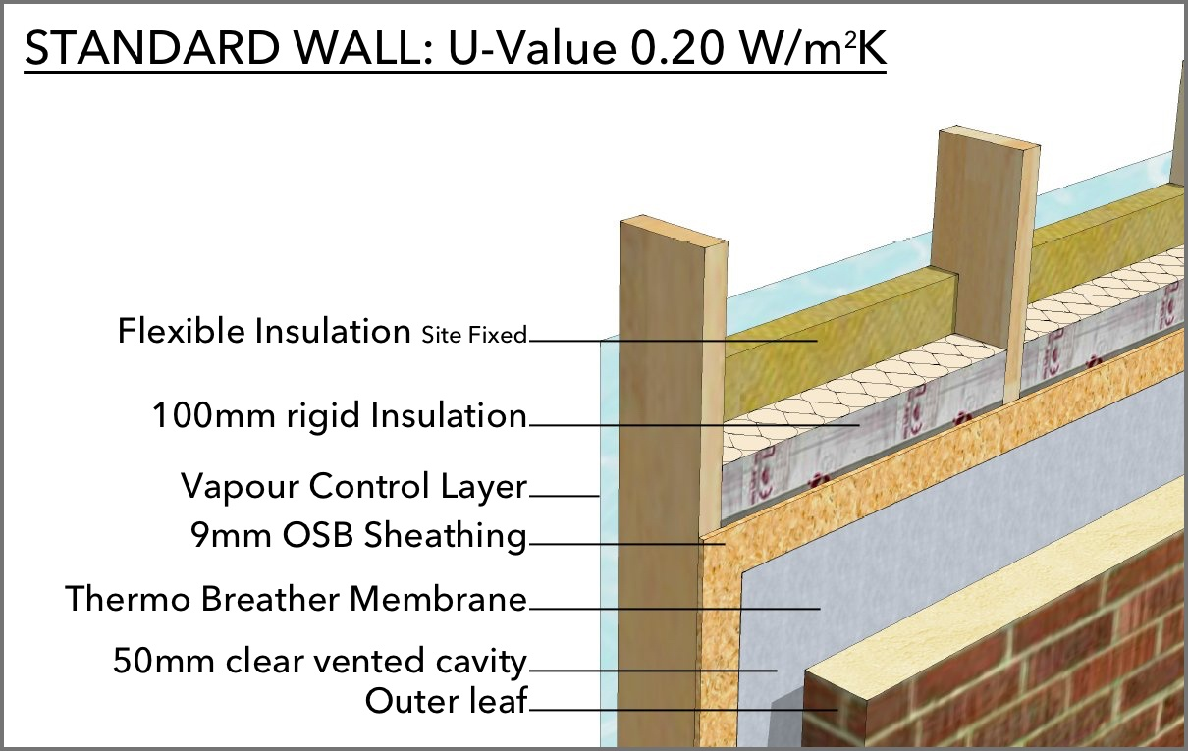
Cavity wall with timber frame inner wall

Slide 31
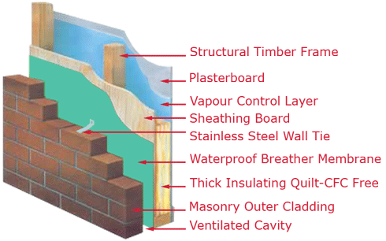
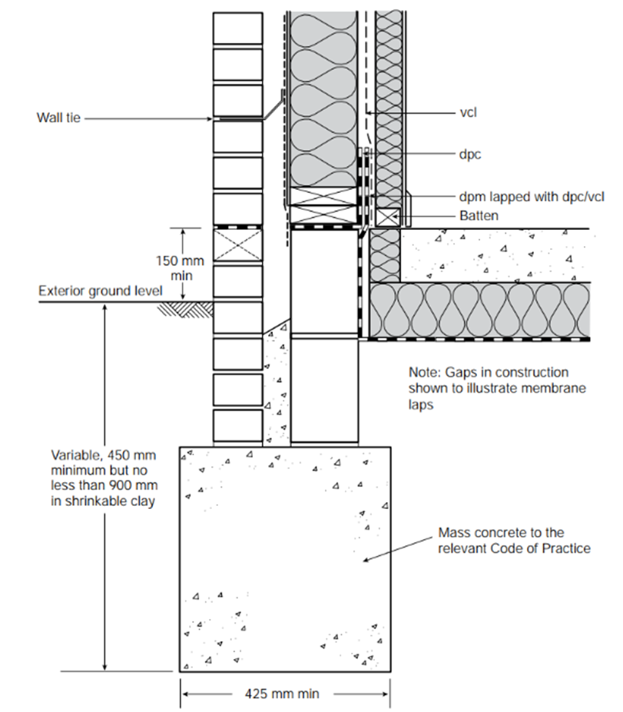
Cavity wall with timber frame inner wall

Slide 32
VAPOUR CONTROL BARRIER / LAYER (VAPOUR CHECK)
To stop the warm moisture in a room from entering the wall and affecting insulation and other elements inside (structure frame etc.)
Not needed in warm climates
If in the wrong position, it can cause more harm than benefit
Always in the warm side (between insulation and drywall)
Depending on the type of construction, we may to consider a waterproof, breathable layer.

