Slide 1
Management Economics
(LCBB5008)
Week 2 Lesson 2
Supply Managers and Application

Slide 2
Basic supply and demand under perfect competition – market supply
Assumptions
Firms produce for profit
Higher prices mean more higher profit and firms will expand output
Increased supply from q1 to q2
Gives increase in price (and profit) to p2
At higher prices marginal firms enter the market
Conversely, a fall in price leads to a contraction in supply p3 to q3
Movements along a curve
This is a normal supply curve
Price (p)
supply (s)
p2
p1
p3
q3
q1
q2
Quantity (q)

Slide 3
Basic supply and demand under perfect competition – changes in supply
Assumptions
Changes in costs of production
Changes in the prices of related commodities
Changes in the weather
Changes in indirect taxation and subsidies
Curve shifts from s1 to s2 where less is supplied at all price levels
Curve shifts from s1 to s3 where more is supplied at all price levels
S3
s3
S1
S1
price charged
Price (p)
S2
S2
s2
quantity demanded
quantity demanded
Quantity (q)

Slide 4
Elasticity of supply – perfectly inelastic supply
Assumptions
Elasticity of supply measures the responsiveness of a change in quantity to a change in price
Here, any change in price has no effect on quantity demanded
Es equals zero or Es = 0
Price (p)
Es = 0
p2
p1
p3
q
Quantity (q)

Slide 5
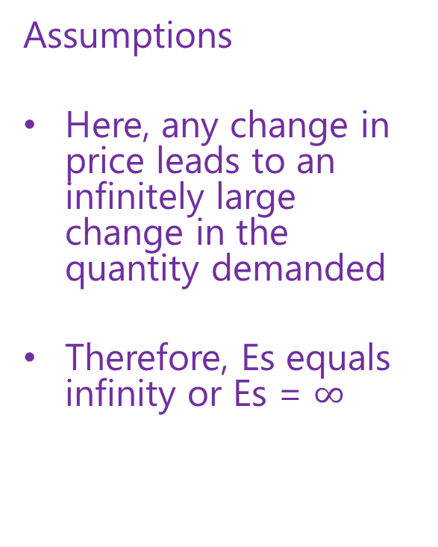

Elasticity of supply – perfectly elastic supply
Assumptions
Here, any change in price leads to an infinitely large change in the quantity demanded
Therefore, Es equals infinity or Es = $∞$
Price (p)
p
Es = $∞$
Quantity
(q)
q1 q2 q3

Slide 6
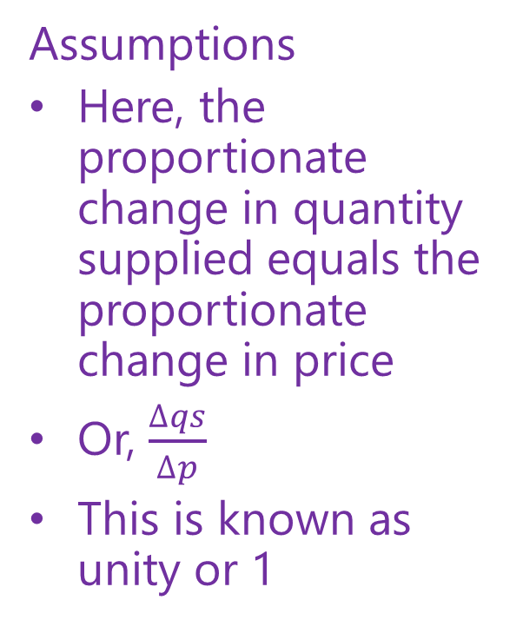
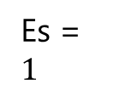
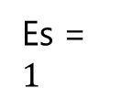
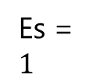
Elasticity of supply – proportionate of elasticity of supply
Assumptions
Here, the proportionate change in quantity supplied equals the proportionate change in price
Or, $\frac{∆qs}{∆p}$
This is known as unity or 1
Price (p)
Es = $1$
Es = $1$
Es = $1$
Quantity (q)

Slide 7
Determinants of elasticity of supply
The time period
Factor mobility
Availability of stocks
Behaviour of costs as output changes
Availability, reliability, and deployment of information and communications technology (ICT)

Slide 8
Basic supply and demand under perfect competition - equilibrium
Assumptions
Utility-seeking buyers
Full information for buyers and sellers
Profit-seeking sellers
Sellers are price-takers
Market clears at the equilibrium interface (e)
No surpluses or shortages
The market functions efficiently
supply (s)
Price (p)
equilibrium (e)
p1
demand (d)
q1
Quantity (q)

Slide 9
Basic supply and demand – decrease in supply
Assumptions
Decrease in market supply q1 to q2 leads to a higher price charged by producers p1 to p2
The equilibrium market clearing interface moves backwards and upwards e1 to e2
A fall in supply leads to an increase in price
This is a shift in the supply curve and therefore there could be a number of causes responsible
s2
Price (p)
s1
price charged
e2
p2
e1
p1
p1
(d1)
q2 q1
Quantity (q)

Slide 10
Basic supply and demand – increase in demand
Assumptions
Increase in market demand q1 to q2 leads to a higher price charged by producers p1 to p2
The equilibrium market clearing interface moves forwards and upwards e1 to e2
An increase in demand leads to an increase in price
This is a shift in the demand curve, and therefore there could be a number of causes responsible
price charged
s1
Price (p)
e2
P2
p1
p2
e1
p1
d2
d1
q1
Quantity (q)
q1 q2

Slide 11
Summary
Basic supply and demand theory is based on the notion of perfect competition
The main assumptions are that both sellers and buyers always make rational decisions and have full (perfect) information.
The supply and demand curves used here are mostly depicted as linear trajectories
The concept of elasticity is an important one, and is often central to business decision-making
The basics of classical supply and demand allows a critical perspective in order from which to critically evaluate real world business situations and decision-making

