Slide 1
International Business Communications

Slide 2
The Concept of trust
Explore the development of ‘Trust’ on international business communications
Look at the importance of relationship building and networking across cultures
Discuss the role of hierarchies in different cultures

Slide 3
Why is TRUST important in international business communications?
How would you define TRUST
Work together with two other people and write your definition on your piece of paper
Work together with two other people and identify three key reasons why TRUST is important in IBC

Slide 4
Trust
“An expectation that a party can be relied on to keep to agreements, will perform its role competently and that the party will behave honourably even where no exploit promises or performance guarantees have been made.”
Boersma et al, Trust in international joint venture relationships,Journal of Business Research 56 (2003) 1031 – 1042

Slide 5
Different types of trust?
“关系 / Guānxi is a general Chinese term used to
describe relationships that may result in the exchanges of favors or "connections" that are beneficial for the parties involved” (World Learner Chinese)
Sviazi (Russia) is “a social network that involves giving and receiving favors in order to get things done or to obtain access to funds or state property” (Berger et al, 2017)
Middle east: “Wasta refers to the advantage and benefits one gains from being part of a particular group or having connections. …Wasta is meant to forward the interests of the individual and contribute to the betterment of the whole group. (Tashakova, 2015)

Slide 6
But:
Westerners base trust on rules and regulations which are applied to all (Universalism)
People in many other parts of the world trust their friends and family because legal systems were/are unreliable
Westerners base their business on formal deals that are written up as detailed contracts and enforced by a legal system.
Other cultures use human relationships as the foundation for business, and these relationships are based on personal honor, filial duty, friendship, or long-term mutually beneficial behaviour (favours).“
Using relationships with friends and family for business and treating them differently may seem unethical to a Westerner but is seen as morally correct in other cultures.

Slide 7
Where are these differences coming from?
Individualism/Collectivism( Hofstede, Trompenaars)
High context/low context (Hall)
Particularism/Universalism (Trompenaars)

Slide 8
How to build successful business relations
Focus on building credibility with your global business partners
  You’re credible if you’re honest, transparent and tell it like it is.
Set the right expectations so you can always follow-through
  Don’t assume there’s understanding; ensure that everyone understands what is being promised.
Listen to your global business partners and adapt your offerings accordingly
  Listen to your global partners and ensure that you align your offerings with their goals. You have to be able to answer their question, “What’s in it for me?”.
Adapted from: http://www.tradeready.ca/2015/trade-takeaways/5-considerations-building-strong-international-business-relationships/

Slide 9
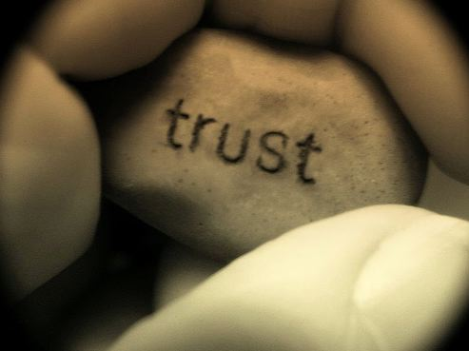
How to build successful business relations (cont)
Share any knowledge that will help your partnerships succeed.
Ask for referrals from people you already trust. Recommendations can go a long way to establish an initial relationship
Build trust - it leads to successful business transactions which are repeated for many years. It is the foundation for long, lasting and fruitful relationships.
Adapted from: http://www.tradeready.ca/2015/trade-takeaways/5-considerations-building-strong-international-business-relationships

Slide 10
In summary
Successful international business relationships depend on the development of trust
The basis of trust is culturally different. In Western contexts, rules and regulations applied to all form the basis of business relationships.
In many other cultures, relationship networks based on the exchange of favours are a key element of trust building.
These cultural differences need to be acknowledged and managed in order to build trust between business partners

Slide 11
References
BERGER, Ron, HERSTEIN, Ram, SILBIGER, Avi and BARNES, Bradley (2017). Developing international business relationships in a Russian context. Management International Review, 57 (3), 441-471.
Boersma et al, Trust in international joint venture relationships,Journal of Business Research 56 (2003) 1031 – 1042
Tashakova (2015) Nepotism versus wasta in business globalisation
https://www.khaleejtimes.com/business/nepotism-versus-wasta-in-business-globalisation
http://www.tradeready.ca/2015/trade-takeaways/5-considerations-building-strong-international-business-relationships/
World Learner Chinese http://www.worldlearnerchinese.com/content/what-guanxi

