Slide 1

Programme: Certificate of Higher Education and Social Care
Module: Psychology in Health and Social Care
Module code: LCHS4010
Assessment 1: Individual Presentation
Student Name: Josephine Taller
Student ID: 2431097
Lecturer: Peace Ukachukwu
Submission date: 17 November 2025 2:00 PM

Slide 2
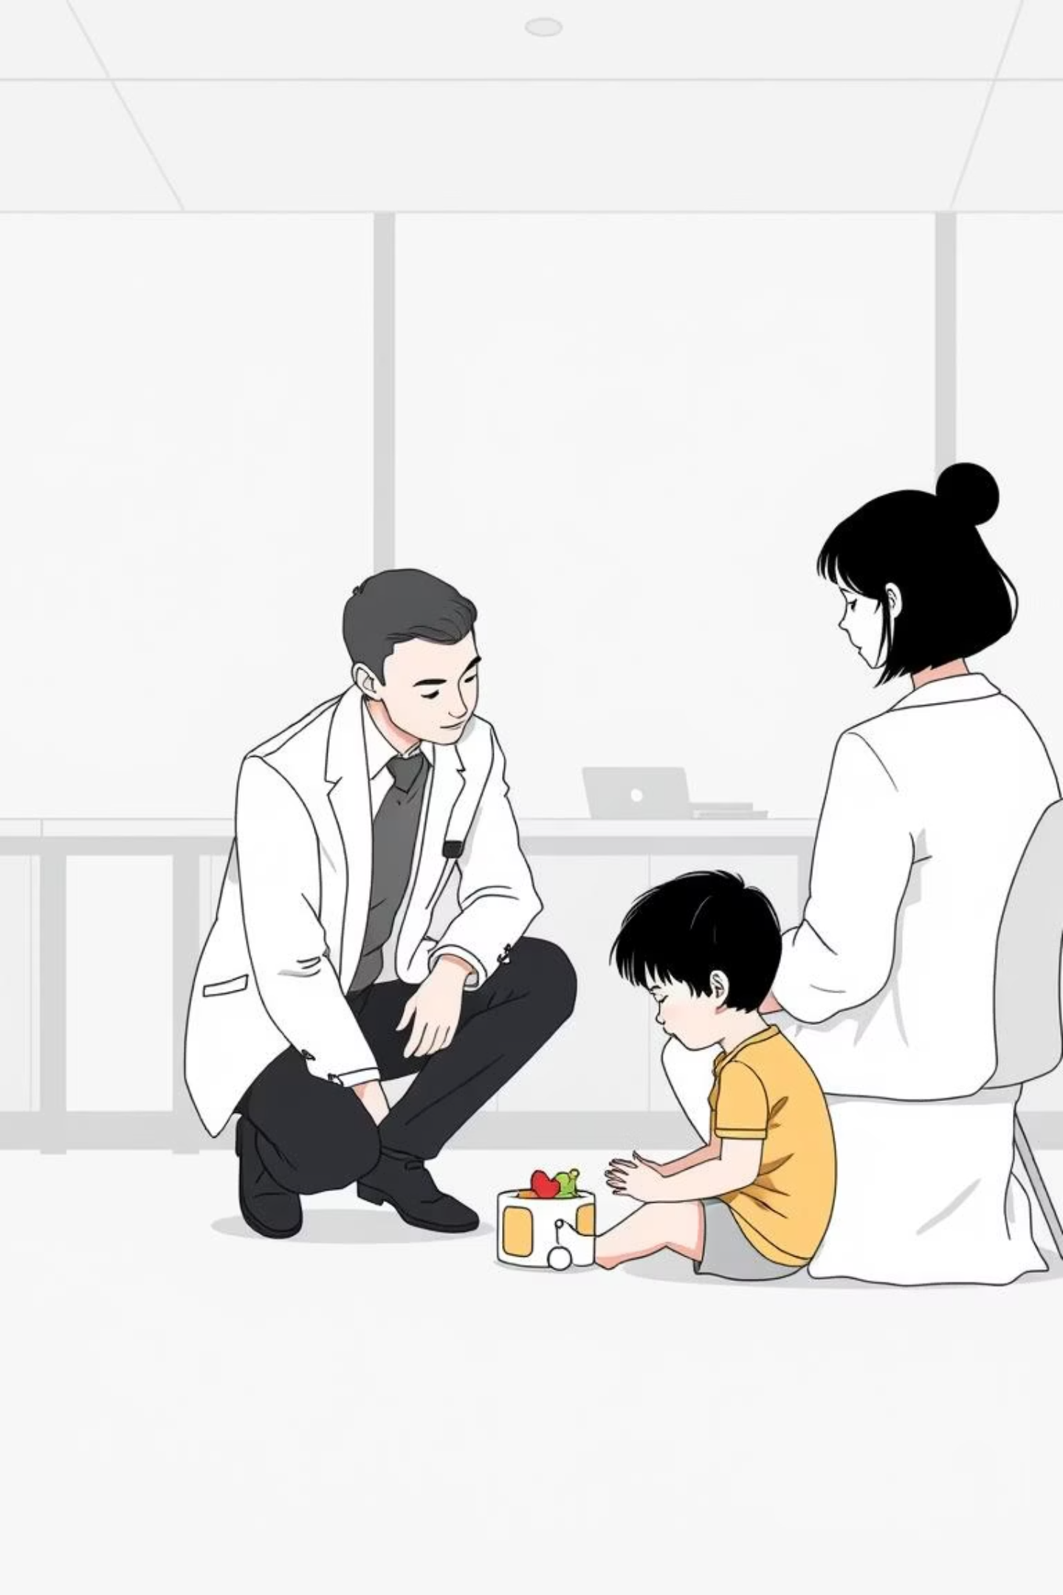
Context of the Assignment
Erik Erikson’s Psychosocial Theory and Early Childhood Development
A deep dive into Amira’s developmental challenges through the lens of Erikson's theory, providing context for early childhood educators and trainee child psychologists.

Slide 3
Introduction and Aim
To examine the case of Amira, a three-year-old in a nursery setting exhibiting significant developmental anxieties.
The Case Study: Amira
Our Goal: Applying Theory to Practice
Exhibits anxiety during separation from carers.
Utilise Erikson’s psychosocial theory (Scheck, 2014) to:
Insufficient expressive speech skills.
Explain her emotional and social difficulties.
Inability to participate in group play (Rachman, 2019).
Examine biological and environmental factors.
Offer practical interventions for development (Zionts, Zionts and Simpson, 2012).
Notes:
Amira is a three-year-old boy who is in a nursery. She exhibits anxiety when she is separated with carers, insufficient speech, and inability to participate in group play (Rachman, 2019). The presentation discusses the developmental needs of Amira using the psychosocial theory of Erik Erikson (Scheck, 2014).
The goal is to use the theory in the explanation of her emotional and social issues, biological and environmental factors, and offer practical interventions to help her achieve development (Zionts, Zionts and Simpson, 2012).

Slide 4
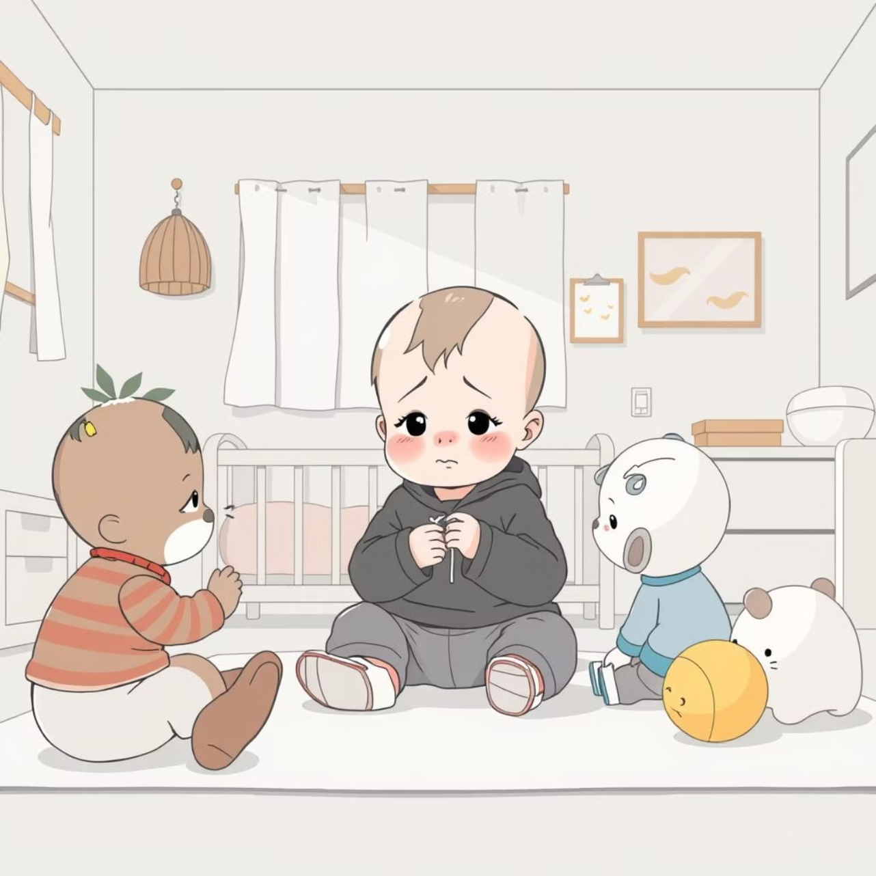
Case Summary: Amira’s Development
Amira is currently navigating the early childhood stage, a critical period for developing both independence and key social learning skills.
Emotional Struggle: She is acutely affected by separation anxiety and struggles significantly to initiate interaction with her peers (Pini and Milrod, 2023).
Skill Deficits: Her limited verbal proficiency and low self-confidence actively impact her ability to engage in play and manage emotional regulation.
Environment: The nursery environment, while structured to be accommodating, remains unfamiliar and challenging for her (Gardner et al., 2021).
These behaviours strongly suggest a potential delay or impediment in resolving the psychosocial tasks of this stage: Autonomy and Initiative.
Notes:
Amira is at early childhood stage where independence and social learning are developing. She is affected by the feeling of separation anxiety, and she struggles to interact with her peers (Pini and Milrod, 2023). The lack of verbal proficiency and low confidence influences her playing and emotional control. The nursery setting is accommodating and unfamiliar (Gardner et al., 2021).
These behaviours are signs of potential delay or retardedness in the development of autonomy and initiative, the psychosocial tasks of this stage.

Slide 5






Overview of Erik Erikson’s Theory
Erikson posited eight stages of psychosocial development spanning the entire human lifespan. Each stage presents a critical dilemma that must be successfully navigated for healthy psychological progression (Carr and McNulty, 2014).
Successful Resolution
Fosters core psychological strength and confidence.
Psychosocial Dilemma
Each stage presents a central conflict.
Unsuccessful Resolution
May result in suspicion, guilt, or other psychological obstacles.
Stages Most Applicable to Early Childhood
Trust vs. Mistrust (0–1 year)
Autonomy vs. Shame and Doubt (1–3 years) (Ross, 2019)
Initiative vs. Guilt (3–6 years)
Notes:
Erikson came up with eight psychosocial development stages throughout our lives. Every developmental stage entails a psychosocial dilemma, which should be solved to achieve health (Carr and McNulty, 2014). An effective resolution fosters strength and confidence, and failure may cause suspicion and guilt.
Most applicable to early childhood are the following three stages:
Trust vs Mistrust (0–1 year)
Autonomy vs Shame and Doubt (13 years or younger) (Ross, 2019).
Initiative vs Guilt (3–6 years)
Each of the phases is in contact with the relations and surrounding of the child.

Slide 6


Early Childhood Stages: Autonomy and Initiative
Autonomy vs. Shame and Doubt
Initiative vs. Guilt
This second stage focuses on the development of personal independence. Children begin to exert control over basic functions like feeding, dressing, and toileting (Sileo and Potter, 2021).
The third stage emphasises exploration and decision-making. Children start engaging in imaginative play, socialising, and setting simple objectives (Chasen, 2011).
Outcome: Positive support fosters leadership; harsh criticism risks causing withdrawal and pervasive guilt.
Outcome: Encouragement builds confidence; excessive control or criticism causes fear and self-doubt.
The successful resolution of these two phases is highly predictive of emotional and social maturity in the early years (Berk, 2022).
Notes:
The second stage is Autonomy vs Shame and Doubt and entails the development of independence. Children start to have control over things that include feeding, dressing and toileting (Sileo and Potter, 2021). Confidence is encouraged by encouragement; fear and self-doubt are caused by excessive control. Initiative vs Guilt is the third stage and it emphasizes on exploration and decision-making. Children initiate imaginations, socializing and setting objectives (Chasen, 2011). Positive support encourages initiative and leadership whereas criticism has the chance of causing guilt or withdrawal. These two development phases are very potent towards emotional and social maturity during early years (Berk, 2022).

Slide 7
Application to Amira’s Case
Amira’s behaviours align with potential unresolved conflicts in the Autonomy and Initiative stages.
Inability to Group Play & Initiative
Limited Communication & Trust
Separation Anxiety & Autonomy
Her reluctance to join group play may stem from a lack of initiative or a fear of error/failure, leading to withdrawal (Berger and Lorenz, 2016).
Limited verbal output implies slow development of trust in communicating her needs and ideas effectively.
Her nervousness during separation suggests an unresolved conflict in autonomy, where a lack of freedom may lead to hesitancy in engaging with new environments and reliance on carers (Vakoch and Castrillón, 2014).
Consistent, friendly caregivers can significantly assist Amira in moving from dependency toward self-trust, empowering her to explore her social world through nurturing connections (Southam-Gerow, 2019).
Notes:
Amira is a nervous person during separation and it could be an issue of unresolved conflict in the autonomy stage. The lack of freedom would lead to confusion of engaging with new environments (Vakoch and Castrillón, 2014). Limited communication implies slow trust in providing information in terms of requirements and ideas. Inability to play in a group can mean lack of initiative or fear of error (Berger and Lorenz, 2016). Friendly care givers have a chance of assisting Amira to overcome dependency to self trust. She can be empowered to seek out her social world through consistent and nurturing connections with the other person (Southam-Gerow, 2019).

Slide 8
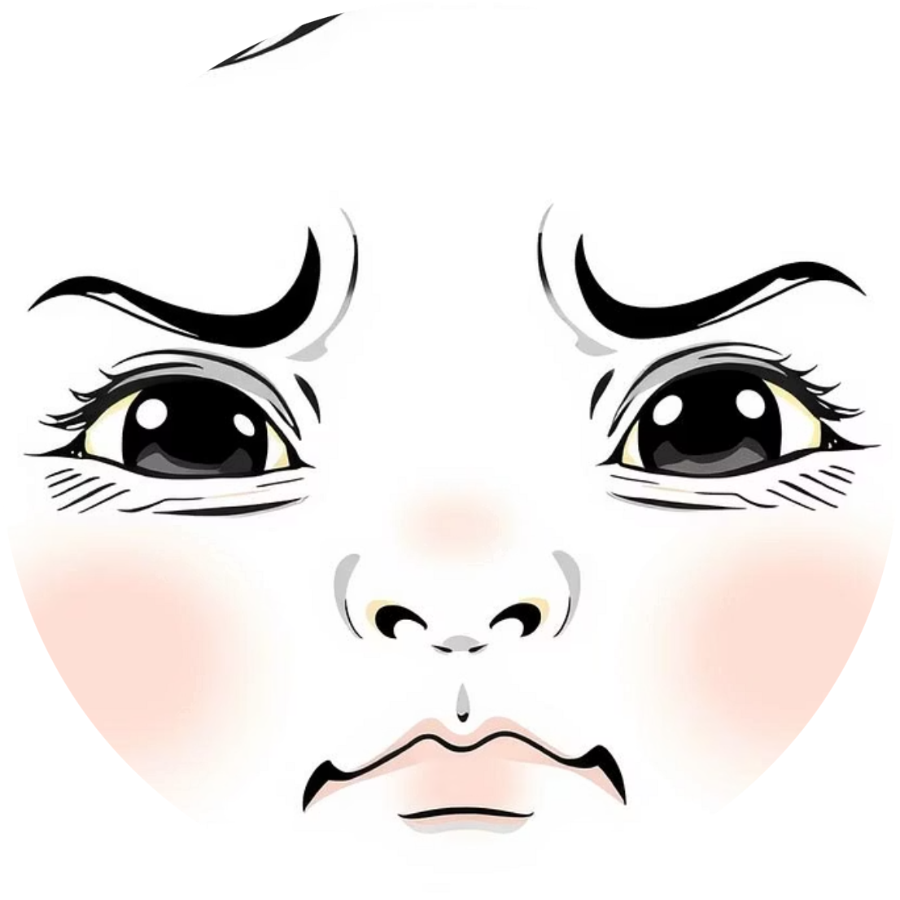
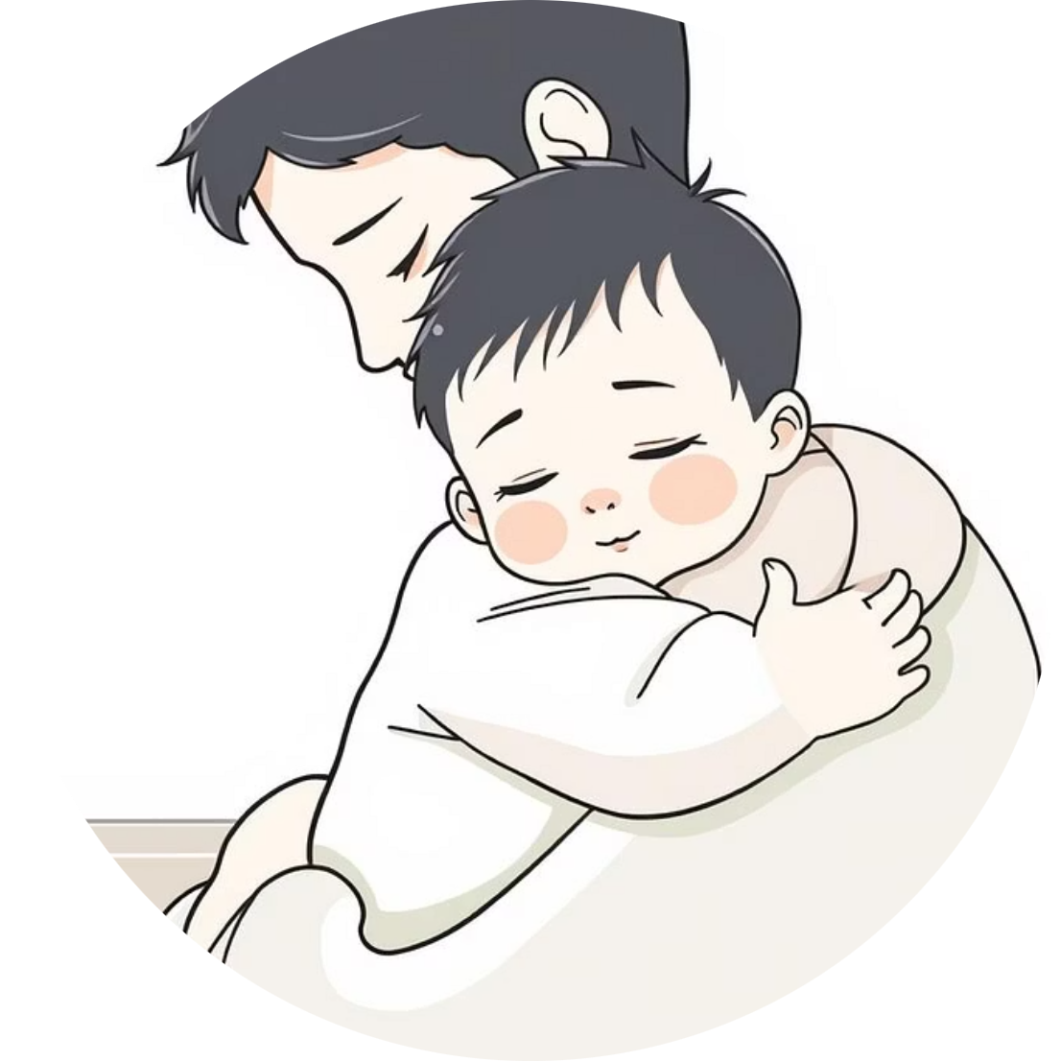

Biological and Environmental Influences
Development is a complex interplay between an individual’s biological predisposition and environmental interactions.
Biological Factors (Nature)
Environmental Factors (Nurture)
Amira’s development is influenced by her inherent temperament and the rate of emotional and language development, which govern her behavioural responses (Corr, 2013).
Key external elements include family attachment quality, caregiver consistency, and peer experiences in the nursery setting. A secure attachment history encourages confidence against separation (Kay-Flowers, 2019).
A balanced focus on both nature and nurture is essential for tailoring Amira’s developmental support. Inconsistent care or domestic stress can exacerbate anxiety. Social learning is heavily modulated by the nursery's climate, staff interactions, and peer relationships.
(Plomin, Defries and Fulker, 2014).
Notes:
Growth is reliant on biological as well as environmental developmental factors. Amira is biologically sensitive to temperament, emotional and language speed that affects behavior (Corr, 2013). The aspects associated with the environment would be family attachment, the consistency of the caregivers and the peer experience. Confidence in the case of separation is encouraged by a secure attachment history (Kay-Flowers, 2019). Inconsistent care practices or domestic stress can increase anxiety and shyness. Social learning is also influenced by nursery setting, communication between the staff, and peer relationships. The balanced focus on nature and nurture can be used to focus on the developmental needs of Amira (Plomin, Defries and Fulker, 2014).

Slide 9

Practical Strategies and Interventions
Nursery staff can apply structured, Erikson-informed approaches to foster Amira's psychosocial growth.
Establish Gradual Separation Routines
Decreasing anxiety through structured, predictable drop-off and pick-up routines helps build security and trust (Kathleen Hague Armstrong et al., 2014).
Encourage Independent Tasks
Promoting small-scale independent tasks (e.g., selecting toys, tidying up) develops a sense of autonomy and capability.
Use Guided Group Activities
Facilitate co-operation and initiative by introducing guided activities that gently integrate group play, reinforcing confidence with praise and positive feedback.
Implement Emotion-Coaching
Teaching Amira to name, understand, and cope with her emotions is crucial for self-regulation (Bornstein, 2018).
Foster Home-Nursery Collaboration
Close collaboration between the nursery and family ensures continuous, consistent support for her psychosocial development.
Notes:
The structured approaches of Erikson stages can be applied by the nursery staff. Anxiety can be decreased through gradual separation routines (Kathleen Hague Armstrong et al., 2014). Regular drop-off and pick-up schedules facilitate security. Independent tasks of a small scale should be encouraged because it develops autonomy (selecting toys or cleaning up). Confidence is reinforced by praise and positive feedback. The cooperation can be fostered by guided activities that introduce group play. Emotion-coaching assists Amira to name and cope with emotions (Bornstein, 2018). Nursery and family are to work closely to provide her with the continuous support of psychosocial development.

Slide 10
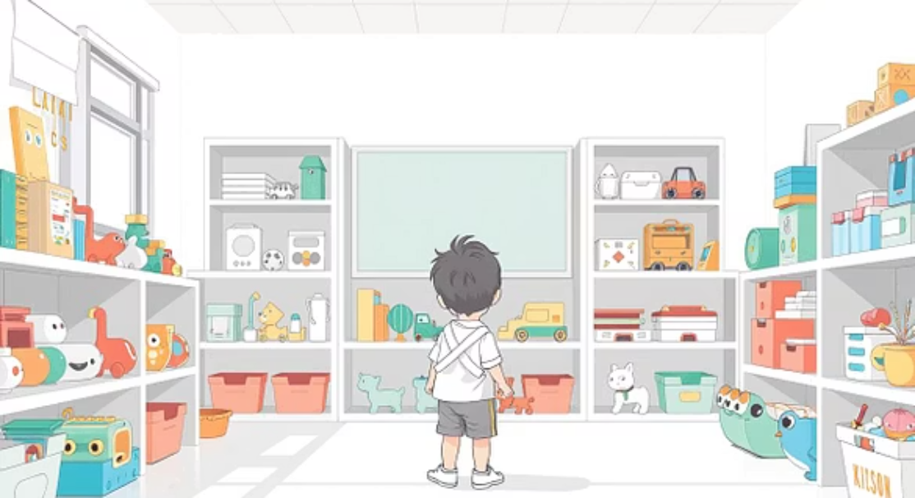
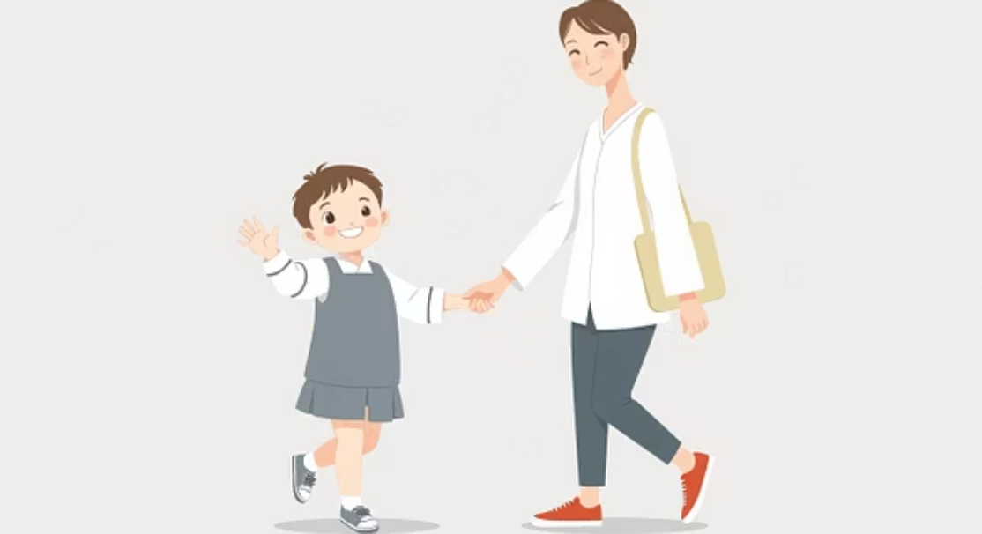
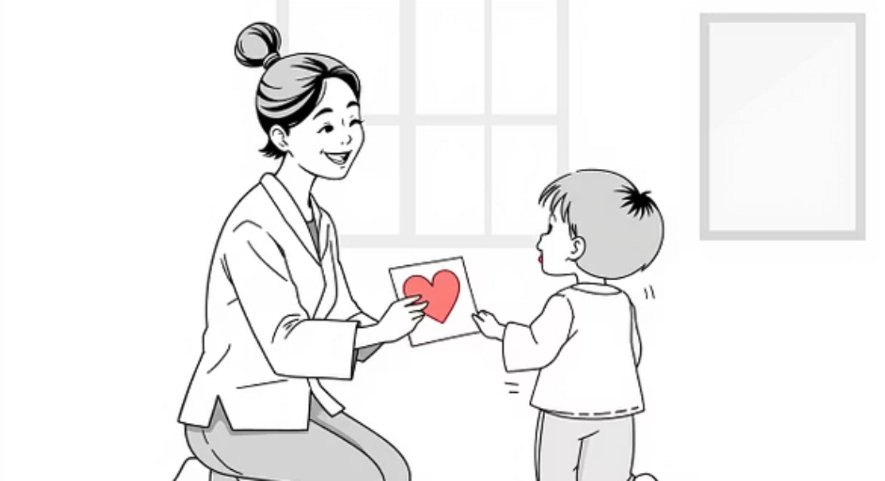
Research and Supporting Evidence
Empirical evidence supports the efficacy of autonomy-focused interventions in early childhood settings.
Studies indicate that autonomy-supportive environments significantly enhance early childhood adjustment. Children empowered to make minor decisions demonstrate superior social and language development (Thomas, 2013).
Research on early attachment reveals that children with insecure attachment histories often exhibit higher levels of anxiety. Positive reinforcement and consistent routine exercises are proven effective in minimising withdrawal behaviours (Carnwath and Miller, 2013).
Erikson’s model remains a foundational framework, extensively used in education and healthcare to inform effective emotional and social development protocols.
Notes:
Research indicates that autonomy-supportive settings enhance the adjustment in early childhood. Children who are proposed to make little decisions show better social and language growth (Thomas, 2013). Evidence of early childhood studies shows more anxiety in children who are insecurely attached. It has been evidenced that positive reinforcement and routine exercises should be used to minimise withdrawal behaviours (Carnwath and Miller, 2013). The model by Erikson is still extensively used in the early education and health care to inform emotional and social development models.

Slide 11
The Analysis of the Erikson Theory
Erikson's theory provides an invaluable framework for understanding emotional and social development across the lifespan, particularly in early childhood.
Strengths of the Model
Limitations and Considerations
Provides a clear link between social experiences and identity formation.
The prescriptive stages may not perfectly apply across all cultures or individual temperaments.
Offers practical guidelines for practitioners in supporting self-identity and confidence (Miller, 2012).
The theory is heavily focused on social aspects, potentially understating the influence of biology and diverse cultural backgrounds (Siegler, Deloache and Eisenberg, 2014).
Emphasises the developmental importance of key relationships.
Despite these limitations, the framework remains highly viable for analysing early childhood behaviour and designing targeted interventions.
Notes:
The theory of Erikson is appreciated because it provides a connection between emotional and social lifespan development. It describes the support mechanisms of relationships that facilitate confidence and self-identity (Miller, 2012). The model offers an effective guideline to early years practitioners. Nevertheless, the same boundaries might not apply to cultures or individuals. The theory focuses on social aspects but does not pay much attention to biology and cultural diversity (Siegler, Deloache and Eisenberg, 2014). Nonetheless, it is still viable to learn about early childhood behaviour and develop interventions.

Slide 12
Conclusion
Amira's case, like many observed in early childhood, can be largely explained through Erikson's psychosocial stages of autonomy vs. shame and doubt (ages 1-3) and initiative vs. guilt (ages 3-5). Her behaviors reflect the critical developmental tasks associated with these periods, emphasizing the profound influence of her interactions and environment.
Positive Reinforcement
Impact of Relationships and Environment
Educational Application
Providing consistent positive reinforcement and encouragement is crucial for fostering a child's sense of autonomy and initiative, allowing them to explore and learn without fear of failure or criticism.
Erikson's framework remains an invaluable tool for early childhood educators, offering insights into children's developmental needs and guiding the design of supportive, stage-appropriate interventions and learning experiences.
The quality of a child's relationships with caregivers, peers, and the overall learning environment significantly influences their psychosocial development, shaping their self-perception and confidence.
Notes:
The problematic case of Amira can be explained by the psychosocial stages of autonomy and initiative. Positive reinforcement and frequent support can assist her to develop self esteem and self reliance (Hockenberry, 2022). The theory emphasizes the impact of relationships and surrounding environment on emotional and social development. The framework developed by Erikson can assist educators in early childhood practice to establish supportive, organized, and empowering learning environments, which facilitate sound health and resilience among the children (McDevitt et al., 2019).

Slide 13
References
Berger, R.J. and Lorenz, L.S. (2016). Disability and Qualitative Inquiry. Routledge.
Berk, L.E. (2022). Exploring Lifespan Development. SAGE Publications.
Bornstein, M.H. (2018). The SAGE Encyclopedia of Lifespan Human Development. SAGE Publications.
Carnwath, T. and Miller, D.M. (2013). Behavioural Psychotherapy in Primary Care : a Practice Manual. Burlington: Elsevier Science.
Carr, A. and McNulty, M. (2014). The Handbook of Adult Clinical Psychology. Routledge.
Chasen, L.R. (2011). Social skills, emotional growth, and drama therapy : inspiring connection on the autism spectrum. London ; Philadelphia: Jessica Kingsley Publishers.
Corr, P.J. (2013). The Reinforcement Sensitivity Theory of Personality. Cambridge University Press.
Hockenberry, M.J. (2022). Wong’s Nursing Care of Infants and Children - E-Book. Elsevier Health Sciences.
Kathleen Hague Armstrong, Ogg, J.A., Sundman-Wheat, A.N. and St, A. (2014). Evidence-Based Interventions for Children with Challenging Behavior. New York, Ny Springer.
Kay-Flowers, S. (2019). Childhood experiences of separation and divorce. Policy Press.
McDevitt, T., Ormrod, J., Cupit, G., Chandler, M. and Aloa, V. (2019). Child Development & Education eBook. Melbourne: P. Ed Australia.
Miller, P.H. (2012). Theories of developmental psychology. New York: Worth ; Basingstoke.
Pini, S. and Milrod, B. (2023). Separation Anxiety in Adulthood. Springer Nature.
Plomin, R., Defries, J.C. and Fulker, D.W. (2014). Nature and nurture during infancy and early childhood. Cambridge ; New York: Cambridge University Press.
Rachman, S. (2019). Anxiety. New York: Routledge.
Scheck, S. (2014). The Stages of Psychosocial Development According to Erik H. Erikson. München: GRIN Verlag GmbH.
Siegler, R.S., Deloache, J.S. and Eisenberg, N. (2014). How children develop. New York: Worth Publishers.
Sileo, F.J. and Potter, C.S. (2021). When Your Child Has a Chronic Medical Illness. American Psychological Association.
Southam-Gerow, M.A. (2019). Exposure therapy with children and adolescents. New York: The Guilford Press.
Thomas, N. (2013). Children, family and the state : Decision-making and child participation. Bristol, The Policy Press.
Vakoch, D.A. and CastrillónF. (2014). Ecopsychology, Phenomenology, and the Environment The Experience of Nature. New York, Ny Springer.
Zionts, P., Zionts, L. and Simpson, R.L. (2012). Emotional and Behavioral Problems. Corwin Press.
Notes:
References
Berger, R.J. and Lorenz, L.S. (2016). Disability and Qualitative Inquiry. Routledge.
Berk, L.E. (2022). Exploring Lifespan Development. SAGE Publications.
Bornstein, M.H. (2018). The SAGE Encyclopedia of Lifespan Human Development. SAGE Publications.
Carnwath, T. and Miller, D.M. (2013). Behavioural Psychotherapy in Primary Care : a Practice Manual. Burlington: Elsevier Science.
Carr, A. and McNulty, M. (2014). The Handbook of Adult Clinical Psychology. Routledge.
Chasen, L.R. (2011). Social skills, emotional growth, and drama therapy : inspiring connection on the autism spectrum. London ; Philadelphia: Jessica Kingsley Publishers.
Corr, P.J. (2013). The Reinforcement Sensitivity Theory of Personality. Cambridge University Press.
Gardner, S.L., Carter, B.S., Hines, M.E. and Niermeyer, S. (2021). Merenstein & Gardner’s Handbook of neonatal intensive care : An interprofessional approach. 9th ed. St. Louis, Missouri: Elsevier.
Hockenberry, M.J. (2022). Wong’s Nursing Care of Infants and Children - E-Book. Elsevier Health Sciences.
Kathleen Hague Armstrong, Ogg, J.A., Sundman-Wheat, A.N. and St, A. (2014). Evidence-Based Interventions for Children with Challenging Behavior. New York, Ny Springer.
Kay-Flowers, S. (2019). Childhood experiences of separation and divorce. Policy Press.
McDevitt, T., Ormrod, J., Cupit, G., Chandler, M. and Aloa, V. (2019). Child Development & Education eBook. Melbourne: P. Ed Australia.
Miller, P.H. (2012). Theories of developmental psychology. New York: Worth ; Basingstoke.
Pini, S. and Milrod, B. (2023). Separation Anxiety in Adulthood. Springer Nature.
Plomin, R., Defries, J.C. and Fulker, D.W. (2014). Nature and nurture during infancy and early childhood. Cambridge ; New York: Cambridge University Press.
Rachman, S. (2019). Anxiety. New York: Routledge.
Ross, A. (2019). EBOOK: Introducing Contemporary Psychodynamic Counselling and Psychotherapy: The art and science of the unconscious. McGraw-Hill Education (UK).
Scheck, S. (2014). The Stages of Psychosocial Development According to Erik H. Erikson. München: GRIN Verlag GmbH.
Siegler, R.S., Deloache, J.S. and Eisenberg, N. (2014). How children develop. New York: Worth Publishers.
Sileo, F.J. and Potter, C.S. (2021). When Your Child Has a Chronic Medical Illness. American Psychological Association.
Southam-Gerow, M.A. (2019). Exposure therapy with children and adolescents. New York: The Guilford Press.
Thomas, N. (2013). Children, family and the state : Decision-making and child participation. Bristol, The Policy Press.
Vakoch, D.A. and CastrillónF. (2014). Ecopsychology, Phenomenology, and the Environment The Experience of Nature. New York, Ny Springer.
Zionts, P., Zionts, L. and Simpson, R.L. (2012). Emotional and Behavioral Problems. Corwin Press.

