Slide 1
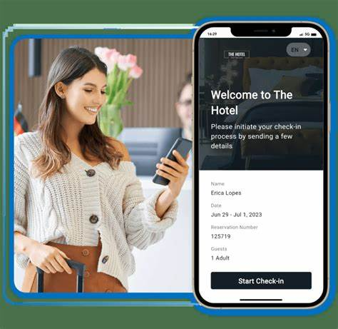
Revolutionising Guest Experience: The Impact of Mobile Apps on Check-in and Check-out Processes in the Hospitality Industry
Annisa Sathi
Student ID: 2119261
The module title: Contemporary Themes in the Hotel and Hospitality Sector
Module code: BMIH6001
Module Lecturer: Natalie Brailsford

Slide 2
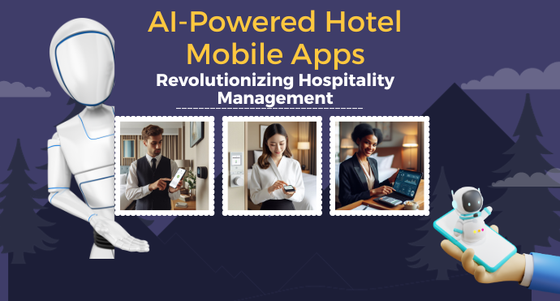
Abstract
Mobile apps have increased operational efficiency, personalised guest experiences, and streamlined hotel management. However, challenges like technology adoption, data security, and balancing human interaction with technological convenience continue. Furthermore, via articulating these issues via models like the Technology Acceptance Model and Lewin’s Change Management Model, the following report evaluated the benefits and limitations of mobile app integration, offering insights into the future of hospitality driven by AI and biometric technologies.

Slide 3
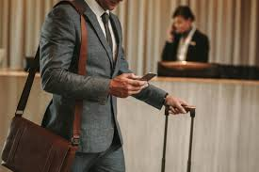
Introduction
Hotels are using digital tools to make life easier for guests and staff. One significant change is the effective use of mobile apps for checking in and out of hotels (Abdelmoaty et al. 2020).
As discussed in En.loungeup (2024), around 45% of hotel chains have been found to be using automated check-in for VIP guests. Meanwhile, more or less 34% of hotel chains have been reported to be offering smart locks (keyless doors) for room access, and another 34% are planning to implement them.
As a result of this, the hospitality sector has been forced to use mobile apps for check-in and check-out, which allows the guests to mark their check-ins or outs via their phones.
Notes:
The hospitality industry is changing with the passage of time and with the introduction of technology, the pace of change has been increased significantly. Hotels are applying digital tools to make things easier for guests and staff and one of the significant changes is the effective application of mobile apps for checking in and out of hotels (Abdelmoaty et al. 2020). As discussed in En.loungeup, (2024), around 45% of hotel chains have been found to be using automated check-in for VIP guests. Whereas, more or less 34% of hotel chains have been reported to be offering smart lock (keyless door) for access to rooms, and another 34% are planning to implement it. The change has been introduced to mitigate the waiting time as guests had to wait in line at the front desk to check in or out. Likewise, it also meant that hotel staff had to do a lot of paperwork. These old processes sometimes made guests for the longer period of times. As a result of this, the hospitality sector has been forced to use mobile apps for check-in and check-out, which allows the guests to mark their check-ins or outs via their phones. However, it has been reported that few of the guests worry that it makes the hotel experience less personal. Similarly, few worry that older guests might find the apps hard to use. Hence, the following assignment critically assesses how mobile apps for check-in and check-out are changing the perspective at hotels.

Slide 4
Literature Review
Current State of Digital Transformation in Hospitality
According to Boo et al. (2022), with the effective application of the technologies, the hospitality sector has changed a lot. In addition, the use of technology has allowed the hospitality sector to make things better for guests and easier for staff. Some hotels now have mobile apps, self-service kiosks, and smart room controls.
Evolution of Check-in/Out Processes in Hotels
(Kılıçhan et al. 2020), took a positive stance on the effective use of technology in the hospitality sector and added that when the technology was not even introduced, guests had to wait in line at the front desk to check in or out, which took a significant amount of time and resulted in creating a sufficient amount of frustration, especially for the guests, who had already completed a long journey.
Mobile App Adoption in the Hotel Industry
More and more hotels are creating mobile apps, which put the guests in a position from where they can mark their check-ins, open their room door, and order room services. Some big hotel chains like Marriot have had a lot of success with their apps, with millions of people downloading and using them (Marriott, 2024).
Impact of Mobile Apps on Guest Satisfaction and Loyalty
According to Ramgade et al. (2021), the use of technology in the hospitality sector is a double-edged sword and this is one of the potential reasons why mobile apps on guest satisfaction and loyalty is a topic of much debate.
Notes:
Current State of Digital Transformation in Hospitality
According to Boo et al. (2022), with the effective application of the technologies, the hospitality sector has been changed a lot. In addition, the use of technology has allowed the hospitality sector to make things better for guests and easier for staff. Some hotels now have mobile apps, self-service kiosks, and smart room controls. These new technologies are changing how hotels work and how guests experience their stay. On one side, supporters say digital transformation is making hotels more efficient and modern (Ivasciuc, 2020). Alieva et al. (2023), added that with the use of technology, the revenues of the hotels have been increased as it has allowed the hotels to offer good quality of services at relatively lower services. However, it has been noted that hotels that have been depending on the use of technology has made it extremely difficult for the Gen X or in some cases Gen Y, as they find it difficult to use technology, specifically, when it comes to pre-book rooms (Ivasciuc, 2020).
Evolution of Check-in/Out Processes in Hotels
(Kılıçhan et al. 2020), took the positive stance for the effective use of technology in the hospitality sector and added that when the technology was not even introduced, guests had to wait in line at the front desk to check in or out, which took a significant amount of time and resulted in creating sufficient amount of frustration, especially for the guests, who had already completed a long journey. Similarly, Pillai et al. (2021) also echoed the same stance, and added that the recent shift amid pandemic has shifted the demand of the tourists and many tourists now prefer quick, contactless services, and digital methods let hotel staff focus on other ways to make guests' stays better, instead of spending time on paperwork. In addition, the staff has also accepted the change positively, the training was reported to be provided to the staff members regarding the effective of automated check-ins, which has been perceived positively by the staff members working in the different hotels, who are further educating the guests regarding the use of automated or digitised check-ins (Bhaskar et al. 2022).
Mobile App Adoption in the Hotel Industry
More and more hotels are creating their own mobile apps, which put the guests in a position from where they can mark their check ins, open their room door, and order room services. Some big hotel chains like Marriot have had a lot of success with their apps, with millions of people downloading and using them (Marriott, 2024). Furthermore, the similar stance has also been echoed by Tuomi et al. (2021), who said that apps make things more convenient for guests and allow them to feel that they are in command of many things without having to talk to staff. Apps can also send personalised offers to guests, which encourages them to spend more money at the hotel. However, Yağmur et al. (2024) did not agree to this, and added that with the use of applications, there has been some sort of concern regarding the data theft as guests have been continuously complaining regarding the misuse of their personal data.
Impact of Mobile Apps on Guest Satisfaction and Loyalty
According to Ramgade et al. (2021), the use of technology in the hospitality sector is a double-edged sword and this is one of the potential reasons that why mobile apps on guest satisfaction and loyalty is a topic of much debate. In response to this, Bhaskar et al. (2022) have found that hotels with good mobile apps tend to have higher guest satisfaction scores, which makes many parts of the hotel stay easier, from checking in to ordering food. In addition, Bano et al. (2024) also mentioned the positive aspects and articulated that when apps work well, they make guests feel comfortable and more likely to come back. However, Bharwani et al. (2021) added that the use of technology has created a lot of issues for the hotels. For instance, certain glitches or taking some extra minutes or respond make the guests feel frustrated. Hence, even after providing good quality of services with excellent hygiene, the technology can jeopardise the experience of the guests (Tai et al. 2021).

Slide 5
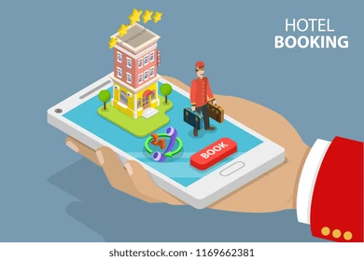
Application to the Hotel and Hospitality Sector
Political
Governments have been quite stringent towards the hotels when it comes to the data. The General Data Protection Regulation (GDPR) and the Data Protection Act 2018 play crucial roles in how hotels collect, process, and store guest data via mobile apps.
For example, the Hilton has had to update its mobile app privacy policy to comply with these regulations. They now provide detailed information about data collection practices and allow guests to manage their privacy preferences directly through the app (Marriott, 2024).
Notes:
Political
Governments have been quite stringent towards the hotels when it comes to the data. The General Data Protection Regulation (GDPR) and the Data Protection Act 2018 play crucial roles in how hotels collect, process, and store guest data via mobile apps. As a result of this, to protect the personal information of the customers, these regulations have forced the hotels to obtain explicit consent from guests for data collection and guarantee clear information about how their data will be used (Yallop et al. 2023). For example, the Hilton has had to update its mobile app privacy policy to comply with these regulations. They now provide detailed information about data collection practices and allow guests to manage their privacy preferences directly through the app (Marriott, 2024). However, the hotels seem to be frustrated with the use of these regulations as they believe that that strict data protection rules make it harder for hotels to personalise services and improve guest experiences (Klar, 2020). In response to this, Daigle et al. (2020) further added that the complexity of compliance discourages smaller UK hotels from adopting mobile app technologies.
Economic
The economic impact of mobile apps for check-in/out processes in hotels is a subject of much debate, specifically regarding the cost-benefit analysis and the effect on staff roles. Developing and implementing a mobile app has been proved out to be a significant investment for the hotels (Mahmood, 2024). The cost has been ranging from £20,000 to £500,000 or more, depending on the app's complexity and the size of the hotel chain (Kidecha, 2024). However, these investments have started to produce some good results. For instance, the InterContinental Hotels Group (IHG), which includes brands like Holiday Inn and Crowne Plaza, reported a 10% increase in revenue per available room (RevPAR) for properties that fully adopted their mobile app features, also mentioned in Standard, (2024), which complies with the notion of the Maslow Theory of Motivation, as guests feel motivated. However, Elphick, (2024), took the different stance and dignified that the return on investment takes time to materialise, and as a result of this, smaller, independent hotels have been struggling big time to justify the initial outlay, especially if their target demographic is less likely to use mobile apps. As a result of this, the effective use of technology in the hospitality sector has been halted or in some cases created the disparity as the hotels working on the smaller scales are not able to comply with the cost required for the application of the effective technologies (Gaur et al. 2021).

Slide 6
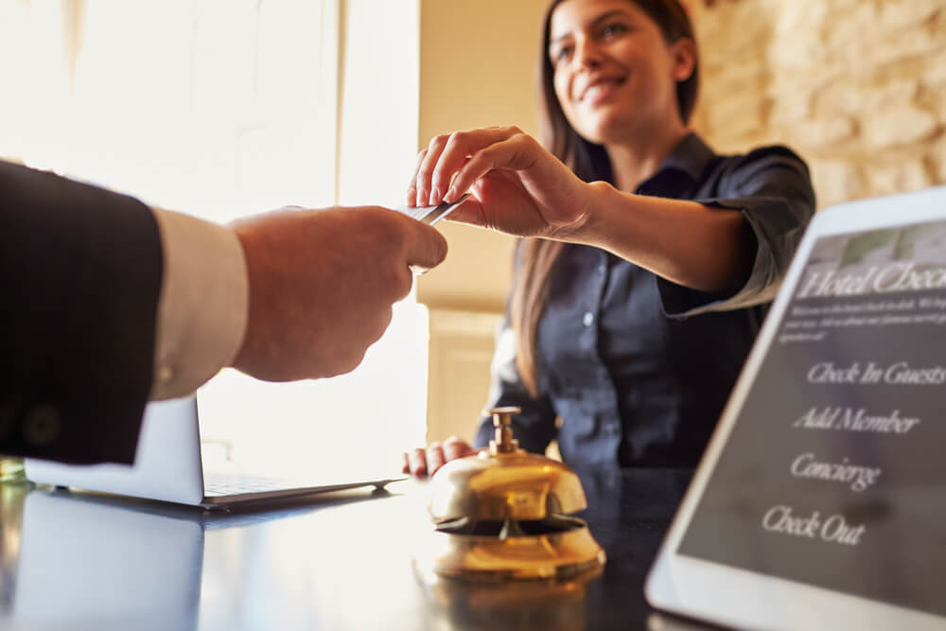
Application to the Hotel and Hospitality Sector
Economic
The economic impact of mobile apps for check-in/out processes in hotels is a subject of much debate, specifically regarding the cost-benefit analysis and the effect on staff roles. Developing and implementing a mobile app has been proven out to be a significant investment for the hotels (Mahmood, 2024).
The cost has been ranging from £20,000 to £500,000 or more, depending on the app's complexity and the size of the hotel chain (Kidecha, 2024). However, these investments have started to produce some good results.

Slide 7
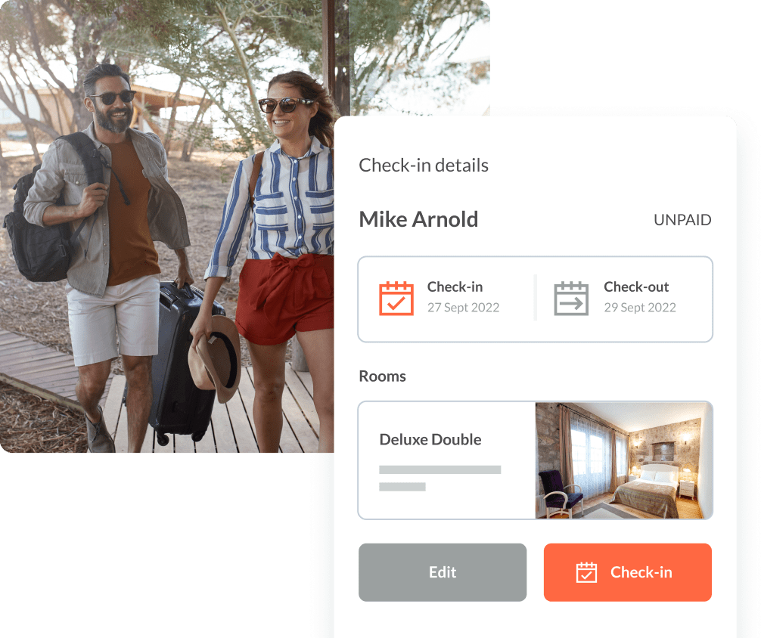
Application to the Hotel and Hospitality Sector
Social
Statista, (2023), found that more or less 62% of UK hotel guests would be more likely to check in to a hotel via the app, which is specifically preferred by Gen Z, with 74% of 18–24-year-olds expressing a preference for mobile check-ins. In response to this, added that mobile apps cater to the growing demand for contactless, efficient services and apps provide a personalised experience, which allows the guests to customise their stay according to their preferences.
Notes:
Social
Statista, (2023), found that more or less 62% of UK hotel guests would be more likely to check in to a hotel via app, which is specifically preferred by Gen Z, with 74% of 18–24-year-olds expressing a preference for mobile check-ins. In response to this, added that mobile apps cater to the growing demand for contactless, efficient services and apps provide a personalised experience, which allows the guests to customise their stay according to their preferences (Statista, 2023). However, Karagiannis, (2024), did not agree to the aforementioned facts and articulated more than usually dependence on apps will make it difficult of the guests belonging to Gen X or those who value human interaction. Whereas the numbers have been sharing different story, found that hotels with well-designed mobile apps saw an average increase of 7% in guest satisfaction scores (Gaur et al. 2021).
Technological
The technological aspects of using mobile apps for check-in/out processes involve integration with existing systems and cybersecurity concerns. For instance, Property Management Systems (PMS) like Opera by Oracle or Guestline have been opted by the hotels. However, the integration of these systems with the mobile apps has been challenging yet important for seamless operations (Oracle, 2024). The Dorchester and 45 Park Lane, successfully integrated their mobile app with the Opera PMS, which allowed their guests to have real-time room inventory updates and instant guest profile synchronisation. Furthermore, with the increasing use of mobile apps, cybersecurity has become a major concern for hotels. In addition, the hospitality industry has been a target of cyberattacks, with the Information Commissioner's Office (ICO) fining Marriott International £18.4 million in 2020 for a data breach (Reuters, 2024). Hence, it can be articulated that mobile apps have also created new vulnerabilities that are required to be sorted accordingly.

Slide 8
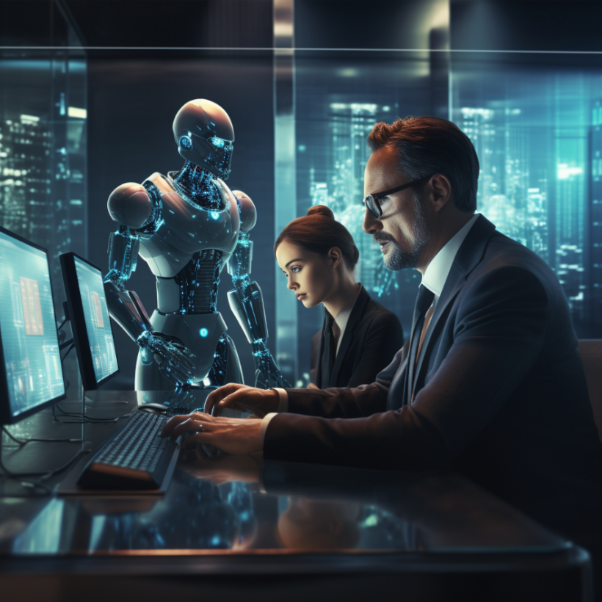
Application to the Hotel and Hospitality Sector
Technological
The technological aspects of using mobile apps for check-in/out processes involve integration with existing systems and cybersecurity concerns. For instance, Property Management Systems (PMS) like Opera by Oracle or Guestline have been opted by the hotels. However, the integration of these systems with mobile apps has been challenging yet important for seamless operations (Oracle, 2024).

Slide 9
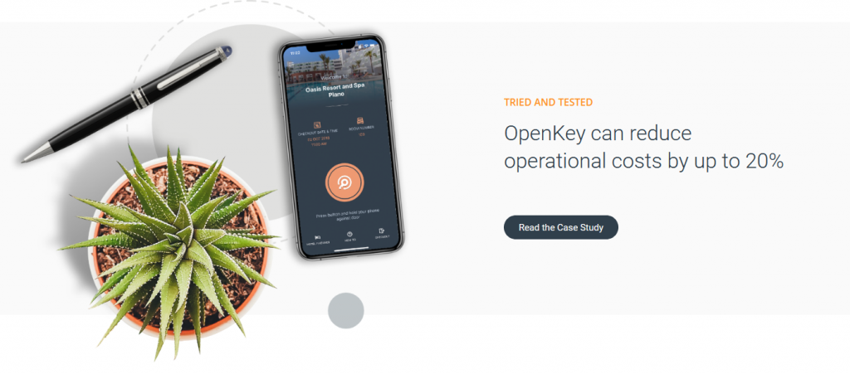
Application to the Hotel and Hospitality Sector
Environmental
The environmental impact of mobile app implementation has been all good, as all the hotels that have been relying on the use of technology or applications for marking the check-ins or outs have stopped using papers (Nandwani et al. 2023). For instance, AccorHotels reported a 50% reduction in paper consumption for check-in processes after introducing their mobile app. In response to this, further added that the limited use of paper inter-links with growing environmental concerns among travelers.
Legal
Amid the legal concerns regarding data theft in the hospitality sector, hotels have been forced to comply with laws like the Privacy and Electronic Communications Regulations (PECR), and the Equality Act 2010 (Harkins, 2020). For example, the Radisson Hotel guarantees their mobile app complies with the Equality Act by offering a sufficient amount of accessibility features for guests with disabilities (Radisson, 2024).
Notes:
Environmental
The environmental impact of mobile app implementation has been all good, as all the hotels that have been relying on the use of technology or application for marking the check-ins or outs have stopped to use papers (Nandwani et al. 2023). For instance, AccorHotels reported a 50% reduction in paper consumption for check-in processes after introducing their mobile app. In response to this, further added that the limited use of paper inter-links with growing environmental concerns among travellers. However, quite of the box question has been raised by Ivasciuc, (2020), who added that whether the environmental benefits of reduced paper usage outweigh the environmental costs of manufacturing and powering the devices needed to use these apps. On the contrary, BR, (2022) stated that the focus on digital solutions has shifted the attention from other, more impactful environmental initiatives like The Edwardian Hotels integrated their mobile app with smart room controls allowing guests to manage room temperature and lighting more efficiently, which pointed out that apps are used to educate guests about the hotel's sustainability efforts and encourage more environmentally friendly behaviours (Maitra et al. 2022).
Legal
Amid the legal concerns regarding the data theft in the hospitality sector, hotels have been forced to comply with laws like the Privacy and Electronic Communications Regulations (PECR), and the Equality Act 2010 (Harkins, 2020). For example, the Radisson Hotel guarantees their mobile app complies with the Equality Act by offering sufficient amount of accessibility features for guests with disabilities (Radisson, 2024). However, mobile apps have raised new liability issues for the hotels like if a guest is unable to access their room amid an app malfunction, the hotel will be held liable for any resulting inconvenience or losses. The Jury's Inn hotel addresses this by maintaining traditional key card access alongside their mobile key feature to ensure that guests always have a backup option.

Slide 10
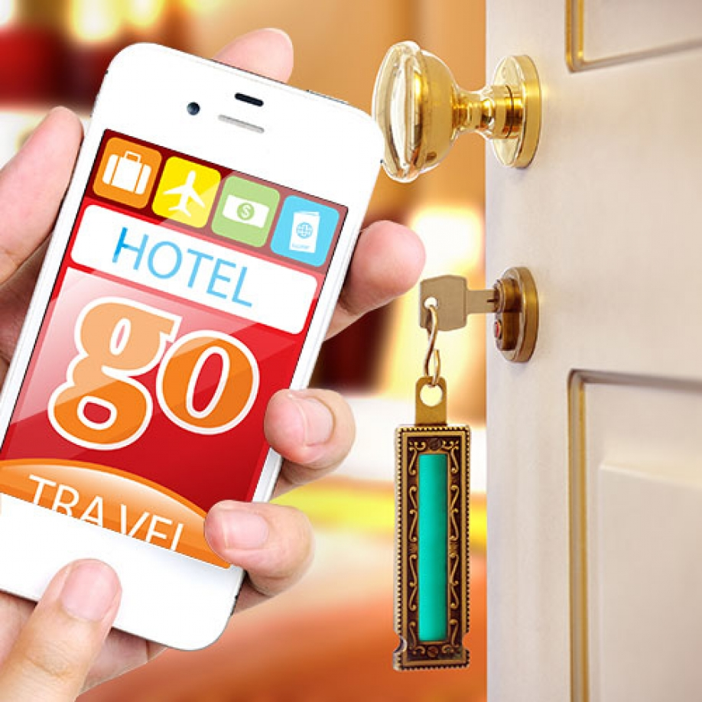
Evaluate Future Policy and Management Options
Hotels thinking about using mobile apps have a lot to consider. These apps make things easier for guests and hotel staff, but they also come with certain hurdles like getting guests to use mobile apps for checking in and out. It has been believed that some travelers love using apps for everything, while others prefer talking to a real person. As a result of this, hotels have been in the middle of finding ways to make their apps appealing to all types of guests.
However, the given strategy has certain limitations as guests are being pushed to use technology, they might be willing to use (Jayawardena et al. 2023). And if too many guests use the app, the hotel starts to lose those face-to-face moments that make a stay special.
Notes:
Hotels thinking about using mobile apps have a lot to consider. These apps make things easier for guests and hotel staff, but they also come with certain hurdles like getting guests to actually use mobile apps for checking in and out. It has been believed that some travellers love using apps for everything, while others prefer talking to a real person. As a result of this, hotels have been in the middle to find ways to make their apps appealing to all types of guests. As a result of this, the first recommendation is the use of Technology Acceptance Model, which dignifies that guests are more likely to use new technology if they think it's useful and easy to use (Lew et al. 2020). In addition, the similar notion has also been well perceived with the effective application of the PESTLE analysis. Hence, as discussed in political factors, hotels are asked to focus on making their apps super easy to use and showing guests how the app can make their stay better with more focus on ensuring guests’ satisfaction and ensuring their data is secured with the hotels (Lew et al. 2020). However, the given strategy has certain limitations as guests are being pushed to use technology, they might be willing to use (Jayawardena et al. 2023). And if too many guests use the app, the hotel start to lose those face-to-face moments that make a stay special. To overcome these issues, hotels could offer both app-based and traditional check-in options (Jayawardena et al. 2023).
In addition, as discussed in literature section of the study, there is also a need of providing sufficient amount of training to the employees. The reason is when hotels start using mobile apps, they will have to to make sure their staff knows how to use them. One good approach is to use Lewin's Change Management Model, which consists of the steps like unfreeze, change, and refreeze. First, hotels need to help staff understand why the change is happening (unfreeze) (Ali et al. 2021). Then, they train staff on the new system (change). Finally, they make the new way of doing things the normal way (refreeze). For example, a hotel will start by explaining to staff how the app will make their jobs easier and improve guest experiences (Ali et al. 2021). Then, as also mentioned in the literature section of the study, they could offer hands-on training sessions where staff practice using the app. Finally, they could update job descriptions and performance reviews to include app-related tasks (Belias et al. 2022). But this approach can have some problems too. Some staff might resist the change, especially if they are worried about losing their jobs to technology. To address these issues, hotels will have to involve staff in the app development process, which will help staff feel more invested in the new system (Belias et al. 2022).

Slide 11
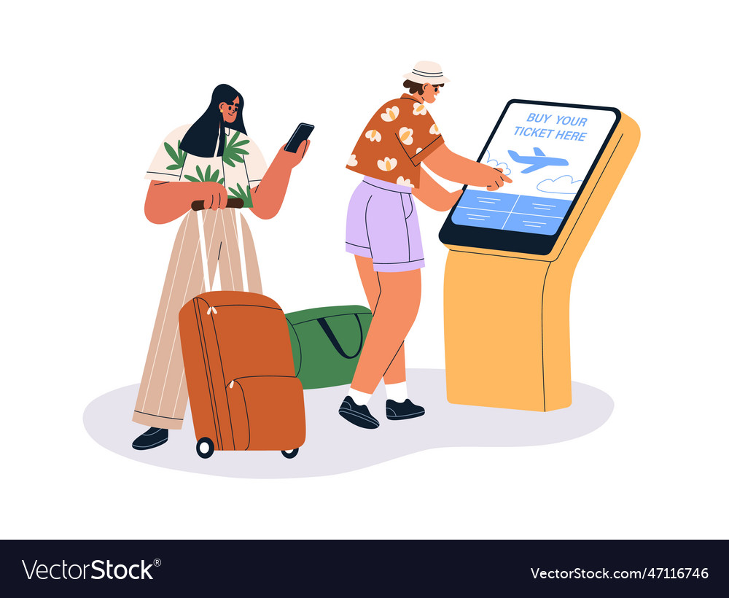
Evaluate Future Policy and Management Options
Hotel apps are likely to get even more advanced in the future. Two big trends are the use of biometrics (like fingerprint or face recognition) and artificial intelligence (AI). Biometrics will make check-in even faster and more secure. Guests might be able to unlock their room doors just by looking at their phone. As a result of this, AI will help hotels customise the guest experience even more (Gupta et al. 2023).
For example, an AI system will learn a guest's preferences and automatically adjust room temperature or suggest activities they want to enjoy. These technologies sound exciting, but they also raise some concerns. Biometrics involve very personal data, so hotels might need to be extra careful about security (Xu et al. 2021).
Notes:
Hotel apps are likely to get even more advanced in the future. Two big trends are the use of biometrics (like fingerprint or face recognition) and artificial intelligence (AI). Biometrics will make check-in even faster and more secure. Guests might be able to unlock their room doors just by looking at their phone. As a result of this, AI will help hotels customise the guest experience even more (Gupta et al. 2023). For example, an AI system will learn a guest's preferences and automatically adjust room temperature or suggest activities they want to enjoy. These technologies sound exciting, but they also raise some concerns. Biometrics involve very personal data, so hotels might need to be extra careful about security (Xu et al. 2021). Furthermore, while the effective use of AI makes things more personalised, guests might find it creepy if the hotel seems to know too much about them (Xu et al. 2021). To address these issues, hotels are recommended to be very clear about how they use guest data and allow the guests to choose how much information they want to share. While AI suggest things, hotels should always let guests have the final say in decisions about their stay (Gupta et al. 2023).

Slide 12
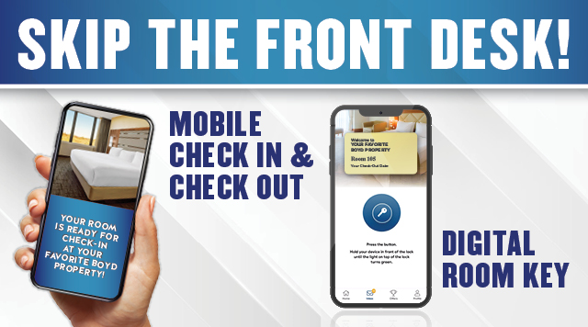
Conclusion
Mobile apps for check-in/out processes have significantly transformed the hotel industry. They offer enhanced efficiency, personalised experiences, and improved operational management. However, their implementation also dignifies challenges like technology adoption barriers, data security concerns, and the need to balance high-tech solutions with high-touch service. The broader implications of this digital transformation are far-reaching. Hotels are reimagining their service delivery models, staff roles are changing with each passing day, and guest expectations are shifting. This digital shift is likely to accelerate, with emerging technologies like AI and biometrics playing larger roles. Looking ahead, the future of guest experiences in a digitally transformed hotel industry appears to be a blend of technological convenience and personalised human interactions.

Slide 13
References
Abdelmoaty, G. A., & Soliman, S. A. E. M. (2020). Smart Technology Applications in Tourism and Hospitality Industry of The New Administrative Capital, Egypt. Journal of Association of Arab Universities for Tourism and Hospitality, 19(2), 102-129.
Boo, H. C., & Chua, B. L. (2022). An integrative model of facial recognition check-in technology adoption intention: the perspective of hotel guests in Singapore. International Journal of Contemporary Hospitality Management, 34(11), 4052-4079.
En.loungeup, (2024). Key figures on the role of technology in the hotel guest experience. Retrieved from https://en.loungeup.com/blog/key-figures-on-the-role-of-technology-in-the-hotel-guest,experience#:~:text=45%25%20of%20hotel%20chains%20use,adopt%20this%20type%20of%20technology. Accessed on: ( 14 Oct 2024).
Gupta, S., Modgil, S., Lee, C. K., & Sivarajah, U. (2023). The future is yesterday: Use of AI-driven facial recognition to enhance value in the travel and tourism industry. Information Systems Frontiers, 25(3), 1179-1195.
Harkins, D. (2020). Data Protection & Freedom of Information Policy. Policy.
Jayawardena, C., Ahmad, A., Valeri, M., & Jaharadak, A. A. (2023). Technology acceptance antecedents in digital transformation in the hospitality industry. International Journal of Hospitality Management, 108, 103350.
Kidecha, S. (2024). A Comprehensive Guide to Hotel Booking App Development with AI Integration. Retrieved from https://kodytechnolab.com/blog/hotel-booking-app-development/ Accessed on: ( 12 Oct 2024).
Kılıçhan, R., & Yılmaz, M. (2020). Artificial intelligence and robotic technologies in tourism and hospitality industry. Erciyes Üniversitesi Sosyal Bilimler Enstitüsü Dergisi, (50), 353-380.
Mahmood, R. (2024). The Impact of Mobile Apps on Transforming the Hospitality Industry in 2024. Retrieved from https://www.tekrevol.com/blogs/the-impact-of-mobile-apps-on-transforming-the-hospitality-industry-in-2024/#:~:text=With%20a%20well%2Ddesigned%20mobile,the%20service%20they%20are%20getting. Accessed on: ( 13 Oct 2024).

Slide 14
References
Marriott, (2024). Marriott.com. Retrieved from https://www.hilton.com/en/p/global-privacy-statement/ Accessed on: ( 12 Oct 2024).
Nandwani, P., & Bhatnagar, D. (2023). Comprehensive and Psychological Review and its Impact on Technology Driven Applications on Business Development and Diversities of Tourism and Hospitality Industry during Pandemic in Indian Prospective. Journal for ReAttach Therapy and Developmental Diversities, 6(8s), 405-418.
Oracle, (2024). Hotel PMS and Hotel POS Solutions. (n.d.). Retrieved from https://www.oracle.com/pk/hospitality/hotel-property-management/ Accessed on: ( 13 Oct 2024).
Radisson, (2024). Radisson Group. Available at https://www.radissonhotels.com/en-us/digital-accessibility Accessed on: ( 12 Oct 2024).
Ramgade, A., & Kumar, A. (2021). Changing trends of hospitality industry: Emergence of millennials and gen Z as future customers and their influence on the hospitality industry. Vidyabharati International Interdisciplinary Research Journal, 12(01), 336-342.
Statista, (2023). Statista Research Department, & 7, S. (2023). Hotel smartphone check-in preference by age 2017 survey. Retrieved from https://www.statista.com/statistics/707326/hotel-smartphone-check-in-preference-by-age-united-kingdom-uk Accessed on: ( 12 Oct 2024).
Xu, F. Z., Zhang, Y., Zhang, T., & Wang, J. (2021). Facial recognition check-in services at hotels. Journal of Hospitality Marketing & Management, 30(3), 373-393.

