Slide 1
Enterprise & Innovation
Creativity & Innovation

Slide 2
Overview
Idea generation
  The Neuroscience of idea generation
  Brain waves & idea generation
  Whole-brain application
  In and out of the box thinking

Slide 3
Spark of Genius
When / at what time do you usually get good ideas?
Note: Value and make a note of your ideas.

Slide 4
Neuroscience & Ah-ha epiphanies
5min Video - Professor John Kounios: The neuroscience behind Ah-ha epiphanies.
    Further reading: How to Harness the Science of Sparking Ideas

Slide 5
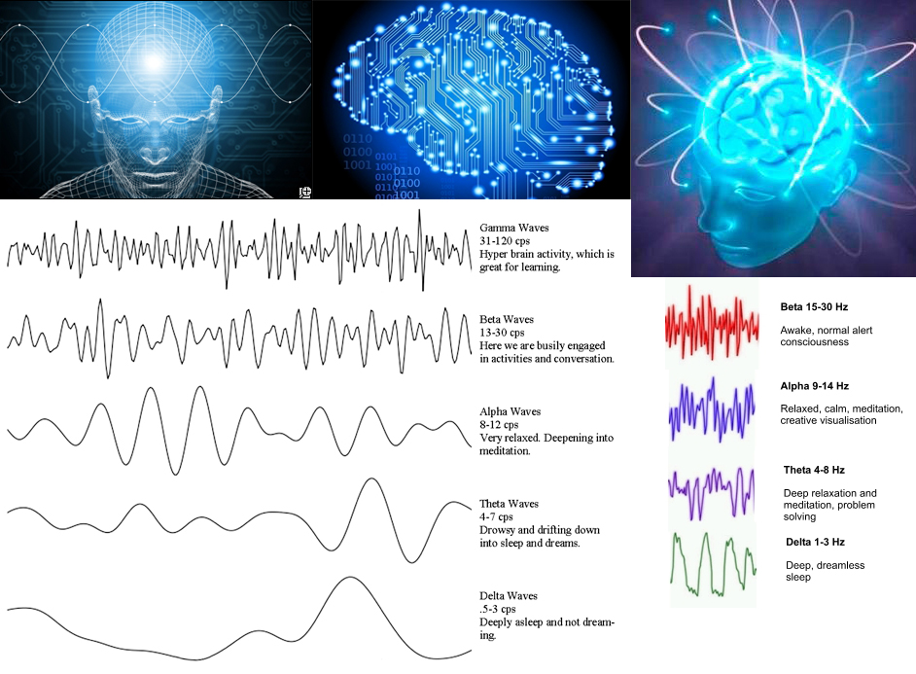
Ah-ha moment & Brain-waves

Slide 6
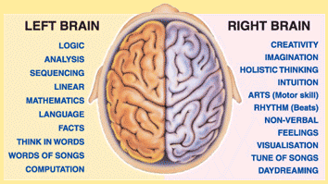
Whole brain application:
Left and Right Brain Hemispheres
Innovation involves the use of our whole brain i.e. imaginative idea generation and practical planning and application.

Slide 7
Activity: ‘In & Out’ of the box thinking
1. Tutor: Draw a Simple problem to solve (e.g. a Cat in a Tree).
2. Students: Document ways to bring the Cat to safety?
  Using Practical and Logical thinking? i.e. Left brain
  / Convergent thinking / Vertical thinking.
  Creative thinking? i.e. Right brain or Divergent thinking / Lateral thinking.
Tip - in & Out of the Box Thinking: To maximise our potential we need to use both our intellect & imagination - the Left and Right sides of our brain. This balanced approach allows us to be Creative innovators allowing us to solve problems and create solutions in whatever area of work we choose.
Further information:
Despite what you've been told, you aren't 'left-brained' or 'right-brained' - You're both.
Left Brain vs Right Brain - Understanding the Myth of Left Brain and Right Brain Dominance.
The Importance of Divergent Thinking for Research in Graduate School and Beyond
Creativity and IQ. What Is Divergent Thinking? How Is It Helped by Sleep, Humor and Alcohol?
30 Ways to Inspire Divergent Thinking
The Benefits of Divergent Versus Convergent Brainstorming
Student Engagement: Fuel Creativity in the Classroom With Divergent Thinking.

Slide 9
Idea generation
Idea generation is an essential part of innovation, whether you're working in a large organisation or starting a business.
To come up with a new idea / solution / product, you need to think creatively and identify opportunities that solve problems.
Once you've come up with your idea, you need to test it to find out if it's something people want.
Once you've done this, you can start the planning / designing and developing phases.

Slide 10
Bg: Optional Private Activity: Multiple Intelligences
Activity: Consider how a Successful Entrepreneur may use the following capabilities:
What is Physical intelligence?
What is Intellectual intelligence?
What is Creative intelligence?
What is Emotional intelligence?
What is Social intelligence?
What is Intuitive intelligence?
Further information:
Holistic Thinking - Multiple partial views
Background: In a similar way to Howard Gardiner's theory of multiple intelligences according to Stephen Covey (Successful Educator, Author and Businessman) there is a need for a recovery and application of the 'Whole person', and that people have four intelligences - physical, intellectual, emotional and spiritual. Denial of any of them reduces a persons capabilities. He states the Industrial Age was such a period and Covey believed the Information Age and a foreseen Age of Wisdom require whole people (in whole jobs). And that to reach our full potential all intelligences should be valued and developed.* Gardner's multiple intelligence theory* Stephen Covey intelligences.* Belbin's Team Role Theory.* Additional E.g. 6 Types of intelligence

Slide 11
Ideas & Problem solving
Problems = New innovations.
Are there any problems you would like to solve? Focus on finding 'solutions‘.
= Enterprising Growth Mindset.

Slide 12
Bg: Optional Private Activity: The Entrepreneur & the Creative Process
Activity: In Small Teams consider how we come-up with 'new ideas'? Document the steps and facilities involved in the creation of a new idea and illustrate the 'Creative-process'? (use pen-paper for now, white-board later).
  Tip: Consider what happens when you create a new idea? Consider using terms such as: Stimulus, Inspiration, Problem, Motivation, Emotion, Imagination, Feeling, Environment, Mind, Consciousness, Focus, Team, Eureka, Ah Ha, Present Moment, Heart, Passion, Love, Thought, Plan, Design, etc...

