Slide 1
Effective Management
BMGM4000
Dr Jayne Griffith-Parry

Slide 2
LEADERSHIP IS WINNING THE HEARTS AND SOULS OF OTHERS !

Slide 3

You are starting your shift at 10:00 as a waiter within a busy high street restaurant.
There are 60 diners already booked but there is the capacity for another 40 walk ins
You have 4 waiters working with you.
Today you are the most senior member of staff front of house.
How do you prepare for the service?
What will your role be during service?
What will you do at the end of service
Prepare your plan for the service in writing
Accompanied by 2 PowerPoint slides to illustrate your plan

Slide 4

Key components of leadership
Leadership is a process
Leadership involves influence
Leadership occurs in a group context
Leadership involves goal achievement

Slide 5

The Leaders Role
Defining the direction
Creating the right environment, open transparent communication
Setting & maintaining standards, managing by facts
Aspiring for excellence, striving to continuously improve
Providing a good example, integrity, consistency, passion, empathy
Achieving the business objectives - (Task)
Support, mentoring and coaching - (Individual)
Developing and strengthening the Team - (Team)
Developing the culture from which to grow and develop
Delivering Results with urgency and constancy of purpose

Slide 6

So what traits does a leader have to have?

Slide 7
Intelligence & Action Centered
Accepts Responsibility Task Competence
Understands Needs People Skills
Need for achievement Capacity to motivate
Courage and resolution Perseveres
Trustworthy Self confidence
Decisiveness Assertive
Adaptable and flexible
Has emotional Stability
Creative

Slide 8
How do we become a leader?
Assigned –
Leadership based on occupying a position/ title within an organisation
  Team leaders, section managers
  Department heads
  Directors
Emergent –
An individual perceived by others as the most influential member of a group or organization regardless of the individual’s title.
Emerges over time through communication behaviors
    Verbal involvement ,Being informed, Seeking others’ opinions ,Help others to complete tasks ,Encourages coworkers
    They prove they can do the job before its assigned to them

Slide 9
Authoritarian leadership style:
Command and hold over their employees
Team cannot put forward their views, cannot criticize or question
Speedy decision-making, greater productivity, gets things done
Greater employee alienation, de-motivation, absence, turnover
The Laissez Faire Leadership Style:
Totally trusts their employees to perform the job themselves.
Concentrates on the intellectual / rational aspect of his work not on the management aspects.
Team share views and suggestions which are best for organisational interests works only when the employees are skilled, loyal, experienced and intellectual

Slide 10
Democratic / Participative leadership style: invite and encourage the team members to play an important role in decision-making ultimate decision-making power rests with the leader. guides employees on what to perform and how to perform, encourages feedback leads to satisfied, motivated and more skilled employees, positive environment, creativity only drawback that it is time-consuming.
Bureaucratic leadership:
  leaders strictly adhere to the organizational rules and policies
  make sure that the employees/team also strictly follows the rules and procedures
  Promotions take place on the basis of employees’ ability to adhere to organizational rules.
  style gradually develops over time.
  This leadership style is more suitable when safe work conditions and quality are required.
  discourages creativity and does not make employees self-contented.

Slide 11
Your leadership style
Take 15 minutes to right a list of strengths and weaknesses based on the role of a Leader…
What do you do well?
What do you struggle with?
Are you:
Authoritarian
Laissez Faire
Democratic
Bureaucratic

Slide 12
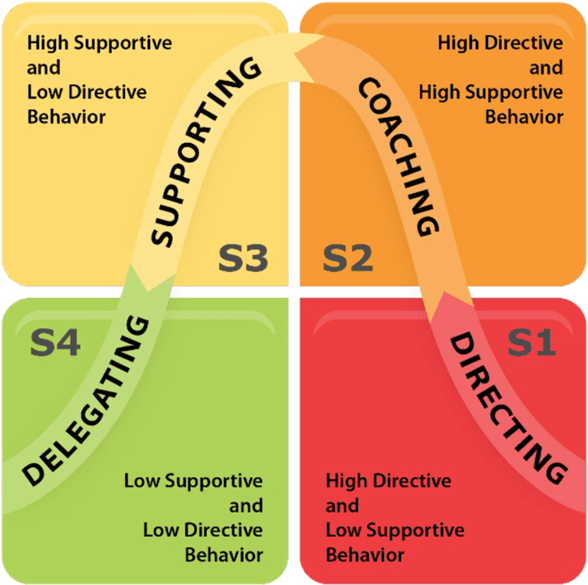
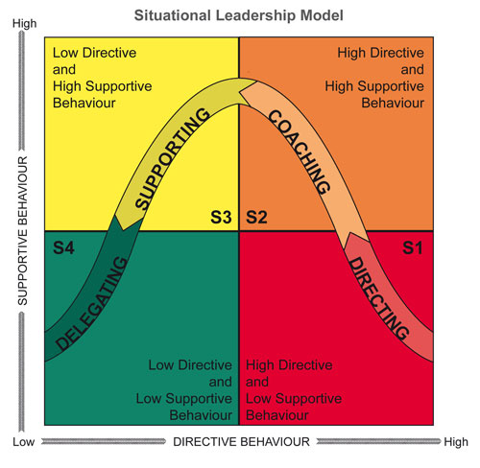
Model of Theory: Hersey and Blanchard (1969)
Leader does NOT focus solely on goals; uses supportive behaviors to bring out employee skills in accomplishing the task
Leader delegates day-to-day decision-making control, but is available to facilitate problem solving
Leader focuses communication on achievement & supporting subordinates’ socioemotional needs
Requires leader involvement through encouragement and input
Leader focuses communication on goal achievement
Spends LESS time using supportive behavior
Leader offers LESS task input &support; facilitates confidence and motivation
lessens involvement in planning, control of details, and goal clarification and gives control and refrains from intervention

Slide 13
Action Centred Leadership – John Adair
Equal emphasis is placed on -
Achieving the Task
Developing individuals
Creating and building the Team
The key is to establish the right balance and deliver results -
Being able to do all these things, and keep the right balance, gets results, builds morale, improves quality, develops teams and productivity, and is the mark of a successful manager and leader.
TASK
L
TEAM
INDIVIDUAL

Slide 14


Slide 15

Culture represents the social glue and generates a ‘we’ feeling
Culture offers a shared system of meanings and is the basis for communication and mutual understanding
Culture significantly impacts the efficiency of an organisation – either positively or negatively
Culture influences so many aspects of an organisation, its success or its failure

Slide 16

Culture
  learned beliefs, values, rules, norms, symbols, & traditions that are common to a group of people
  shared qualities of a group that make them unique
  is the way of life, customs, & scripts of a group of people
Terms related to culture
  Multicultural – approach or system that takes more than one culture into account
  Diversity – existence of different cultures or ethnicities within a group or organisation
Peter G. Northouse, Leadership: Theory and Practice, Seventh Edition. © 2016 SAGE Publications, Inc.

Slide 17

Prejudice
  A largely fixed attitude, belief, or emotion held by an individual about another individual or group
  based on faulty or unsubstantiated data
  Involves generalisations that are resistant to change or evidence
  Leaders face the challenge of dealing with their own prejudices and those of followers
  Can be toward the leader or leader’s culture
  Can face followers who represent culturally different groups, and they may have their own prejudices toward one another
  A skilled leader needs to find ways to negotiate with followers from various cultural backgrounds
Peter G. Northouse, Leadership: Theory and Practice, Seventh Edition. © 2016 SAGE Publications, Inc.

Slide 18
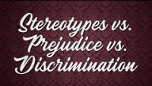

Slide 19
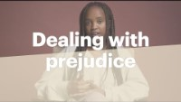

Slide 20


How would you ensure, your colleagues or guests do not feel excluded/ discriminated against within your organisation?
Take 15 minutes to write a basic strategy to promote inclusion and prevent discrimination

Slide 21

Ethnocentrism
  The tendency for individuals to place their own group (ethnic, racial, or cultural) at the center of their observations of the world
  Perception that one’s own culture is better or more natural than other cultures is a universal tendency, and each of us is ethnocentric to some degree
  Prevents people from understanding or respecting other cultures
  Ethnocentrism can be a major obstacle to
effective leadership
Peter G. Northouse, Leadership: Theory and Practice, Seventh Edition. © 2016 SAGE Publications, Inc.

Slide 22
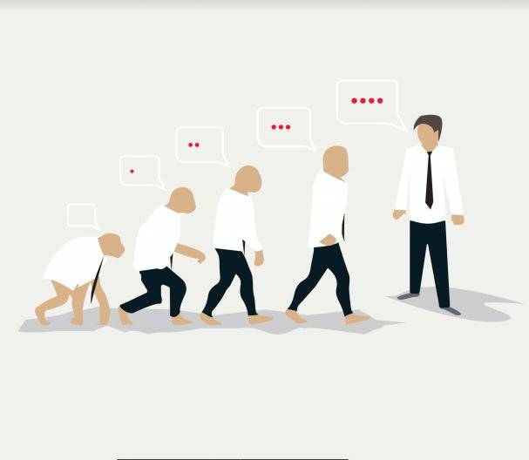
Sources of organisational culture
Brown (1995) in his book “Organisational Culture” (Pitman) – poses the question - where does an organisation’s culture originate ? - Three of the most important sources of organisational culture are:
  The societal or national culture within which an organisation is physically situated
  The vision, management style and personality of an organisation’s founder or dominant leader
  The type of business an organisation conducts and the nature of its business environment

Slide 23
Importance of Organisation Culture
The culture decides the way employees interact at their workplace. A healthy culture encouraging the employees to stay motivated and loyal towards the management.
The culture of the workplace goes a long way in promoting healthy competition at the workplace.
The culture of an organisation represents certain predefined policies which guide the employees and give them a sense of direction at the workplace.
It is the culture of an organisation which makes it distinct from others.
The work culture goes a long way in creating the brand image of the organisation. The work culture gives an identity to the organisation.
The work culture unites the employees who are otherwise from different back grounds, families and have varied attitudes and mentalities.
The work culture promotes healthy relationship amongst the employees.
The culture of the organisation extracts the best out of each team member.
The culture develops a habit in the individuals which makes them successful at the workplace.

Slide 24
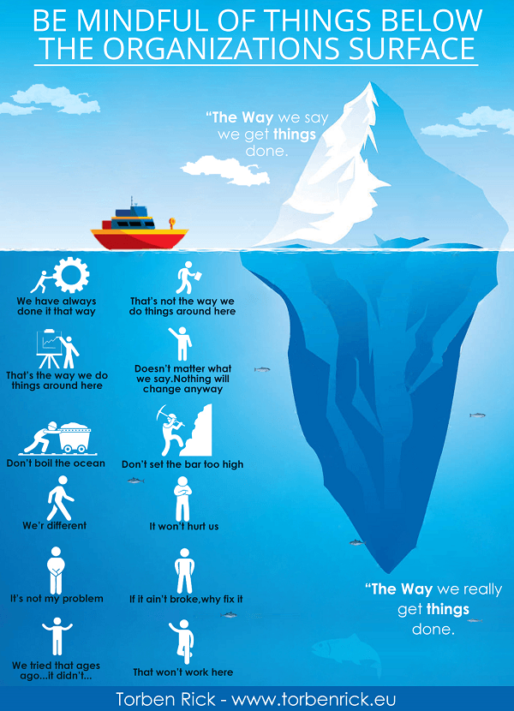

Slide 25

What's your organisational culture and what are the implications?
Lets discuss….

Slide 26

Cultural diversity
In the workplace is when companies actively hire employees from all different backgrounds; regardless of race, religion and culture.
When companies recruit and retain a diverse pool of people, it brings about different benefits to the company as well as its employees.
Think of humanity as a whole; we are a very diverse species across the globe, with many different cultures, languages and beliefs.
Why then, in this age of globalisation, should we not focus on ensuring our workforces are just as diverse?

Slide 27
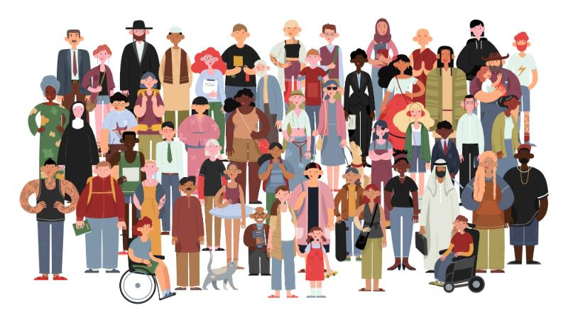
What do you think are the challenges of ensuring and maintaining diversity in workplace?
How would you as a leader over come these challenges?
Let's discuss…….

